Slide 1
Output Data Analysis for a Single System
Chapter 9

Slide 2
9.1 Introduction
Output data analysis is often not conducted appropriately
  Treating output of a single simulation run as “true” system characteristics
Appropriate statistical techniques must be used
  Both in designing and analyzing system experiments

Slide 3
9.2 Transient and Steady-State Behavior of a Stochastic Process
Steady state
  All values have the same distribution after a given time index
  Steady state distribution does not depend on the initial conditions
    Rate of convergence of the transient distributions does

Slide 4
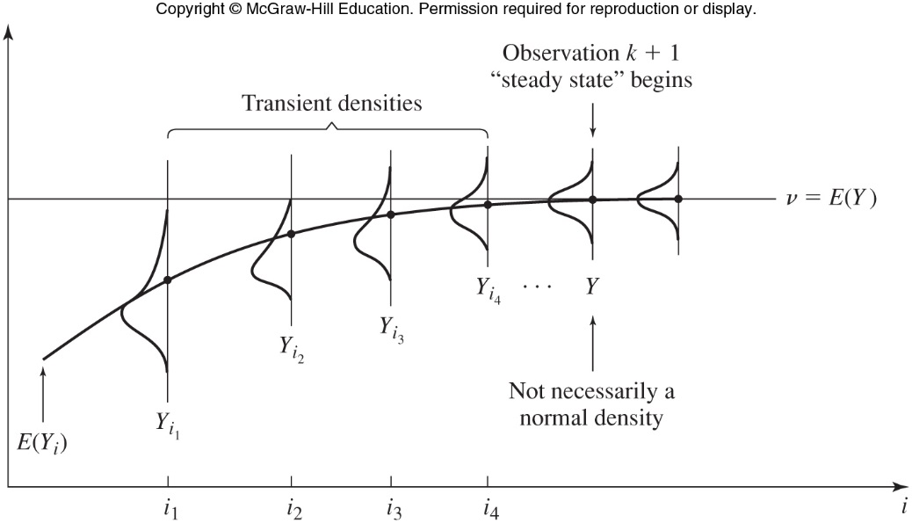
Transient and Steady-State Behavior of a Stochastic Process
Figure 9.1 Transient and steady state density functions for a particular stochastic process Y₁,Y₂… and initial conditions I

Slide 5
9.3 Types of Simulations with Regard to Output Analysis
Simulation types
  Terminating
    A natural event specifies the length of each run
    Initial conditions generally affect the performance measures
  Nonterminating
    There is no natural event to specify run length
    We may be interested in the steady state mean or probability P(y) for some real number y

Slide 6
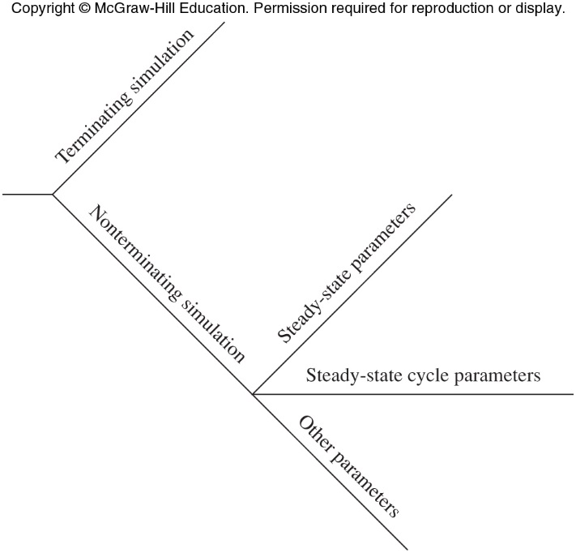
Types of Simulations with Regard to Output Analysis
Figure 9.4 Types of simulations with regard to output analysis

Slide 7
Types of Simulations with Regard to Output Analysis
Stochastic processes for most real systems do not have steady state distributions
  System characteristics change over time
Simulation model may have a steady state distribution
  Model characteristics assumed constant
    New information on system characteristics leads to re-doing the analysis

Slide 8
Types of Simulations with Regard to Output Analysis
Stochastic process for a nonterminating simulation without a steady state distribution
  Can be broken up into cycles
    Example: manufacturing system eight-hour shift
Steady state cycle parameter
  Steady state parameter of the appropriate cycle process

Slide 9
9.4 Statistical Analysis for Terminating Simulations
Suppose we make n independent replications of a terminating simulation
  Begin with the same initial conditions
  Use different random numbers for each replication
  Assume a single performance measure is of interest

Slide 10
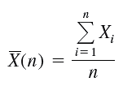

Statistical Analysis for Terminating Simulations
Estimating means
  Point estimate and confidence interval for the mean

Slide 11

Statistical Analysis for Terminating Simulations
Disadvantage of fixed sample size procedure
  Analyst has no control over the error in the mean or half-length of the confidence interval
Total number of replications required to give an absolute error, β

Slide 12
Statistical Analysis for Terminating Simulations
From exploratory experiment of n replications, can estimate number of replications required to estimate the mean with an absolute error, β
Regardless of the time per replication
  At least three to five replications should be conducted

Slide 13
Statistical Analysis for Terminating Simulations
Comparing alternate systems or policies based on average system behavior alone may lead to false conclusions
Other useful performance measures
  Proportions
  Probabilities
  Quantiles

Slide 14
Statistical Analysis for Terminating Simulations
Example: incorrect choice of initial conditions
  Want to determine average delay of bank customers arriving between noon and 1 pm
  Using initial condition of zero customers at noon will cause expected average delay to be biased low
  One solution: begin simulation at 9am (bank opening time) with zero customers
    Run for four simulated hours

Slide 15
Statistical Analysis for Terminating Simulations
Another approach for bank example
  Collect data on the number of customers present in the bank at noon for several different days
    Choose initial conditions randomly from the distribution

Slide 16
9.5 Statistical Analysis for Steady-State Parameters
Problem of the initial transient
  Also known as the startup problem
  Suggested solution: warming up the model or initial data deletion
How to choose the warm-up period
  Graphical procedure by Welch (1981, 1983)
  See Figure 9.8 and discussion on Pages 513-515

Slide 17
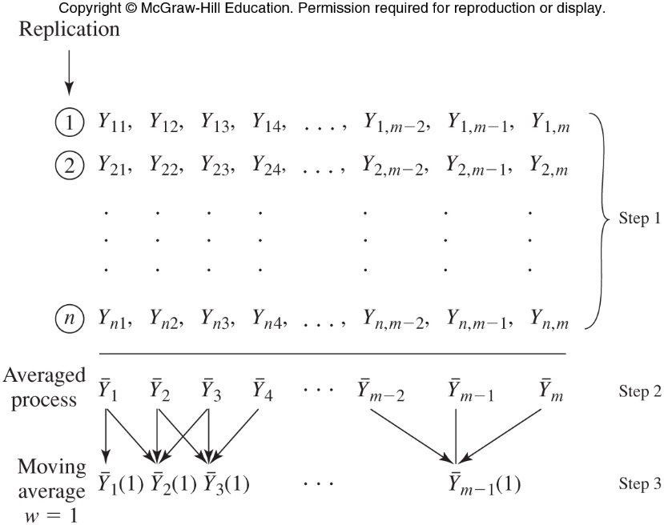
Figure 9.8 Averaged process and moving average with w=1 based on n replications of length m

Slide 18
Statistical Analysis for Steady-State Parameters
Replication/deletion approach for means
  Used to estimate the steady-state mean of a process
  Should give reasonably good statistical performance
  Easiest method to understand and implement
  Applies to all types of output parameters
  Can be used to estimate several different parameters

Slide 19
Statistical Analysis for Steady-State Parameters
Replication/deletion approach
  See Page 524 in the text for details
Other approaches
  Fixed sample size procedures
    Make a single simulation run of an arbitrary fixed length
    Construct a confidence interval from the available data

Slide 20
Statistical Analysis for Steady-State Parameters
Other approaches (cont’d.)
  Sequential procedures
    Keep increasing the length of the single simulation run until an acceptable confidence interval can be constructed
    Several techniques exist for determining when to stop the simulation run

Slide 21
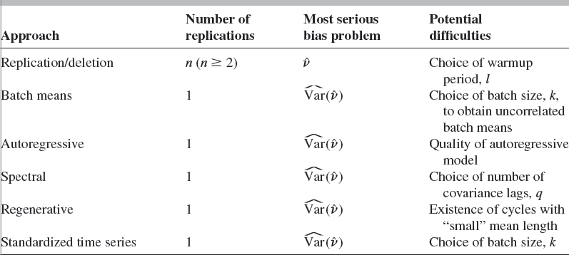
Table 9.8 Properties of steady-state estimation procedures

Slide 22
9.6 Statistical Analysis for Steady-State Cycle Parameters
Estimating a steady-state cycle parameter
  Special case of estimating a steady-state parameter
  Techniques of Section 9.5 apply, except to the cycle variables

Slide 23
9.7 Multiple Measures of Performance
Most real-world simulations
  Multiple performance measures are of interest
  Suppose we have k performance measures
Bonferroni inequality
  Given by Equation 9-12 in the text
  States the probability that all k confidence intervals simultaneously contain their respective true measures
  Results in the multiple comparisons problem

Slide 24
Multiple Measures of Performance
If k is small (fewer than 10)
  Practical solution discussed on Page 545 may be used
Approach for greater values of k
  Construct the usual 90 or 95 percent confidence intervals
  Be aware than one or more of these intervals does not contain its true measure

Slide 25
9.8 Time Plots of Important Variables
Plotting one or more key variables over the simulation duration
  Easy way to gain understanding of long-term dynamic system behavior

Slide 26
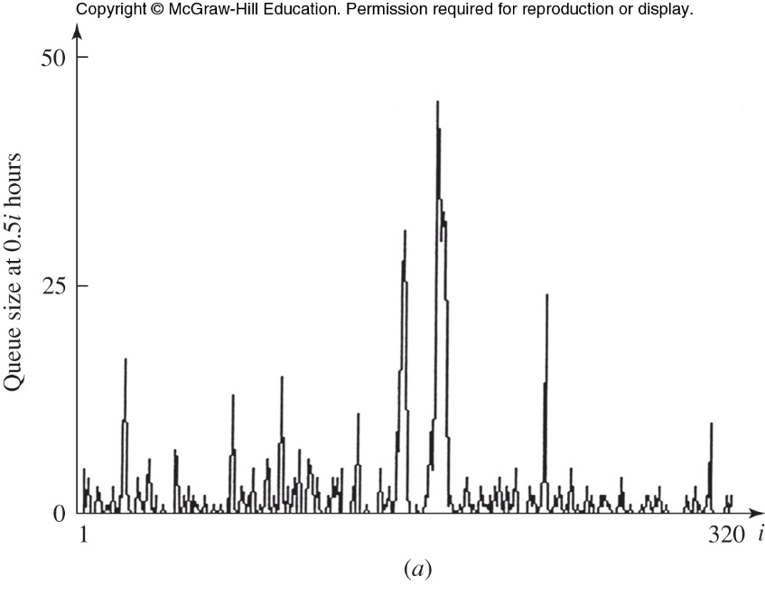
Figure 9.22(a) Time plot for number in queue in time increments of 30 minutes (run 1), small factory machine queue

