Slide 1
Generating Random Variates
Chapter 8

Slide 2
8.1 Introduction
Assume a distribution has already been specified
What problem is addressed in this chapter?
  How to generate random variates for use in a simulation model
Basic ingredient
  Source of IID U(0,1) random variates
    Statistically reliable U(0,1) random number generator must be available

Slide 3
Introduction
Factors when choosing an algorithm for generating random variates from a distribution
  Exactness
  Efficiency (storage space and execution time)
  Complexity
  Robustness

Slide 4

8.2 General Approaches to Generating Random Variates
Inverse transform
  Suppose we wish to generate a continuous random variate, X
  X has distribution function F that is continuous and strictly increasing when F(x) is between zero and one
  Algorithm:

Slide 5
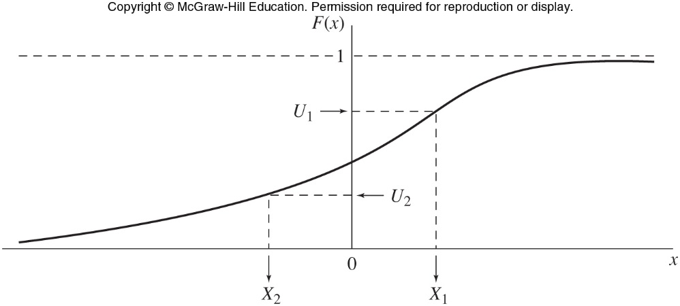
General Approaches to Generating Random Variates
Figure 8.1 Inverse-transform method for continuous random variables

Slide 6


General Approaches to Generating Random Variates
Inverse transform method if X is discrete
  Distribution function F(x) defined by:
  Algorithm:
    Generate U ~ U(0,1)
    Determine the smallest positive integer, I such that U ≤ F(x_{I}) and return X = X_{I}

Slide 7
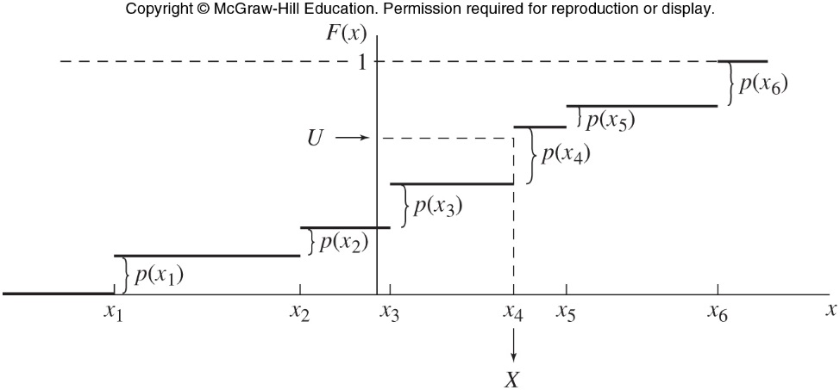
General Approaches to Generating Random Variates
Figure 8.4 Inverse-transform method for discrete random variables

Slide 8

General Approaches to Generating Random Variates
Generalized inverse-transform method
  Works for a mixed distribution
Disadvantage of the inverse-transform method in the continuous case
  Might not be possible to write a formula for
  F⁻¹(U)
  Numerical methods can be used

Slide 9
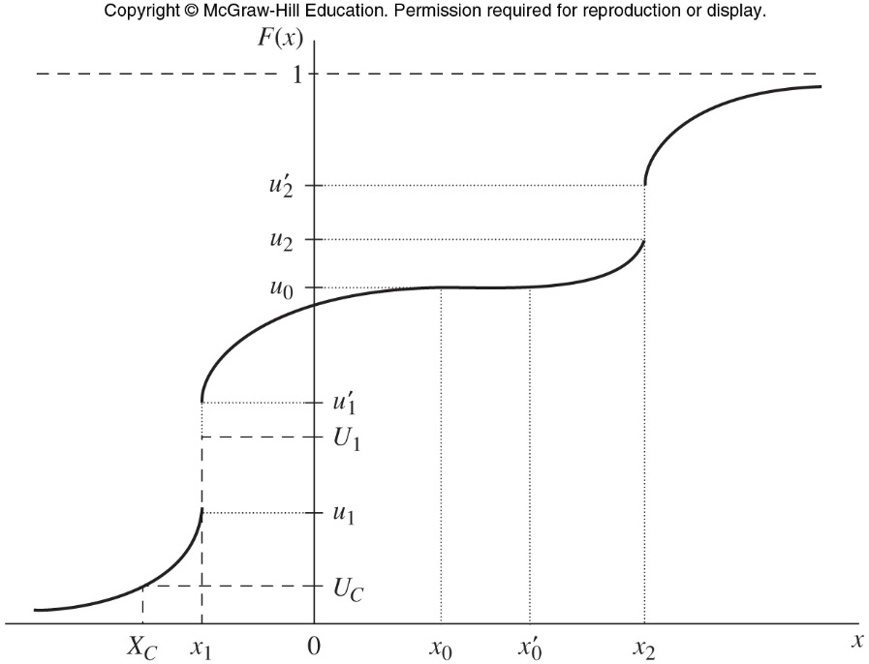
Figure 8.5 Inverse-transform method for a mixed distribution

Slide 10


General Approaches to Generating Random Variates
Composition technique
  Applies when the distribution function F can be expressed as a convex combination of other distribution functions
Assume that for all x, F(x) can be written as

Slide 11

General Approaches to Generating Random Variates
Composition algorithm
  Generate a positive random integer J such that:
  Return X with distribution function F_{J}.

Slide 12

General Approaches to Generating Random Variates
Convolution
  For several important distributions, the desired random variable X can be expressed as the sum of other IID random variables
    The other random variables (Y) can be generated more readily than X

Slide 13
General Approaches to Generating Random Variates
Convolution algorithm
  Generate Y₁, Y₂,…Y_{m} IID each with distribution function G
  Return X= Y₁ +Y₂+…Y_{m}

Slide 14
General Approaches to Generating Random Variates
Acceptance-Rejection
  This method is less direct than the previous methods
  Can be useful when previous methods fail or are inefficient
  Specify a function t, called the majorizing function, such that t(x) ≥ f(x) for all x

Slide 15

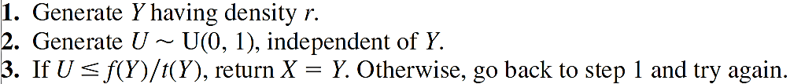
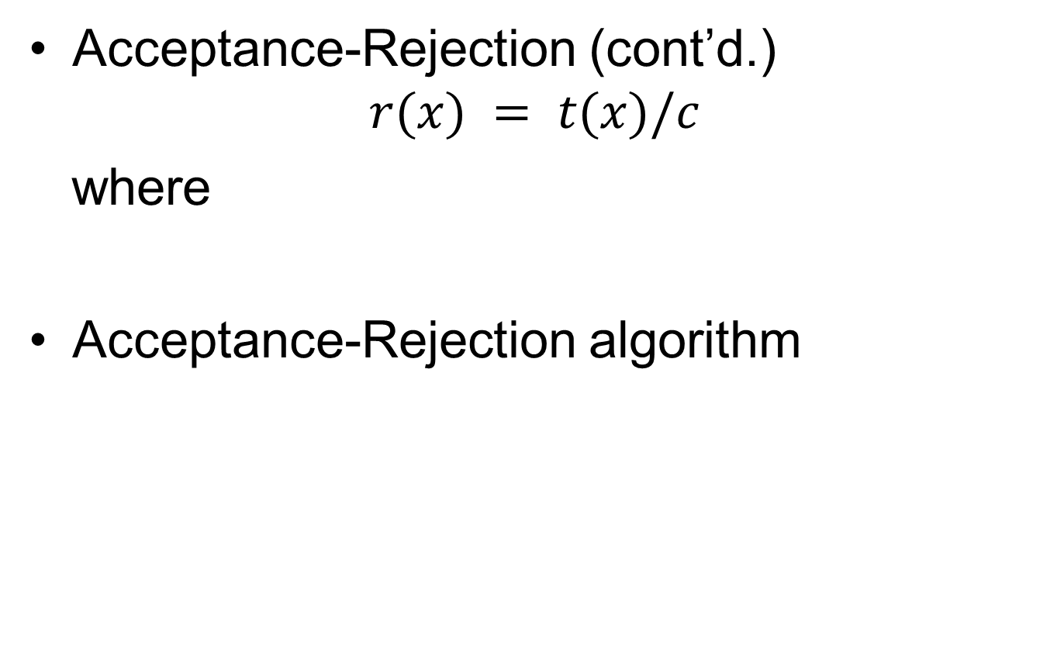
General Approaches to Generating Random Variates
Acceptance-Rejection (cont’d.)
$$r(x) = t(x)/c$$
where
Acceptance-Rejection algorithm

Slide 16
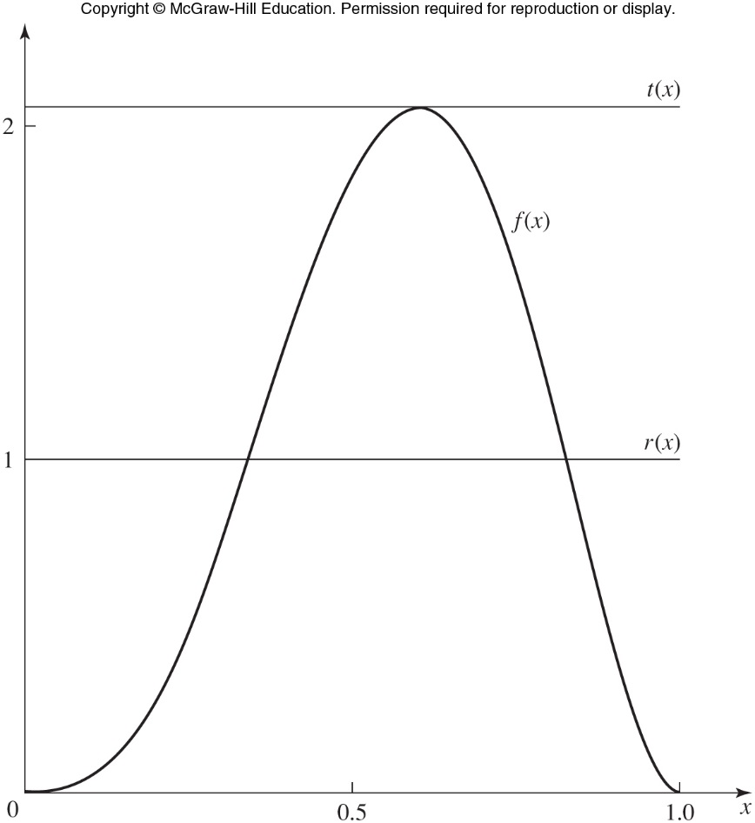
Figure 8.8 f(x), t(x), and r(x) for the acceptance-rejection method, beta(4,3) distribution

Slide 17

General Approaches to Generating Random Variates
Ratio of uniforms method
  Developed by Kinderman and Monohan in 1977
  Based on the relationship between random variables U, V, and V/U
  See Pages 448-449 in the text for more detail
General algorithm

Slide 18


8.3 Generating Continuous Random Variates
Uniform distribution
  Distribution function of a U(a,b) random variable is inverted by solving U = f(x) for x
  For 0 ≤ u ≤ 1
  Use the inverse-transform method to generate X

Slide 19
Generating Continuous Random Variates
Exponential
  Use inverse-transform method
m-Erlang
  Use convolution or inverse-transform method
Gamma
  See mathematical development on Pages 453 through 456 of the text
Weibull
  Use inverse-transform method

Slide 20

Generating Continuous Random Variates
Normal
  Box and Muller method (1958)
  Polar method
Lognormal
  Use the following algorithm
Beta
  See Pages 458-459 in the text

Slide 21
8.4 Generating Discrete Random Variates
Discrete inverse-transform method can be used for any discrete distribution
Alias method
  Developed by Walker (1977) and refined by Kronmal and Peterson (1979)
  Can be used for generating any discrete random variate with a finite range of values
  For an infinite range, alias method can be used with the general composition approach

Slide 22
8.5 Generating Random Vectors, Correlated Random Variates, and Stochastic Processes
Previously considered methods generate one random variate at a time
  Apply algorithm repeatedly to generate a sequence of IID random variates
May want to generate a random vector
  From specified multivariate distribution
  Individual components of the vector might not be independent
    See Pages 472-476 in the text for more detail

Slide 23
8.6 Generating Arrival Processes
Stationary Poisson process algorithm
  Rate λ > 0
  Interarrival times A_{i} = t_{i} – t_{i-1}
    Where i = 1, 2, 3,…
Generate the ts recursively from the first t value
  Generate U ~ U(0,1) independent of any previous random variates
  Return t_{i} = t_{i-1} – (1/ λ) ln U

Slide 24

Generating Arrival Processes
Nonstationary Poisson process
  Use thinning algorithm by Lewis and Shedler (1979)
  General thinning algorithm:

Slide 25
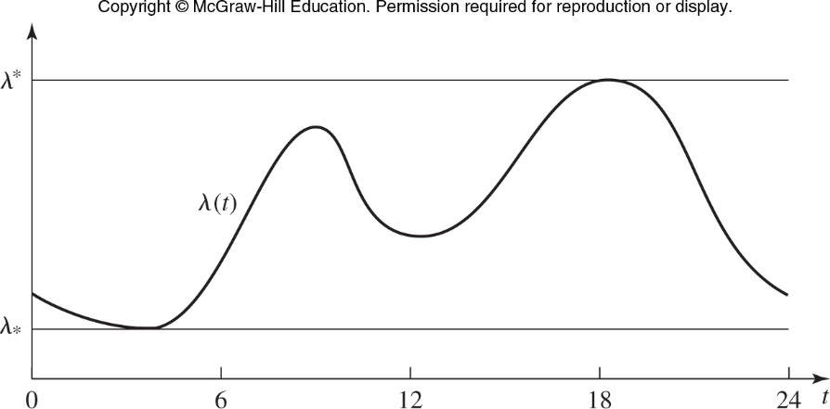
Generating Arrival Processes
Figure 8.15 Nonstationary Poisson process

Slide 26
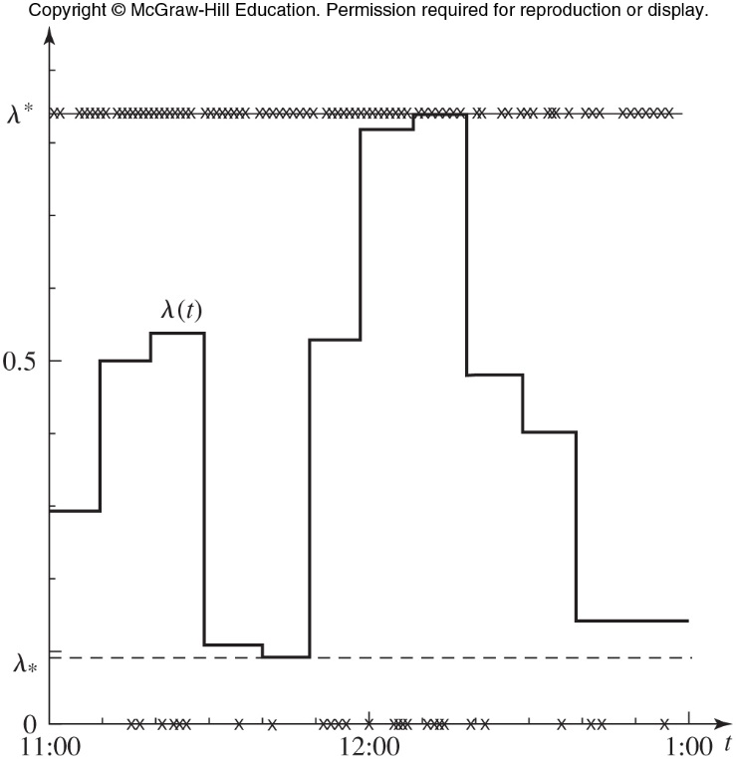
Figure 8.16 Generating a nonstationary Poisson process by thinning

Slide 27
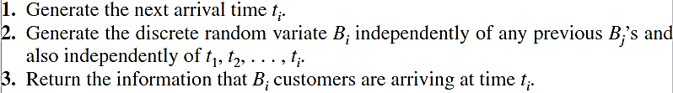
Generating Arrival Processes
Batch arrivals
  The i^{th} batch of customers arrives at time t_{i}
  Number of customers in the batch is a discrete random variable B_{i}
  Assume B_{i}s are IID and independent of the t_{i}s
  Algorithm:

