Slide 1
Random Number Generators
Chapter 7

Slide 2
7.1 Introduction
Random numbers
  Random variates generated from the U(0,1) distribution
Early methods for generating random numbers
  By hand
    Casting lots, throwing dice, or pulling numbered balls from a well-stirred urn

Slide 3
Introduction
Early methods (cont’d.)
  Arithmetic methods (1940s and 1950s)
    New number determined by one or several preceding numbers according to a fixed formula
Example: midsquare method
  Does not work well at all
  Degenerates rapidly to zero
  Not truly random

Slide 4
Introduction
Properties of a “good” random number generator
  Produces numbers that appear to be distributed uniformly on [0,1]
  Produces numbers that do not exhibit any correlation with each other
  Is fast
  Does not need much storage memory

Slide 5
Introduction
Properties of a “good” random number generator (cont’d.)
  Can reproduce a given stream of random numbers exactly
  Can easily produce separate streams of random numbers
  Produces the same sequence of random numbers for all standard compilers and computers

Slide 6

7.2 Linear Congruential Generators
A sequence of integers Z₁, Z₂,…defined by the recursive formula
  m, a, c and Z₀ are nonnegative integers
  0 < m, a < m, c < m, and Z₀ < m
Looping behavior
  Random numbers repeat on a cycle
  Length of cycle called period of the generator

Slide 7
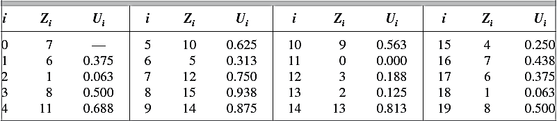
Linear Congruential Generators
Example 7.2
  Consider the LCG defined by m = 16, a = 5, c = 3, and Z₀ = 7
  The table below gives the values for Z_{i} and U_{i} for i = 1, 2…19

Slide 8
Linear Congruential Generators
Example 7.2 (cont’d.)
  Note that Z₁₇ = Z₁, Z₁₈ = Z₂, and so on
  This illustrates the looping behavior of the LCG
    The period is 16
  For most generators, m would be chosen to be much, much larger
The period of a good LCG generator should be very large

Slide 9
Linear Congruential Generators
Mixed generators
  Good choice of m: m=2^{b}
    Where b is the number of binary digits in a word on the computer being used for storage
Multiplicative generators
  More widely used than mixed generators
  c is not needed
  Choice for m: largest prime number that is less than 2^{b}

Slide 10
Linear Congruential Generators
Many experts recommend that LCG’s with modulus m = 2³¹ should no longer be used as the random number generator for general purpose software
  The period of the generator can be exhausted within a few minutes
  The generator has relatively poor statistical properties
    Can bias the results for sample sizes much smaller than the period of the generator

Slide 11
7.3 Other Kinds of Generators
More general congruences
Composite generators
  Combines output from two or more separate generators to generate the final numbers
  Shuffle generators
  Combining MRGs in a particular way
Feedback shift register generators
  Linear feedback shift register (LFSR)
    Also called Tausworthe generators

Slide 12
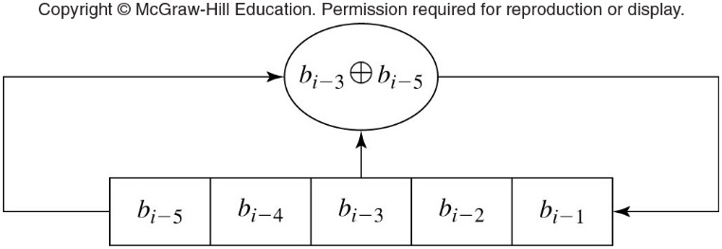

Other Kinds of Generators
Figure 7.1 A LFSR generator corresponding to the recurrence equation above (Eq. 7.5) with r=3 and q=5.

Slide 13
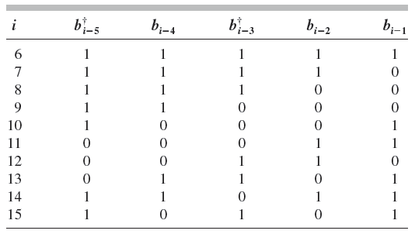
Other Kinds of Generators
Table 7.3 Successive states of the LFSR generator for r = 3 and q = 5.

Slide 14
Other Kinds of Generators
Feedback shift register generators (cont’d.)
  Generalized feedback shift register (GFSR)
  Twisted GFSR generator
    Example: Mersenne twister
    Has period of 2^{19,937} − 1 and excellent statistical properties

Slide 15
7.4 Testing Random Number Generators
Empirical tests
  Use the generator to generate random numbers
    Then examine them statistically
  Check for uniform distribution
  Serial test
  Runs (or runs-up) test
    Tests for independence only, not uniformity
  Estimate correlation at lags j = 1, 2 … l

Slide 16
Testing Random Number Generators
Disadvantage of empirical tests
  Only a certain segment of the cycle is examined
    No information about how generator would perform on other segments of the cycle
Theoretical tests
  Tests how well a generator can perform
    Based on generator structure and defining constants

Slide 17
Testing Random Number Generators
Random numbers fall mainly in the planes
  Pairs will be arranged in a lattice fashion along families of parallel lines
  Spectral test computes the distance between the planes
Large number and variety of tests exist
  Controversy over which tests are best
Chosen test should be consistent with intended use

Slide 18
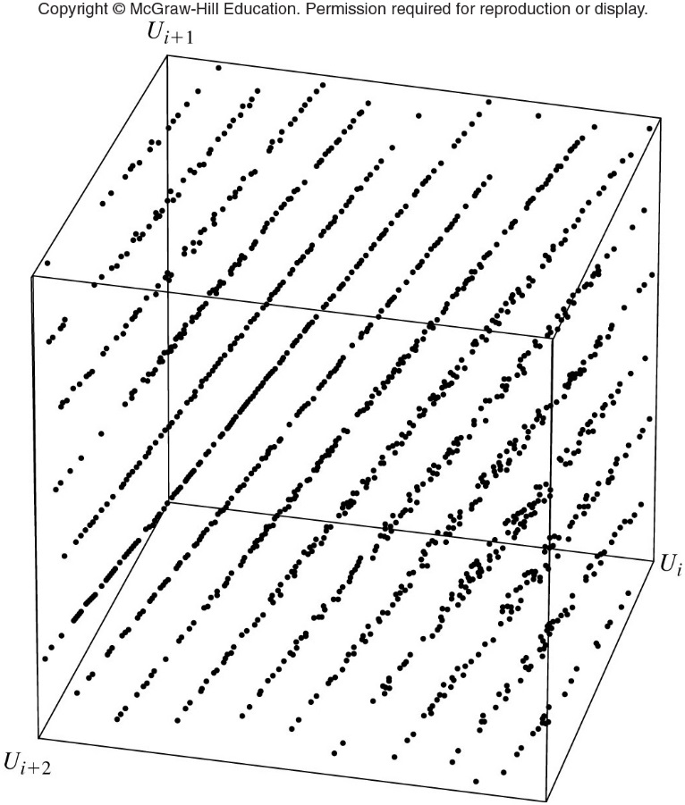
Figure 7.4 Three-dimensional lattice structure for 2000 triples from the multiplicative LCG RANDU with m = 2³¹ and a = 65,539

