Slide 1
Selecting Input Probability Distributions
Chapter 6

Slide 2
6.1 Introduction
Simulation using random inputs
  Must specify probability distributions
Failure to choose a “correct” distribution can dramatically affect simulation results
Process: Fit the best distribution to the observed service time data
  Exponential, gamma, normal, lognormal, or Weibull distribution

Slide 3
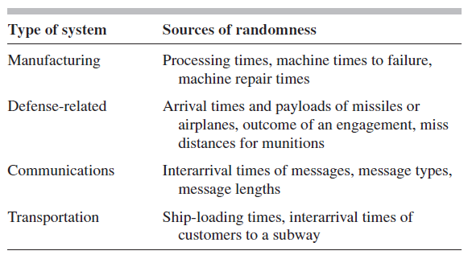
Introduction
Table 6.1 Sources of randomness for common simulation applications

Slide 4
Introduction
Processes for selecting distributions
  Use data values themselves directly in the simulation
  Define an empirical distribution function from the data values
  Fit a theoretical distribution to the data

Slide 5
6.2 Useful Probability Distributions
For a given family of continuous distributions
  There are several ways to parameterize the probability distribution
Three basic types of parameters
  Location parameter
  Scale parameter
  Shape parameter

Slide 6
Useful Probability Distributions
Continuous distributions
  See Table 6.3 in the text for descriptions and applications for 13 continuous distributions
Discrete distributions
  See Table 6.4 in the text
Empirical distributions

Slide 7
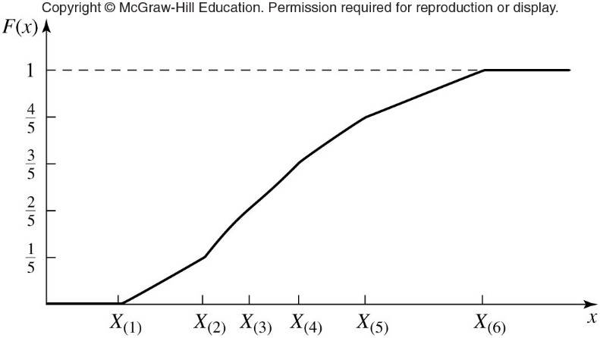
Useful Probability Distributions
Figure 6.24 Continuous, piecewise-linear empirical distribution function from original data

Slide 8
6.3 Techniques for Verifying Sample Independence
A key assumption
  Individual observations represent independent samples from an underlying distribution
An example of non-independent data
  Hourly samples of temperature from a specific city, starting at noon
    Adjacent sample values will be positively correlated

Slide 9
Techniques for Verifying Sample Independence
Graphical techniques
  Correlation plot
  Scatter diagram
Rank von Neumann test
  Requires there be no “ties” (equal values) in the data
  This requirement generally will not be met for discrete data
Run the test

Slide 10
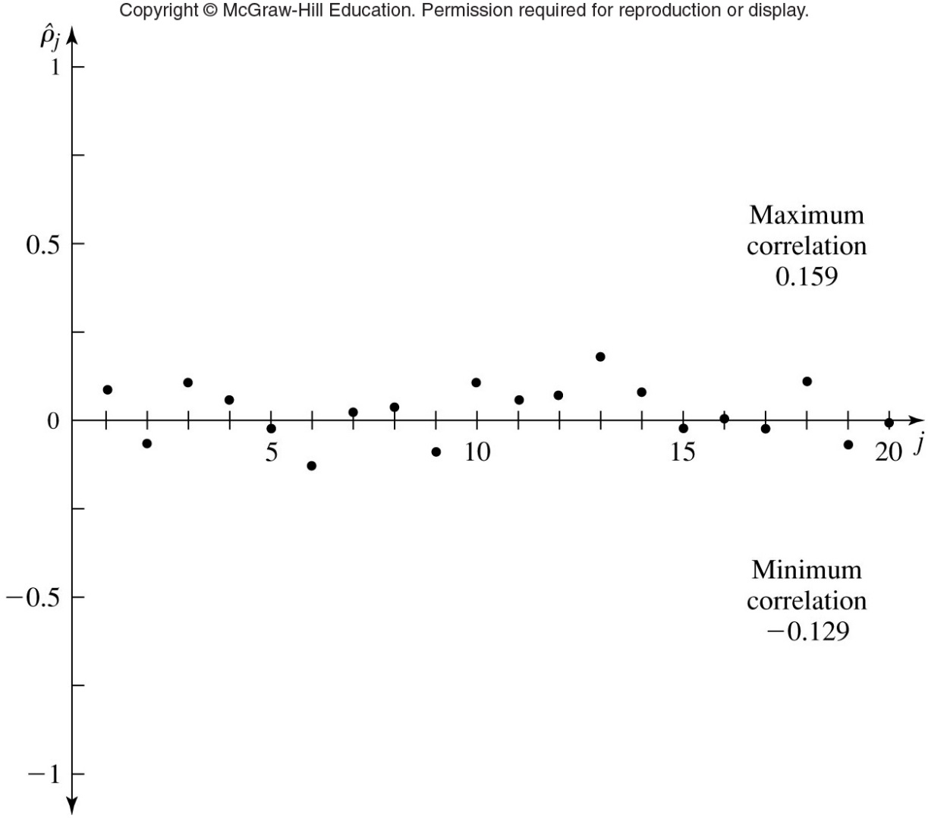
Techniques for Verifying Sample Independence
Figure 6.27 Correlation plot for independent, exponential data

Slide 11
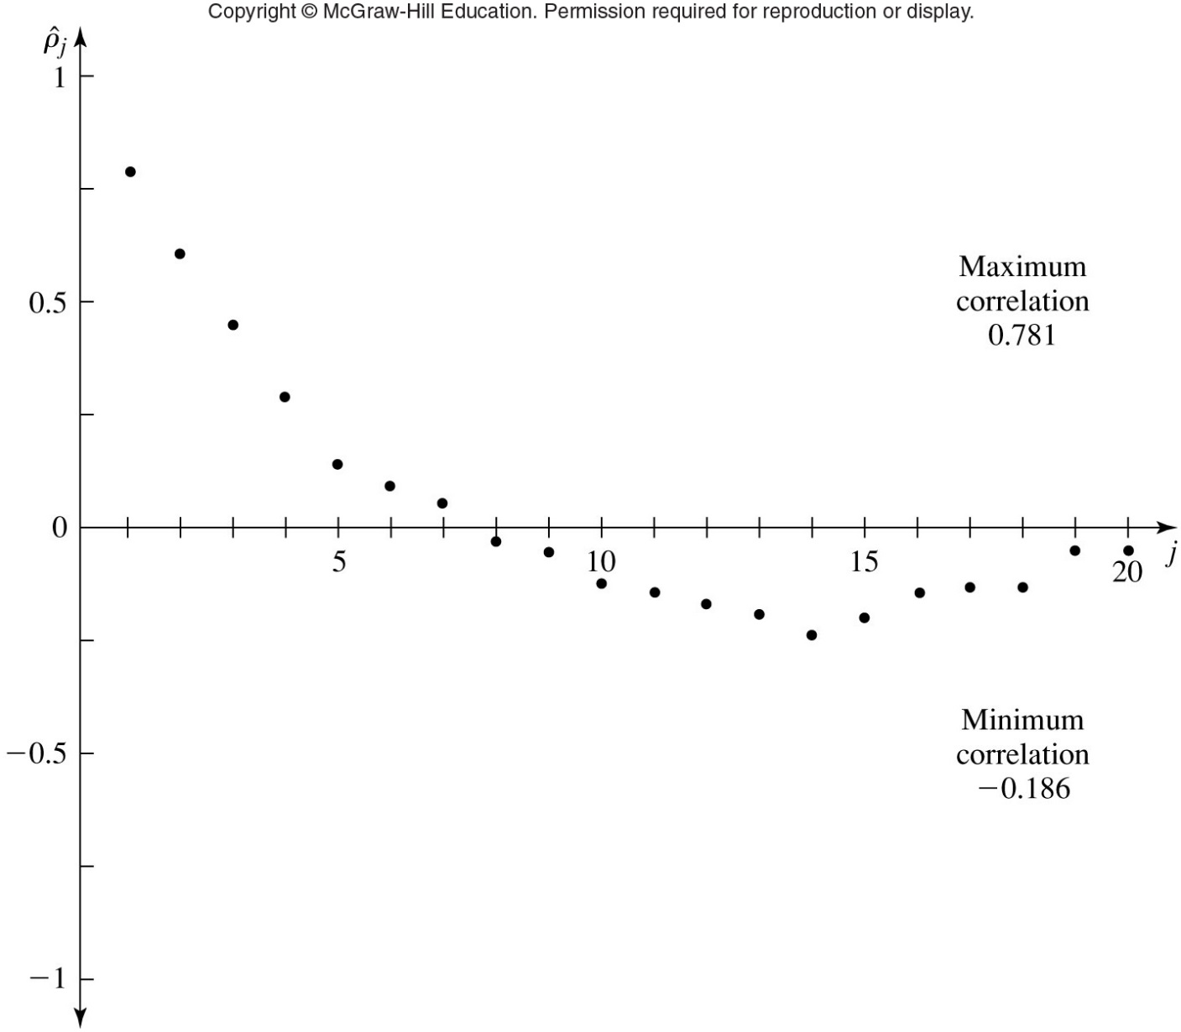
Figure 6.29 Correlation plot for correlated queuing data

Slide 12
6.4 Activity I: Hypothesizing Families of Distributions
Process of determining appropriate general families of distributions, based on their shape
  Without concern for parameter values
Prior knowledge can sometimes be used
Summary statistics
  See Table 6.5 in the text

Slide 13
Activity I: Hypothesizing Families of Distributions
Histogram
  Graphical estimate of plot of density function of the distribution
  Constructed by breaking up values into adjacent intervals of the same width
Quantile summary
  Useful for determining whether the distribution is symmetric or skewed right or left
  Box plot: its graphical representation

Slide 14
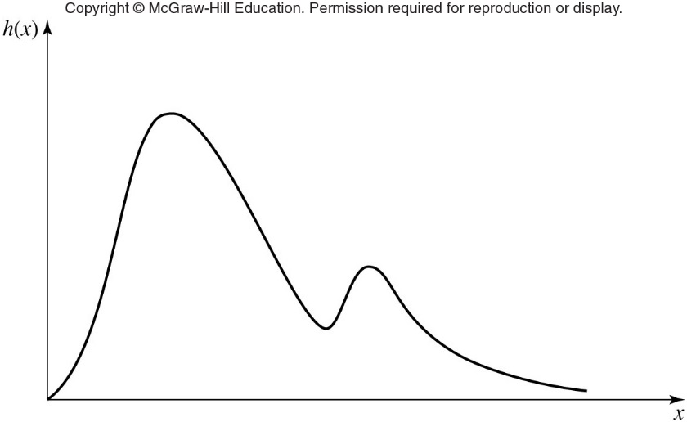
Activity I: Hypothesizing Families of Distributions
Figure 6.31 Histogram corresponding to a density function with two local modes

Slide 15
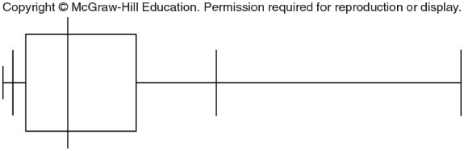
Activity I: Hypothesizing Families of Distributions
Figure 6.33 Quantile summary and box plot for the interarrival time data

Slide 16
6.5 Activity II: Estimating Parameters
Estimator
  Numerical function of the data
  Maximum-likelihood estimators (MLEs) considered here
Desirable statistical properties of MLEs
  Unique
  Invariant
  Asymptotically normally distributed
  Strongly consistent

Slide 17
6.6 Activity III: Determining How Representative the Fitted Distributions Are
None of the fitted distributions will be exactly correct
  Goal: accurate enough for intended purposes of the model
Heuristic procedures
  Density-histogram plots and frequency comparisons
  Distribution-function-differences plots
  Probability plots

Slide 18

Activity III: Determining How Representative the Fitted Distributions Are
Goodness-of-fit tests
  Statistical hypothesis test
  Used to assess whether the observations are an independent sample from a particular distribution with distribution function $\hat{F}$

Slide 19
Activity III: Determining How Representative the Fitted Distributions Are
Examples of goodness-of-fit tests
  Chi-square tests
  Kolmogorov-Smirnov tests
  Anderson-Darling tests
  Poisson-Process tests

Slide 20
6.7 The ExpertFit Software and an Extended Example
Commercial versions of ExpertFit
  Will automatically determine which of 40 probability distributions best fits a data set
ExpertFit’s four modules
  Data
    Imports the data, displays summary statistics and histograms, and more
  Models
    Fits distributions to the data

Slide 21
The ExpertFit Software and an Extended Example
ExpertFit’s four modules (cont’d.)
  Comparisons
    Compares best distributions to the data to determine quality of fit
  Applications
    Displays and computes characteristics of a fitted distribution
Student version of ExpertFit
  Available at www.mhhe.com

Slide 22
6.8 Shifted and Truncated Distributions
Modifying a distribution may provide a better fit in some cases
  Example: bank teller cannot serve a customer in less than 30 seconds
    Shift distribution to the right to disallow values less than 30 seconds

Slide 23
6.9 Bézier Distributions
Alternative to an empirical distribution for modeling a data set not well represented by a standard theoretical distribution
Software package for fitting Bézier distributions
  Developed by Wagner and Wilson
Difficulty: Bézier distributions not implemented in most simulation packages

Slide 24
6.10 Specifying Multivariate Distributions, Correlations, and Stochastic Processes
Random input variables may be statistically related to each other
  May form a random vector to be specified by the modeler
  Could be a correlation between different random input variables
    With their own individual, or marginal, distributions

Slide 25
Specifying Multivariate Distributions, Correlations, and Stochastic Processes
Specifying multivariate distributions
  Multivariate normal
  Multivariate lognormal
  Multivariate Johnson translation system
  Bivariate Bézier
Specifying stochastic processes
  AR and ARMA processes
    Autoregressive or autoregressive moving average models

Slide 26
Specifying Multivariate Distributions, Correlations, and Stochastic Processes
Specifying stochastic processes (cont’d.)
  Gamma processes
    Developed by Lewis (1989)
  ARTA processes
    Developed by Cario and Nelson (1996)
  VARTA processes
    Developed by Biller and Nelson (2003)

Slide 27
6.11 Selecting a Distribution in the Absence of Data
Some simulation studies
  Not possible to gather data on random variables of interest
  Example: if system does not exist in some form
Approaches
  Triangular-distribution approach
  Choose shape parameters assuming density function is skewed to the right

Slide 28
6.12 Models of Arrival Processes
Poisson process
  Most commonly used model for arrival process of customers to a queuing system
  Requirements
    Customers arrive one at a time
    Customers’ arrival times do not depend on the number of arrivals in the earlier time interval
    Customers’ arrival times do not depend on time of day

Slide 29
Models of Arrival Processes
Nonstationary Poisson process
  Requirements
    Customers arrive one at a time
    Customers’ arrival times in disjoint intervals are independent
    Arrival rate is now allowed to be a function of time
Batch arrivals
  Appropriate when customers arrive in groups

Slide 30
6.13 Assessing the Homogeneity of Different Data Sets
Sometimes analysts collect different data sets and would like to know if they are homogeneous
  If homogeneous, data can be merged
Kruskal-Wallis hypothesis test for homogeneity
  Compute the K-W test statistic and T

