Slide 1
Building Valid, Credible, and Appropriately Detailed Simulation Models
Chapter 5

Slide 2
5.1 Introduction and Definitions
We would like to determine whether:
  A simulation model is an accurate representation of the actual system
  There is sufficient detail in the model
Verification
  Determining whether the assumptions document has been correctly translated into a computer program

Slide 3
Introduction and Definitions
Validation
  Process of determining whether a simulation model is a valid representation of a system
    For particular study objectives
Credibility
  The extent to which the results are accepted as “correct”

Slide 4
Introduction and Definitions
Accreditation
  Official certification that a simulation model is acceptable for a particular purpose

Slide 5
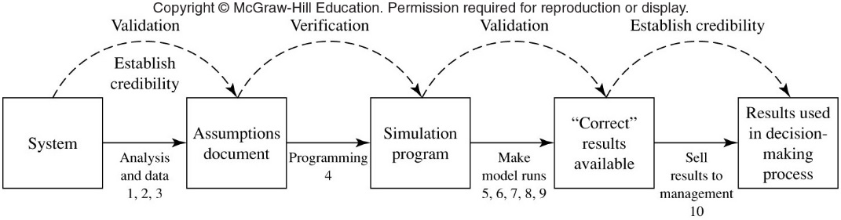
Introduction and Definitions
Figure 5.1 Timing and relationships of validation, verification, and establishing credibility

Slide 6
5.2 Guidelines for Determining the Level of Model Detail
Define specific issues to be investigated by the study
Define performance measures that will be used for evaluation
Entity moving through the simulation model does not have to be the same as entity moving through the system
Use subject-matter experts to help determine the level of model detail

Slide 7
Guidelines for Determining the Level of Model Detail
Do not include more detail than necessary to address the issues of interest
Level of detail should be consistent with the type of data available
Consider time and money constraints
If number of factors is large, use a coarse simulation model or an analytic model
  To determine which factors have a significant impact on system performance

Slide 8
5.3 Verification of Simulation Computer Programs
Eight techniques for debugging simulation model computer program
  Write code in modules or subprograms
    Main program and few key subprograms should be written and debugged first
  Have more than one person review the program
    Structured walk-through of program’s code

Slide 9
Verification of Simulation Computer Programs
Eight techniques for debugging simulation model computer program (cont’d.)
  Run the simulation under a variety of settings of the input parameters
    Check to see that output is reasonable
  Trace state variables, statistical counters, etc.
    Or use an interactive debugger
  Run the model under simplified assumptions for which true characteristics are known

Slide 10
Verification of Simulation Computer Programs
Eight techniques for debugging simulation model computer program (cont’d.)
  Observe an animation of the simulation output
  Compute sample mean and variance values and compare them with historical mean and variance
  Use a commercial simulation package

Slide 11
5.4 Techniques for Increasing Model Validity and Credibility
Analyst should make use of all available information in building the model
Resources
  Conversations with subject-matter experts
  Observations of the system
  Existing theory
  Relevant results from similar simulation studies
  Modelers’ experience and intuition

Slide 12
Techniques for Increasing Model Validity and Credibility
Interacting with the manager on a regular basis is essential to:
  Maintaining manager’s interest and involvement
  Continued focus on the nature of the problem
Maintain a written assumptions document
  Perform a structured walk-through of this document with both SMEs and managers
  Correct missing or invalid assumptions

Slide 13
Techniques for Increasing Model Validity and Credibility
Use quantitative techniques to validate model components
  Perform a sensitivity analysis to determine which factors significantly impact performance
Validate output from overall simulation model
  Compare with an existing system
  Use a Turing test to compare output data from the model to those of the system

Slide 14
Techniques for Increasing Model Validity and Credibility
Model’s ability to predict future system behavior
  Data collected at a later time can be compared with predictions to validate the model
  Use discrepancies to improve the model if suggested objectively by the results

Slide 15
Techniques for Increasing Model Validity and Credibility
Calibration of the model
  Parameters are tweaked until two data sets agree closely
  Use one data set for calibration and another, independent data set for model verification
Compare results with expert opinion
  If consistent with perceived system behavior, model is said to have face validity

Slide 16
5.5 Management’s Role in the Simulation Process
Responsibilities of the manager
  Formulate problem objectives
  Direct personnel to provide information and data to the simulation modeler
    And to attend the structured walk-through
  Interact with the simulation modeler on a regular basis
  Use the simulation results as an aid in the decision-making process

Slide 17
5.6 Statistical Procedures for Comparing Real-World Observations and Simulation Output Data
Classical statistical tests are not applicable
  Output processes are nonstationary and autocorrelated
Inspection approach
  Basic inspection approach
    Compare two sets of statistics from real-world output and simulation output
    Problem: each statistic is a sample size 1 from the underlying population, vulnerable to inherent randomness

Slide 18
Statistical Procedures for Comparing Real-World Observations and Simulation Output Data
Correlated inspection approach
  “Drive” the model with historical system input data
    Also called a trace-driven simulation
  Then, compare the model and system outputs
  The more definitive method to validate the assumptions of the simulation model

Slide 19
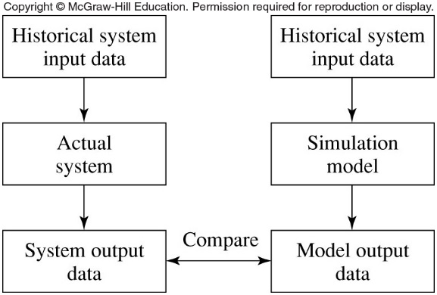
Statistical Procedures for Comparing Real-World Observations and Simulation Output Data
Figure 5.6 The correlated inspection approach

Slide 20
Statistical Procedures for Comparing Real-World Observations and Simulation Output Data
Confidence-interval approach based on independent data
  More reliable approach, when possible, to collect large data sets from both system and model
  Compare model to system by constructing a confidence interval
    Use paired-t approach or Welch approach

Slide 21
Statistical Procedures for Comparing Real-World Observations and Simulation Output Data
Time-series approaches
  Require only one set of each type of output data
  Spectral-analysis approach
    Compute the sample spectrum of each output process
    Construct a confidence interval for the difference of the logarithms of the two spectra
    Output processes must be covariance-stationary

Slide 22
Statistical Procedures for Comparing Real-World Observations and Simulation Output Data
Other approaches
  Hypothesis test for a trace-driven simulation model
    Kleijnen, Bettonvil, and Van Groenendaal (1998)
  Distribution-free hypothesis test based on bootstrapping
    Kleijnen, Cheng, and Bettonvil (2000, 2001)
Confidence interval preferred to hypothesis test for validation of the model

