Slide 1
Review of Basic Probability and Statistics
Chapter 4

Slide 2
4.1 Introduction
Use of probability and statistics
  Integral part of a simulation study
  Every modeling team should include at least one thoroughly trained person
  Understanding how to model a probabilistic system and validate the model
  Needed to choose input probability distributions and generate random samples
  Required to analyze output data

Slide 3
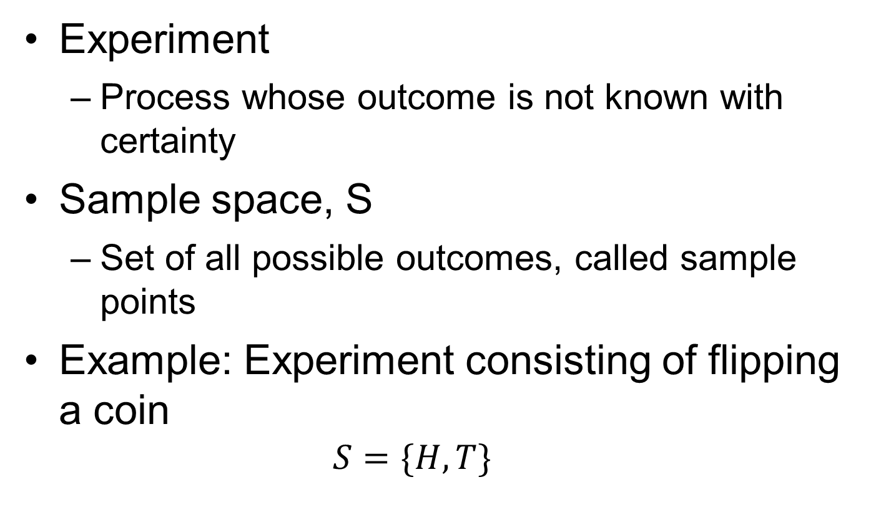
4.2 Random Variables and Their Properties
Experiment
  Process whose outcome is not known with certainty
Sample space, S
  Set of all possible outcomes, called sample points
Example: Experiment consisting of flipping a coin
  $$S=\{H,T\}$$

Slide 4
Random Variables and Their Properties
P(X ≤ x)
  Probability associated with the event {X ≤ x}
Discrete random variables
  Can take on a countable number of values
Continuous random variables
  Can take on an uncountably infinite number of different values

Slide 5
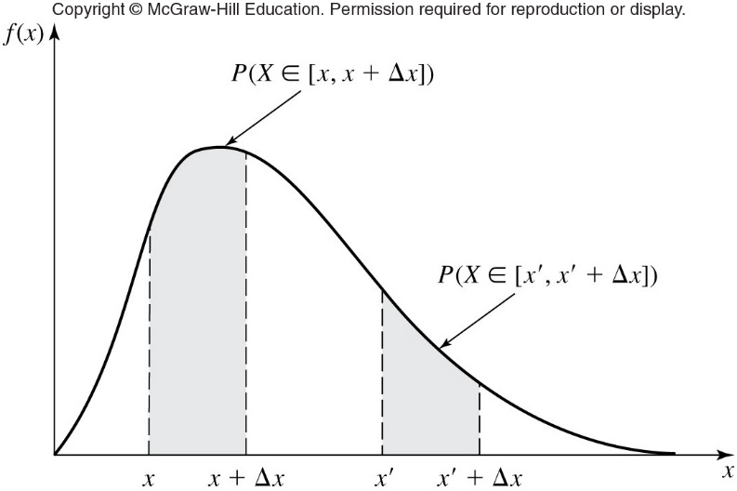
Random Variables and Their Properties
Figure 4.3 Interpretation of the probability density function f(x)

Slide 6
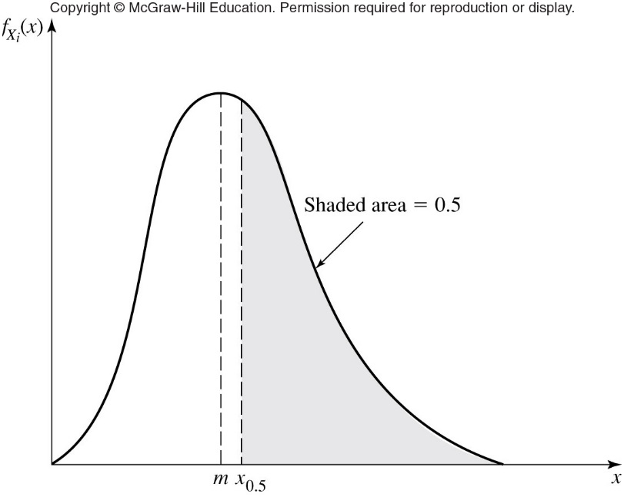
Random Variables and Their Properties
Figure 4.8 The median x_{0.5} and mode m for a continuous random variable

Slide 7

Random Variables and Their Properties
Variance
  Measure of the dispersion of a random variable about its mean
Standard deviation of random variable X_{i}
Covariance measures dependence between two random variables X_{i} and X_{j}

Slide 8
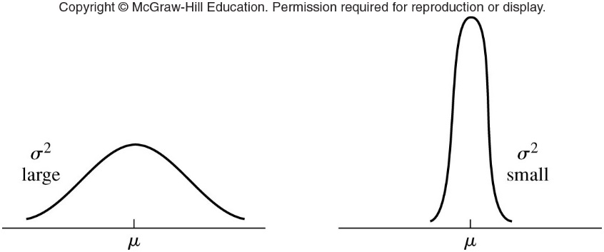
Random Variables and Their Properties
Figure 4.9 Density functions for continuous random variables with large and small variances

Slide 9
4.3 Simulation Output Data and Stochastic Processes
Simulation output data are random
  Because random variables used as input
  Take care in drawing conclusions
Stochastic process
  Collection of similar random variables ordered over time defined on a common sample space

Slide 10

Simulation Output Data and Stochastic Processes
A discrete-time stochastic process X₁, X₂,… is said to be covariance-stationary if:

Slide 11


4.4 Estimation of Means, Variances, and Correlations
Sample mean of a set of random variables X₁, X₂,…X_{n} with finite population mean μ and finite population variance σ²
Sample variance given by

Slide 12
Estimation of Means, Variances, and Correlations
Simulation output data are almost always correlated

Slide 13
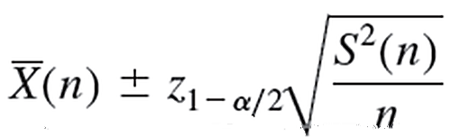
Confidence Intervals and Hypothesis Tests for the Mean
Confidence interval expression 1
  If n is sufficiently large, an approximate 100(1-α) percent confidence interval for μ is given by
  Problem: The more skewed the underlying distribution, the larger the value of n is needed

Slide 14

Confidence Intervals and Hypothesis Tests for the Mean
Confidence interval expression 2
  Known as the t confidence interval
  If the X_{i}’s are normal random variables, an exact (for any n ≥ 2) 100 (1- α) percent confidence interval for μ is given by

Slide 15
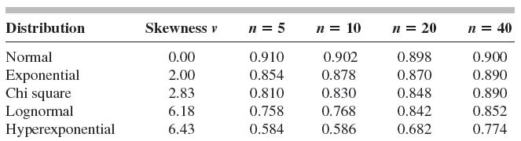
Confidence Intervals and Hypothesis Tests for the Mean
Table 4.1 Estimated coverages based on 500 experiments

Slide 16
Confidence Intervals and Hypothesis Tests for the Mean
Testing the null hypothesis H₀ against an alternative hypothesis H₁
Type I error
  Rejecting H₀ when in fact it is true
  Probability is equal to the level α
Type II error
  Failure to reject H₀ when it is false
  Probability denoted by β

Slide 17
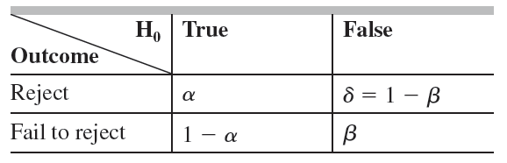
Confidence Intervals and Hypothesis Tests for the Mean
Table 4.2 Hypothesis-testing situations and their corresponding probabilities of occurrence

Slide 18

4.6 The Strong Law of Large Numbers
If one performs an infinite number of experiments, each resulting in an $\overline{X}$(n), and n is sufficiently large, then $\overline{X}$(n) will be arbitrarily close to μ for almost all the experiments

Slide 19
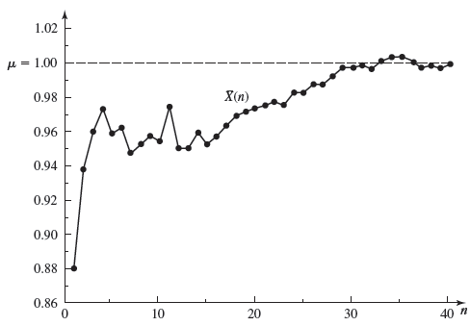
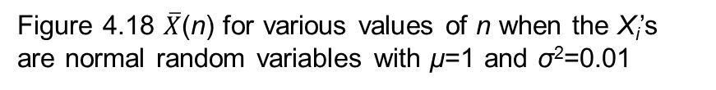
The Strong Law of Large Numbers
Figure 4.18 $\overline{X}$(n) for various values of n when the X_{i}’s are normal random variables with μ=1 and σ²=0.01

Slide 20
4.7 The Danger of Replacing a Probability Distribution by its Mean
Do not replace an input probability distribution by its mean in a simulation model
Example: manufacturing system with single machine tool
  Raw parts arrive at the machine with exponential interarrival times with a mean of one minute

Slide 21
The Danger of Replacing a Probability Distribution by its Mean
Example (cont’d.)
  Processing times at the machine distributed exponentially with a mean of 0.99 minutes
  This system is an M/M/1 queue with utilization factor ρ = 0.99
  It can be shown that average delay in queue of a part in the long run is 98.01 minutes

Slide 22
The Danger of Replacing a Probability Distribution by its Mean
Example (cont’d.)
  If we replace each distribution by its corresponding mean (parts arrive at t = 1 min, t = 2 min, etc.)
    And if each part has a processing time of exactly 0.99 minutes
    Then no part is ever delayed in the queue
The variances as well as the means of the input distributions affect the output measures for queuing-type systems

