Slide 1
Simulation Software
Chapter 3

Slide 2
3.1 Introduction
Many features common to most simulation programs
Special-purpose simulation packages incorporate these common features
Packages discussed in this chapter
  Arena
  ExtendSim
  Simio

Slide 3
3.2 Comparing Simulation Packages with Programming Languages
Advantages of using a simulation package
  Many of the needed features have been incorporated, reducing programming time
  Easier to modify and maintain system models
  Better, automatic error detection
Advantages of using a general purpose programming language
  Most modelers already know a programming language

Slide 4
Comparing Simulation Packages with Programming Languages
Advantages of using a general purpose programming language (cont’d.)
  Generally faster execution time
  Greater programming flexibility
  Object-oriented languages considered better by many analysts and programmers
    Simulation packages not truly object-oriented
  Software cost generally lower

Slide 5
3.3 Classification of Simulation Software
General-purpose simulation package
  Can be used for any application
Application-oriented simulation package
  Designed for a certain class of applications
  Examples: manufacturing, health care, telecommunications

Slide 6
Classification of Simulation Software
Process
  Time-ordered sequence of interrelated events, separated by intervals of time
Most packages use process approach to simulation modeling
  Process routine explicitly contains the passage of simulated time
    Multiple entry points

Slide 7
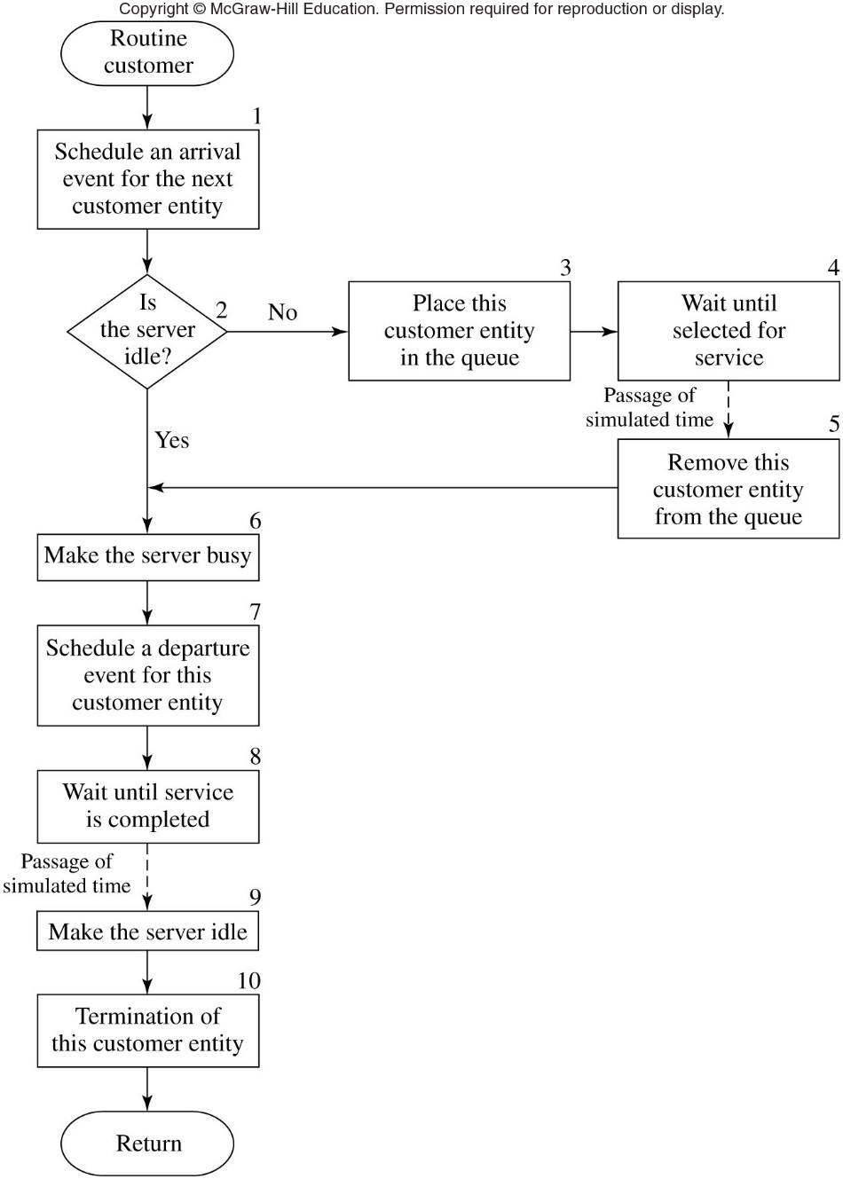
Figure 3.2 Prototype customer-process routine for a single-server queuing system

Slide 8
Classification of Simulation Software
Common modeling elements
  Entity
    Created, moves through the system, and then usually destroyed
  Attributes
    Pieces of information stored within the entity
  Resources
    Entity requests their use while moving through the system
  Queues

Slide 9
3.4 Desirable Software Features
Feature groups
  General capabilities
  Hardware and software considerations
  Animation
  Statistical features
  Customer support and documentation
  Output reports and plots

Slide 10
Desirable Software Features
General capabilities
  Modeling flexibility, including the ability to:
    Define and change attributes for entities and global variables, and use both in decision logic
    Use mathematical expressions and functions
    Create new modeling constructs and modify existing ones
  Ease of use
  Hierarchy
  Good debugging aids

Slide 11
Desirable Software Features
General capabilities (cont’d.)
  Ability to import/export data
  Fast execution speeds
  Cost module
  Ability to initialize to nonempty and idle state
  Ability to save simulation states after run
  Cost of software package

Slide 12
Desirable Software Features
Animation and dynamic graphics
  Icons change position, color, and/or shape
  Helps communicate details to nontechnical people
  Useful in debugging and training
  Ability to create high resolution icons and save for later use

Slide 13
Desirable Software Features
Statistical capabilities
  Random number generator should have at least 100 different streams
  Each source of randomness should be represented by a probability distribution
  Statistically sound method for constructing a confidence interval for the mean
  Statistical experimental designs
  Optimization capability

Slide 14
Desirable Software Features
Customer support and documentation
  Documented well enough to allow use without taking a training class
Output reports and graphics
  Standard and customized reports
  Histograms
  Time plots
  Correlation plots

Slide 15
3.5 General-Purpose Simulation Packages
Arena by Rockwell Automation
  Standard and Professional Editions available
  Modules arranged into a number of templates
  Examples of templates: basic process, advanced process, advanced transfer, and flow process
  Virtual designer used to create concurrent 3-D animations

Slide 16
General-Purpose Simulation Packages
Arena features
  Unlimited number of random number streams
  Twelve standard theoretical probability distributions and empirical distributions
  Includes activity-based costing
  Microsoft VBA and complete ActiveX object model are available

Slide 17
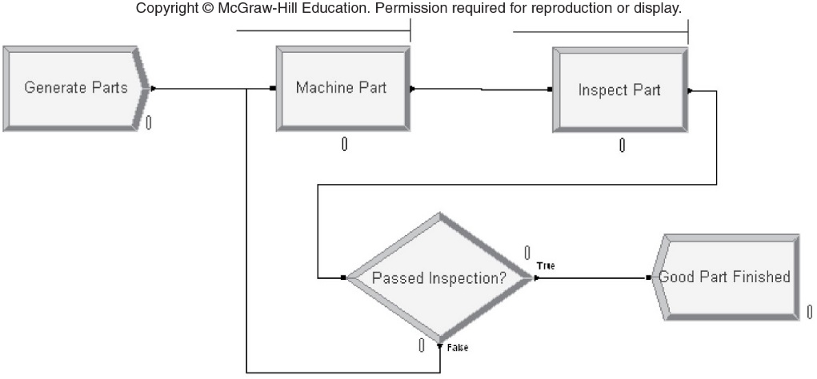
General-Purpose Simulation Packages
Figure 3.3 Arena model for the manufacturing system

Slide 18
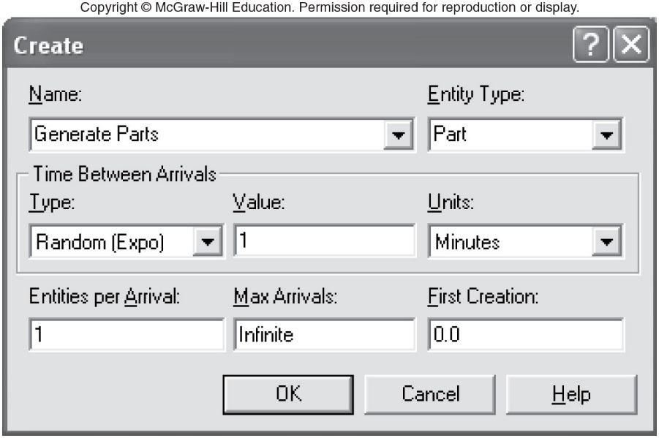
General-Purpose Simulation Packages
Figure 3.4 Dialog box for the Arena Create module “Generate Parts”

Slide 19
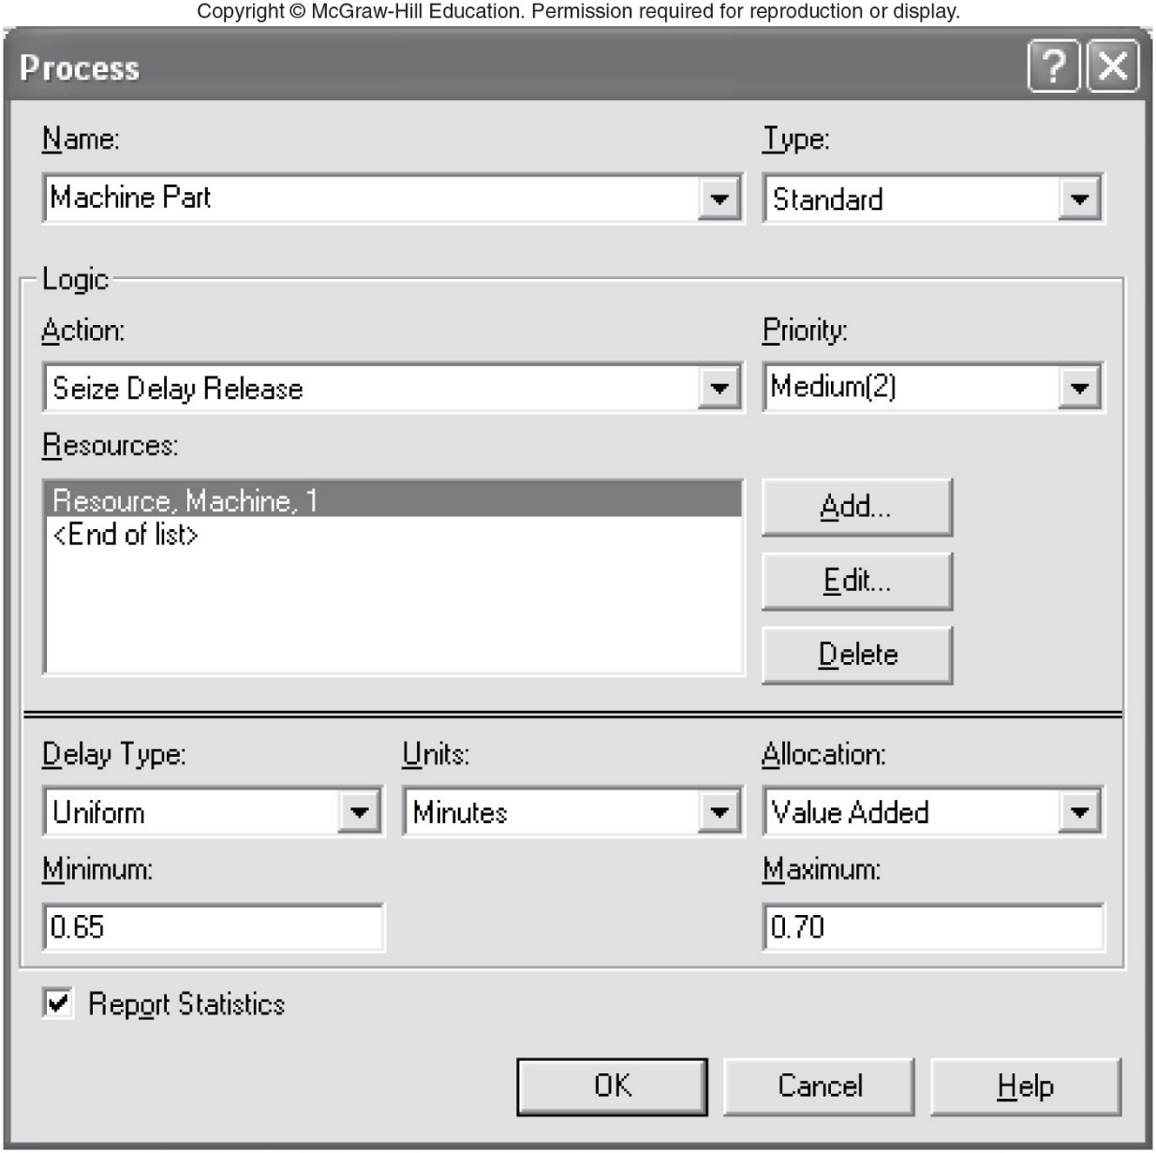
Figure 3.5 Dialog box for the Arena Process module “Machine Part”

Slide 20
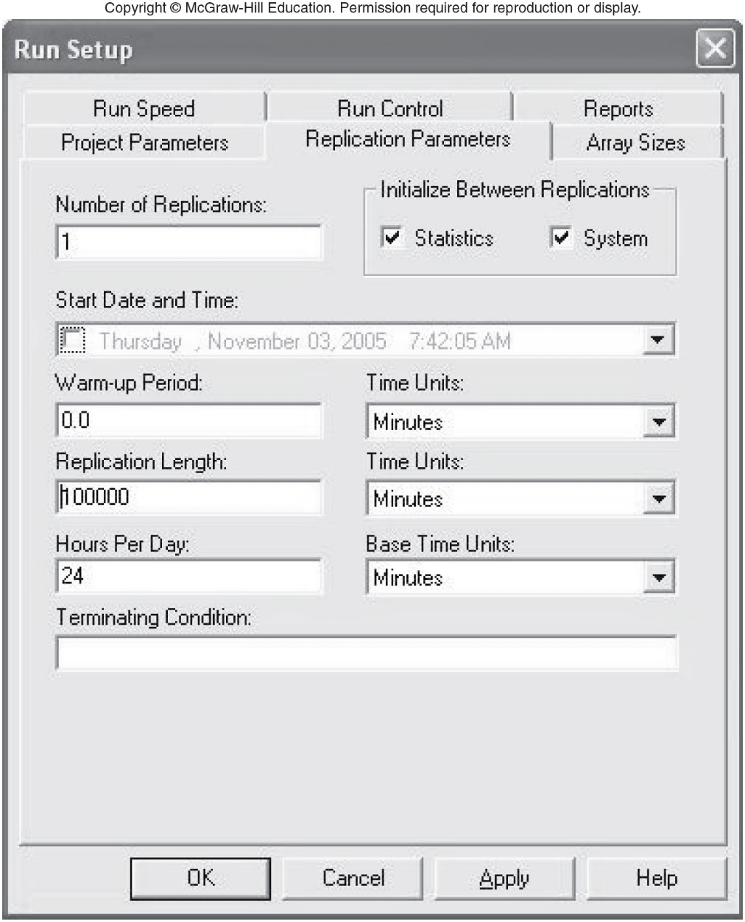
Figure 3.8 Dialog box for the Arena Run Setup configuration options

Slide 21
General-Purpose Simulation Packages
ExtendSim by Imagine That, Inc.
  Construct model by selecting blocks from libraries
  Connect blocks to indicate flow of entities or values through the system
  Detail blocks using dialog boxes
  ModL language can be used to create new blocks or modify existing blocks

Slide 22
General-Purpose Simulation Packages
ExtendSim features
  Unlimited number of random number streams
  Thirty-four standard theoretical probability distributions and empirical distributions
  Includes activity-based costing
  Scenario Manager allows investigating multiple scenarios of interest

Slide 23
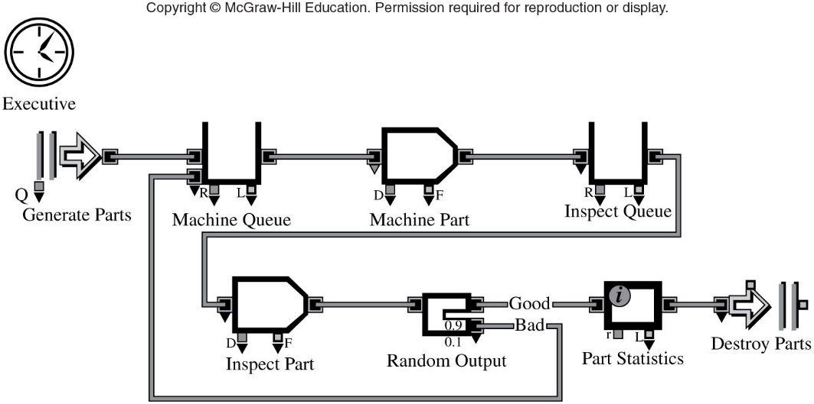
Figure 3.10 ExtendSim model for the manufacturing system

Slide 24
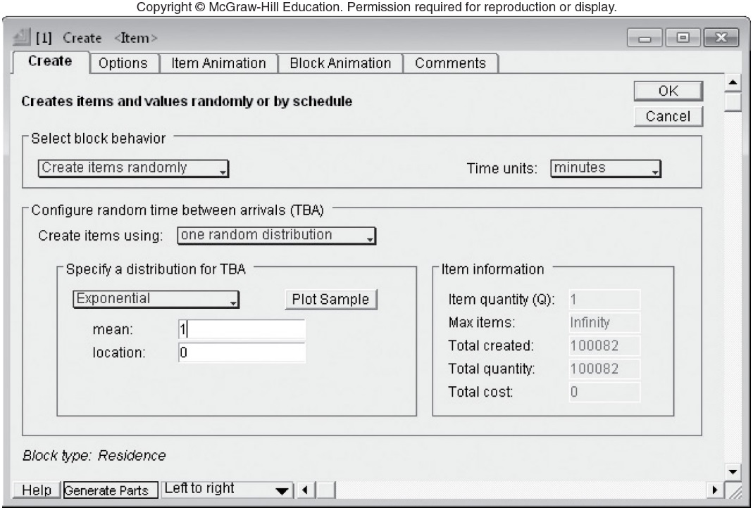
Figure 3.11 Dialog box for the ExtendSim Create block “Generate Parts”

Slide 25
General-Purpose Simulation Packages
Simio by Simio LLC
  Object-oriented
  Library of objects
    Five base classes of objects
  Create model by dragging objects into Facility window and connect them using links
    Objects detailed using a property editor
  Objects have states that change values during simulation

Slide 26
General-Purpose Simulation Packages
Simio features
  Ability to create a wide range of object behaviors from the base classes
  Process approach
  Unlimited number of random number streams
  Nineteen standard theoretical probability distributions and empirical distributions
  Allows defining an experiment with a set of scenarios

Slide 27
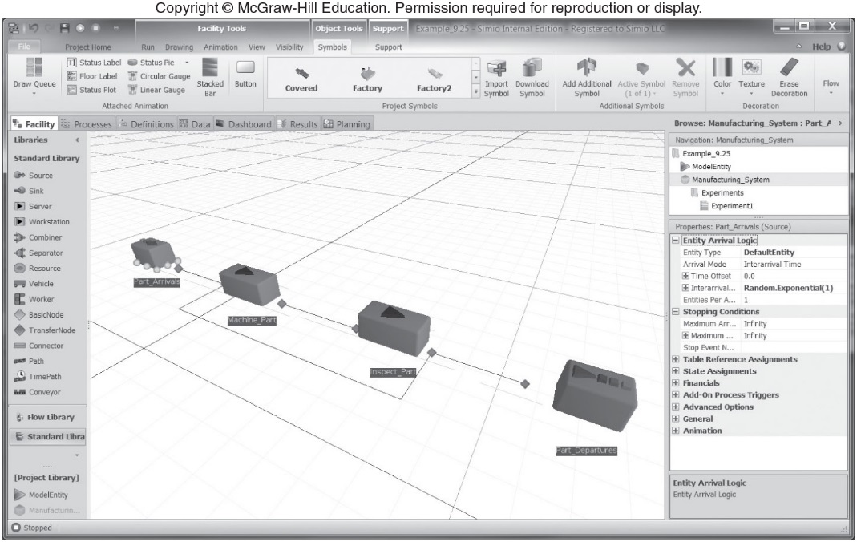
Figure 3.19 Simio model for the manufacturing system

Slide 28
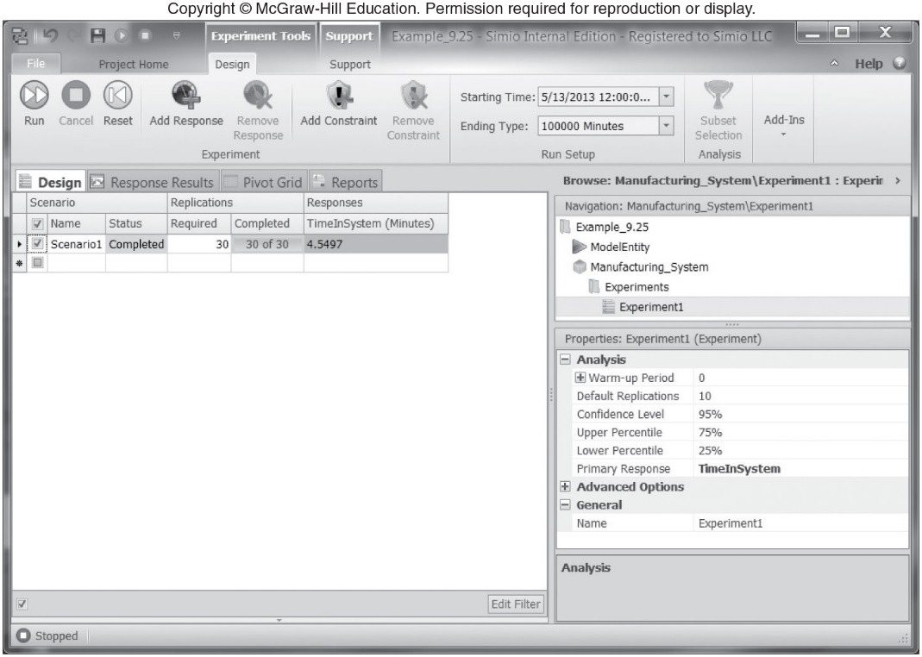
Figure 3.21 Design view for creating an experiment

Slide 29
3.6 Object-Oriented Simulation
Object-oriented programming and object-oriented simulation
  Originated from SIMULA, introduced in the 1960s
True object-oriented simulation packages
  Simio
  AnyLogic
  FlexSim

Slide 30
3.7 Examples of Application-Oriented Simulation Packages
Manufacturing
  AutoMod, Enterprise Dynamics, FlexSim, Plant Simulation, ProModel, WITNESS
Communications
  OPNET Modeler, QualNet
Healthcare
  FlexSim Healthcare, MedModel

Slide 31
Examples of Application-Oriented Simulation Packages
Process reengineering and services
  Process Simulator, ProcessModel, ServiceModel
Animation (stand-alone)
  Proof Animation

