Slide 1
Modeling Complex Systems
Chapter 2

Slide 2
2.1 Introduction
List processing
  An activity that takes place in most simulations
simlib
  A group of ANSI-standard C support functions
    Includes common simulation activities
  Complete source code can be downloaded from www.mhhe.com/law

Slide 3
2.2 List Processing in Simulation
Examples in chapter 1 contained either one or no lists of records
  Other than the event list
  Always processed as first-in, first-out (FIFO)
Most complex simulations require many lists
  May not be processed in a FIFO manner

Slide 4
List Processing in Simulation
Approaches to storing lists in a computer
  Sequential-allocation
    Records are stored in physically adjacent memory
  Linked-allocation
    Each record contains pointers that specify its logical relationship to other records in the list
    Has several advantages for simulation modeling

Slide 5
2.3 A Simple Simulation Language: simlib
C-based
Implements linked storage allocation
Includes 19 functions
  Each designed to perform a frequently-occurring simulation activity

Slide 6
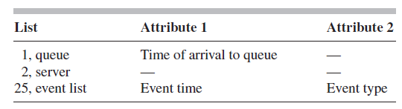
2.4 Single-Server Queuing Simulation with simlib
Identify the events
  Arrival: type 1 event
  Departure: type 2 event
Define the simlib lists and the attributes in their records

Slide 7

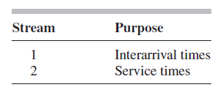
Single-Server Queuing Simulation with simlib
Identify all sampst and timest variables used
Identify separate random number streams for interarrival times and service times

Slide 8
Single-Server Queuing Simulation with simlib
Code given in Figures 2.6 − 2.11 in the text
Output is different from the output obtained for the same system in Chapter 1
  Average delay in queue changed by over 20 percent
    Reason: now using dedicated random number stream
  Both programs are correct

Slide 9
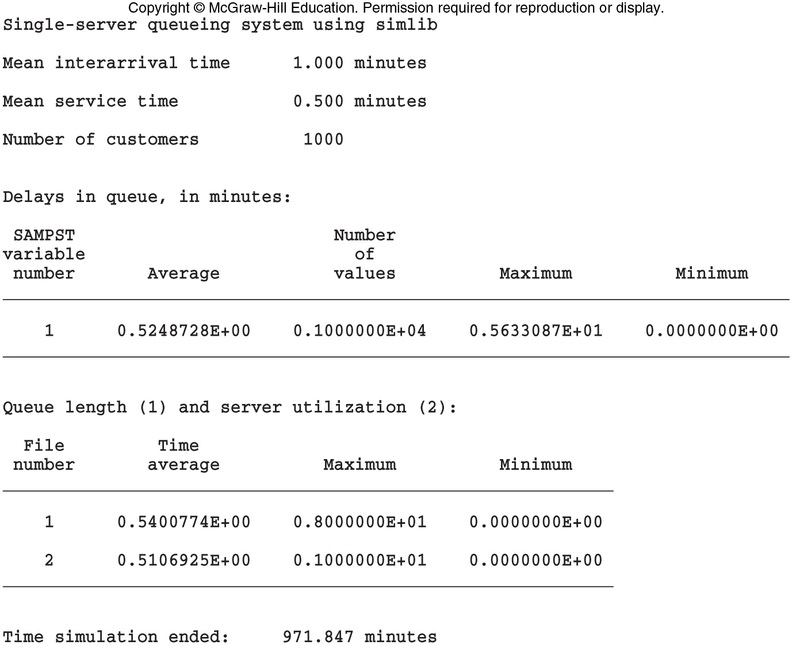
Single-Server Queuing Simulation with simlib
Figure 2.12 Output report, queuing model with simlib

Slide 10
2.5 Time-Shared Computer Model
Simulate a model of a time-shared computer facility
  Single CPU with n terminals
  Operators send jobs to CPU
  Arriving jobs join a single queue
  Jobs are served in a round-robin manner
    Not FIFO

Slide 11
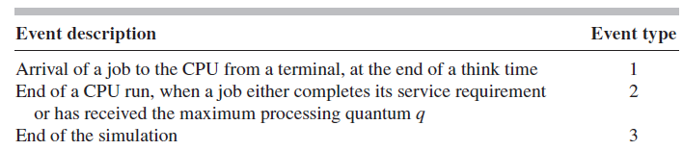
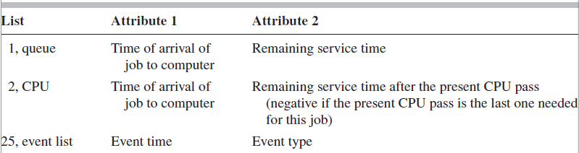
Time-Shared Computer Model
Events for this model
Lists of records

Slide 12

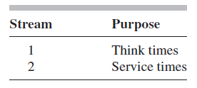
Time-Shared Computer Model
One discrete-time statistic of interest
  Response times
Two types of random variables

Slide 13
Time-Shared Computer Model
Code given in Figures 2.15 – 2.18, 2.20, 2.21 – 2.23 in the text
Output
  Congestion worsens as number of terminals rises
  System could handle about 60 terminals
    Response time degrades to 30 seconds at that point

Slide 14
2.6 Multiteller Bank with Jockeying
System with bank tellers and customers who are allowed to move from one queue to another
  Each teller has a separate queue
  An arriving customer joins the shortest queue
  Simulate with different numbers of tellers
    Expected time-average total number of customers in queue, expected average and maximum delays in queue

Slide 15
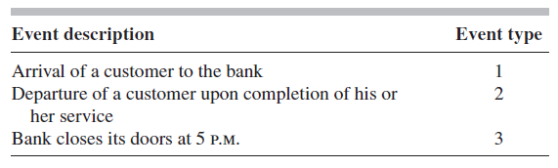
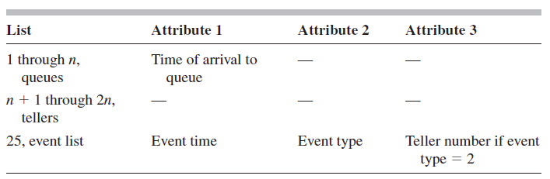

Multiteller Bank with Jockeying

Slide 16
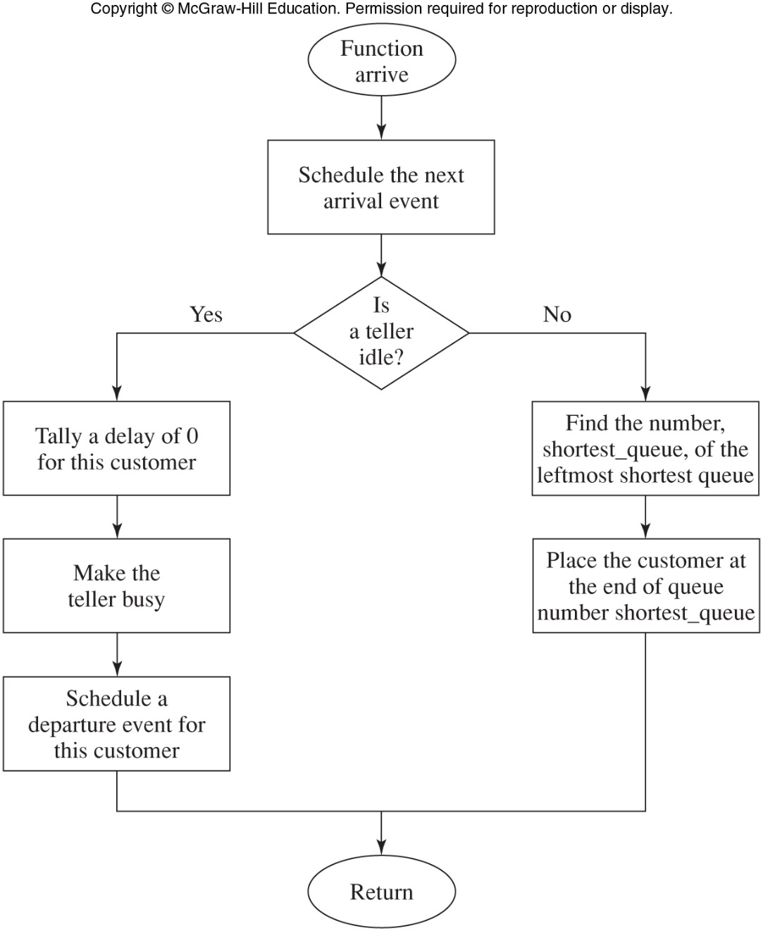
Figure 2.29 Flowchart for arrival function, bank model

Slide 17
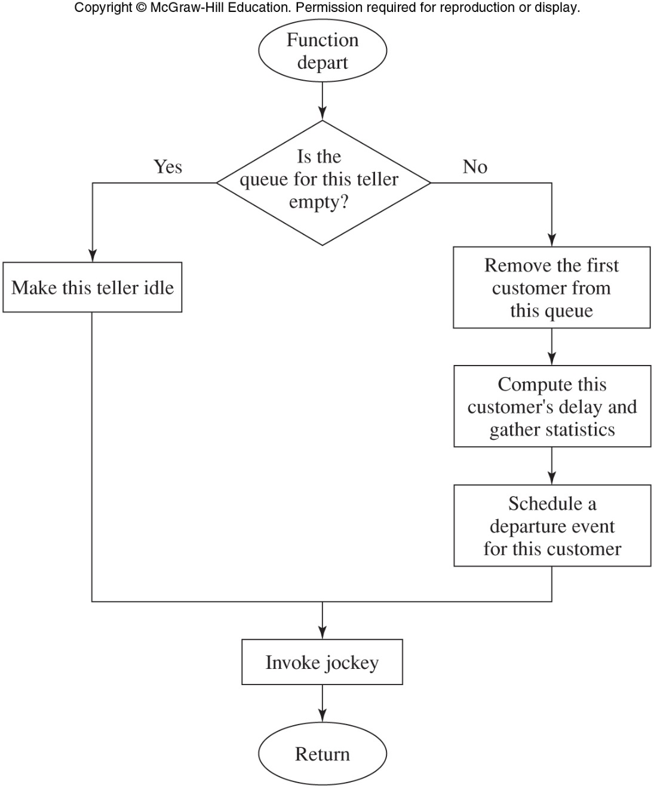
Figure 2.31 Flowchart for departure function, bank model

Slide 18
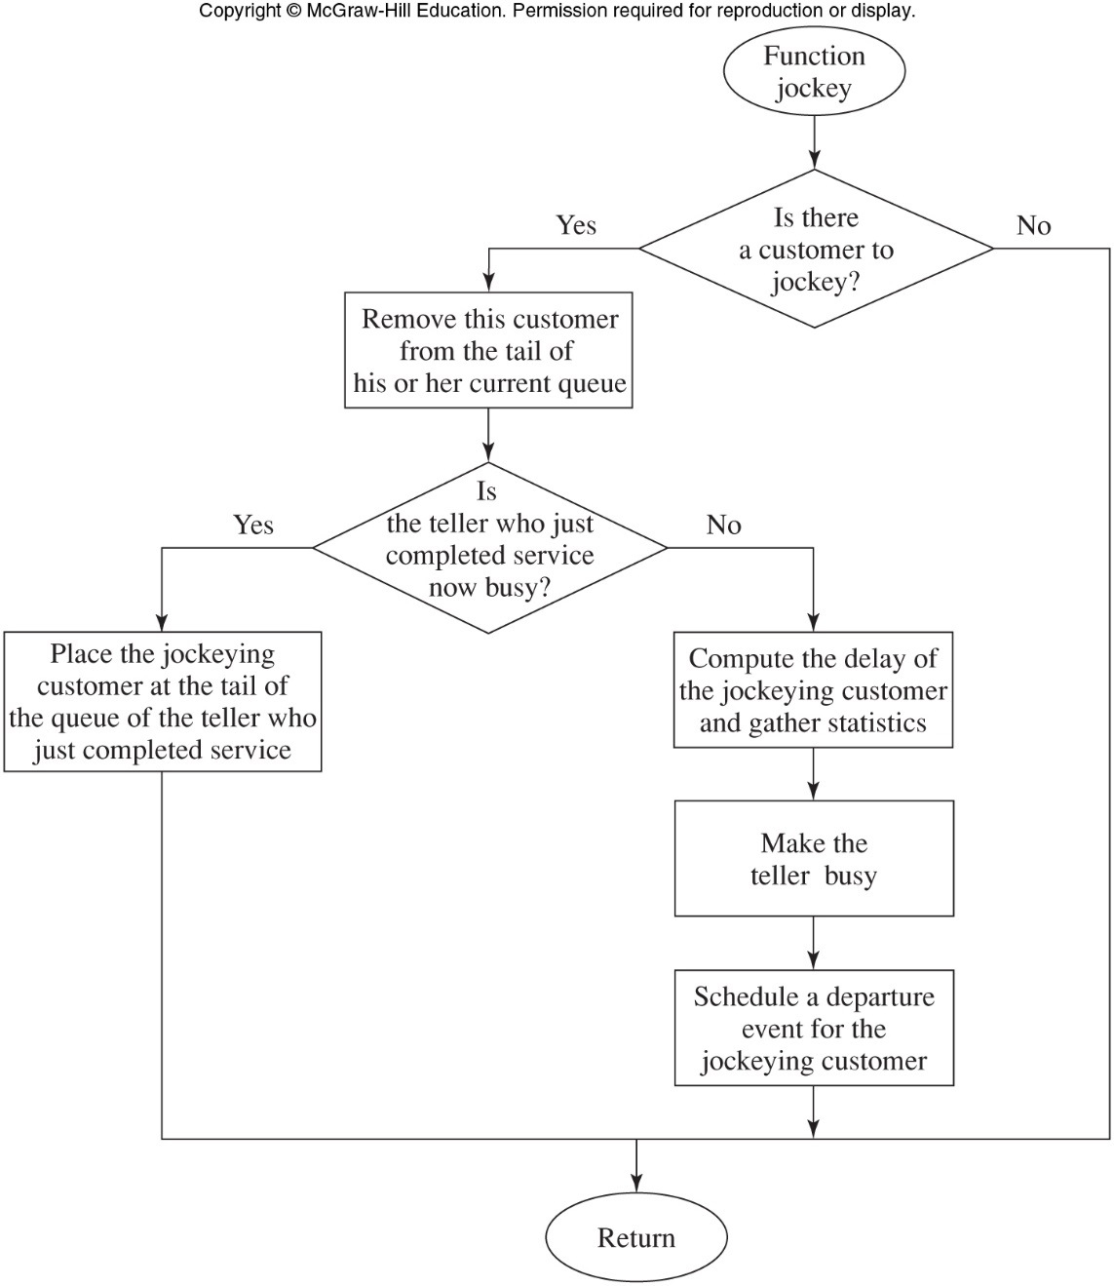
Figure 2.33 Flowchart for jockey function, bank model

Slide 19
Multiteller Bank with Jockeying
Output
  See Figure 2.36 in the text
  Reduction from five to four tellers would increase queue lengths and delays in queue
  Adding a sixth teller would bring a substantial improvement
  Adding a seventh teller does not greatly improve results over the six teller option
    Probably would not be justified financially

Slide 20
2.7 Job Shop Model
Simulating a manufacturing system
  Can identify bottlenecks in a production process
Example job shop
  Manufacturing system with five workstations
Define symbolic constants for event types and random-number stream numbers
Define maximum values for number of stations and job types

Slide 21
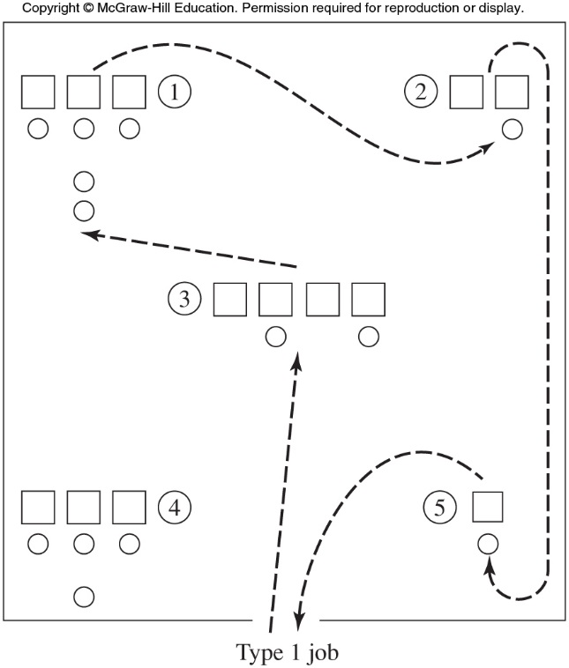
Job Shop Model
Figure 2.37 Manufacturing system with five workstations, showing the route of type 1 jobs

Slide 22
Job Shop Model
Output identifies stations 1, 2 and 4 as potential bottlenecks
  These have the highest average delay in queue
Simulate potential solutions to reduce the bottleneck
  Add a machine to station 1
  Add a machine to station 2
  Add a machine to station 4

Slide 23
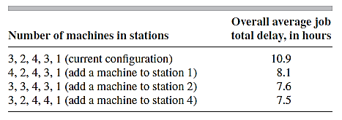
Job Shop Model
Table 2.1 Estimated expected overall average job total delays for current and proposed machine configurations

Slide 24
2.8 Efficient Event-List Management
For complex systems with a large number of events
  Much of the computer time is used on event-list processing
One solution: use more efficient data structure and search technique
  Median-pointer linked list
  Other approaches
    Heaps and trees, calendar or ladder queues, etc.

