Slide 1
Simulation of Manufacturing Systems
Chapter 14

Slide 2
14.1 Introduction
Why is simulation widely applied to manufacturing systems?
  Complex automated systems can be analyzed by simulation
  Cost of equipment and facilities is quite high
    Cost of computing has decreased dramatically
  Improved simulation software has decreased model development time

Slide 3
14.2 Objectives of Simulation in Manufacturing
Benefit of simulation in manufacturing
  Allows a system-wide view of effect of local changes to the manufacturing system
Other potential outcomes
  Increased throughput
  Decreased times in system of parts
  Reduced inventories
  Increased utilization of resources

Slide 4
Objectives of Simulation in Manufacturing
Categories of issues typically addressed
  Need for and amount of equipment and personnel
    Number, type, and layout of machines, location and size of inventory buffers
  Performance evaluation
    Throughput, time-in-system, and bottleneck analysis
  Evaluation of operational procedures
    Production scheduling, control strategies

Slide 5
14.3 Simulation Software for Manufacturing Applications
Material handling systems must be modeled correctly
FlexSim
  True object-oriented simulation package
  Model constructed by dragging objects into “Model View”
    Editing parameters using dialog boxes
  Includes a variety of material handling devices

Slide 6
Simulation Software for Manufacturing Applications
FlexSim (cont’d.)
  Bundled with ExpertFit distribution-fitting software
  OptQuest optimization module available as an option
ProModel
  Modeling constructs
    Locations, entities, arrivals, processes, and resources

Slide 7
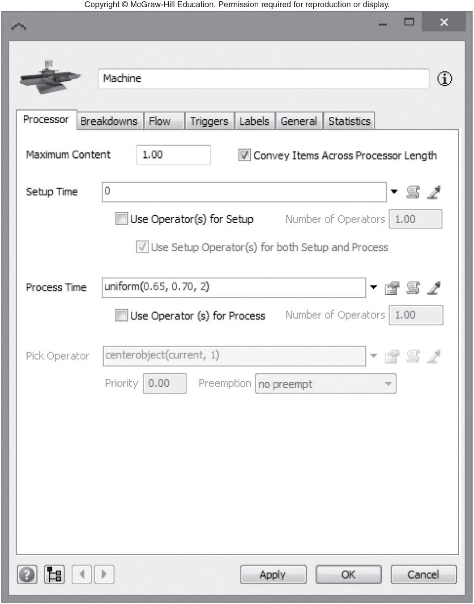
Figure 14.4 Dialog box for the FlexSim processor object “Machine”

Slide 8
Simulation Software for Manufacturing Applications
Methods for creating a model in ProModel
  Graphically
  By filling in data fields
  Programming with an internal pseudo-language
Scenario Manager used to make independent replications
Results displayed in Output Viewer

Slide 9
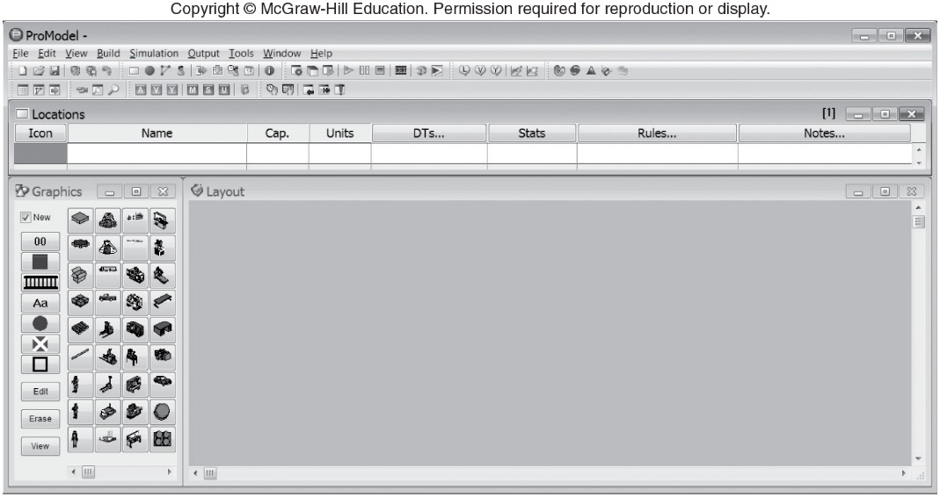
Figure 14.9 Locations module for ProModel

Slide 10
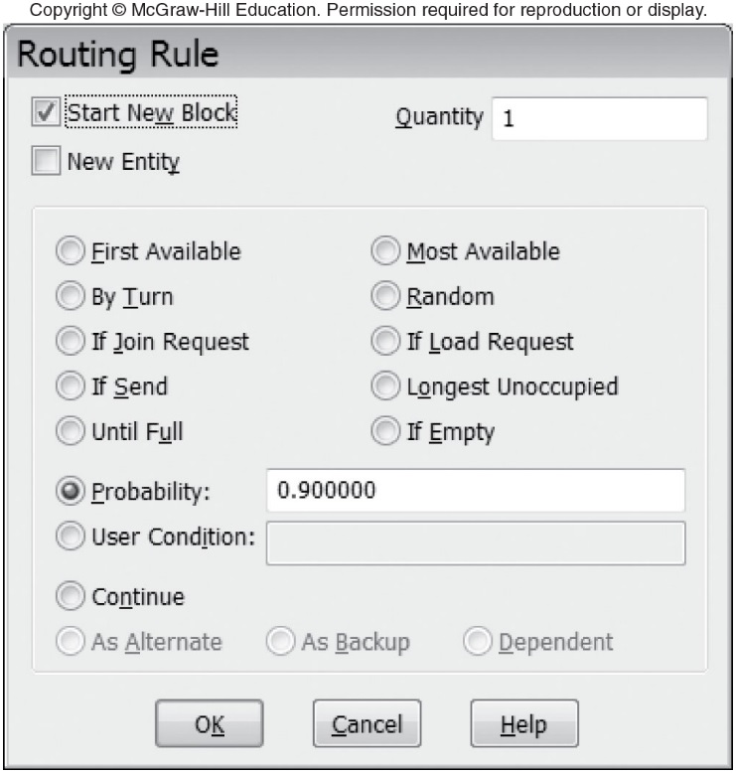
Figure 14.16 Routing rule dialog box for the ProModel model

Slide 11
14.4 Modeling System Randomness
Sources of randomness
  Interarrival times of parts or raw materials
  Processing, assembly, or inspection times
  Times to failure of a machine
  Time to repair a machine
  Loading and unloading time
  Yield
  Rework

Slide 12
Modeling System Randomness
Some systems
  Assume there is an unlimited supply of parts or raw materials in front of the first machine
    Rate at which parts enter system equals processing rate of first machine
Jobs may arrive according to a production schedule
Discrete distributions less common than continuous distributions

Slide 13
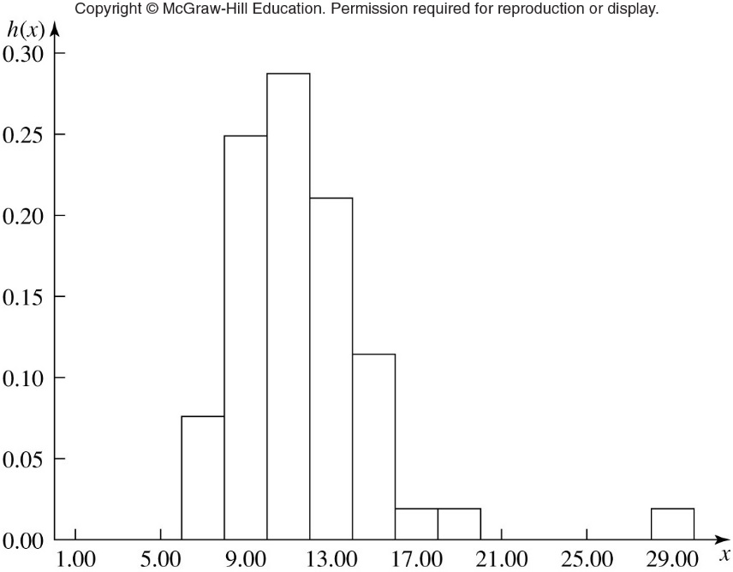
Figure 14.19 Histogram of 52 processing times for an automotive manufacturer

Slide 14
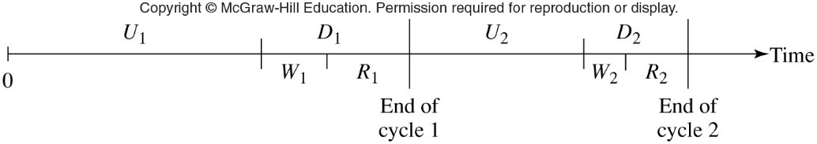
Modeling System Randomness
Machine downtimes
  Unscheduled downtime: common source of randomness for many systems
A machine goes through a series of cycles
Figure 14.22 Up-down cycles for a machine

Slide 15
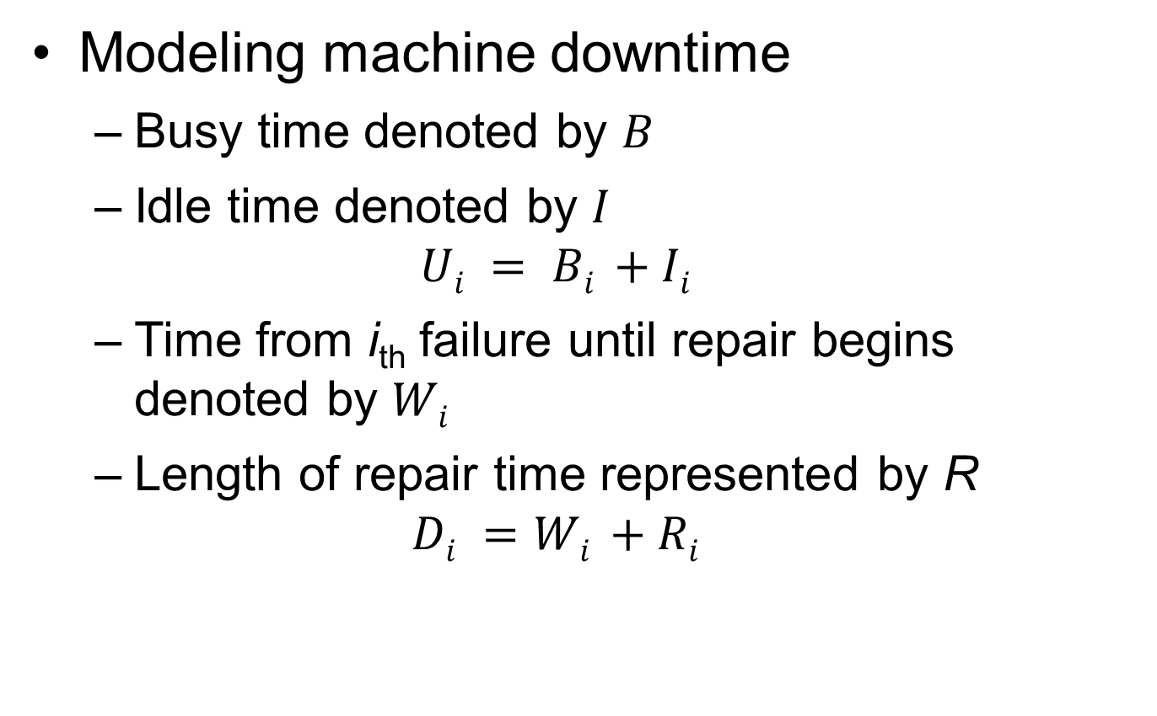
Modeling System Randomness
Modeling machine downtime
  Busy time denoted by $B$
  Idle time denoted by $I$
  $$Ui = Bi +Ii$$
  Time from i_{th} failure until repair begins denoted by $Wi$
  Length of repair time represented by R
  $$Di =Wi +Ri$$

Slide 16
Modeling System Randomness
Two approaches to modeling time
  Calendar time approach
  Busy time approach

Slide 17
14.5 An Extended Example
System consists of workstations and forklift trucks
Determine the number of machines needed at each workstation
Jobs arrive at the input/output station and are moved by forklift from one station to another
Single FIFO queue at each station

Slide 18
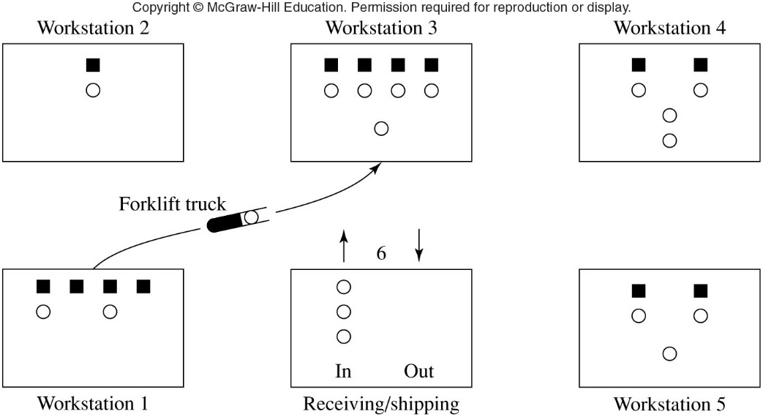
An Extended Example
Figure 14.26 Layout for the manufacturing system

Slide 19
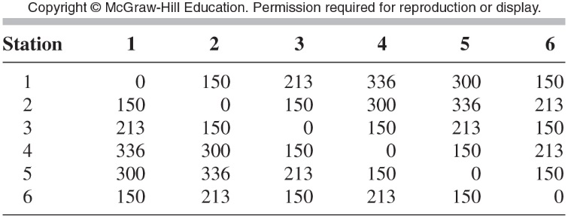
An Extended Example
Table 14-3 Distances (in feet) between the six stations

Slide 20
An Extended Example
Routings and service times are given for each job type and operation
Expected throughput: 120 jobs per eight hour day
Goal: choose best system design
For additional detail, calculations, and simulation output for six system designs, see text

Slide 21
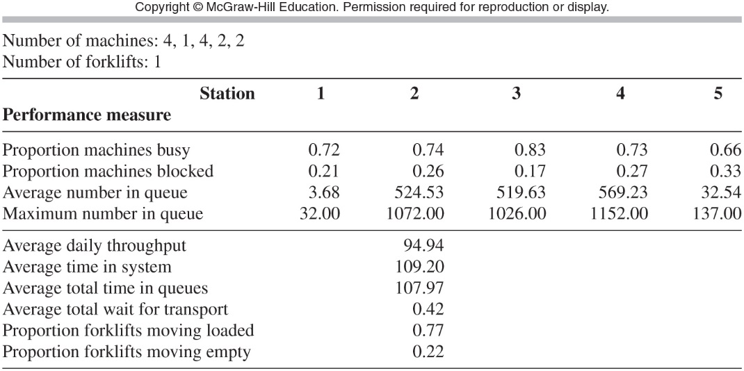
An Extended Example
Table 14-8 Simulation results for system design 1

Slide 22
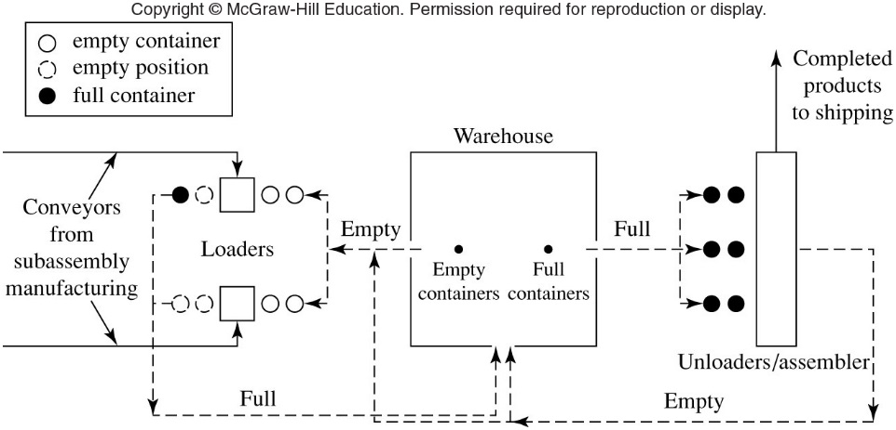
14.6 A Simulation Case Study of a Metal Parts Manufacturing Facility
Figure 14-31 Layout of the system

Slide 23
A Simulation Case Study of a Metal Parts Manufacturing Facility
Study goals
  Number of containers required
  Number of forklifts required and their control logic
  Number of staged containers in the input queues
  Number of output queue positions for the loaders
  Required shifts

Slide 24
A Simulation Case Study of a Metal Parts Manufacturing Facility
Model was built and verified
Tested seven different scenarios
  Five simulation runs made for each scenario
Output from first phase presented to stakeholders
Six more scenarios tested

Slide 25
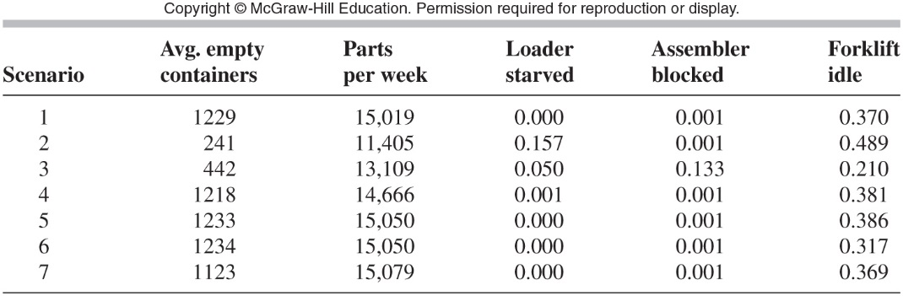
A Simulation Case Study of a Metal Parts Manufacturing Facility
Table 14-18 Summary of simulation results for initial set of runs

Slide 26
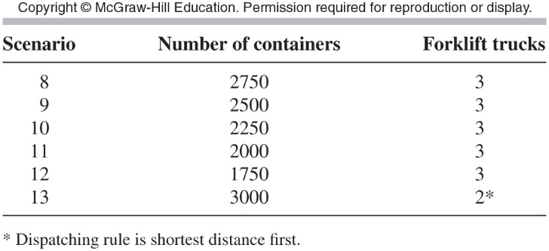
A Simulation Case Study of a Metal Parts Manufacturing Facility
Table 14-19 Scenarios for the second set of simulation runs

Slide 27
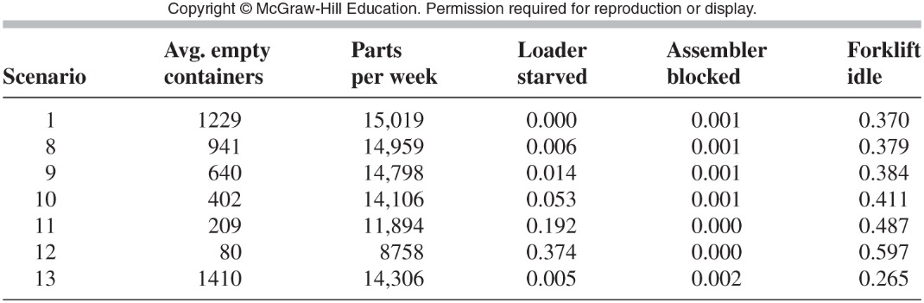
A Simulation Case Study of a Metal Parts Manufacturing Facility
Table 14-20 Summary of simulation results for second set of runs

Slide 28
A Simulation Case Study of a Metal Parts Manufacturing Facility
Result
  Company will buy 2,250 containers instead of the 3,000 originally planned
  Throughputs for scenarios 1, 8, 9, and 10 are each sufficient
  By using fewer containers, the company expects to save $528,000 in the first year

