Slide 1
Agent-Based Simulation and System Dynamics
Chapter 13

Slide 2
13.1 Introduction
Dynamic simulation models
  Represent a system as it changes over time
  Events may be either discrete (DES) or continuous
    Agent-based simulation is a variation of DES
Monte Carlo simulation
  A scheme employing random numbers
    Used for solving certain problems

Slide 3
13.2 Agent-Based Simulation
Agent
  An autonomous entity that can sense its environment
    Uses information in decision-making
Agents have attributes
  Behavior determined by set of basic if/then rules
  May also learn and adapt their behavior

Slide 4
Agent-Based Simulation
Examples of types of agents
  People, animals, vehicles, and organizations
Agent-based simulation (ABS)
  Agents interact with their environment and other agents in a major way
  A special case of discrete event simulation
  Usually implemented in object-oriented software
    Methods correspond to behaviors

Slide 5
Agent-Based Simulation
Emergent behavior
  System behavior caused by interactions of the low level agents
  Often unexpected or novel in some way
General DES can also exhibit emergent behavior
  Examples: unexpected bottlenecks, oscillations, or deadlocks

Slide 6
Agent-Based Simulation
ABS might be used in situations where:
  Entities in the system naturally interact with each other and the environment
  Entities need to learn and adapt their behavior
  An entity’s movement depends on situational awareness
    Not “scripted”

Slide 7
Agent-Based Simulation
Complex adaptive system (CAS)
  System of interacting agents
  Collective behavior shows adaptation, self-organization, and emergence
  Examples: stock market, ant colonies, the human brain, the ecosystem

Slide 8
Agent-Based Simulation
Four simulation packages for performing ABS
  AnyLogic
  MASON
  NetLogo
  Repast Simphony
Two major approaches for advancing time: NETA and FITA
  Virtually all ABSs have used FITA

Slide 9
Agent-Based Simulation
Predator-prey example
  From NetLogo simulation software “Models Library”
  Default model assumptions
    100 sheep and 50 wolves randomly placed on the grid
    Each sheep has initial amount of energy uniformly distributed on the set {0,1,…7}
    Each wolf has initial amount of energy uniformly distributed on the set {0,1,…39}

Slide 10
Agent-Based Simulation
Predator-prey example (cont’d.)
  Each animal moves forward one unit for each tick of the integer-valued simulation clock
  Wolves gain energy by eating sheep and sheep gain energy by eating grass
  Offspring are created with specified probability
  At each time step, a wolf will randomly select a sheep on its patch (if any) to eat

Slide 11
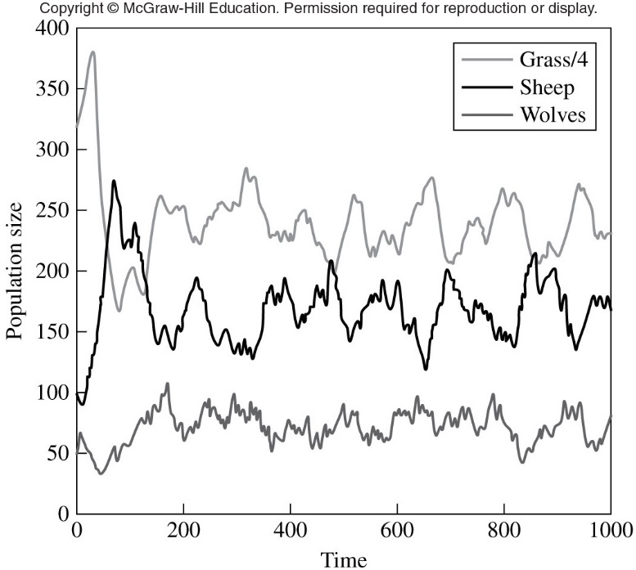
Figure 13-2 Population sizes as a function of time for the default parameter values, predator-prey model

Slide 12
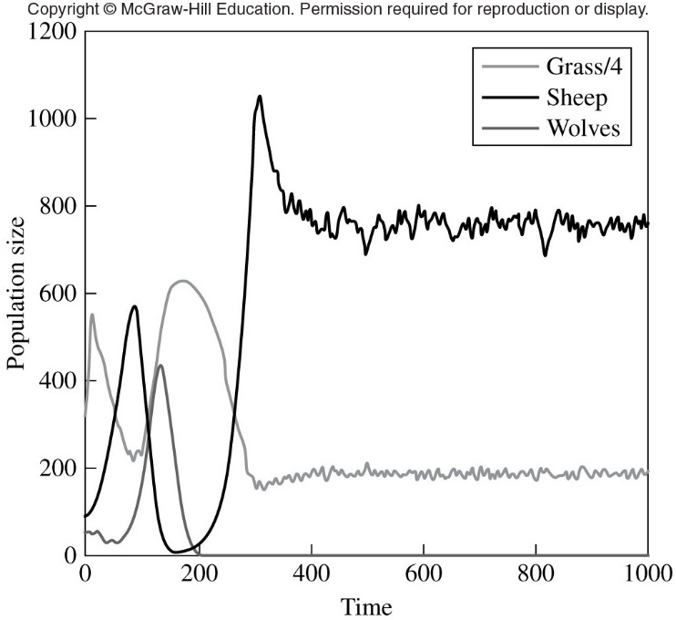
Figure 13-4 Population sizes as a function of time for grass regrowth time equal to 10, predator-prey model

Slide 13
13.3 Continuous Simulation
Models involve differential equations
  Give relationships for rates of change of state variables over time
  Numerical analysis techniques used to integrate the differential equations numerically
Continuous simulation uses equation-computed updates to the state variables
  DES schedules events to update the state variables

Slide 14
Continuous Simulation
Products designed for building continuous simulation models
  SIMULINK
  acs1X
  Dymola
Arena and ExtendSim
  Can do both DES and continuous simulation

Slide 15
Continuous Simulation
System dynamics
  Type of continuous simulation used for designing or improving policies or strategies
    Business, military, and government
  Most models are deterministic
    Random components are possible, however
Commercial simulation products typically used for system dynamics models
  AnyLogic, iThink, Powersim, Vensim

Slide 16
Continuous Simulation
Definitions
  Stock: accumulation of a resource
  Flow: stream of a resource into or out of a stock
  Information link: brings information from a stock or variable into the valve of a flow

Slide 17
13.4 Combined Discrete-Continuous Simulation
Three fundamental interactions
  A discrete event may cause a discrete change in the value of a continuous state variable
  A discrete event may cause the relationship governing a continuous state variable to change at a particular time
  A continuous state variable achieving a threshold value may cause a discrete event to occur or be scheduled

Slide 18
Combined Discrete-Continuous Simulation
Packages for building combined discrete-continuous simulation models
  Arena
  ExtendSim

Slide 19
13.5 Monte Carlo Simulation
A scheme employing random numbers
  Used for solving certain stochastic or deterministic problems
Widely used for solving certain statistics problems
Procedures outlined in Section 9.4
  Used to determine the sample size n required to obtain the specified precision in a Monte Carlo simulation

Slide 20
13.6 Spreadsheet Simulation
Excel spreadsheet
  Used for simple DES or Monte Carlo simulations
  Provides a random number generator and the ability to generate random values from some basic distributions
  Has capability for summary statistics and graphical plots

Slide 21
Spreadsheet Simulation
Limitations of spreadsheet simulation
  Only simple data structures are available
  Complex algorithms are difficult to implement
  Longer execution times
  Limited data storage
Spreadsheet add-ins provide additional features
  Crystal Ball, @Risk, Risk Solver

