Slide 1
Experimental Design and Optimization
Chapter 12

Slide 2
12.1 Introduction
Factors
  Input parameters
  Structural assumptions composing a model
Responses
  Output performance measures
Simulation studies typically have several different responses of interest

Slide 3
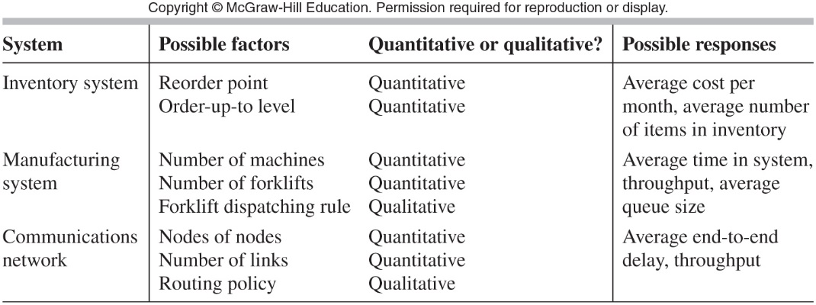
Introduction
Table 12.1 Examples of factors and responses

Slide 4
Introduction
Types of simulation factors
  Controllable
  Uncontrollable
Sensitivity analysis
  Determining which factors have the greatest effect on response

Slide 5
Introduction
Metamodel or response surface goals
  Predict model response for unsimulated conditions
  Find the combination of input factor values that optimize the response

Slide 6
Introduction
Simulation versus physical experiments
  Simulations can control factors that would be uncontrollable in a physical experiment
  Multiple replications are possible in situations where multiple physical experiments would be infeasible

Slide 7
12.2 2^{k} Factorial Designs
Model having a single factor
  Run simulation at various levels of that factor
Model having k factors (k ≥ 2)
  Could use one-factor-at-a-time (OFAT) approach
    Inefficient; requires many simulation runs
    Assumes there are no interactions between factors
  Use 2^{k} factorial design approach

Slide 8
2^{k} Factorial Designs
2^{k} factorial design approach
  Choose two levels for each factor
  Associate minus sign with one level and plus sign with the other level
  Levels should be far enough apart that they would cause a difference in response
    But not so far apart as to be unreasonable
  Assume the response is approximately linear between the two levels

Slide 9
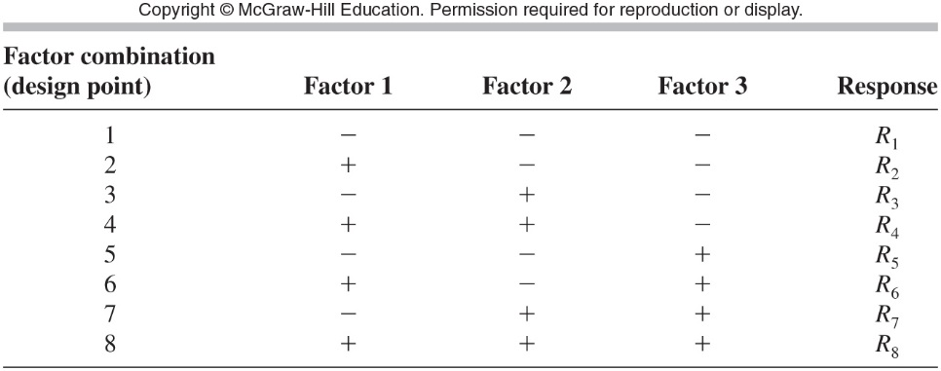
2^{k} Factorial Designs
Table 12.2 Design matrix for a 2³ factorial design

Slide 10

2^{k} Factorial Designs
Main effect of factor j, e_{j}
  Average change in the response due to moving factor j from plus to minus level
Main effect of factor 1 from Table 12-2

Slide 11
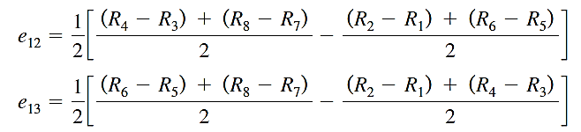

2^{k} Factorial Designs
Two-factor interaction effects

Slide 12
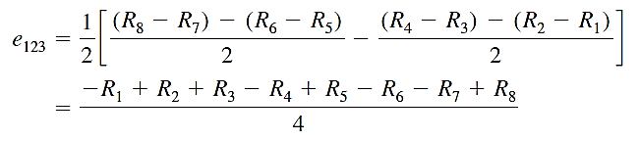
2^{k} Factorial Designs
Three and higher-factor interaction effects
  Possible to define
  Difficult to interpret
Three factor interaction effect from design matrix of Table 12.2

Slide 13
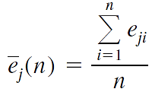
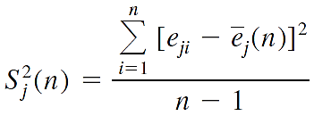

2^{k} Factorial Designs
Constructing confidence intervals for the main effect

Slide 14
2^{k} Factorial Designs
If the confidence interval does not contain zero:
  The effect is statistically significant
    Statistical significance does not necessarily mean the effect is practically significant
Example of 6 factor matrix design
  Shown in Table 12.7 on next slide
  Note factors may be quantitative or qualitative

Slide 15
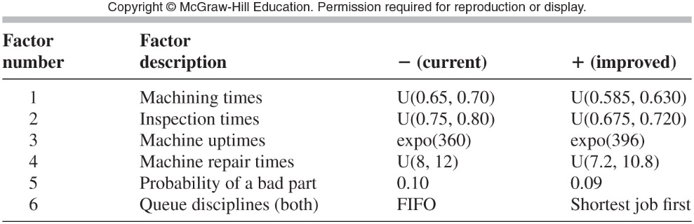
2^{k} Factorial Designs
Table 12.7 Factor coding, small-factory model (all times are in minutes)

Slide 16
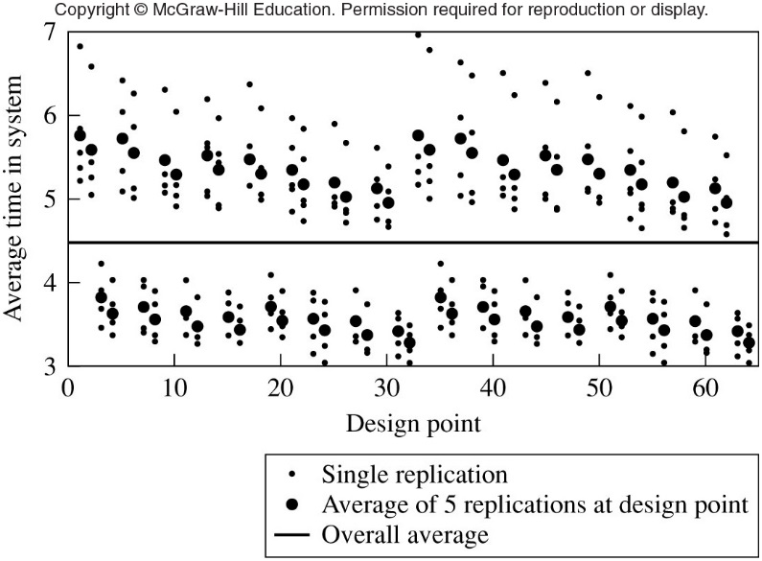
2^{k} Factorial Designs
Figure 12.3 Experimental design for small factory; individual-replication and average-over-replications results

Slide 17
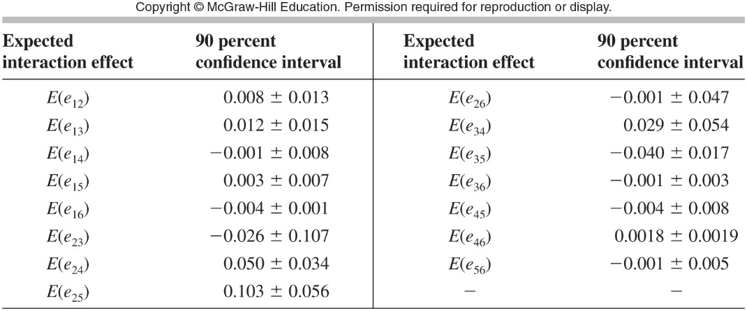
2^{k} Factorial Designs
Table 12.10 90 percent confidence intervals for the expected interaction effects (in minutes), small-factory model

Slide 18
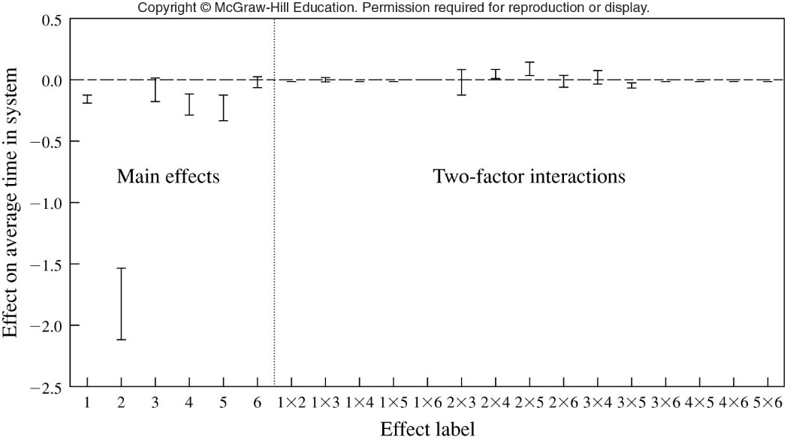
2^{k} Factorial Designs
Figure 12.4 Experimental design for small factory: main effects and two-factor interactions

Slide 19
12.3 2^{k-p} Fractional Factorial Designs
Used when the number of factors is large
Useful in screening out a subset of k important factors of interest
Fractional factorial designs
  Provide good estimates of the main effect and two-factor interactions
  Requires a fraction of the computational effort of a full factorial design

Slide 20
2^{k-p} Fractional Factorial Designs
Confounding
  A common formula between two different effects
  Example: e₄ and e₁₂₃
Higher way interactions
  Often turn out to be small in comparison with main effect and two-factor interactions
  Neglect e₁₂₃ in example above

Slide 21
12.4 Response Surfaces and Metamodels
Metamodel
  Usually a first- or second-order regression equation
  Can predict the response for other factor level combinations of interest
  Can be used to find a set of factor values that optimizes the response
  Example of a metamodel given by Equation 12-8 and illustrated in Figure 12-7(a-b)

Slide 22
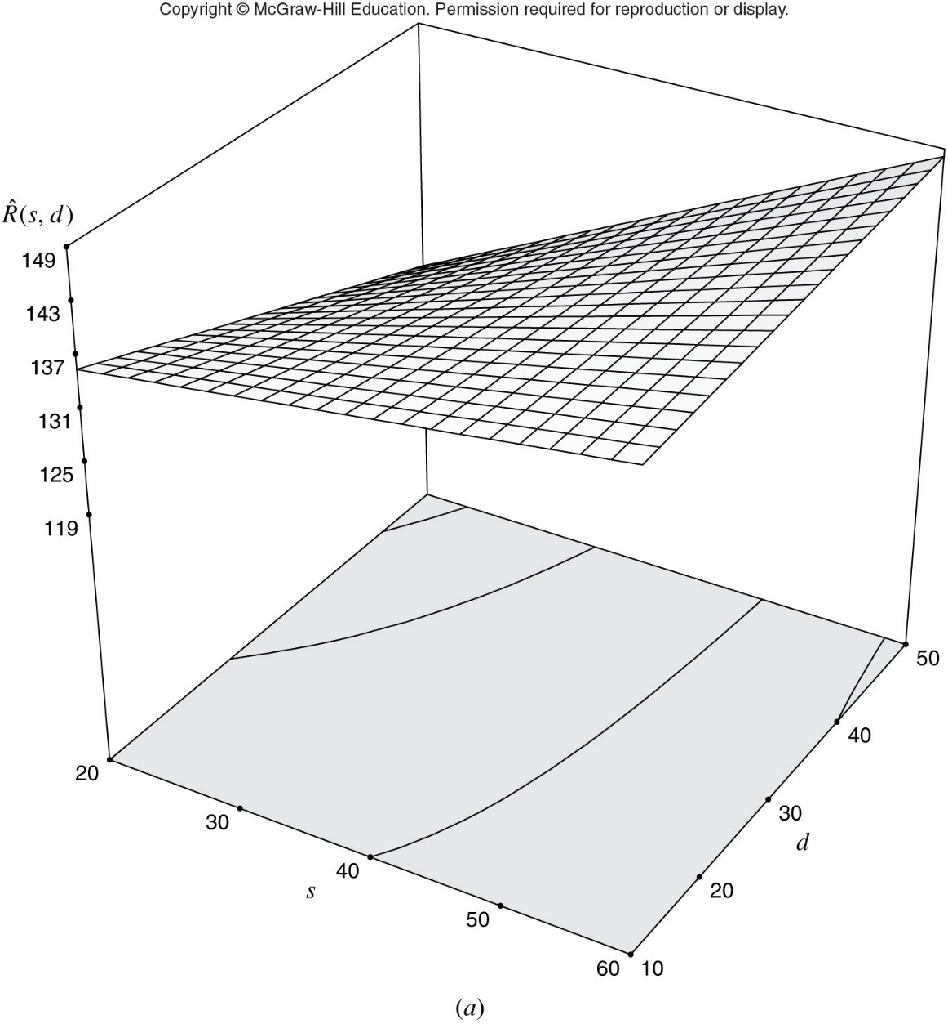
Figure 12.7 (a) Response surface plot and (b) contour plot of the metamodel from the 2² factorial design, inventory model

Slide 23
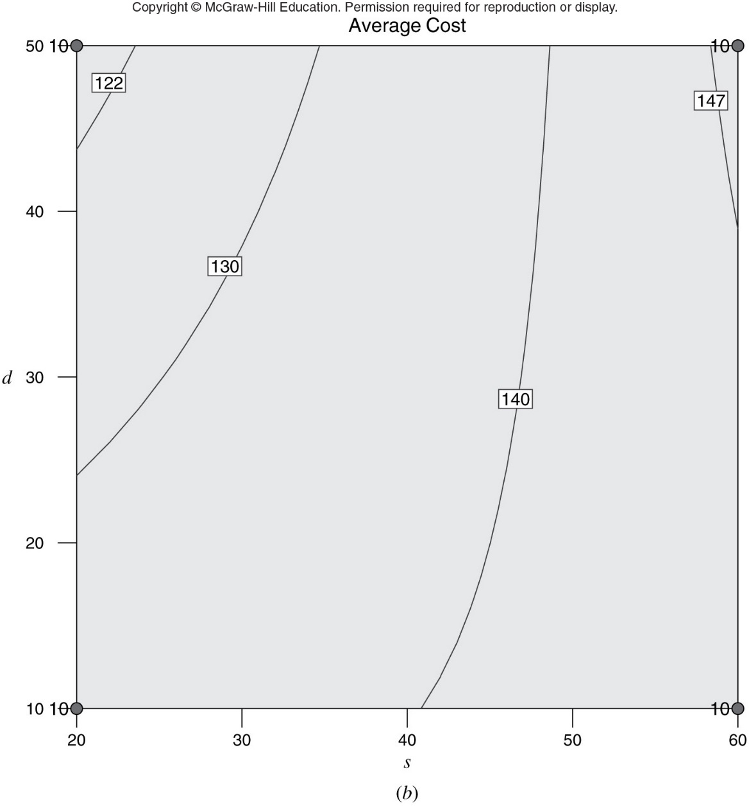
Figure 12.7 (cont’d.) (a) Response surface plot and (b) contour plot of the metamodel from the 2² factorial design, inventory model

Slide 24

Response Surfaces and Metamodels
Regression model chosen varies depending on shape of the response
  Linear
    May be best choice if it appropriately approximates behavior in a local region of interest on a more complex surface
  Quadratic

Slide 25
12.5 Simulation-Based Optimization
An ultimate goal of analyzing a simulation model
  Find a combination of input factors that optimizes a key output performance measure
    Example: find best combination of factors to maximize profit
Optimization is a computationally-intensive activity

Slide 26
Simulation-Based Optimization
Types of optimum-seeking methods in the literature
  Metaheuristics
  Response-surface methodology
  Ordinal optimization
  Gradient-based procedures
  Random search
  Sample-path optimization

Slide 27
Simulation-Based Optimization
Metaheuristic methods
  The focus of the text
Some desirable optimization package features
  Quality of solution
  Amount of execution time to get to a solution
  Allows linear constraints on decision variables
  Should include several stopping rules
  Should allow multiple cores or computers

Slide 28
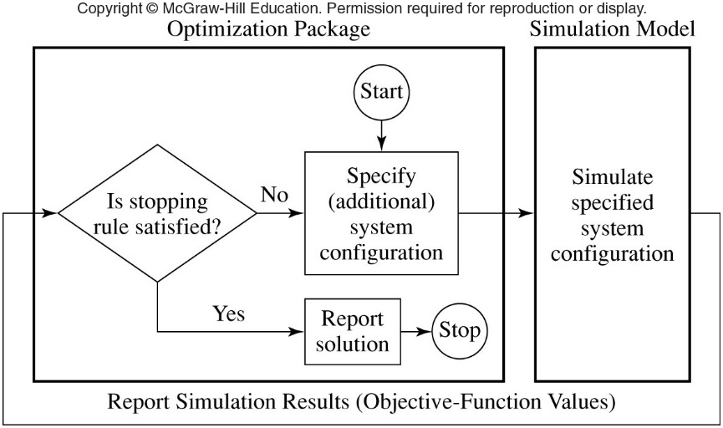
Simulation-Based Optimization
Figure 12.22 Interactions between an optimization package and a simulation model

Slide 29
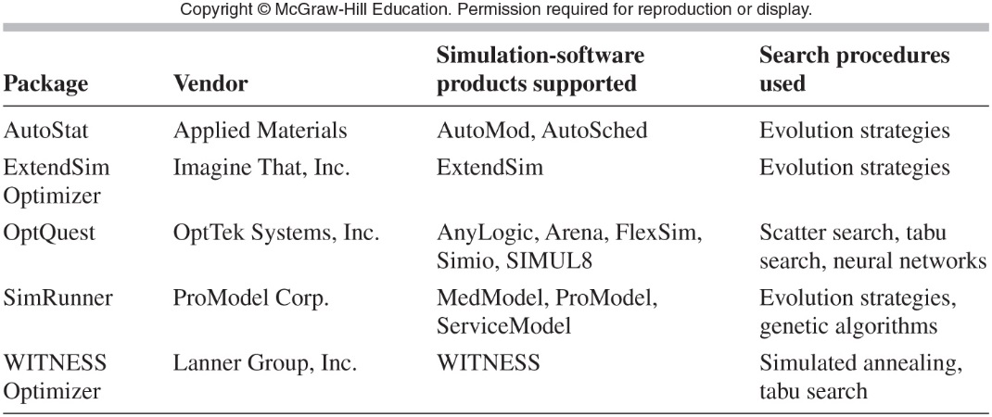
Simulation-Based Optimization
Table 12.26 Optimization packages

