Slide 1
Variance-Reduction Techniques
Chapter 11

Slide 2
11.1 Introduction
Reducing the variance of an output random variable of interest
  Allows achieving a desired precision with less simulating
Method of applying variance reduction techniques (VRTs)
  Depends on the particular model
Impossible to know beforehand how great a variance reduction might be realized

Slide 3
11.2 Common Random Numbers
Most useful and popular VRT
Also called correlated sampling
Applies when comparing two or more alternative system configurations
Basic idea
  Compare alternative configurations under similar experimental conditions
    Experimental conditions are the generated random variates

Slide 4
Common Random Numbers
Using the same set of random numbers to drive each alternative configuration through simulated time
No proof that CRN will always reduce the variance
  For some classes of models, success is guaranteed
Inverse-transform method of variate generation is recommended

Slide 5
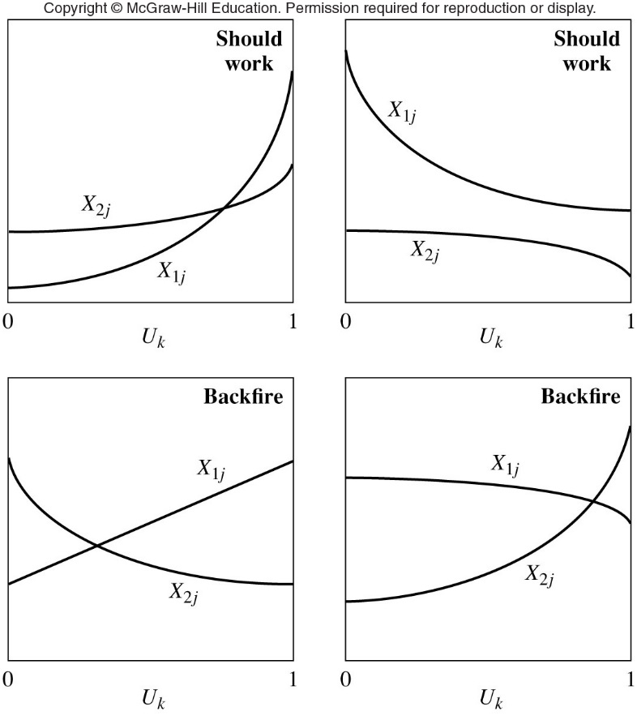
Figure 11.1 Model responses for CRN to work (top row) and backfire

Slide 6
Common Random Numbers
Synchronization
  Specific random number is used for exactly the same purpose in each configuration
  Not enough to start off the simulations with the same seed of a random number stream
Programming tricks
  Can be used to maintain synchronization in a given simulation
  See Pages 594-595 in the text for details

Slide 7
Common Random Numbers
May be impossible to attain synchronization across all configurations under study
  Might consider synchronizing some of the input random variates and not others

Slide 8
11.3 Antithetic Variates
Antithetic Variates (AV) is a VRT that applies to simulating a single system
  Try to induce correlation between separate runs
    Negative correlation is desired
  Make pairs of runs of the model such that a small observation on one of the runs is offset by a large observation on the other one
    Basic data point for analysis: average of the two observations in the pair

Slide 9
Antithetic Variates
Fundamental requirement for AV to work
  Response to a random number for a particular purpose should be monotonic
Combining AV with CRN
  There is no proof that this is a good idea

Slide 10
11.4 Control Variates
CV method attempts to take advantage of correlation between certain random variables
  To obtain a variance reduction
Success does not depend on the correlation being of a particular sign
Mathematical development of CV
  See Pages 610-613 in the text

Slide 11
Control Variates
In complex models
  Many potential control variates available
  Combine in a reasonable way to get a single CV
Finding and selecting control variates
  Internal
  External
  Multiple estimators

Slide 12
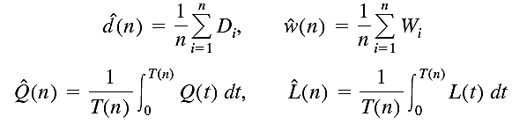
11.5 Indirect Estimation
Applies to queuing-type simulations when quantities to be estimated are steady-state performance measures
Initial experimentation may reveal whether worthwhile variance reductions result
Direct estimators of d, w, Q, and L

Slide 13




Indirect Estimation
Indirect estimator of w
Indirect estimators of Q and L, where λ is the arrival rate

Slide 14
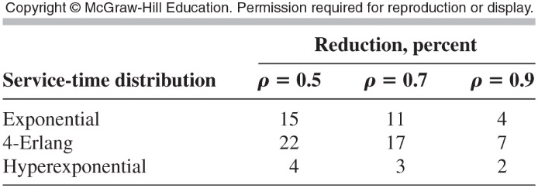
Indirect Estimation
Weakness of indirect estimation technique
  As ρ → 1, the variance reductions decrease to zero
Table 11-10 Exact asymptotic variance reductions for indirect estimation of Q, M/G/1 queue

Slide 15
11.5 Conditioning
Conditioning method replaces an estimate of a quantity by its exact analytical value
  Goal: more stable final output random variable
    No guarantee that this will be the case
Let X be a output random variable whose expectation μ we want to estimate
  Example: customer’s delay in queue

Slide 16



Conditioning
Suppose there is another random variable Z such that
  For any given value z we can analytically compute the conditional expectation
  If Z is discrete with probability mass function
  then

Slide 17
Conditioning
Simulate to get a random observation z on Z
  Plug this observation into the known formula
  and use this as a basic observation
Properties of Z
  Must be easily and efficiently generated
  Conditional expectation can be computed analytically and efficiently for any value z

Slide 18

Conditioning
Properties of Z (cont’d.)
  is large, so that it soaks up a lot of Var(X) in the equation
The conditioning VRT is heavily model-dependent
  Examples on Pages 620-622 of the text illustrate successful implementations

