Slide 1
Comparing Alternative System Configurations
Chapter 10

Slide 2
10.1 Introduction
Very unreliable approach
  Comparing two systems based on the output from a single run of each
Example 10.2 shows that even with n = 20 replications, there is substantial room for error

Slide 3
10.1 Introduction
Basic requirement for using many statistical methods to compare alternative configurations
  Ability to collect IID observations with expectation equal to desired measure of performance
    For terminating simulations, can accomplish this by making independent replications
    Steady state behavior: more complex

Slide 4

10.2 Confidence Intervals: Difference Between the Expected Responses of Two Systems
Form a confidence interval for the difference in the two expectations
  Rather than a hypothesis test to see if each difference is significantly different from zero
Paired-t confidence interval
  Approximate 100(1 - α) confidence interval given by

Slide 5

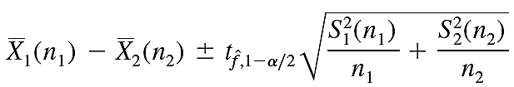
Confidence Intervals: Difference Between the Expected Responses of Two Systems
Modified two-sample-t confidence interval
  Compute the estimated degrees of freedom and confidence interval using Welch approach

Slide 6
Confidence Intervals: Difference Between the Expected Responses of Two Systems
Construct a confidence interval for the difference between two steady-state means
  Use adapted replication/deletion approach
  See Examples 10.5 and 10.6 in the text
  Batch means approach can also be used
    Take care to define batches appropriately

Slide 7
10.3 Confidence Intervals: Comparing More Than Two Systems
Can still use a confidence interval approach with more than two systems
  Make several confidence interval statements simultaneously
Use the Bonferroni inequality to ensure overall confidence level is at least 1 − α

Slide 8
Confidence Intervals: Comparing More Than Two Systems
Comparisons with a standard
  Standard may represent the existing system or policy
  Standard system called 1
    Variants called 2, 3, … k
  Goal: construct k − 1 confidence intervals for the k differences μ₂ − μ₁, μ₃ − μ₁, …μ_{k} − μ₁
  Overall confidence level should be 1 − α

Slide 9
Confidence Intervals: Comparing More Than Two Systems
Comparisons with a standard (cont’d.)
  We can say system i differs from the standard if the interval μ_{i} − μ₁ misses zero
  System i is not significantly different from the standard if μ_{i} − μ₁ includes zero
All pairwise comparisons
  Compare each system with every other system

Slide 10
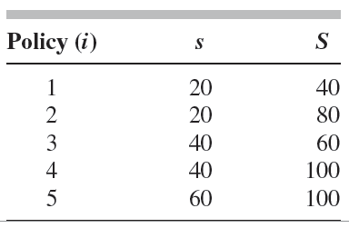
Confidence Intervals: Comparing More Than Two Systems
Example: suppose we wish to compare alternative inventory policies in Table 10-4
Table 10-4 The five alternative inventory policies

Slide 11
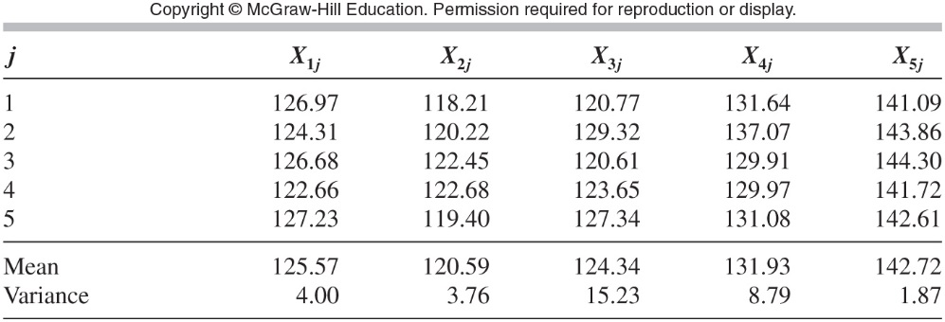
Confidence Intervals: Comparing More Than Two Systems
Use data in Table 10-5
Table 10-5 Average total cost per month for five independent replications of each of the five inventory policies, with sample means and variances

Slide 12
Confidence Intervals: Comparing More Than Two Systems
There are 10 possible pairs
Must make each individual interval at level 99 percent
  To achieve 90 percent overall confidence
Resulting intervals shown in Table 10-7
Another type of comparison
  Multiple comparisons with the best (MCB)
    See Page 569 in the text for details

Slide 13
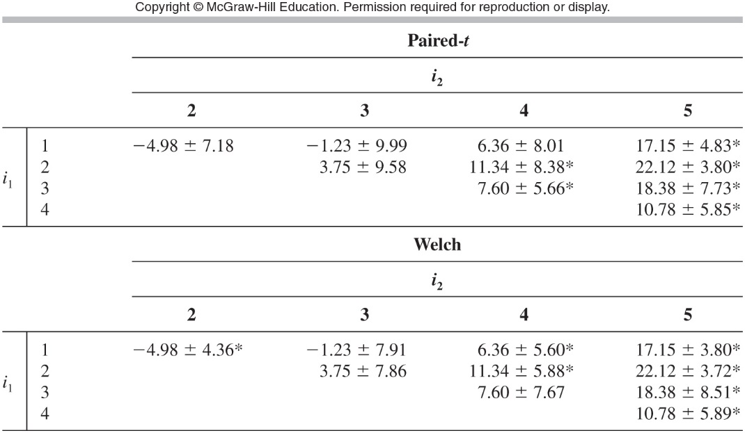
Table 10-7 Individual 99 percent confidence intervals for all pairwise comparisons (μ_{i2}- μ_{i1} for i₁<i₂); * denotes a significant difference

Slide 14
10.4 Ranking and Selection
Different goal: select one of the k systems as being the best one
Correct selection (CS)
  Can never be absolutely sure of making CS
  Specify a probability of CS
  Procedure involves two-stage sampling from each of the k systems
    First stage: fixed number of replications to determine how many more replications needed

Slide 15
Ranking and Selection
Rinott procedure (1978)
  Uses the sample means from the k systems
Dudewicz and Dalal procedure
  Uses weighted sample means from the k systems
  Requires fewer replications than Rinott procedure
Nelson and Matejcik procedure (1995)
  Details on Pages 573-574 of the text

Slide 16
Ranking and Selection
Multiple comparisons with the best (MCB)
  Most indifference zone procedures can be used to construct MCB confidence intervals
    Simultaneously guarantee CS and coverage of the MCB differences with overall confidence level P*
If mean of second-best system is not much different from the best
  May be desirable to choose second-best based on economic or other criteria

Slide 17
Ranking and Selection
Selecting subset of size m containing the best of k systems
  Could be a useful goal in early stages of a simulation study
  Procedure derived by Keonig and Law (1985)
  Likely requires considerably fewer replications than goal of selecting the best system

Slide 18
Ranking and Selection
Other general approaches
  Optimal computing budget allocation approach (Chen, 2000)
    Maximizes probability of CS given a total budget for replications
  Bayesian value of information procedures (Chick and Inoue, 2001a)
  Sequential selection with memory procedure (Pichitlamken et.al, 2006)

Slide 19
Ranking and Selection
Subset selection
  Selecting a subset of random size that contains the best system (Gupta, 1956, 1965)
    Major limitation: assumes known and equal variances
Fully sequential procedures
  Single observation taken from each alternative system still in the running
  Inferior systems are eliminated

Slide 20
Ranking and Selection
Fully sequential procedures (cont’d.)
  Goal: reduce the number of observations
  Shortcoming: time and effort required to switch between simulations
Criteria other than expectations
  Largest probability of producing a good outcome

Slide 21
Ranking and Selection
Correlation between alternatives
  Important that CRN technique not “backfire” to induce negative correlation
Constrained ranking and selection
  Goal: find which of k systems has the smallest or largest mean response subject to constraints on secondary mean responses
  Example: hospital goal to minimize idle time of resources with secondary constraint of an upper bound on mean patient waiting time

