Slide 1
Basic Simulation Modeling
Chapter 1

Slide 2
1.1 The Nature of Simulation
Simulation
  Using computer techniques to simulate a real-world facility or process (the system)
Model
  Mathematical or logical representation of system behavior
Model is evaluated numerically in a simulation

Slide 3
1.2 Systems, Models, and Simulation
Types of systems
  Discrete
    State variables change at separated points in time
  Continuous
    State variables change continuously with time

Slide 4
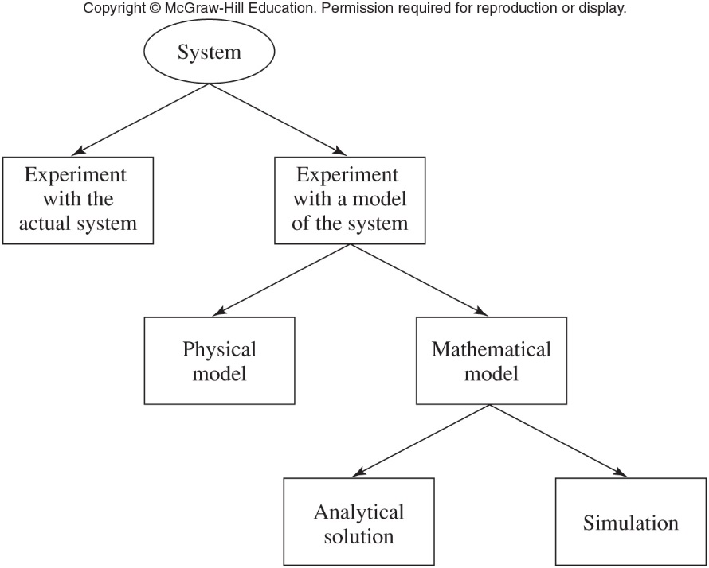
Systems, Models, and Simulation
Figure 1.1 Ways to study a system

Slide 5
1.3 Discrete-Event Simulation
Event
  An instantaneous occurrence that may change the system’s state
Simulation clock
  Variable that gives the current value of simulated time
  Methods for advancing the simulation clock
    Next-event time advance
    Fixed-increment time advance

Slide 6
Discrete-Event Simulation
Next-event time advance
  Clock initialized to zero
  Times of events are determined
  Clock advanced to time of first event
    State of system updated
  Clock advanced to time of next event
    State of system updated
  Continues until stopping condition satisfied

Slide 7
Discrete-Event Simulation
Fixed-increment time advance
  Does not skip over inactive periods
    Can use up a lot of computer time

Slide 8
1.4 Simulation of a Single-Server Queuing System
Example system: a one-operator barbershop
  Interarrival times A₁, A₂…A_{n} are independent, identically distributed random variables
  Customer service times are S₁, S₂…
  Estimate three quantities
    Expected average delay of customers in queue
    Expected average number of customers in queue
    Expected utilization of the server

Slide 9
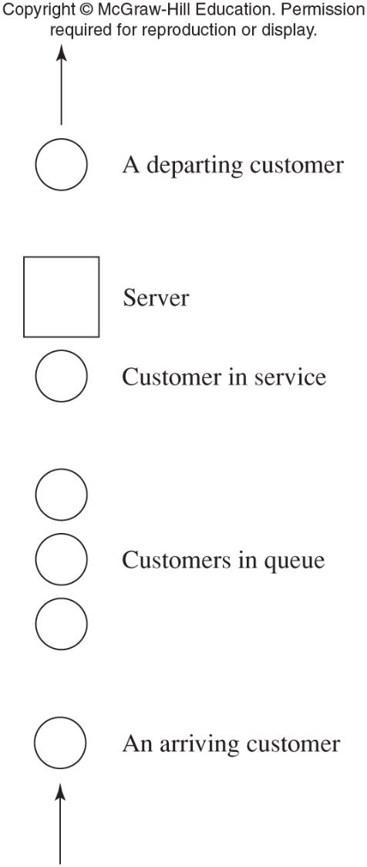
Simulation of a Single-Server Queuing System
Figure 1.4 A single-server queuing system

Slide 10
Simulation of a Single-Server Queuing System
Events for the barbershop example
  Arrival time of a customer
  Departure time of a customer
State variables
  Status of the server
  Number of customers in the queue
  Arrival time of each customer currently in queue
  Time of most recent event

Slide 11
Simulation of a Single-Server Queuing System
Initialization
  State of the system at t = 0
Sequence of events
  t = 0.4 arrival of customer 1
  t = 1.6 arrival of customer 2
  t = 2.1 arrival of customer 3
  t = 2.4 departure of customer 1

Slide 12
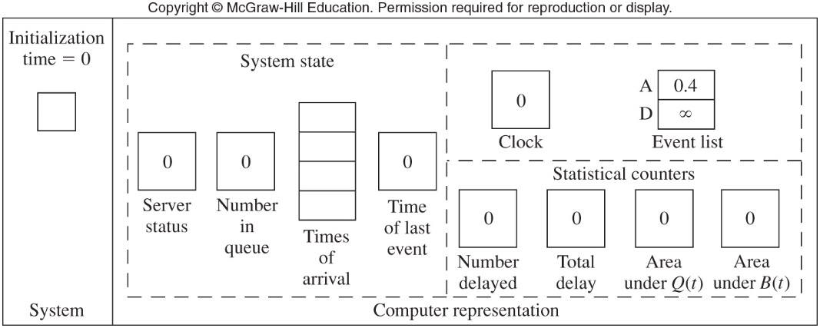
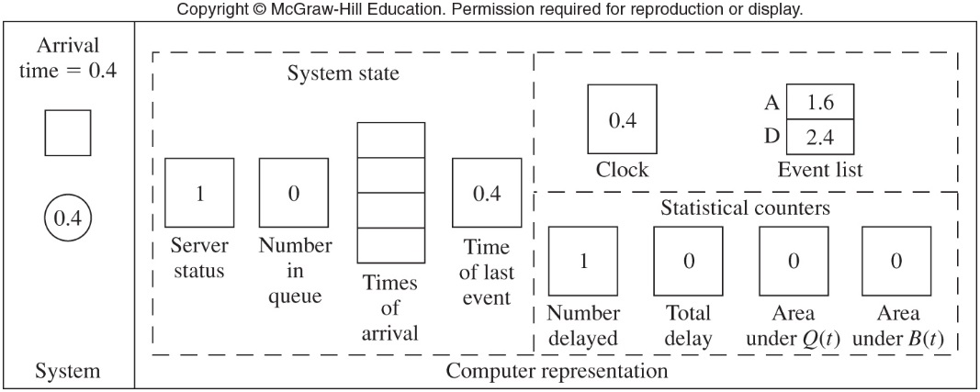
Figure 1.7 (a-b) Snapshots of the system and its computer representation at times t=0 and t=0.4

Slide 13
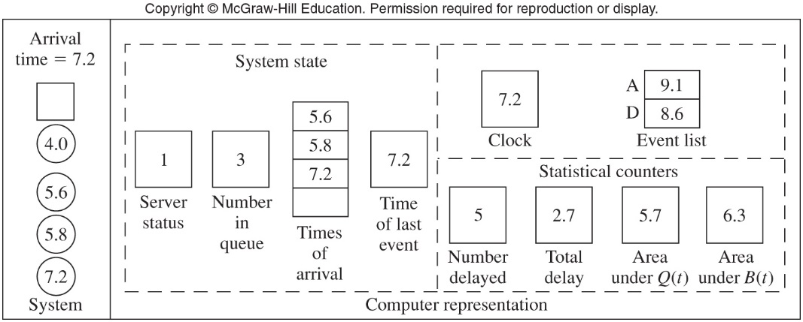
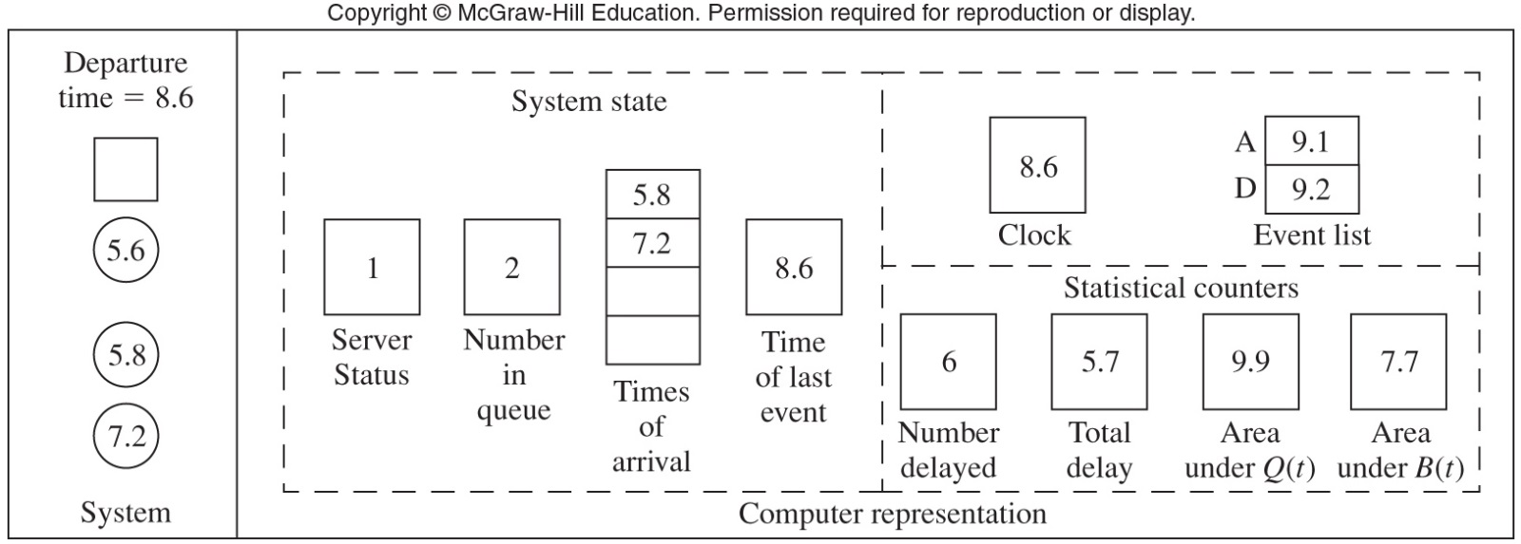
Figure 1.7 (m-n) Snapshots of the system and its computer representation at times t=7.2 and t=8.6

Slide 14
1.4 Simulation of a Single-Server Queuing System
Writing a simulation program
  Our example: C, a general purpose language
  Program modules
    Initialization
    Timing
    Arrive
    Depart
    Report

Slide 15
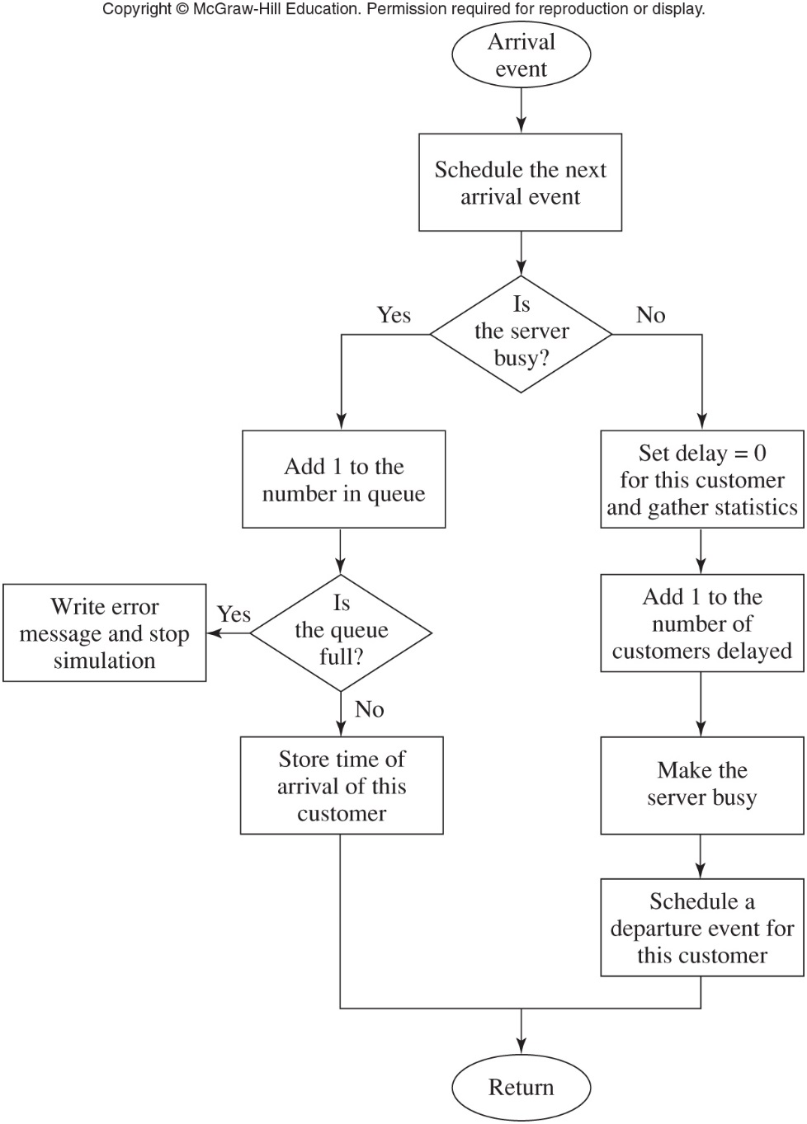
Figure 1.8 Flowchart for arrival routine – queuing model

Slide 16
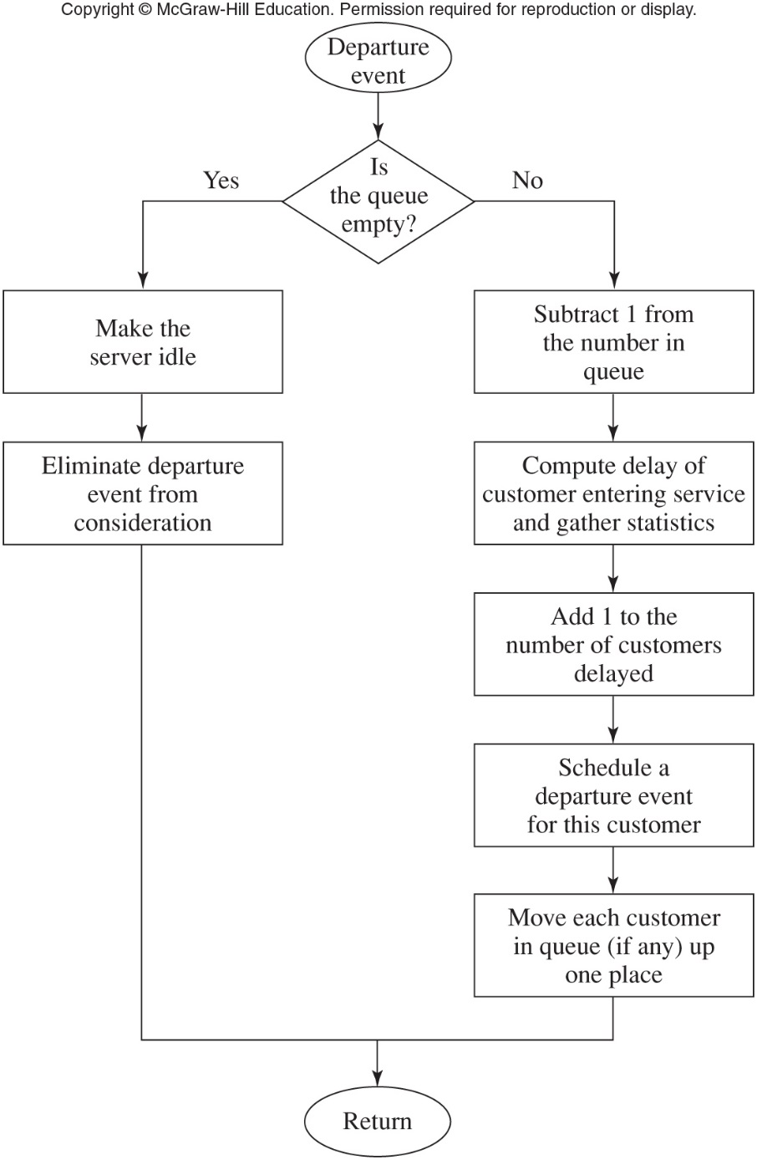
Figure 1.9 Flowchart for departure routine – queuing model

Slide 17
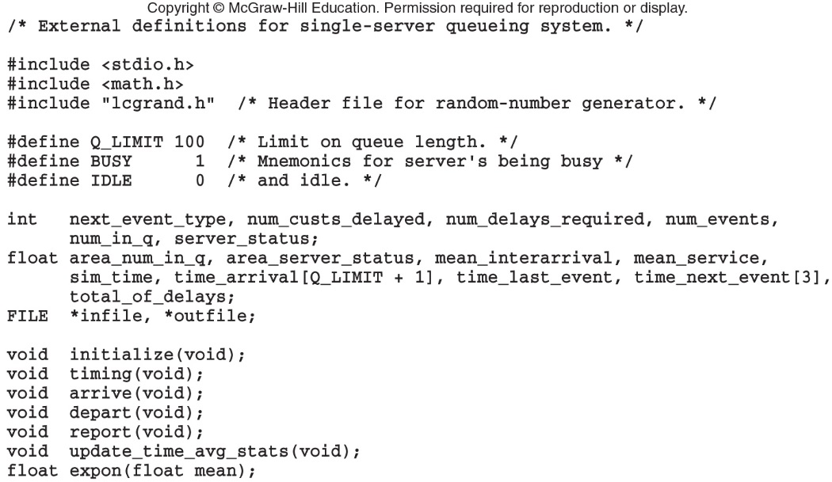
Simulation of a Single-Server Queuing System
Figure 1.10 C code for the external definitions, queuing model

Slide 18
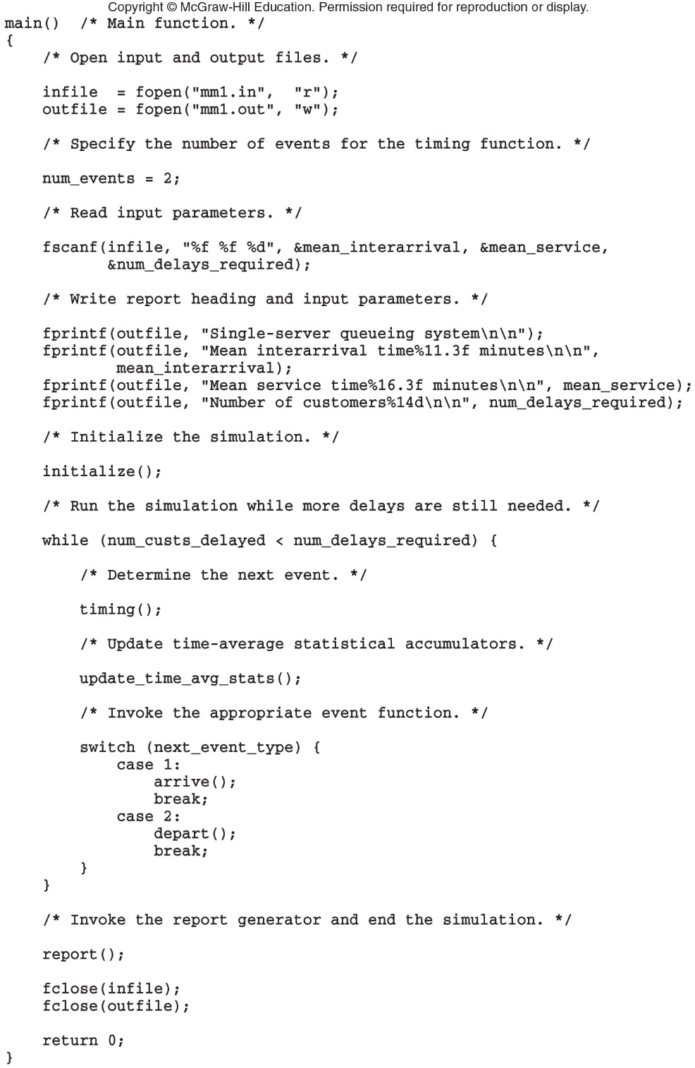
Figure 1.11 C code for the main function, queuing model (continues)

Slide 19
Figure 1.11 C code for the main function, queuing model (cont’d.)

Slide 20
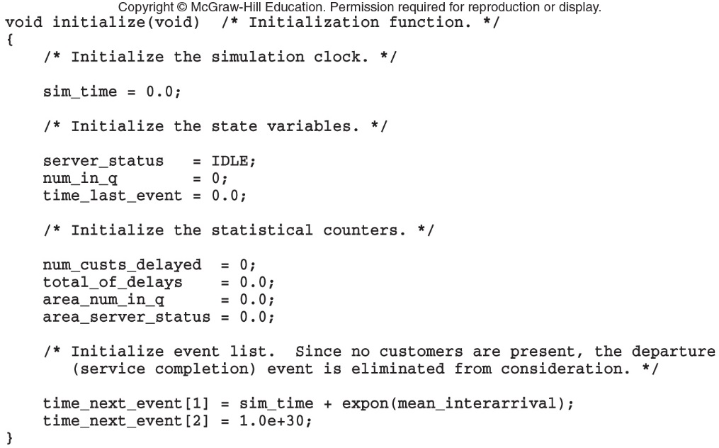
Simulation of a Single-Server Queuing System
Figure 1.12 C code for function initialize, queuing model

Slide 21
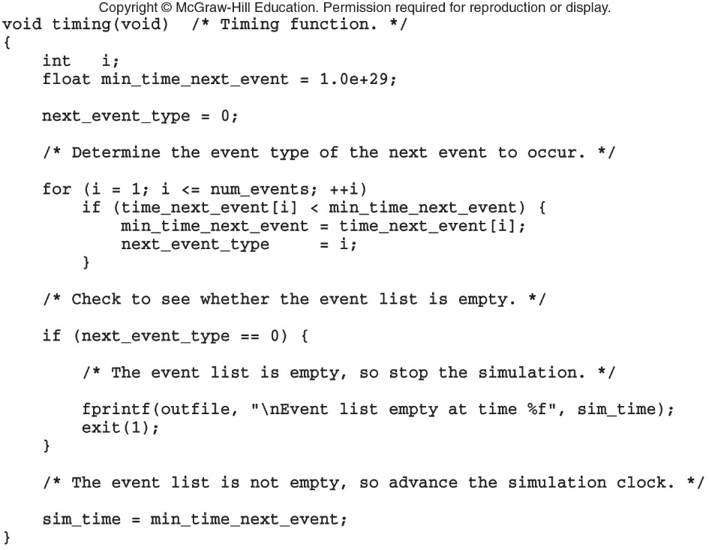
Simulation of a Single-Server Queuing System
Figure 1.13 C code for function timing, queuing model

Slide 22
Simulation of a Single-Server Queuing System
Discussion of simulation output
  Numbers will vary each time the simulation is run
    Not explicit answers but estimates of quantities
  Results are functions of the input parameters, and they way system is initialized
  Might want to study steady state characteristics of the system
  Alternative stopping rules could have been defined

Slide 23
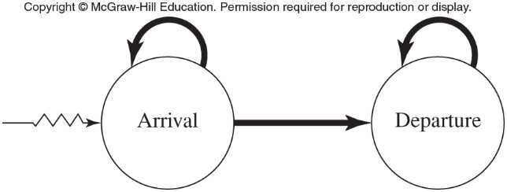
Simulation of a Single-Server Queuing System
Figure 1.25 Event graph, queuing model

Slide 24
1.5 Simulation of an Inventory System
Problem: compare various ordering policies for an inventory system
  Given: initial inventory level, demands, times between demands
  Costs: setup cost, incremental cost, holding and shortage costs
  State variables: inventory level, amount of an outstanding order from company to supplier, and time of last event

Slide 25
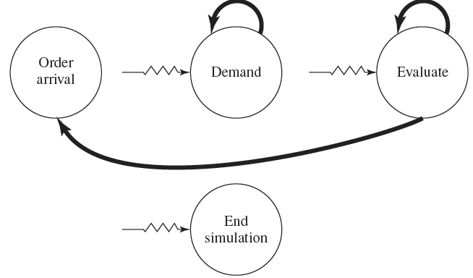
Simulation of an Inventory System
Figure 1.29 Event graph, inventory model

Slide 26
1.6 Parallel/Distributed Simulation and the High Level Architecture
Parallel-discrete event simulation
  Execution of the simulation using multiple processors
  Reduces execution time
  Done by dividing model into several logical processes (LPs)
  Critical issue: determining LPs happen in proper sequence

Slide 27
Parallel/Distributed Simulation and the High Level Architecture
Types of synchronization in parallel simulation
  Conservative
    Avoid any violations of local causality constraint
  Optimistic
    Time-warp mechanism: best known optimistic approach
Distributed simulation
  HLA federation

Slide 28
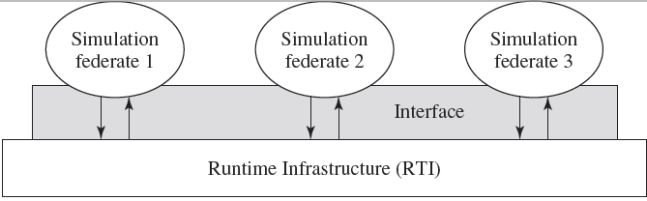
Parallel/Distributed Simulation and the High Level Architecture
Figure 1.45 Functional view of an HLA federation

Slide 29
1.7 Steps in a Sound Simulation Study
Formulate the problem and plan the study
Collect data and define a model
Ensure the assumptions are valid
Construct a computer program and verify
Make the pilot runs
Is the programmed model valid?
Design the experiments

Slide 30
Steps in a Sound Simulation Study
Make the production runs
Analyze the output data
Document, present, and use the results

Slide 31
1.8 Advantages, Disadvantages, and Pitfalls of Simulation
Most complex, real-world systems cannot be accurately described by an analytical mathematical model
  Numerical simulation is the only investigation possible
Simulation allow for the:
  Evaluation of alternative designs
  Study of a system with a long time frame

Slide 32
Advantages, Disadvantages, and Pitfalls of Simulation
Simulation models can be expensive and time-consuming to develop
Large amounts of data can lead to “overconfidence” in the result
What are some causes of failure?
  Lack of well-defined objectives
  Inappropriate level of detail in the model
Crucial to involve the right people in the simulation study

