Slide 1
Managing Engineering and Technology
7th Edition
Morse and Babcock

Slide 2
Managing Engineering and Technology
7th Edition
Morse and Babcock
Controlling
Chapter 8

Slide 3
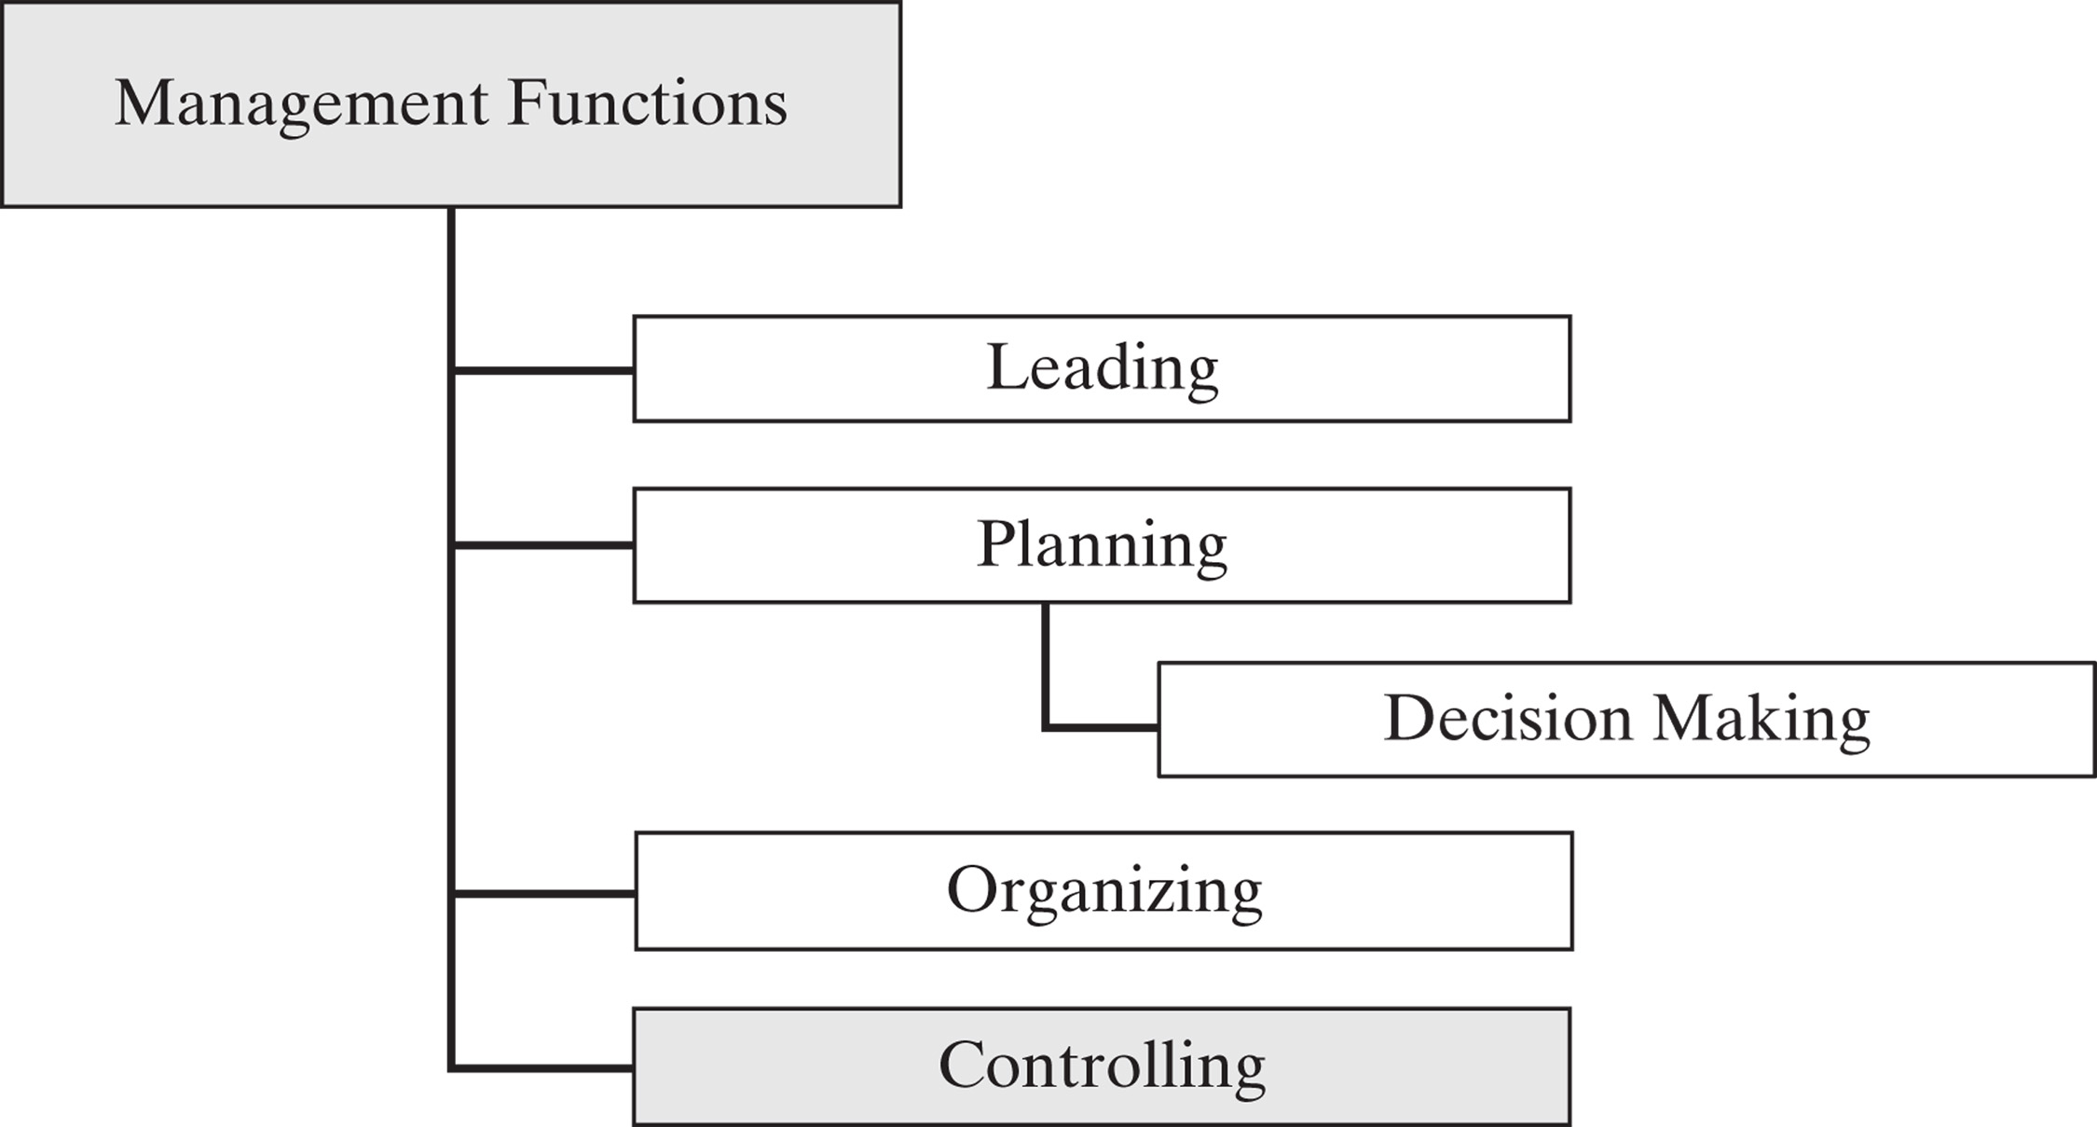

Slide 4
Chapter Objectives
Describe some of the important elements for establishing financial controls
Explain balance sheets, income statements, ratios.
Explain different non-financial control systems

Slide 5
Controlling Definition
“Compelling Events to Conform
to Plans”

Slide 6
Control:
Closed Loop vs. Open Loop
Closed Loop
  Automatic or cybernetic
  Monitors or manages process by internal, self-regulating system
  Essential feature is strong feedback system
  Example: Home thermostat system

Slide 8
Control:
Closed Loop vs. Open Loop
Open Loop
  Requires external monitoring or agent to activate control
  Example: Cruise control on an automobile

Slide 9
Characteristics of Effective Control Systems
Effective
Efficient
Timely
Flexible
Understandable
Tailored
Highlight deviations
Lead to corrective actions

Slide 10
Three Types of Control
Financial
Human Resource
Social

Slide 11
Financial Controls

Slide 12
Budgets
Financial Budgets: Identify sources of cash and intended uses
  Cash Budgets
  Capital Expenditure Budgets
  Balance Sheet Budget

Slide 13
Budget Preparation
Top Management
  Estimates of future sales and production
  Priorities used to meet new objectives
Middle Management
  Prepares proposed revenue and expense budgets designed to attain estimated sales/production levels

Slide 14
Financial:
Three Major Statements
Balance Sheet
  Shows the firm’s financial position at a particular instant in time
  Assets and liabilities
Income Statement
  Shows financial performance of a firm over a period of time
Cash Flow
  Shows where cash comes from and what it is used for

Slide 15
Definitions
Asset
Liability
Equity
Current ratio
Debt-to-equity ratio

Slide 16
Balance Sheet
Quickly get handle on financial strength of company
Includes assets, liabilities, and stockholders’ equity

Slide 17
Balance Sheet, cont.
Assets – Anything business owns that has monetary value
Liabilities – Claims of creditors against the assets of the business

Slide 18
Income Statement
Also called Profit and Loss Statement
Most used business report
Snapshot of money as it flows through business over specific period of time
Basic formula:
revenues – expenses = income/profit

Slide 19
Ratio Analysis
Ratios of two financial numbers taken from financial statements and compared to industry averages
Four Types
  Liquidity: Measures ability to meet short term obligations

Slide 20
Ratio Analysis, cont.
  Leverage: Measures the level of debt in a firm’s financial structure
  Activity: Measures how effectively a firm uses its resources
  Profitability: Measures profit producing performance of firm

Slide 21
Liquidity Ratio
Current ratio is formula referred to
Current assets/current liabilities
Numbers from Balance sheet
Acid test ratio

Slide 22
Profitability Ratio
Net income/Net sales
From Profit and Loss Statement

Slide 23
Terms
Budgets are the plans for the future allocation and use of resources over a fixed period of time.
Income Statement shows financial performance of a firm over period of time. Also called a profit and loss statement.
Cash Flow shows where funds come from and what they are used for.
Balance Sheet shows firm’s financial position at a particular instant in time.

Slide 24
Terms
Assets are what the company owns.
Liabilities are what the company owes.
Ratio Analysis is financial ratio of two financial numbers taken from the balance sheet and/or the income statement.

Slide 25
Responsibility Centers
Cost Centers
  Manager’s primary concern is control of costs
Revenue Center
  Manager’s primary concern is attaining revenue target
Profit Center
  Manager has more freedom to manipulate costs to increase profit

Slide 26
Audits of Financial Data
Verify accuracy of firm’s financial data
May be internal or external
Internal audits also evaluate organizational efficiency

Slide 27
Non-financial Controls
Management Audits
  Evaluate efficiency
Human Resources Accounting
  Quantifies the value of human resources investment
    Costs of recruiting
    Costs of training
    Costs of process improvement

Slide 28
Non-financial Controls
  Social Controls
    Standards
    Comparison with outcomes
    Corrective action

Slide 29
Non-financial Controls
Effectiveness of research activities
Systems for release of drawing release
Inventory control
Quality control

