Slide 1
Managing Engineering and Technology
7th Edition
Morse and Babcock

Slide 2
Managing Engineering and Technology
7th Edition
Morse and Babcock
Some Human Aspects
of Organizing
Chapter 7

Slide 3
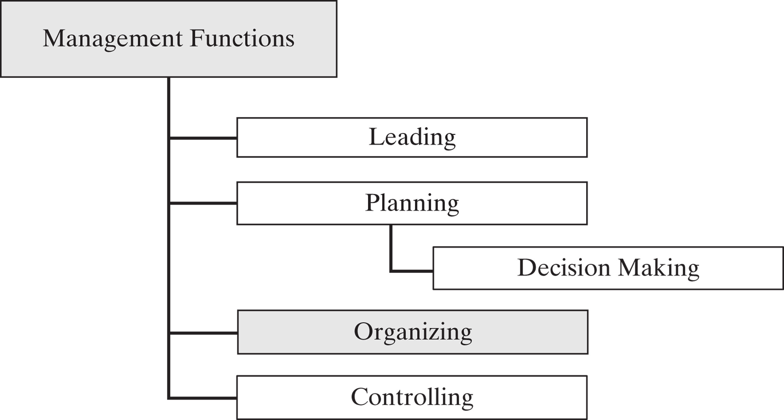

Slide 4
Chapter Objectives
Describe the steps in staffing technical organizations
Discuss the process of an employent application
Explain the importance of delegation

Slide 5
Staffing Technical Organizations
Identify the Skill Base
Estimate the Number of Personnel
Plan Recruiting Policies
Select the Best Applicants
Orient and Train Applicants
Evaluate Performance
Provide Compensation

Slide 6
New Hires
Establish the need for new hires
Determine sources for new hires
  New college graduates
  Experienced professionals
  Technician support
  Other sources

Slide 7
Human Resource Planning
Selection
Usually involves several steps in a filtering process
    Applications/Resumes reviewed
    Interviews accomplished
    References checked
    Candidates passing initial screens formally interviewed

Slide 8
Job Application Process
Employee Viewpoint

Slide 9
Resume
The first impression an engineer makes is usually through the resume

Slide 10
Formatting & Appearance
Make your name stand out with a bold, larger font size
Use standard fonts such as Times New Roman, Arial, or Courier
Type Size: 10–12 point
White, beige, or light gray quality bond paper
Use a laser printer for best finish
Length should generally be one page unless you have extensive experience or graduate school work

Slide 11
Key Components
Heading
Objective
Education
Skills
Experience

Slide 12
Additional Components
Professional affiliations
Honors, awards and activities
Campus/community involvements
Leadership activities
Foreign language proficiency
Computer applications
Volunteer experiences

Slide 13
Heading
Includes contact information:
  Top of the page
  Name: large and bold
  Address: street, town, state & zip code
  Telephone number(s): with professional message
  Email address: professional looking, check on a daily basis
  Website (optional)

Slide 14
Objective
Short
Specific
Type of position
Preferred work environment
Specialized skills
Tailor to each position
What you can do for the employer

Slide 15
Sample Objectives
Management training internship in a community service agency leading to a career in service to the public.
Program development position working with geriatric clients
Paralegal position with opportunity to conduct title searches and other research
Tax professional with a national accounting firm

Slide 16
Education
Educational institutions or specialized training programs you have attended
Name and location of the institution
Major, minor and area of concentration
Graduation or anticipated graduation date
GPA – if 3.2 or higher
Certifications and/or licensure related to employment goal
Relevant coursework and/or thesis may be included

Slide 17
Relevant Skills
Gained through:
Coursework
Employment
Internship / Co-op
Volunteer experience
Student leadership
Computer usage
Foreign language

Slide 18
Professional Experience
Related employment (full-time or part-time)
Internships (paid or unpaid)
Co-op
Summer jobs
Volunteer/Service learning
Senior projects or academic research

Slide 19
References
Separate page that complements resume – do not include with resume initially
Lists professional contacts who have direct knowledge of your skills and qualifications
References may include faculty, former employers, and internship supervisors
Obtain permission from references in advance and provide them with current resume

Slide 20
Cover Letters & Business Correspondence

Slide 21
Do’s and Don’ts
DO follow rules of a standard business letter
DO target your correspondence to the audience/employer (ex: avoid “To whom it may concern, Dear Sir/Madam)
DO make sure there are no spelling, grammar or punctuation errors
DO limit to one page
Notes:
Mention the importance of taking their letter to the University Writing Center at 407-823-2197

Slide 22
Do’s and Don’ts, cont.
DO keep a copy of everything that you send out
DO make sure there is an original signature on all the documents that you mail out
DO close with a direct request for some type of action (Ex: interview, phone call, etc.)
DO use high-quality stationery for hard copies

Slide 23
Do’s and Don’ts, cont.
DON’T start every sentence with “I”
DON’T use language that is gimmicky, jargonish, unprofessional (don’t try to be a comic)
DON’T include personal information that is not relevant to the position
DON’T give false impressions
Notes:
Mention the importance of taking their letter to the University Writing Center at 407-823-2197

Slide 24
Types of Correspondence
Cover letter types
  Application
  Prospecting/Letter of inquiry
  Networking
Thank you letters
Letters of acceptance, withdrawal and rejection
Employment applications
E-mail correspondence

Slide 25
Cover Letters
Format
Introductory paragraph
  Who are you?
  What is your interest?
  How did you hear of the opening?

Slide 26
Cover Letters, cont.
Body
  1–2 paragraphs containing a summary of skills and qualifications
  Highlight targeted experiences included on your resume (DON’T repeat your entire resume)
  Sales pitch: Explain your value to the organization
  Show that you’ve done your homework

Slide 27
Cover Letters, cont.
Closing Paragraph
  Thank the reader for reviewing your enclosed resume
  Restate your interest in the position
Arrange a follow-up contact
  Passive Approach: puts responsibility on employer to make contact with the applicant
  Active Approach: the applicant offers to initiate further contact with the employer in the near future
Closing (i.e.; Sincerely)

Slide 28
Cover Letters
Application Letter
Use as response to specific job advertisements and vacancy announcements
Strategy is to demonstrate that your qualifications fit the requirements of the position
Study the position description carefully and persuasively show how your skills, education and experience fit the position

Slide 29
Employment Application
If the resume creates a favorable impression the job candidate will be asked to fill out an application
May be redundant with the resume but will usually lead to an interview

Slide 30
Campus Interview
Graduating engineer typically makes contact with potential employers on campus
Successful campus interviews
  Applicant learns about employment opportunities and other advantages with firm
  Interviewer learns enough about the applicant

Slide 31
Site (Plant) Visit
Means company has a substantial interest
Normally means three or four staff interviews
Would include a tour of the area in which the candidate will work
Normally includes a briefing on company benefit programs and general company policies

Slide 32
The Job Offer
Is a formal letter offering specific position and identifies
  Salary
  Reporting date
  Position and title
  The supervisor the candidate reports to
  Provisions regarding moving expenses (if applicable)

Slide 33
Job Application Process
Employer Viewpoint

Slide 34
Orientation and Training
Helps newcomer become aware of organization and values

Slide 35
Orientation and Training
Some corporations
  Hold orientation classes
  Rotate newcomers through short assignments in various key departments
Includes total socialization of newcomer to the environment and culture of the organization

Slide 36
Appraising Performance
Provide feedback to the employee
  Guidance on how to improve performance
  Performance basis for rewards/promotions
  Objective documentation for actions against non-performers

Slide 37
Sources of Power
Legitimate or formal authority
Reward
Coercive
Expert
Referent

Slide 38
Committees
Reasons for using committees
Policy making/administration
Representation
Shared knowledge
Securing cooperation
Pooling of authority
Training of participants

Slide 39
Effective Committees
Committee purpose and chair
Size
Preparation – agenda
Conduct of meeting
Meeting follow-up

