Slide 1
Managing Engineering and Technology
7th Edition
Morse and Babcock

Slide 2
Managing Engineering and Technology
7th Edition
Morse and Babcock
Organizing
Chapter 6

Slide 3
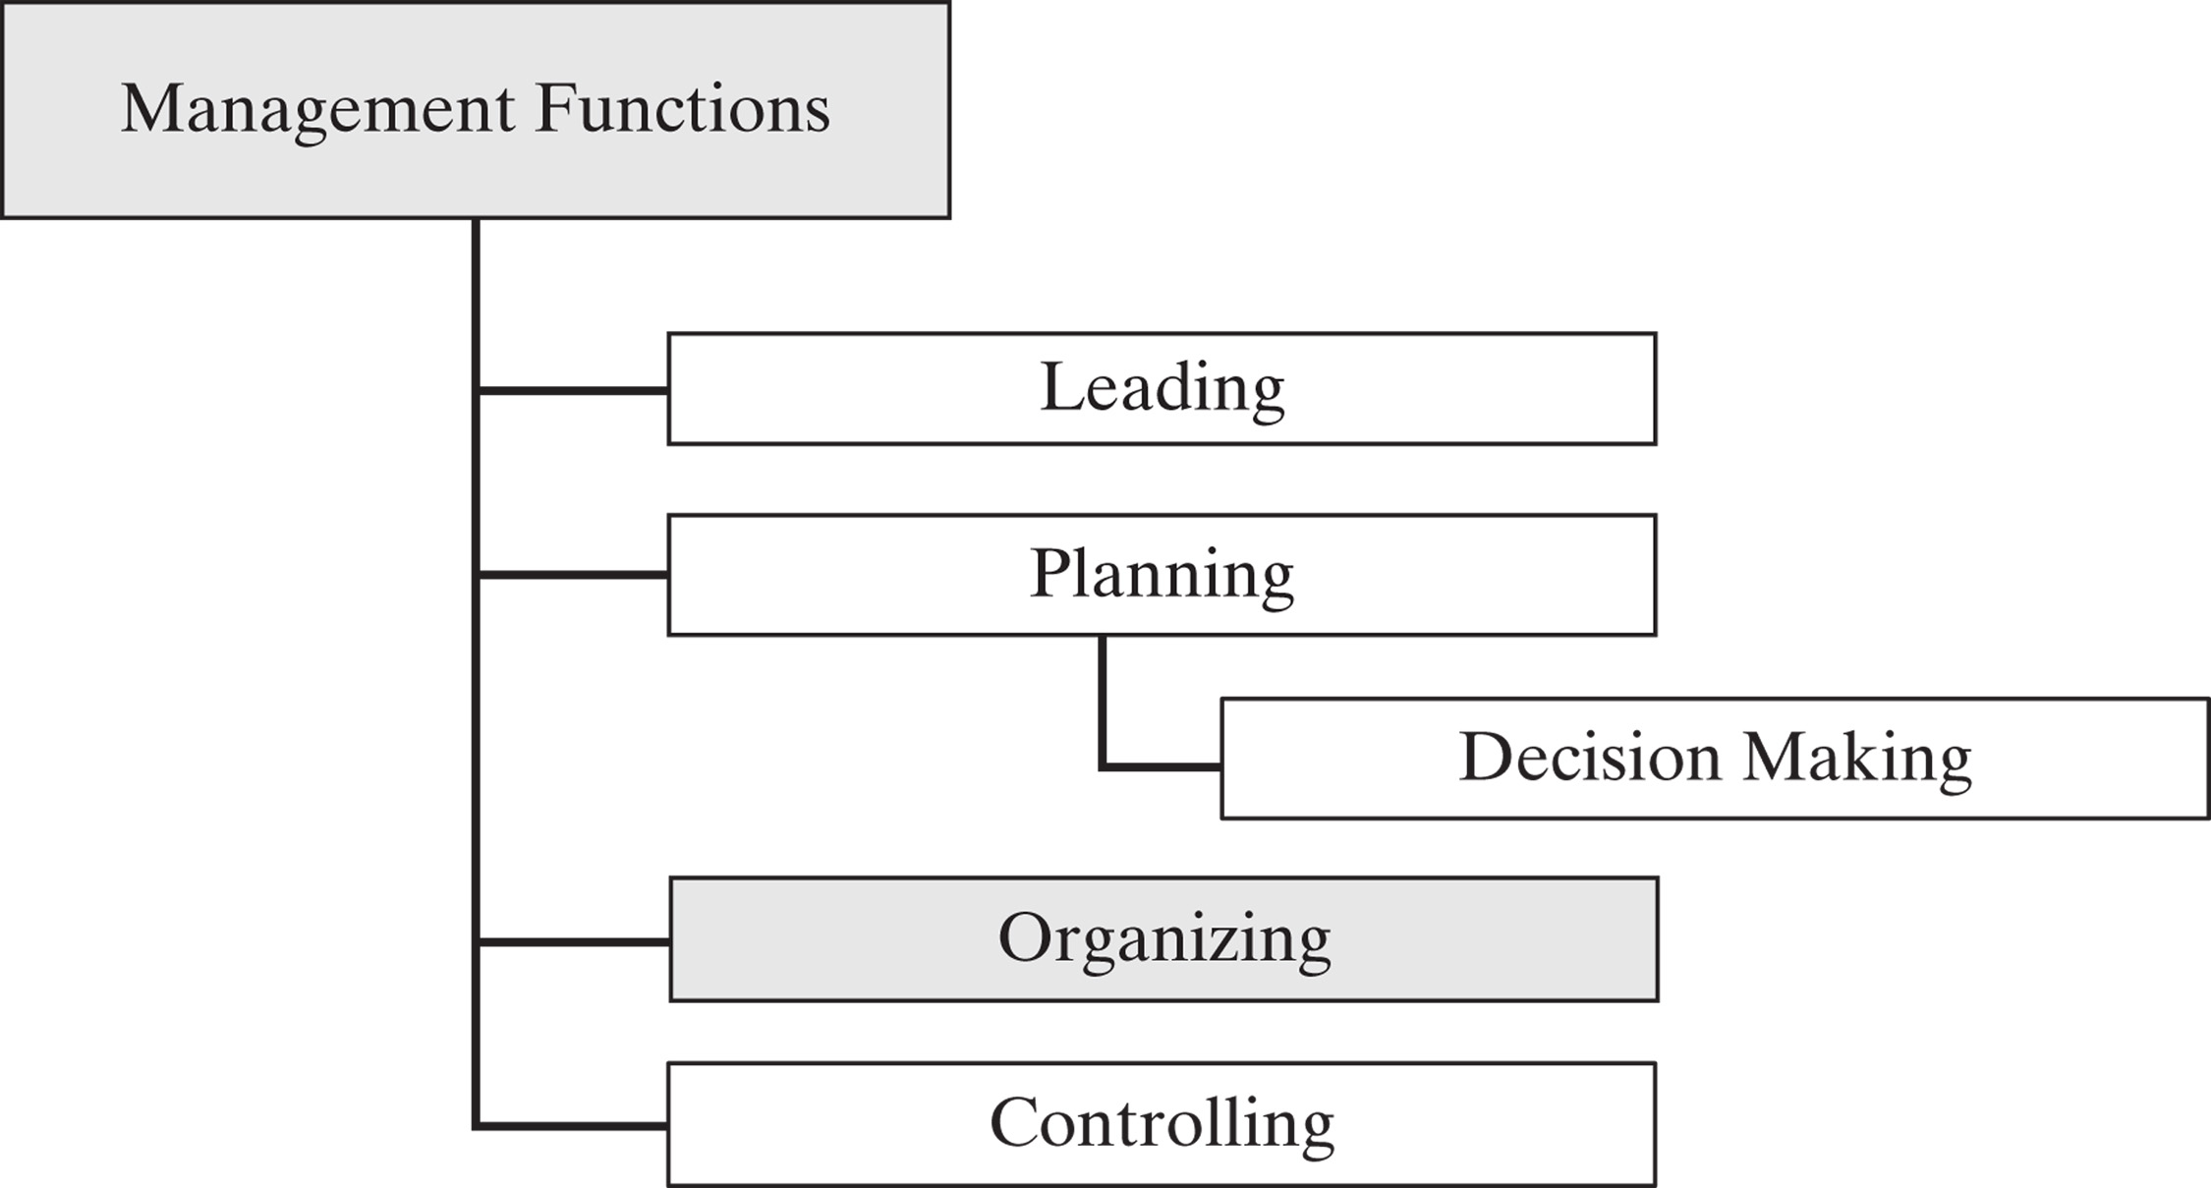

Slide 4
Chapter Objectives
Analyze the different forms of an organization
Explain different organizational structures
Describe the differences in line and staff relationships
Describe the use and value of teams

Slide 5
Legal Forms of Organization
Sole Proprietorship
  Few legal restrictions
  Owner forced to make all decisions
  Profits taxed once

Slide 6
Legal Forms of Organization
Partnership
  Two or more partners
  Easy to organize
  Partners do individual tax
  Unlimited liability for partners debts

Slide 7
Legal Forms of Organization
Limited Liability Company (LLC)
  Owners have limited personal liability
  Only taxed once

Slide 8
Legal Forms of Organization
Corporations
  Owned by shareholders
  No liability beyond stock
  Taxed twice
  Subject to many state and federal controls

Slide 9
Legal Forms of Organization
Cooperatives
  Owned by users and customers
  Usually tax free

Slide 10
Patterns of Departmentation
Basic
Functional
Product
Geographic
Mixed

Slide 11
Methods of Departmentation:
Basic
YOU
Jane
Jack
Jill

Slide 12
Methods of Departmentation:
Functional Organization
President
Finance
Manager
Production
Manager
Sales
Manager
Designer

Slide 13
Methods of Departmentation:
Product Organization
President
Vice-President
Finance
Vice-President
Production
CD Cabinet
Division
Disk Box
Division
Vice-President
Marketing
Vice-President
R&D
Accounting
Accounting
Production
Production
Marketing
Marketing
Human
Resources
Human
Resources

Slide 14
Spans of Control
Subordinate training
Nature of jobs
Rate of change of activities and personnel
Clarity of delegation
Staff assistance

Slide 15
Spans of Control

Slide 16
Line and Staff Relationships
Line: Superior/Subordinate relationships typically represented vertically in organizational charts

Slide 17
Line and Staff Relationships
Staff: Advisory in nature, degree of influence may vary
  Provide advice on request
  Recommendations when appropriate
  Must be consulted by line but have no direct authority
  Concurring authority – veto authority over line

Slide 18
Line and Staff Relationships
Service: Centralized support functions
  Custodial
  Security
  Medical

Slide 19
Line and Staff Relationships
Staff
Line

Slide 20
Line and Staff Relationships
Functional: Specialized authority
  As binding as line authority
  Usually procedural
    Budget formats
    Computer systems
  Cafeteria

Slide 21
Teams
Small group of people
Serve interests of its members
Exchange ideas freely and clearly
Have common goals
Committed to achieving goals
Each team member treated equally

Slide 22
Computer Technology’s Impact on the Work Force
Factory workers will require a higher level of skills
  Visualization
  Conceptual thinking
  Knowledge of production process
  Statistical inference
  Oral and visual communication
  Attentiveness
  Individual responsibility

