Slide 1
Managing Engineering and Technology
7th Edition
Morse and Babcock

Slide 2
Managing Engineering and Technology
7th Edition
Morse and Babcock
Decision Making
Chapter 5

Slide 3
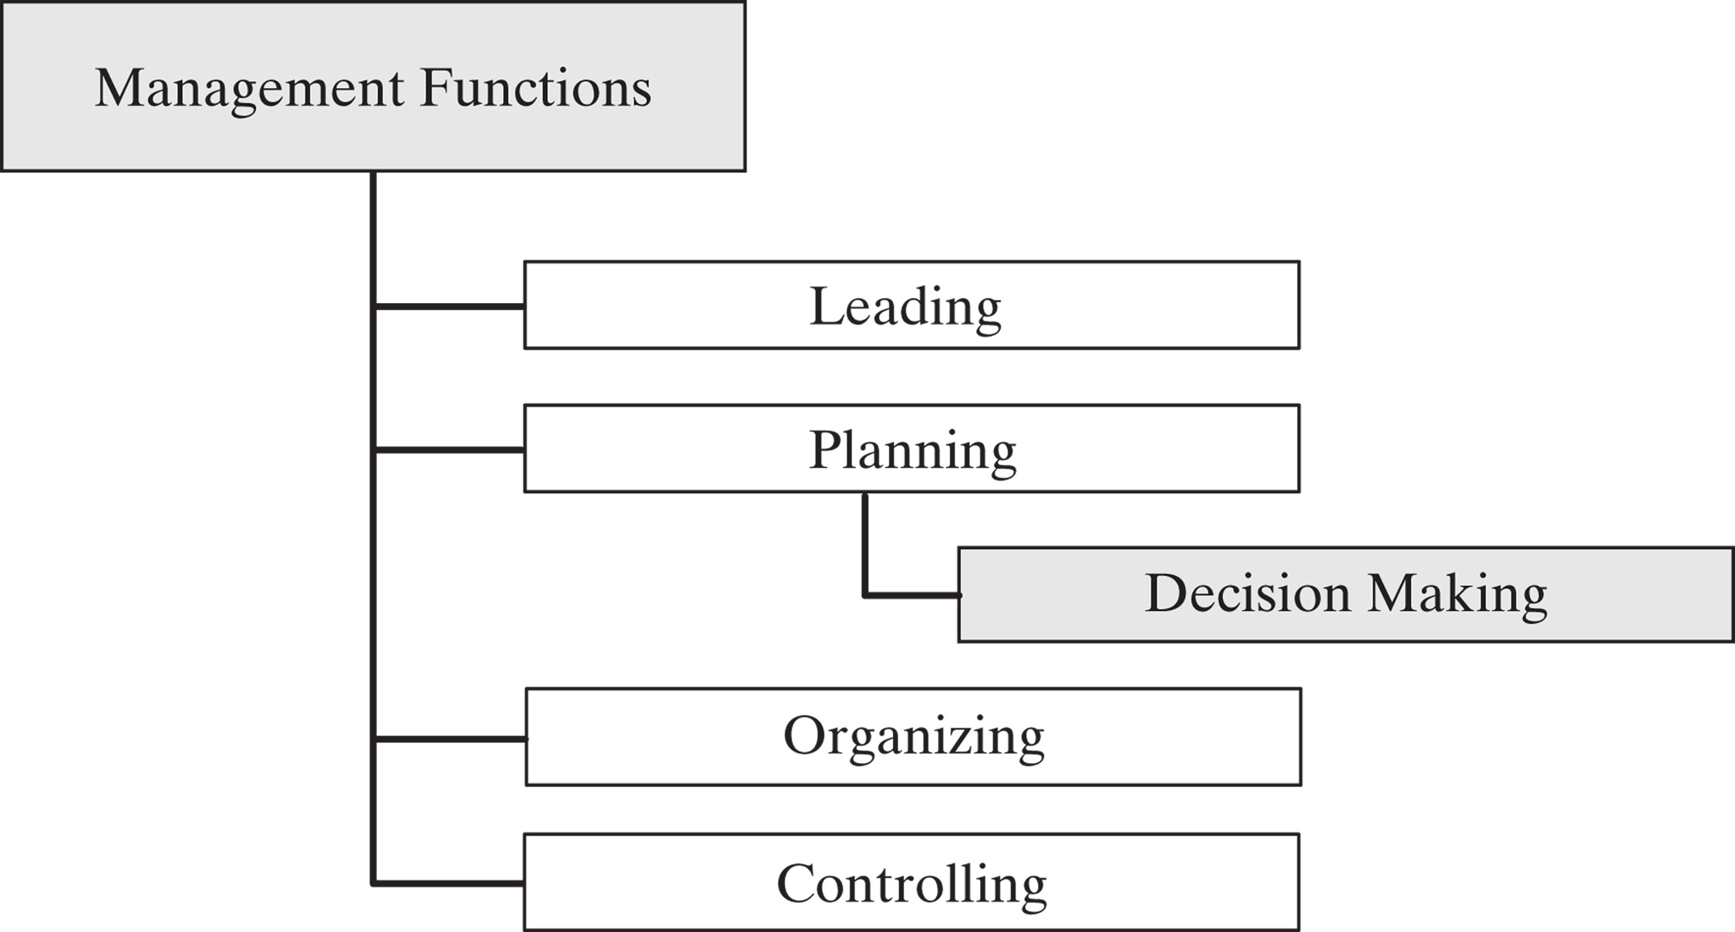

Slide 4
Objectives
Discuss how decision making relates to planning
Explain the process of engineering problem solving
Be able to solve problems using three types of decision making tools
Discuss the differences between decision making under certainty, risk, and uncertainty
Describe the basics of other decision making techniques

Slide 5
Relation to Planning
Managerial decision making is the process of making a conscious choice between two or more rational alternatives

Slide 6
Management Science
Characteristics
Systems view of the problem
Team approach
Emphasis on use of formal mathematical models and statistical and quantitative techniques

Slide 7
Management Science Process
Formulate the Problem
  Construct a Mathematical Model
  Test the Model
  Derive a Solution from the Model
Apply the Model’s Solution to the Real System

Slide 8
Planning Process
Scientific Method
Define the problem
Collect data
Develop hypotheses
Test hypotheses
Analyze results
Draw conclusion

Slide 9
Engineering Problem Solving Approach
Define the problem
Collect and analyze the data
Search for alternatives
Evaluate alternatives
Select solution and evaluate the impact

Slide 10


Slide 11
Categories of Decision Making Tools
Certainty
Risk
Uncertainty

Slide 12
Decision Making Certainty
Linear Programming
One of best known tools of Management Science
Used to determine optimal allocation of an organization’s limited resources

Slide 13
Linear Programming
State the problem
Decision Variables
Objective function
Constraints

Slide 14
Decision Making Under Risk
Expected Value
Decision Trees
Queuing
Simulation

Slide 15
Decision Making Uncertainty
Maximax
Maximin
Hurwicz
Equally likely

Slide 16
Other Techniques
Six Thinking Hats
Rock, Paper, Scissors
Coin flipping, drawing straws, throwing dice

