Slide 1
Managing Engineering and Technology
Sixth Edition
Morse and Babcock

Slide 2
Managing Engineering and Technology
Sixth Edition
Morse and Babcock
Planning and Forecasting
Chapter 4

Slide 3
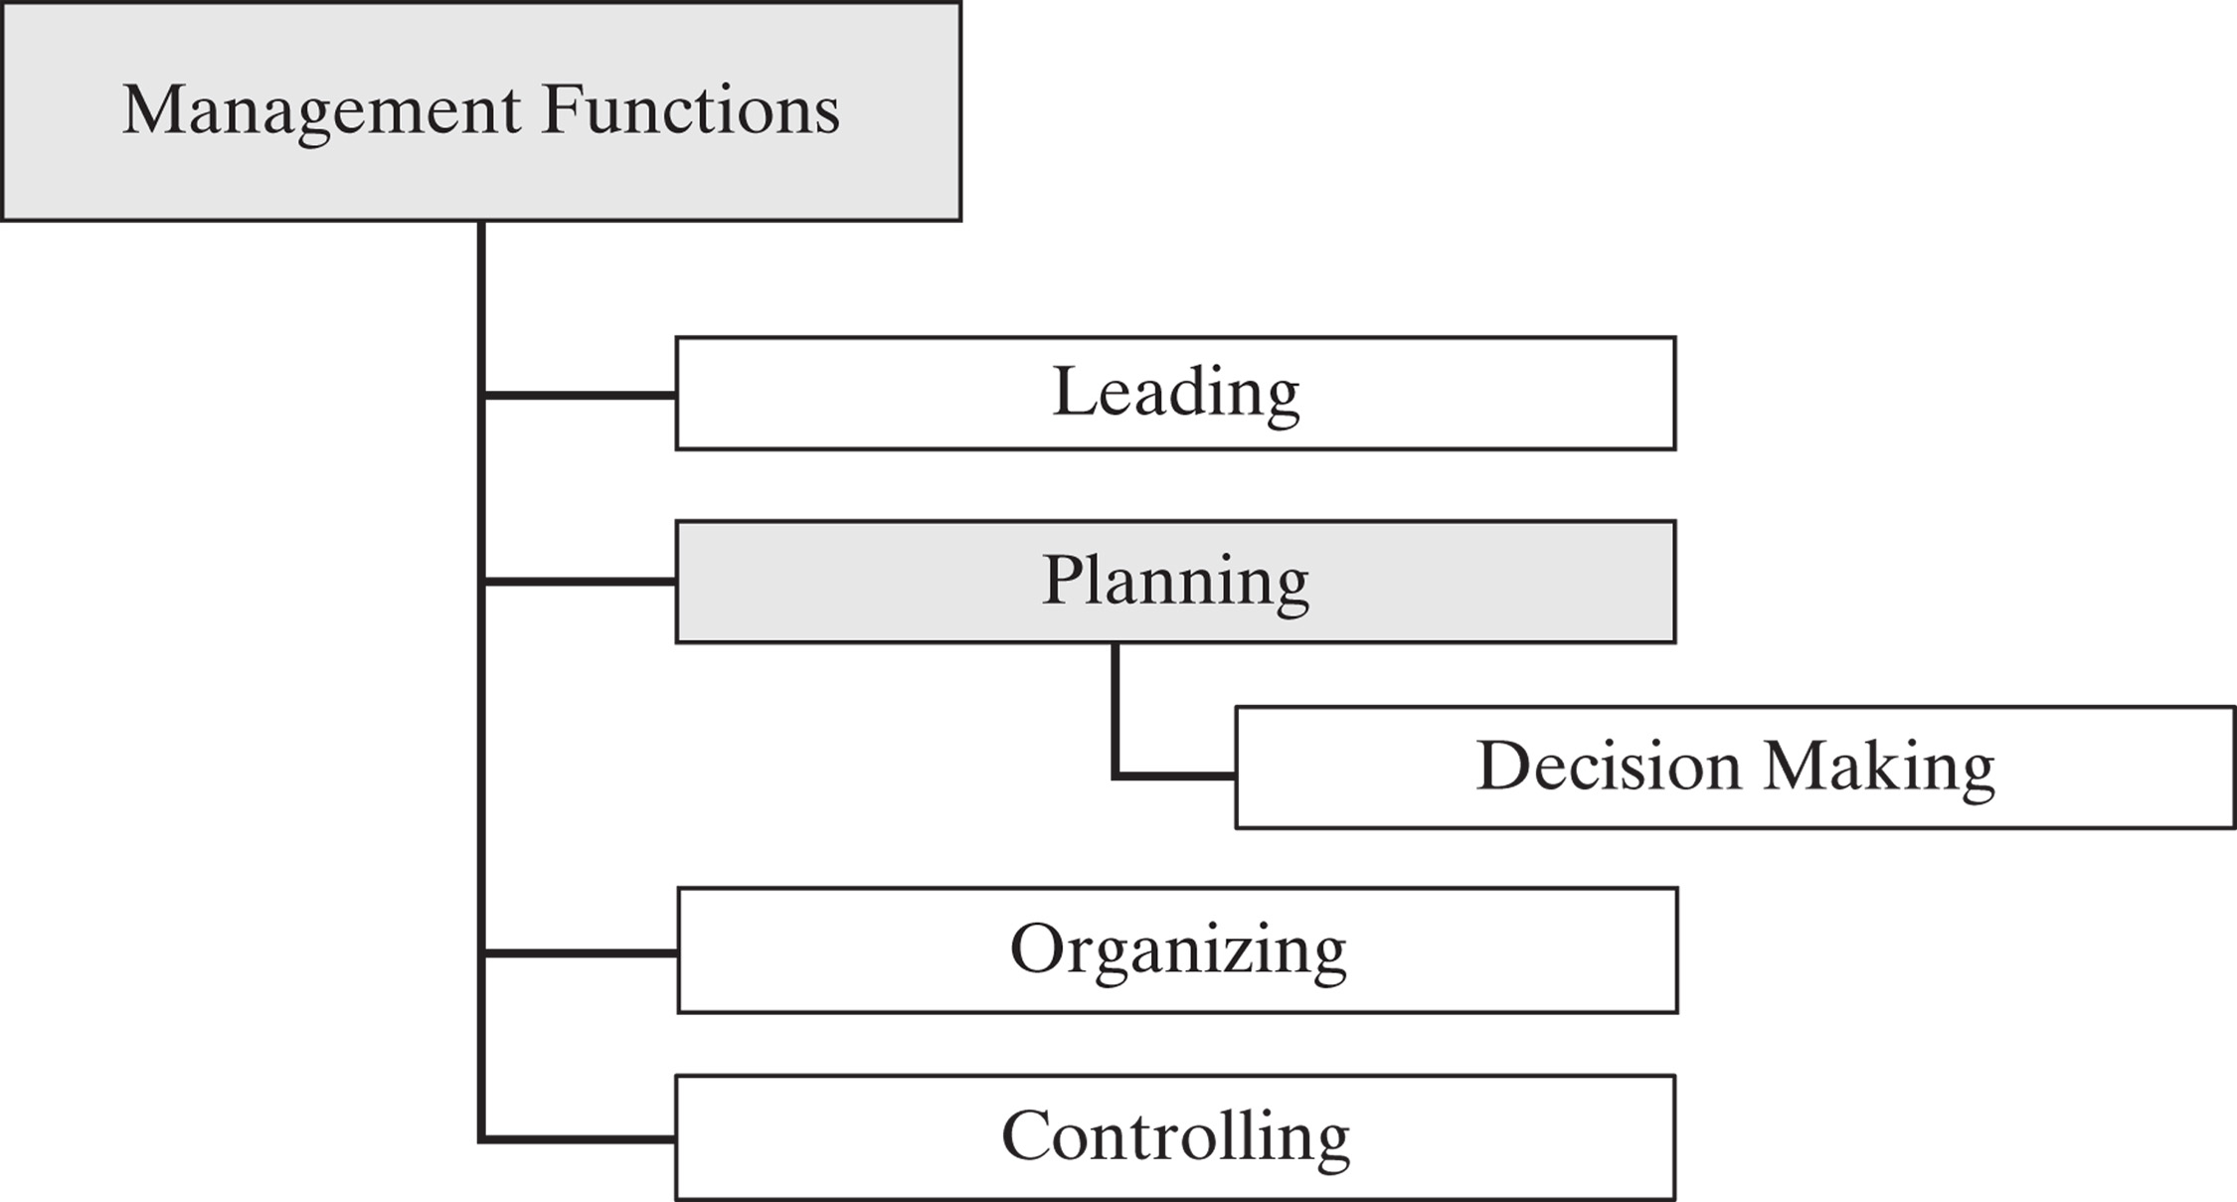

Slide 4
Chapter Objectives
Explain the importance of planning
Identify missions
Explain the roles of goals and objectives
Identify strategies
Define the different types of forecasting
Describe the Delphi Method
Define different approaches to forecasts
Discuss some strategies for managing technology

Slide 5
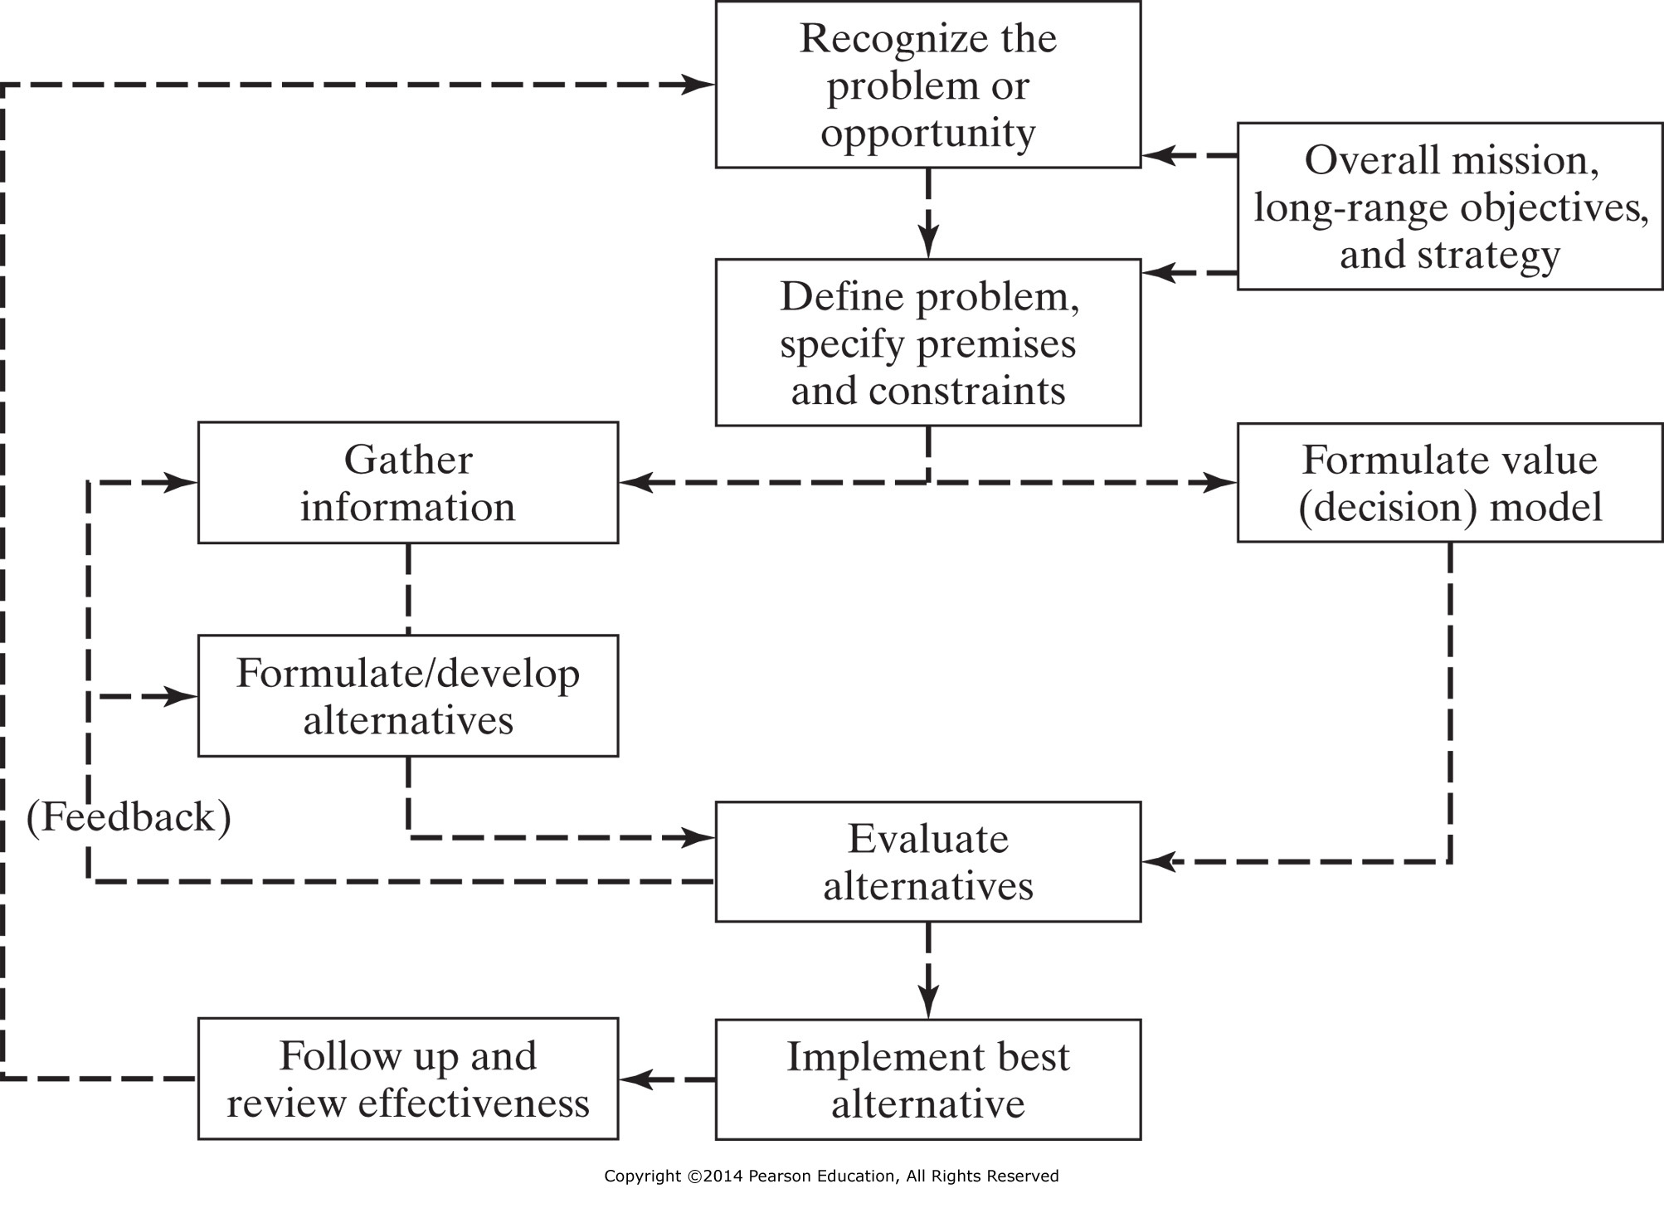

Slide 6
Planning
Provides method for identifying objectives
Design sequence of programs and activities to achieve objectives

Slide 7
Effective Planning
Plan to plan
People implementing plan should be involved in preparing plan

Slide 8
Planning
What must be done?
Who will do it?
How will it be done?
When must it be done?
How much will it cost?
What do we need to do it?

Slide 9
Planning
What is the Problem/Purpose?
Establish Goal/Objectives
What Client Need is Being Satisfied by the Project?
Identify Success Criteria

Slide 10
The Foundation for Planning
Mission
Purpose or Goal
Objectives
Strategies
All Customer Driven

Slide 11
Strategic Planning
Vision/Mission
SWOT Analysis
Gap Analysis
Goals
Objectives
Strategies

Slide 12
Mission
Goal 1
Goal 2
Goal 3
Objective 1
Objective 2
Strategy 1
Strategy 2

Slide 13
Strategic Plan
Suggests ways (strategies) to identify
and to move toward desired future
states
Consists of the process of
developing and implementing plans
to reach goals and objectives

Slide 14
Strategic Plan
Not a business plan
Not an operational plan

Slide 15
Vision
A vision statement describes in graphic terms where the goal-setters want to position themselves in the future.

Slide 16
Vision – Microsoft (1980s)
“A personal computer on every
desk, and every computer running
Microsoft software.”

Slide 17
Planning
Mission Statement
First step in planning process
What do we want to do

Slide 18
Mission Statement
Resembles a vision statement
Has a more immediate business focus with a time horizon

Slide 19
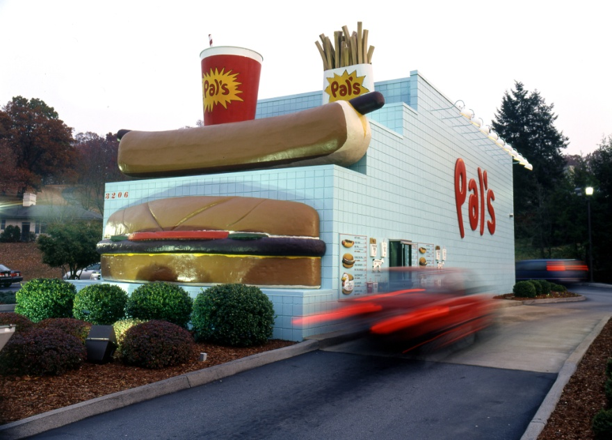
Mission – Pal’s
To deliver excellence in food service while providing a menu focused on exceptional quality.

Slide 20

Mission Example
The mission of Southwest Airlines is dedication to the highest quality of Customer Service delivered with a sense of warmth, friendliness, individual pride, and Company Spirit.
http://www.southwest.com 9/9/05

Slide 21
Strategic Planning

Slide 22
SWOT Analysis
Mission
Internal Strengths
External Opportunities
Analysis
Internal Weaknesses
External Threats
Strategy

Slide 23
SWOT Analysis
Internal
Strengths
Weaknesses
External
Opportunities
Threats

Slide 24
Planning
Goal Statement
Why?
What do we do?
For whom do we do it?

Slide 25
Planning
Goal Statement
Gives purpose and direction
Used as continual point of reference for questions regarding scope or purpose

Slide 26
Planning
Objectives
More detailed goal statement
Clarifies goal
How do we go about it?
To (action verb)
Consistent with organization

Slide 27
Planning
Develop Objectives
Specific
Measurable
Attainable
Realistic
Time-limited

Slide 28
Objectives
Characteristics
Outcome – what is to be accomplished
Time Frame – expected completion date
Measure – metrics for success
Action – how the objective will be met

Slide 29
Goals and Objectives
Drucker’s Objectives for Organizational Survival
  Market Share
  Innovation
  Productivity
  Physical and Financial Resources
  Manager Performance and Development
  Worker Performance and Attitude
  Profitability
  Social Responsibility

Slide 30
Management by Objectives
Commonly Referred to as MBO
Corollary MBWA
(Management by Walking Around)

Slide 31
Forecasting

Slide 32
Forecasting
Essential preliminary to effective planning
Engineering manager must be concerned with both future markets and future technology

Slide 33
Why Forecasting?
New facility planning
Production planning
Work force scheduling

Slide 34
Long Range Forecasts
Design new products
Determine capacity for new product
Long range supply of materials

Slide 35
Short Range Forecasts
Amount of inventory for next month
Amount of product to produce next week
How much raw material delivered next week
Workers schedule next week

Slide 36
Forecasting
Qualitative Methods
Judgment Methods
Expert Opinion
Delphi
Historical
Counting Methods
Market Testing
Market Survey

Slide 37
Delphi Method
Eliminates effects of interactions between members
Experts do not need to know who other experts are
Delphi coordinator asks for opinions, forecasts on subject

Slide 38
Delphi Method, cont
Develop objective of forecast
Determine number of participants
Select and contact participants
Develop first questionnaire and submit
Coordinator analyzes responses

Slide 39
Delphi Method, cont
Develop second questionnaire based on results of first
Analyze responses
Rounds continue until consensus reached or experts’ opinions cease to change

Slide 40
Forecasting
Quantitative Methods
Time Series Methods
Moving Average
Weighted Moving Average
Exponential Smoothing
Association or Causal Method
Multiple Regression

Slide 41
Forecasting Methods
Objective
Time Series Methods
Moving Average
Weighted Moving Average
Exponential Smoothing
Association or Causal Method
Multiple Regression

Slide 42
Which Method?
Select a few methods
Make forecasts
Take simple average
No one best answer

Slide 43
Forecasting New Products
First use judgmental
Expert opinions
Consumer intentions

Slide 44
Technological Change
Use of Internet
Social Media

Slide 45
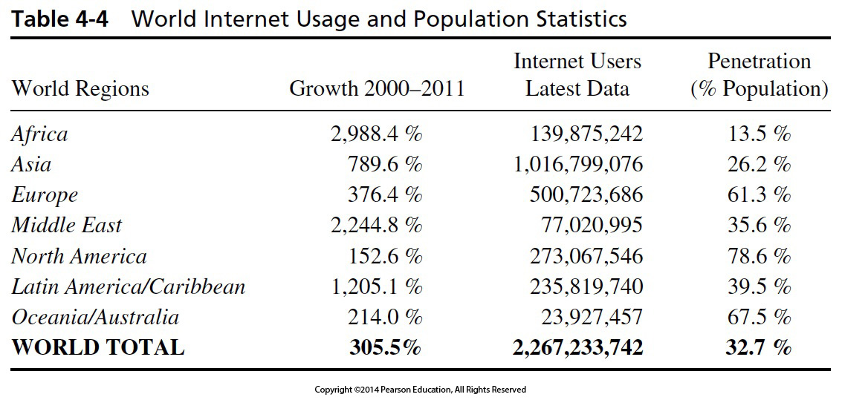
Internet Usage

