Slide 1
Managing Engineering and Technology
7th Edition
Morse and Babcock

Slide 2
Managing Engineering and Technology
7th Edition
Morse and Babcock
Leading Technical People
Chapter 3

Slide 3
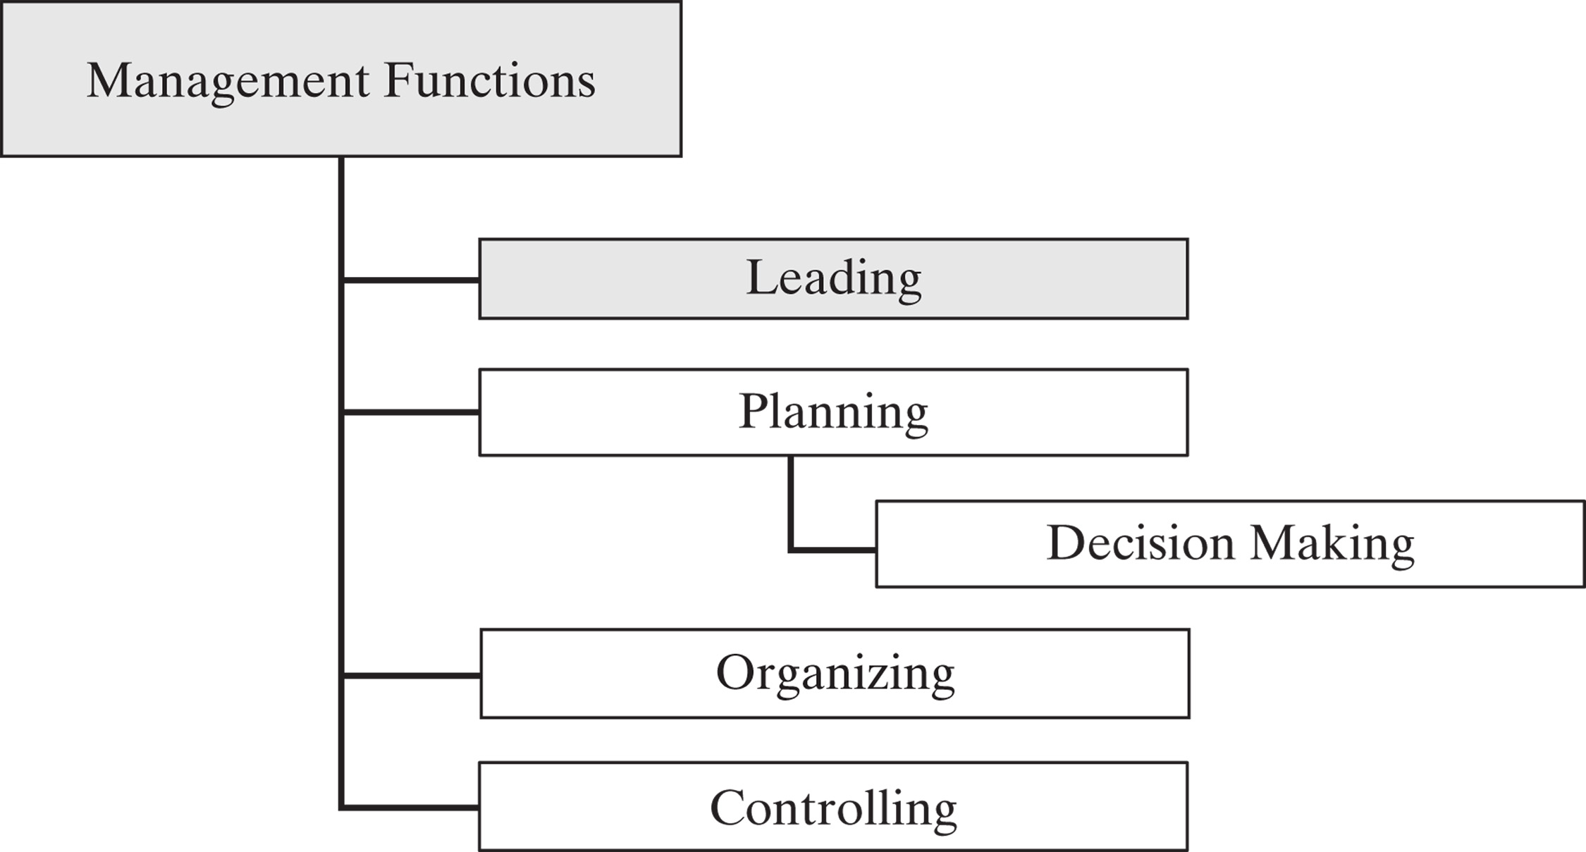

Slide 4
Objectives
Explain the difference between leaders and managers
Describe the nature of leadership and its significance to an organization
Address the application of servant leadership in current organizations
Recognize the different views of motivation

Slide 5
If your actions inspire others to dream more, learn more, do more and become more, you are a leader.
–John Quincy Adams

Slide 6
Leadership

Slide 7
Managers | Leaders
Administer | Innovate
Ask how and when | Ask what and why
Focus on systems | Focus on people
Do things right | Do the right things
Maintain | Develop
Short term perspective | Longer term perspective
Imitate | Originate
Are a copy | Are original

Slide 8
Leadership
Nature of Leadership
  It is the ability to get people to do what they don’t want to do and like it
Leadership Traits
  Physical Qualities
  Personal Attributes
  Character Attributes
  Intellectual Qualities

Slide 9
Leadership Continuum
Autocratic
Diplomatic
Consultative
Participative

Slide 10
Leadership Examples
Jack Welch
Shackleton
Rudy Giuliani
Oprah Winfrey
Bill Gates
George Washington
Hsun Tzu
Bill Swanson

Slide 11
Servant Leadership
Practical philosophy which supports people who choose to serve first
Then lead as a way of expanding service to individuals and institutions.

Slide 12
Motivation

Slide 13
Motivation
Dale Carnegie states that “there is only one way under high heaven to get anybody to do anything. And that is by making the other person want to do it.”

Slide 14
Motivation Theories
McGregor
Maslow
Herzberg

Slide 15
McGregor:
Theory X and Theory Y
Theory X – authoritarian management style
Theory Y – participative management style

Slide 16
Maslow’s Hierarchy
Physiological
Safety
Love
Esteem
Self-actualization

Slide 17
Maslow, cont.
Higher Level
Self-Actualization
Realizing one’s full potential;
Creativity, self-development
Esteem
Self respect, prestige, recognition
Affiliation
Acceptance by others, being part of a group

Slide 18
Maslow, cont.
Lower Level
Security/Safety
Job security, predictable work environment
Physiological
Food, shelter, air, water

Slide 19
Herzberg’s Two-Factor Theory
Motivator factors that are intrinsic to the job
Hygiene factors that are intrinsic to the job

Slide 20
Hygiene Factors
Salary
Working Conditions
Company Policies
Relationship with Boss
Relationship with Peers

Slide 21
Motivator Factors
Recognition
Work Itself
Responsibility
Advancement
Achievement

Slide 22
Behavior Modiﬁcation
Positive reinforcement
Negative reinforcement, or avoidance
Punishment
Extinction

Slide 23
Differences Among Technical Professionals
Scientists vs. engineers
Field of technical employment

