Slide 1
Managing Engineering and Technology
7th Edition
Morse and Babcock

Slide 2
Managing Engineering and Technology
7th Edition
Morse and Babcock
Engineering Ethics
Chapter 16

Slide 4
Chapter Objectives
Explain the importance of ethics in engineering
Describe what is meant by whistle-blowing
Describe the need for ethics in construction
Describe situations where conflict of interest may arise
Apply Guidelines for Facilitating Solutions to Ethical Dilemmas

Slide 5
Professional Ethics and Conduct
Values drive our behavior
Ethical standards within the engineering community

Slide 6
Engineering Ethics
Core Concepts
Public interest
Qualities of truth, honesty, and fairness
Professional performance

Slide 7
Ethical Problems in Consulting and Construction
Political contributions
Distribution of public services
Construction safety

Slide 8
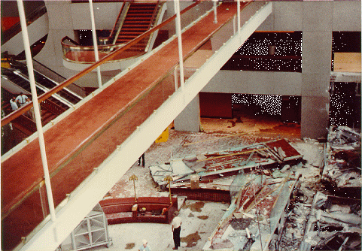
Construction – Hyatt Regency

Slide 9
Ethical Problems
Industrial Practice
Environmental
Conflict of interest
Gifts
Moonlighting
Inside Information
Post-employment limitations
Whistle-blowing

Slide 10

Boeing – Whistle Blowing

Slide 11

Challenger Disaster

Slide 12
Ethical Dilemmas Guidelines in Professional Practice – NIEE
Determine the facts in the situation
Determine the facts in the situation
Assess the motivations of the Stakeholders
Formulate alternative solutions

Slide 13
Guidelines, cont.
Evaluate proposed alternatives
Seek additional assistance, as appropriate
Select the best course of action
Implement the selected solution
Monitor and assess the outcome

Slide 14
Nine Basic Steps to Personal Ethical Decision Making – NIEE
Practice ethical behavior actively
Beware of “new ethics” programs
Define the ethical problem when it arises
Formulate alternatives
Evaluate the alternatives

Slide 15
Nine Steps, cont.
Seek additional assistance
Choose best ethical alternative
Implement the best alternative
Monitor and assess the outcome

