Slide 1
Managing Engineering and Technology
7th Edition
Morse and Babcock

Slide 2
Managing Engineering and Technology
7th Edition
Morse and Babcock
Managing Production Operations
Chapter 12

Slide 4
Chapter Objectives
Define quality
Describe the quality revolution
Discuss some of the tools of quality
Recognize the methods of work measurement

Slide 5
“If you always do what you always did, You’ll always get what you always got.”

Slide 6
Production Operations
Major focus of production operations is on efficiency and effectiveness of processes
Production operations often include substantial measurement and analysis of internal processes

Slide 7
Traditional Quality Measures
Process control charts
Inspection and sampling
Taguchi methods

Slide 8
Quality
Meeting the Requirements, Needs, and Desires of the Customer
Measurable
Each Person’s Responsibility

Slide 9
Background
Total Quality Management
  Deming
  Juran
  Crosby
  Baldrige Award

Slide 10
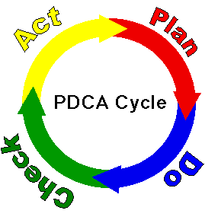
Process for Improvement
  Plan
  Do
  Check
  Act

Slide 11
Malcolm Baldrige
Quality Award Criteria
Leadership
Strategic Planning
Customer and market focus
Measurement, analysis, and knowledge management
Human resource focus
Process management
Business results

Slide 12
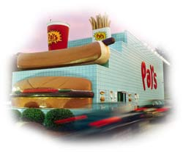
Pal’s

Slide 13
Quality For:
Production processes
Business processes
Service processes
Educational processes

Slide 14
ISO 9000
Requires an organization to create processes in all functional areas that focus on customer needs and reasonable expectation and that validate requirements of quality

Slide 15
International Organization for Standardization (ISO)
Developed highly specific standards since 1947
Generic management business standards
ISO 9000 – 1987
Primarily environmental management
ISO 14000 – 1997

Slide 16
Baldrige/ISO Difference
Baldrige criteria focuses on results and continuous improvement
ISO helps determine what is needed to maintain efficient quality conformance system

Slide 17
Basic Concepts of Quality
Management commitment
Focus on customer
Continuous improvement of processes
Utilization of entire work force
Performance measures for the processes

Slide 18
Customer
Internal or external
Any person receiving the output

Slide 19
Tools and Techniques
Affinity Diagram
Flow Chart
Pareto Chart
Run Chart
Fishbone Chart
Statistical Process Control
Brainstorming
Nominal Group Technique

Slide 20
Work Measurement
Direct time study
Work sampling

Slide 21
Work Measurement
Standard time
Normal time
Normal pace
Actual time
Allowances

Slide 22
Maintenance and Facilities Engineering
Scope of maintenance
Types of maintenance
Additional considerations

