Slide 1
Lecture slides to accompany
Engineering Economy, 8th edition
Leland Blank, Anthony Tarquin
©McGraw-Hill Education. All rights reserved. Authorized only for instructor use in the classroom. No reproduction or further distribution permitted without the prior written consent of McGraw-Hill Education.
Notes:
At this point:
1. Introduce yourself - your students are likely to want to know something about your qualifications and interests - overall, where you are coming from.
2. Have students introduce themselves. Ask why they are taking this class. If you are fortunate enough to have a Polaroid camera, take pictures of each student for later posting on a class “board” so both they and you get to know each other.
3. Discuss both choice of textbook and development of syllabus.
4. If you are expecting students to work in teams, at east introduce the choice of team members. If at all possible, have students participate in a team building or team study exercise. It works wonders. Most student have been told to work in teams in prior classes, but have never examined exactly what a team is and how it works. One hour spent in a team building/examination exercise saves many hours and avoids many problems later on.

Slide 2
Chapter 9
Benefit- Cost Analysis

Slide 3
LEARNING OUTCOMES
Explain difference in public vs. private sector projects
Calculate B/C ratio for single project
Select better of two alternatives using B/C method
Select best of multiple alternatives using B/C method
Use cost-effectiveness analysis (CEA) to evaluate service sector projects
Describe how ethical compromises may enter public sector projects

Slide 4
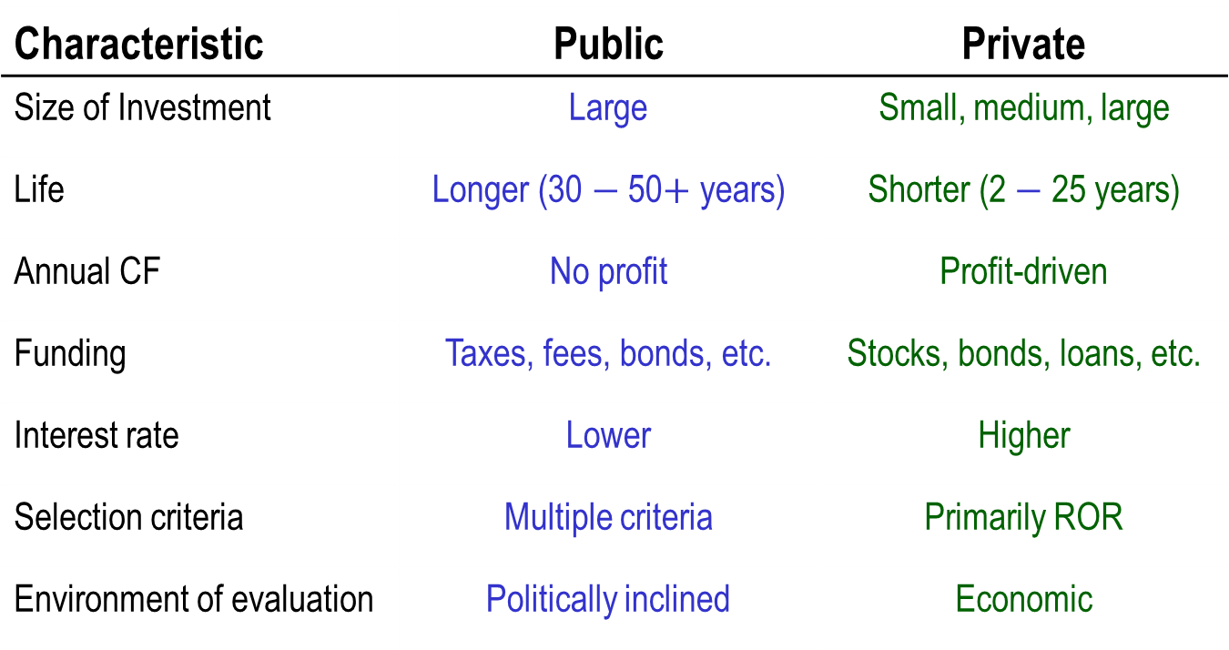
Differences: Public vs. Private Projects
Characteristic | Public | Private
Size of Investment | Large | Small, medium, large
Life | Longer (30 $−$ 50$+$ years) | Shorter (2 $−$ 25 years)
Annual CF | No profit | Profit-driven
Funding | Taxes, fees, bonds, etc. | Stocks, bonds, loans, etc.
Interest rate | Lower | Higher
Selection criteria | Multiple criteria | Primarily ROR
Environment of evaluation | Politically inclined | Economic

Slide 5
Types of Contracts
Contractor does not share in project risk
Fixed price - lump-sum payment
Cost reimbursable - Cost plus, as negotiated
Contractor shares in project risk
Public-private partnerships (PPP), such as:
  Design-build projects - Contractor responsible from design stage to operations stage
  Design-build-operate-maintain-finance (DBOMF) projects - Turnkey project with contractor managing financing (manage cash flow); government obtains funding for project

Slide 6
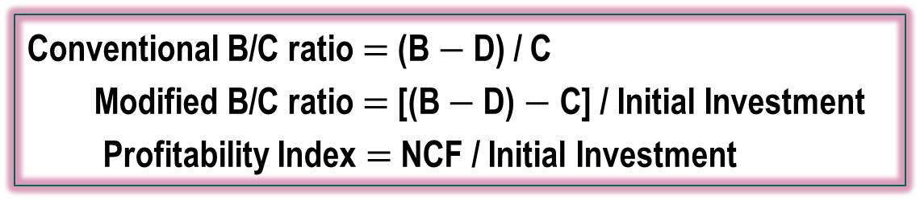
Cash Flow Classifications and B/C Relations
Must identify each cash flow as either benefit, disbenefit, or cost
Benefit (B) -- Advantages to the public
Disbenefit (D) -- Disadvantages to the public
Cost (C) -- Expenditures by the government
Note: Savings to government are subtracted from costs
Conventional B/C ratio $=$ (B$−$D) / C
Modified B/C ratio $=$ [(B $−$D) $−$ C] / Initial Investment
Profitability Index $=$ NCF / Initial Investment
Note 1: All terms must be expressed in same units, i.e., PW, AW, or FW
Note 2: Do not use minus sign ahead of costs

Slide 7
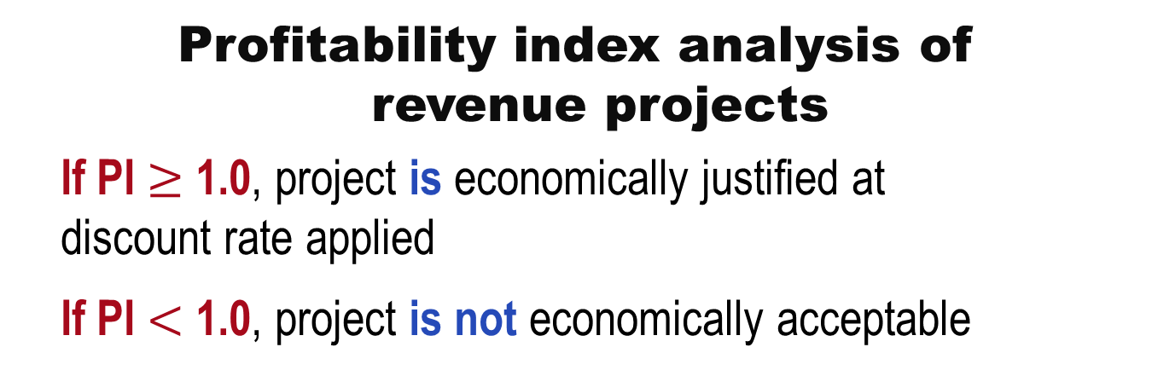
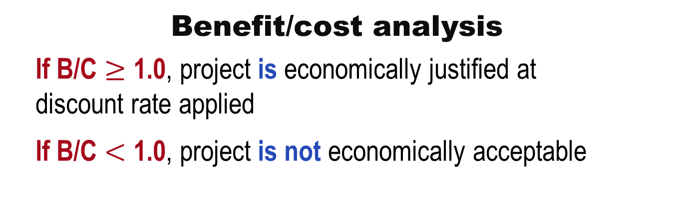
Decision Guidelines for B/C and PI
Benefit/cost analysis
If B/C $≥$ 1.0, project is economically justified at discount rate applied
If B/C $<$ 1.0, project is not economically acceptable
Profitability index analysis of
revenue projects
If PI $≥$ 1.0, project is economically justified at discount rate applied
If PI $<$ 1.0, project is not economically acceptable

Slide 8

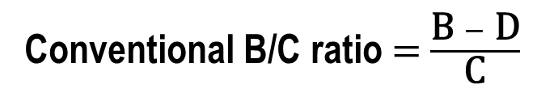
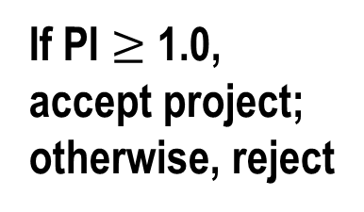
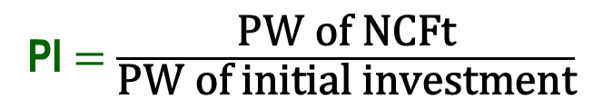
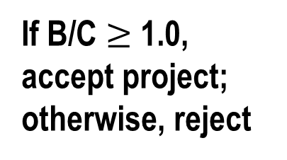
B/C Analysis – Single Project
Conventional B/C ratio $=$ $\frac{\text{B} − \text{D}}{\text{C}}$
If B/C $≥$ 1.0, accept project; otherwise, reject
Modified B/C ratio $=$ $\frac{\text{B} − \text{D} − \text{M}\text{\&}\text{O}}{\text{C}}$
Denominator is initial investment
PI $=$ $\frac{\text{PW} \text{of} \text{NCFt}}{\text{PW} \text{of} \text{initial} \text{investment}}$
If PI $≥$ 1.0, accept project; otherwise, reject

Slide 9
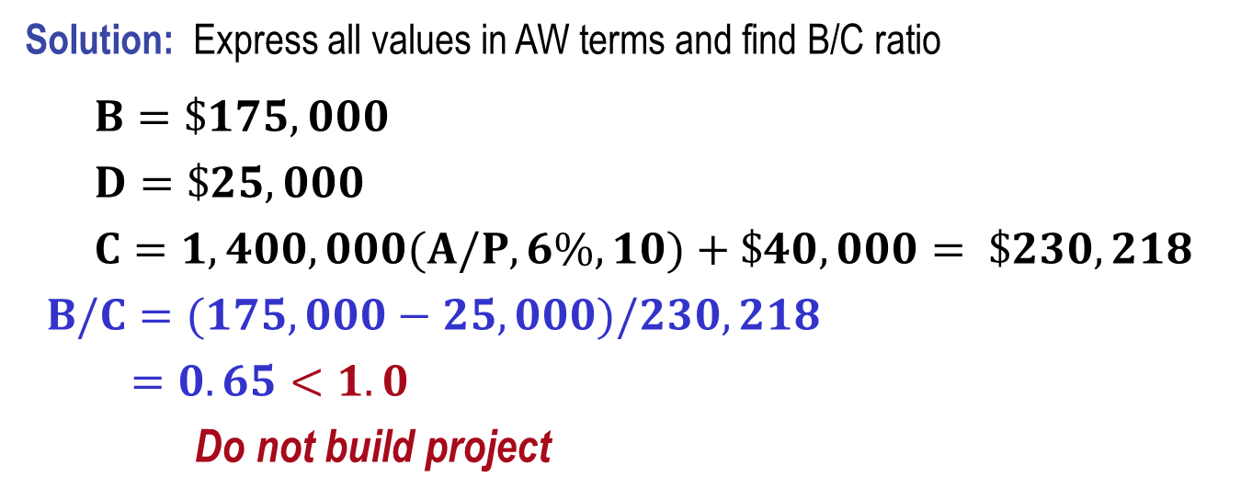
Example: B/C Analysis – Single Project
A flood control project will have a first cost of $1.4 million with an annual maintenance cost of $40,000 and a 10 year life. Reduced flood damage is expected to amount to $175,000 per year. Lost income to farmers is estimated to be $25,000 per year. At an interest rate of 6% per year, should the project be undertaken?
Solution: Express all values in AW terms and find B/C ratio
$B=\$175,000$
$D=\$25,000$
$C=1,400,000(A/P,6\%,10)+\$40,000= \$230,218$
$B/C=(175,000−25,000)/230,218$
$=0.65<1.0$
Do not build project

Slide 10
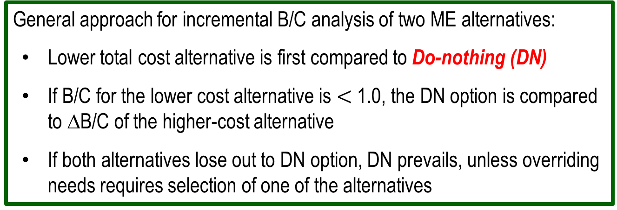
Defender, Challenger and Do Nothing Alternatives
When selecting from two or more ME alternatives, there is a:
Defender – in-place system or currently selected alternative
Challenger – Alternative challenging the defender
Do-nothing option – Status quo system
General approach for incremental B/C analysis of two ME alternatives:
Lower total cost alternative is first compared to Do-nothing (DN)
If B/C for the lower cost alternative is $<$ 1.0, the DN option is compared to ∆B/C of the higher-cost alternative
If both alternatives lose out to DN option, DN prevails, unless overriding needs requires selection of one of the alternatives

Slide 11
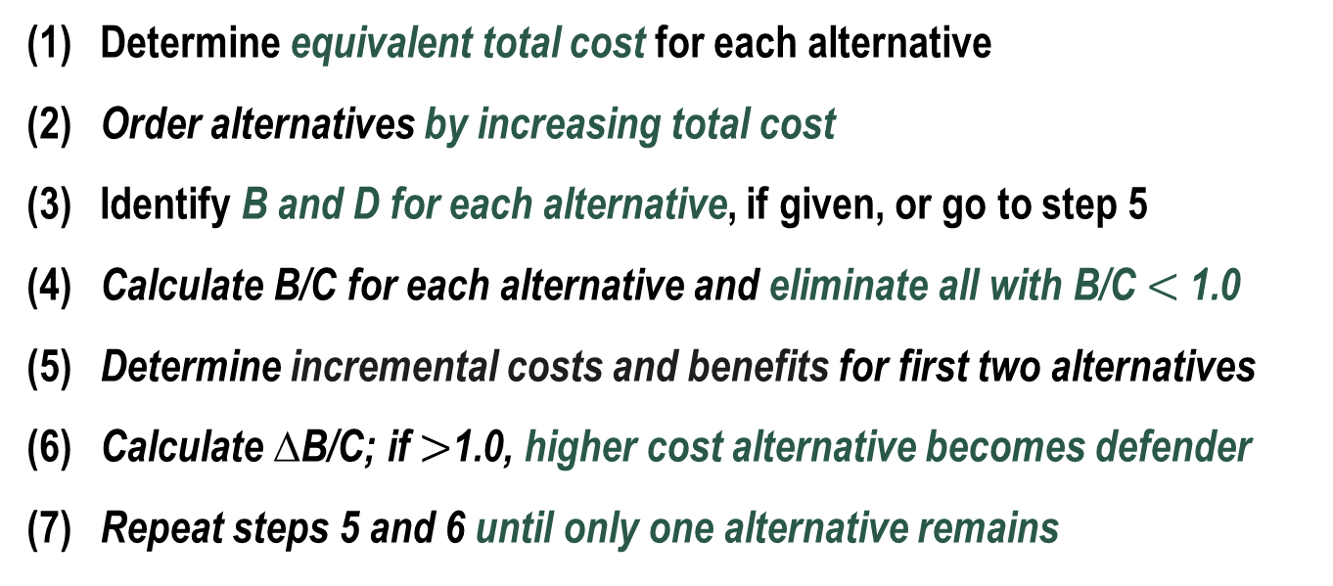
Alternative Selection Using Incremental B/C Analysis – Two or More ME Alternatives
Procedure similar to ROR analysis for multiple alternatives
(1) Determine equivalent total cost for each alternative
(2) Order alternatives by increasing total cost
(3) Identify B and D for each alternative, if given, or go to step 5
(4) Calculate B/C for each alternative and eliminate all with B/C $<$ 1.0
(5) Determine incremental costs and benefits for first two alternatives
(6) Calculate ∆B/C; if $>$1.0, higher cost alternative becomes defender
(7) Repeat steps 5 and 6 until only one alternative remains

Slide 12
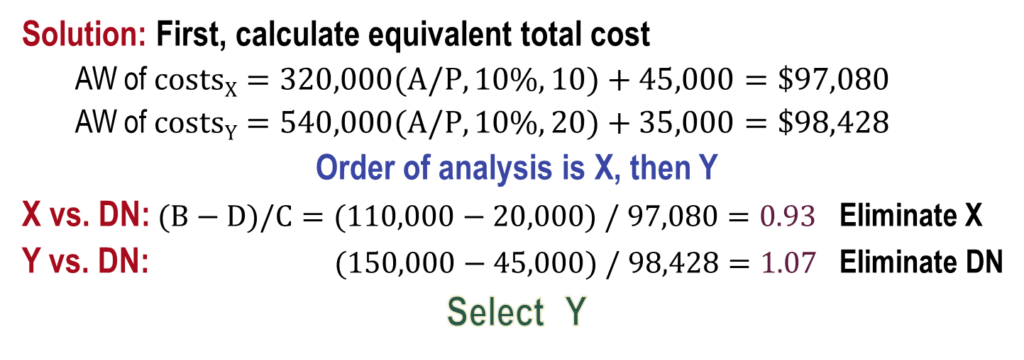
Example: Incremental B/C Analysis
Compare two alternatives using i = 10% and B/C ratio
Alternative X Y
  First cost, $ 320,000 540,000
  M&O costs, $/year 45,000 35,000
  Benefits, $/year 110,000 150,000
  Disbenefits, $/year 20,000 45,000
  Life, years 10 20
Solution: First, calculate equivalent total cost
  AW of $costsX=320,000(A/P,10\%,10)+45,000=\$97,080$
  AW of $costsY=540,000(A/P,10\%,20)+35,000=\$98,428$
Order of analysis is X, then Y
X vs. DN: $(B−D)/C=(110,000−20,000) / 97,080=0.93$ Eliminate X
Y vs. DN: $(150,000−45,000) / 98,428=1.07$ Eliminate DN
Select Y

Slide 13
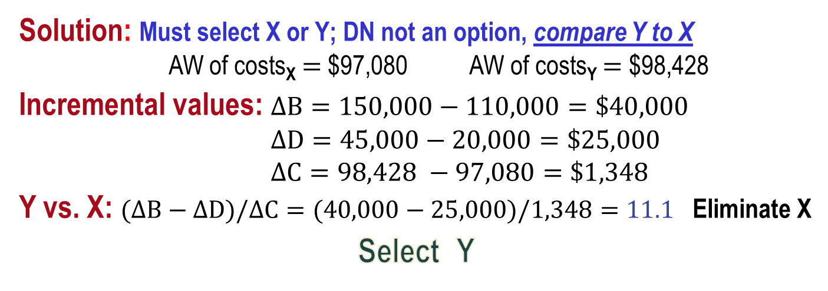
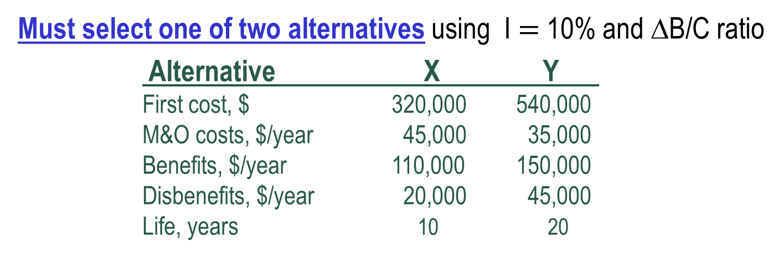
Example: ∆B/C Analysis; Selection Required
Must select one of two alternatives using I $=$ 10% and ∆B/C ratio
Alternative X Y
  First cost, $ 320,000 540,000
  M&O costs, $/year 45,000 35,000
  Benefits, $/year 110,000 150,000
  Disbenefits, $/year 20,000 45,000
  Life, years 10 20
Solution: Must select X or Y; DN not an option, compare Y to X
  AW of costs_{X} $=$ $97,080 AW of costs_{Y} $=$ $98,428
Incremental values: $∆B=150,000−110,000=\$40,000$
$∆D=45,000−20,000=\$25,000$
$∆C=98,428 −97,080=\$1,348$
Y vs. X: $(∆B−∆D)/∆C=(40,000−25,000)/1,348=11.1$ Eliminate X
Select Y

Slide 14
B/C Analysis of Independent Projects
Independent projects comparison does not require incremental analysis
Compare each alternative’s overall B/C with DN option
No budget limit: Accept all alternatives with B/C ≥ 1.0
Budget limit specified: capital budgeting problem; selection follows different procedure (discussed in chapter 12)

Slide 15
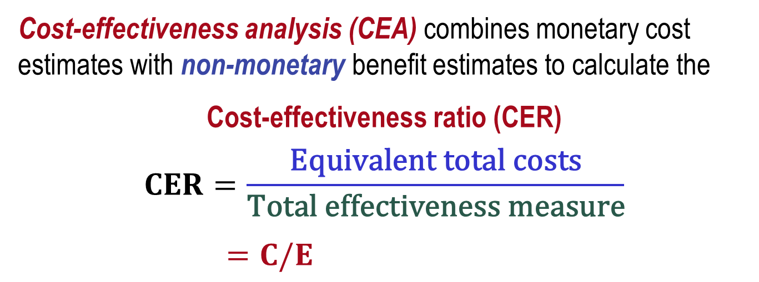
Cost Effectiveness Analysis
Service sector projects primarily involve intangibles, not physical facilities; examples include health care, security programs, credit card services, etc.
Cost-effectiveness analysis (CEA) combines monetary cost estimates with non-monetary benefit estimates to calculate the
Cost-effectiveness ratio (CER)
$$CER=\frac{\text{Equivalent} \text{total} \text{costs}}{\text{Total} \text{effectiveness} \text{measure}}$$
$=C/E$

Slide 16
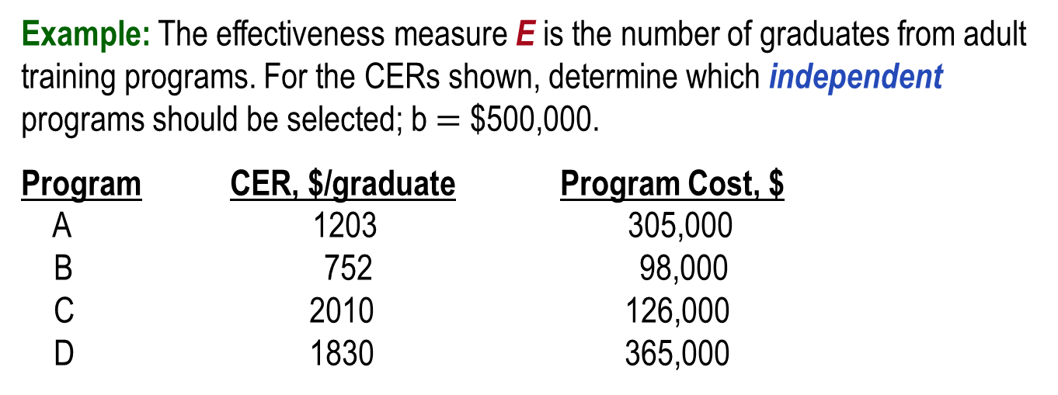
CER Analysis for Independent Projects
Procedure is as follows:
(1) Determine equivalent total cost C, total effectiveness measure E and CER
(2) Order projects by smallest to largest CER
(3) Determine cumulative cost of projects and compare to budget limit b
(4) Fund all projects such that b is not exceeded
Example: The effectiveness measure E is the number of graduates from adult training programs. For the CERs shown, determine which independent programs should be selected; b $=$ $500,000.
Program CER, $/graduate Program Cost, $
A 1203 305,000
B 752 98,000
C 2010 126,000
D 1830 365,000

Slide 17
Example: CER for Independent Projects
First, rank programs according to increasing CER:
Program | CER, $/graduate | Program Cost, $ | Cumulative Cost, $
B | 752 | 98,000 | 98,000
A | 1203 | 305,000 | 403,000
D | 1830 | 365,000 | 768,000
C | 2010 | 126,000 | 894,000
Next, select programs until budget is not exceeded
Select programs B and A at total cost of $403,000
Note: To expend the entire $500,000, accept as many additional
individuals as possible from D at the per-student rate

Slide 18
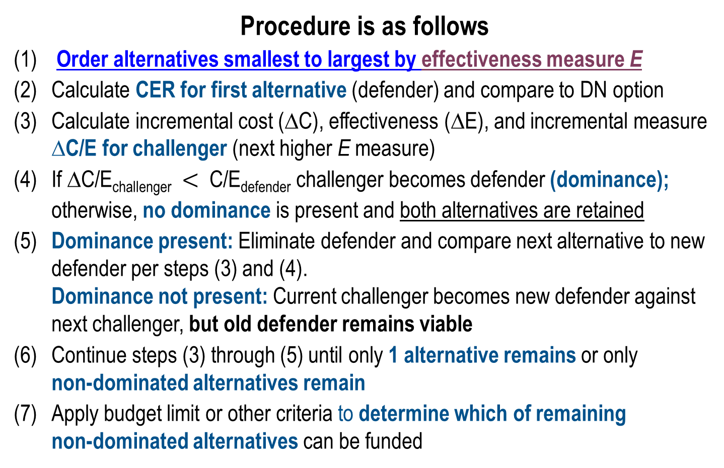
CER Analysis for Mutually Exclusive Projects
Procedure is as follows
(1) Order alternatives smallest to largest by effectiveness measure E
(2) Calculate CER for first alternative (defender) and compare to DN option
(3) Calculate incremental cost (∆C), effectiveness (∆E), and incremental measure ∆C/E for challenger (next higher E measure)
(4) If ∆C/E_{challenger} $<$ C/E_{defender} challenger becomes defender (dominance);
otherwise, no dominance is present and both alternatives are retained
(5) Dominance present: Eliminate defender and compare next alternative to new defender per steps (3) and (4).
Dominance not present: Current challenger becomes new defender against next challenger, but old defender remains viable
(6) Continue steps (3) through (5) until only 1 alternative remains or only
non-dominated alternatives remain
(7) Apply budget limit or other criteria to determine which of remaining
non-dominated alternatives can be funded

Slide 19
Example: CER for ME Service Projects (1)
The effectiveness measure E is wins per person. From the cost and effectiveness values shown, determine which alternative to select.
Program | Cost (C) $/person | Effectiveness (E) wins/person | CER $/win
A | 2,200 | 4 | 550
B | 1,400 | 2 | 700
C | 6,860 | 7 | 980

Slide 20
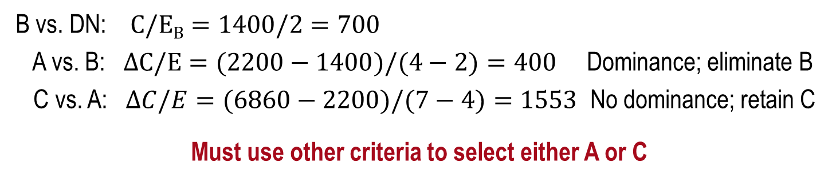
Example: CER for ME Service Projects (2)
Solution:
Order programs according to increasing effectiveness measure E
Program | Cost (C) $/person | Effectiveness (E) wins/person | CER $/win
B | 1,400 | 2 | 700
A | 2,200 | 4 | 550
C | 6,860 | 7 | 980
B vs. DN: $C/EB=1400/2=700$
A vs. B: $∆C/E=(2200−1400)/(4−2)=400$ Dominance; eliminate B
C vs. A: $∆C/E=(6860−2200)/(7−4)=1553$ No dominance; retain C
Must use other criteria to select either A or C

Slide 21
Ethical Considerations
Engineers are routinely involved in two areas
where ethics may be compromised:
Public policy making – Development of strategy, e.g., water system management (supply/demand strategy; ground vs. surface sources)
Public planning – Development of projects, e.g., water operations (distribution, rates, sales to outlying areas)
Engineers must maintain integrity and impartiality and always adhere to Code of Ethics

Slide 22
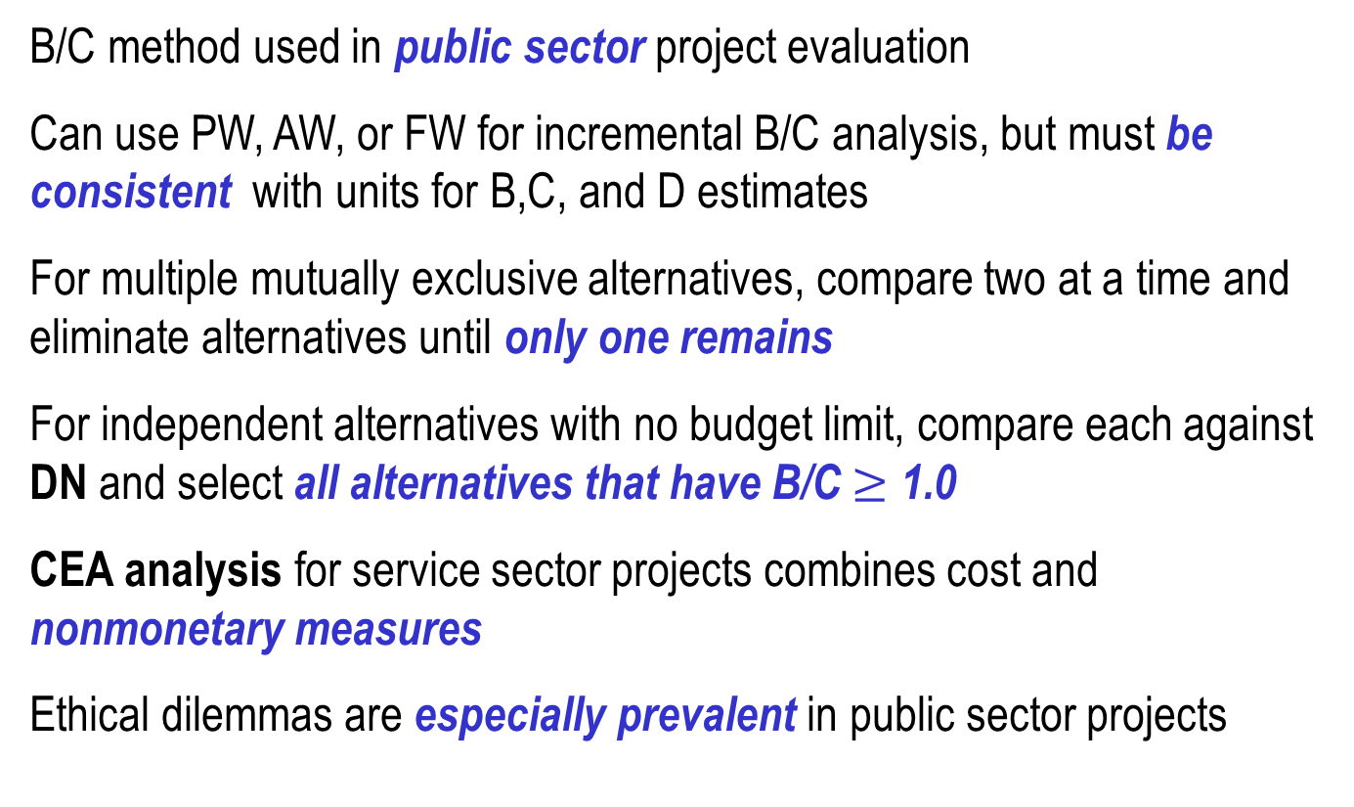
Summary of Important Points
B/C method used in public sector project evaluation
Can use PW, AW, or FW for incremental B/C analysis, but must be consistent with units for B,C, and D estimates
For multiple mutually exclusive alternatives, compare two at a time and eliminate alternatives until only one remains
For independent alternatives with no budget limit, compare each against DN and select all alternatives that have B/C $≥$ 1.0
CEA analysis for service sector projects combines cost and nonmonetary measures
Ethical dilemmas are especially prevalent in public sector projects

