Slide 1
Lecture slides to accompany
Engineering Economy, 8th edition
Leland Blank, Anthony Tarquin
©McGraw-Hill Education. All rights reserved. Authorized only for instructor use in the classroom. No reproduction or further distribution permitted without the prior written consent of McGraw-Hill Education.

Slide 2
Chapter 8
Rate of Return Multiple Alternatives

Slide 3
LEARNING OUTCOMES
Why incremental analysis is required in ROR
Incremental cash flow (CF) calculation
Interpretation of ROR on incremental CF
Select alternative by ROR based on PW relation
Select alternative by ROR based on AW relation
Select best from several alternatives using ROR method

Slide 4
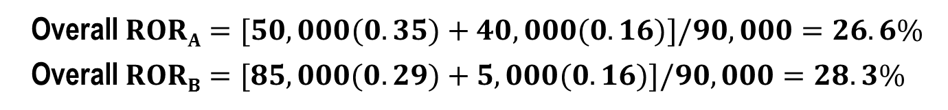
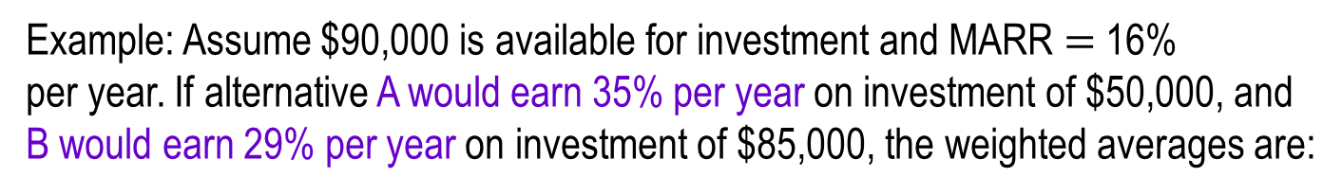
Why Incremental Analysis is Necessary (1)
Selecting the alternative with highest ROR may not yield highest return on available capital
Must consider weighted average of total capital available
Capital not invested in a project is assumed to earn at MARR
Example: Assume $90,000 is available for investment and MARR $=$ 16%
per year. If alternative A would earn 35% per year on investment of $50,000, and B would earn 29% per year on investment of $85,000, the weighted averages are:
Overall $RORA=[50,000(0.35)+40,000(0.16)]/90,000=26.6\%$
Overall $RORB=[85,000(0.29)+5,000(0.16)]/90,000=28.3\%$
Which investment is better, economically?

Slide 5
Why Incremental Analysis is Necessary (2)
If selection basis is higher ROR:
Select alternative A (wrong answer)
If selection basis is higher overall ROR:
Select alternative B
Conclusion: Must use an incremental ROR analysis to make a consistently correct selection
Unlike PW, AW, and FW values, if not analyzed correctly, ROR values can lead to an incorrect alternative selection. This is called the ranking inconsistency problem (discussed later)

Slide 6
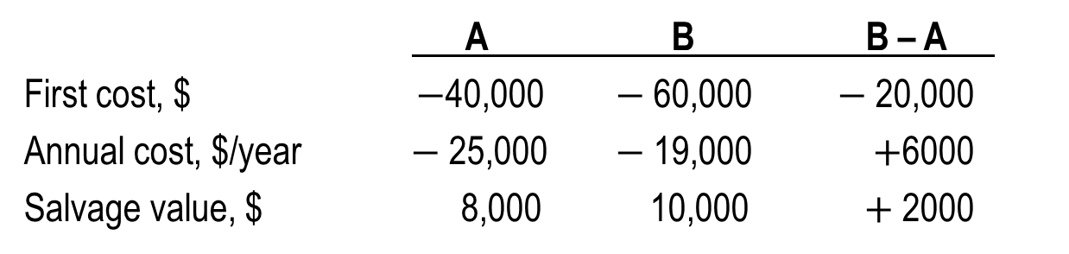
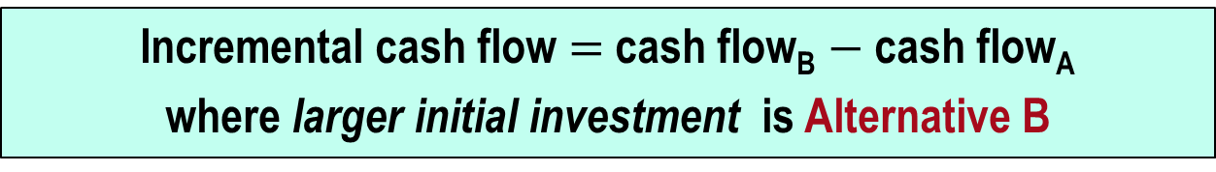

Calculation of Incremental CF
Incremental cash flow $=$ cash flow_{B} $−$ cash flow_{A}
where larger initial investment is Alternative B
Example: Either of the cost alternatives shown below can be used in a grinding process. Tabulate the incremental cash flows.
A B B – A
First cost, $ $−$40,000 $−$60,000 $−$20,000
Annual cost, $/year $−$25,000 $−$19,000 $+$6000
Salvage value, $ 8,000 10,000 $+$2000
The incremental CF is shown in the (B$−$A) column
The ROR on the extra $20,000 investment in B determines which alternative to select (as discussed later)

Slide 7

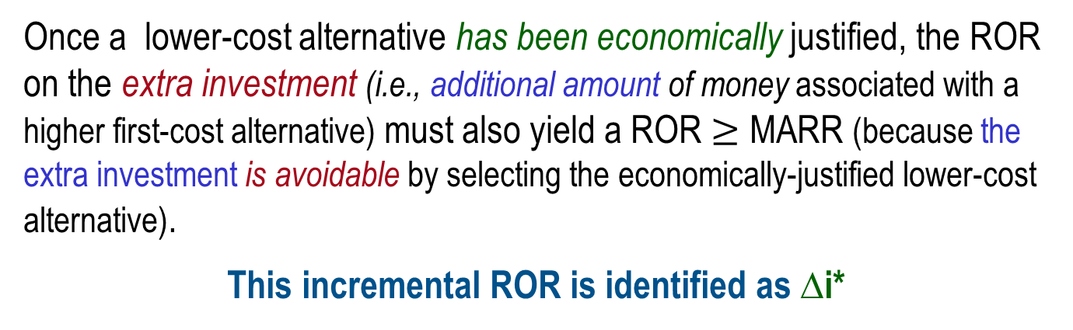
Interpretation of ROR on Extra Investment
Based on concept that any avoidable investment that does not yield at least the MARR should not be made.
Once a lower-cost alternative has been economically justified, the ROR on the extra investment (i.e., additional amount of money associated with a higher first-cost alternative) must also yield a ROR $≥$ MARR (because the extra investment is avoidable by selecting the economically-justified lower-cost alternative).
This incremental ROR is identified as ∆i*
For independent projects, select all that have ROR $≥$ MARR (no incremental analysis is necessary)

Slide 8
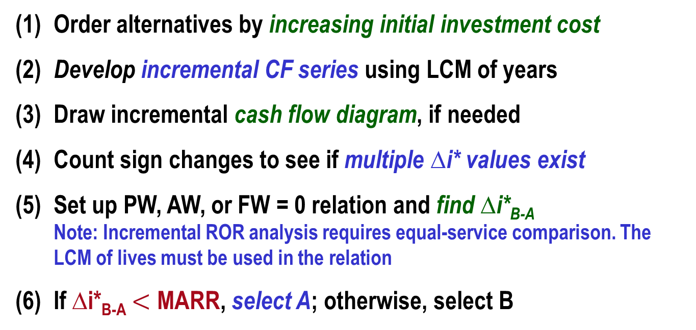
ROR Evaluation for Two ME Alternatives
(1) Order alternatives by increasing initial investment cost
(2) Develop incremental CF series using LCM of years
(3) Draw incremental cash flow diagram, if needed
(4) Count sign changes to see if multiple ∆i* values exist
(5) Set up PW, AW, or FW = 0 relation and find ∆i*_{B-A}
Note: Incremental ROR analysis requires equal-service comparison. The LCM of lives must be used in the relation
(6) If ∆i*_{B-A} $<$ MARR, select A; otherwise, select B
If multiple ∆i* values exist, find EROR using either MIRR or ROIC approach.

Slide 9
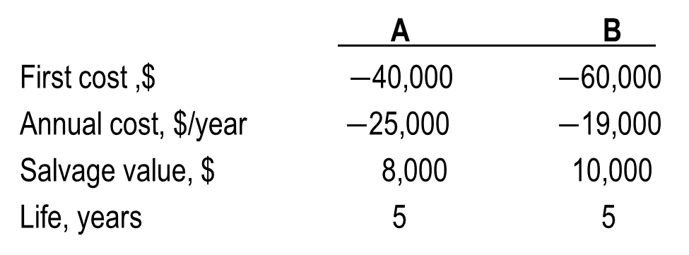
Example: Incremental ROR Evaluation
Either of the cost alternatives shown below can be used in a chemical refining process. If the company’s MARR is 15% per year, determine which should be selected on the basis of ROR analysis?
A B
First cost ,$ $−$40,000 $−$60,000
Annual cost, $/year $−$25,000 $−$19,000
Salvage value, $ 8,000 10,000
Life, years 5 5
Initial observations: ME, cost alternatives with equal life estimates
and no multiple ROR values indicated

Slide 10
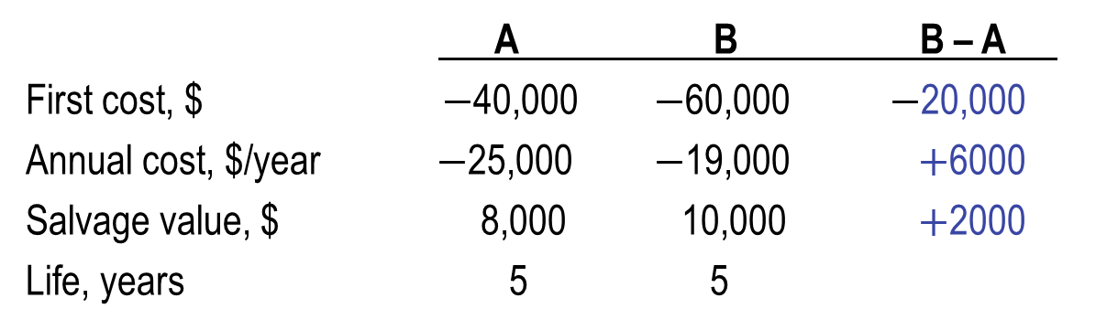
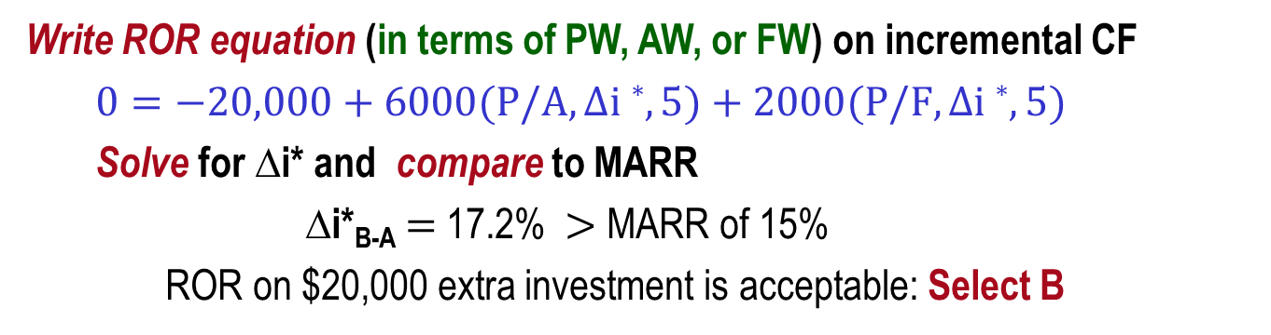
Example: ROR Evaluation of Two Alternatives
Solution, using procedure:
A B B – A
First cost, $ $−$40,000 $−$60,000 $−$20,000
Annual cost, $/year $−$25,000 $−$19,000 $+$6000
Salvage value, $ 8,000 10,000 $+$2000
Life, years 5 5
Order by first cost and find incremental cash flow B $−$ A
Write ROR equation (in terms of PW, AW, or FW) on incremental CF
$0=−20,000+6000(P/A,∆i∗,5)+2000(P/F,∆i∗,5)$
Solve for ∆i* and compare to MARR
∆i*_{B-A} $=$ 17.2% $>$ MARR of 15%
ROR on $20,000 extra investment is acceptable: Select B

Slide 11
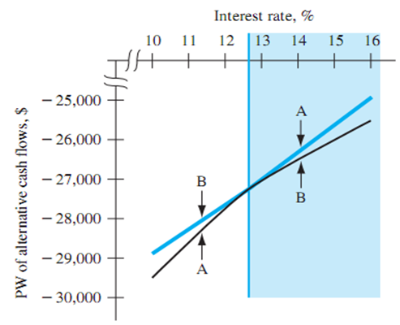
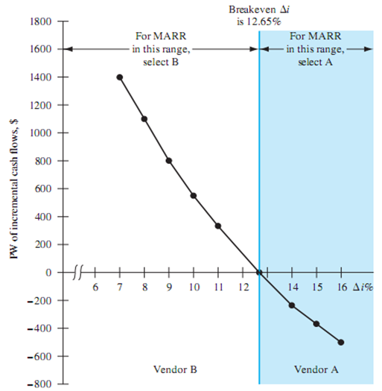
Breakeven ROR Value
A ROR at which the PW, AW or FW values:
Of cash flows for two alternatives are exactly
equal. This is the i* value
Of incremental cash flows between two alternatives are exactly equal.
This is the ∆i* value
If MARR > breakeven ROR, select lower-investment alternative

Slide 12

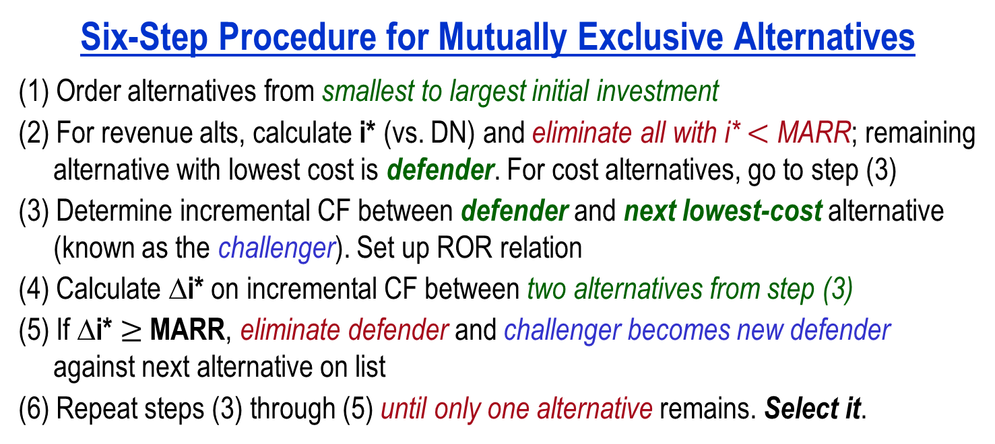
ROR Analysis – Multiple Alternatives
Six-Step Procedure for Mutually Exclusive Alternatives
(1) Order alternatives from smallest to largest initial investment
(2) For revenue alts, calculate i* (vs. DN) and eliminate all with i* $<$ MARR; remaining
alternative with lowest cost is defender. For cost alternatives, go to step (3)
(3) Determine incremental CF between defender and next lowest-cost alternative
(known as the challenger). Set up ROR relation
(4) Calculate ∆i* on incremental CF between two alternatives from step (3)
(5) If ∆i* $≥$ MARR, eliminate defender and challenger becomes new defender
against next alternative on list
(6) Repeat steps (3) through (5) until only one alternative remains. Select it.
For Independent Projects
Compare each alternative vs. DN and select all with ROR $≥$ MARR

Slide 13
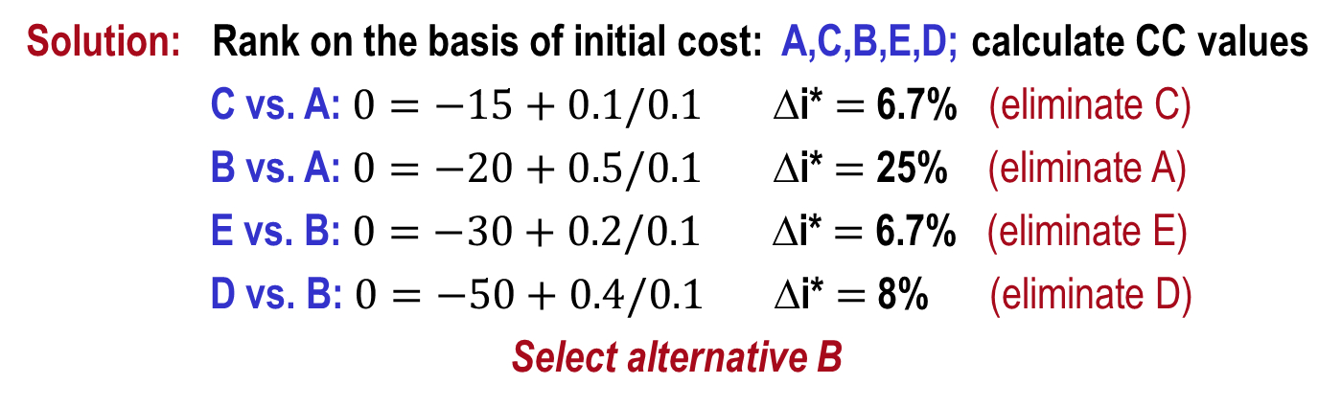
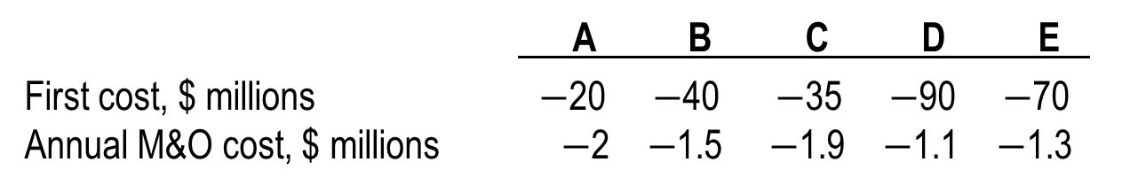
Example: ROR for Multiple Alternatives
The five mutually exclusive alternatives shown below are under consideration for improving visitor safety and access to additional areas of a national park. If all alternatives are considered to last indefinitely, determine which should be selected on the basis of a rate of return analysis using an interest rate of 10%.
A B C D E
First cost, $ millions $−$20 $−$40 $−$35 $−$90 $−$70 Annual M&O cost, $ millions $−$2 $−$1.5 $−$1.9 $−$1.1 $−$1.3
Solution: Rank on the basis of initial cost: A,C,B,E,D; calculate CC values
C vs. A: $0=−15+0.1/0.1$ ∆i* $=$ 6.7% (eliminate C)
B vs. A: $0=−20+0.5/0.1$ ∆i* $=$ 25% (eliminate A)
E vs. B: $0=−30+0.2/0.1$ ∆i* $=$ 6.7% (eliminate E)
D vs. B: $0=−50+0.4/0.1$ ∆i* $=$ 8% (eliminate D)
Select alternative B

Slide 14
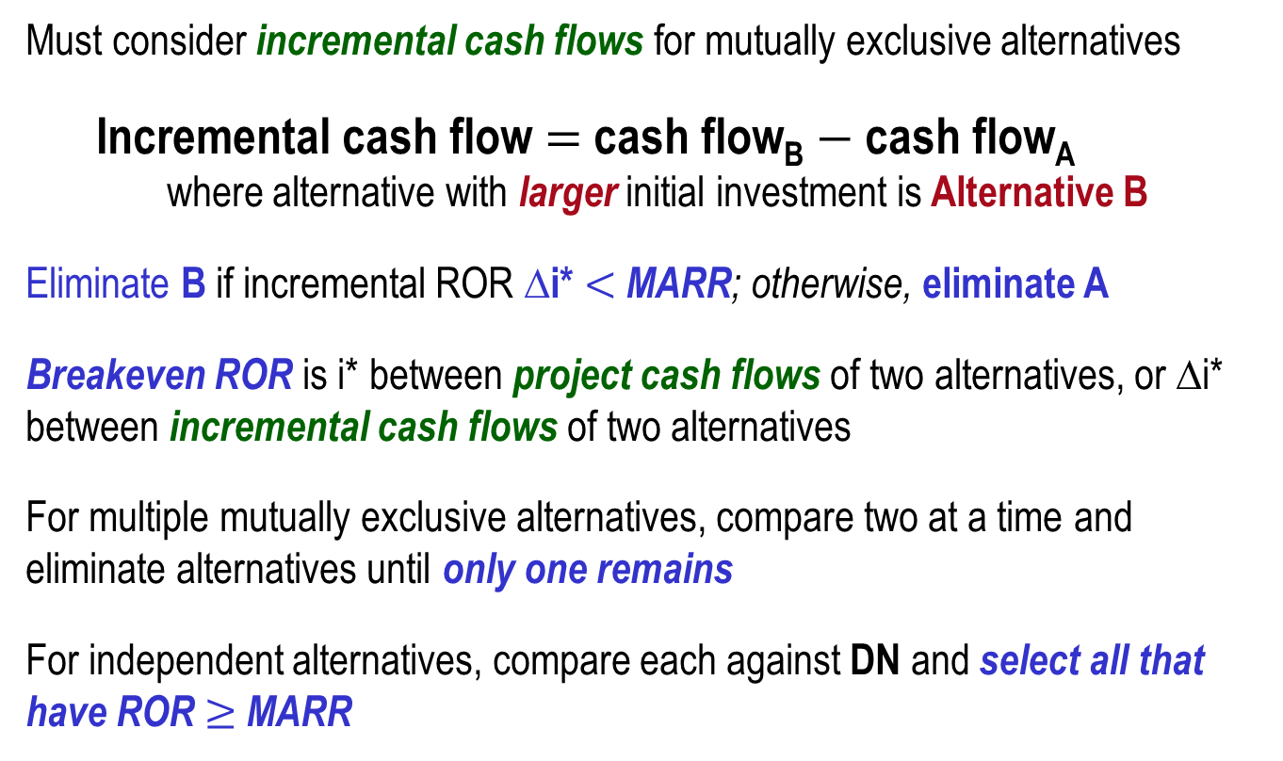
Summary of Important Points
Must consider incremental cash flows for mutually exclusive alternatives
Incremental cash flow $=$ cash flow_{B} $−$ cash flow_{A}
where alternative with larger initial investment is Alternative B
Eliminate B if incremental ROR ∆i* $<$ MARR; otherwise, eliminate A
Breakeven ROR is i* between project cash flows of two alternatives, or ∆i* between incremental cash flows of two alternatives
For multiple mutually exclusive alternatives, compare two at a time and eliminate alternatives until only one remains
For independent alternatives, compare each against DN and select all that have ROR $≥$ MARR

