Slide 1
Lecture slides to accompany
Engineering Economy, 8th edition
Leland Blank, Anthony Tarquin
©McGraw-Hill Education. All rights reserved. Authorized only for instructor use in the classroom. No reproduction or further distribution permitted without the prior written consent of McGraw-Hill Education.

Slide 2
Chapter 7
Rate of Return One Project

Slide 3
LEARNING OUTCOMES
Understand meaning of ROR
Calculate ROR for cash flow series
Understand difficulties of ROR
Determine multiple ROR values
Calculate External ROR (EROR)
Calculate r and i for bonds

Slide 4
Interpretation of ROR
Rate paid on unrecovered balance of borrowed money such that final payment brings balance to exactly zero
with interest considered
ROR equation can be written in terms of PW, AW, or FW
Use trial and error solution by factor or spreadsheet
Numerical value can range from $−$100% to infinity

Slide 5

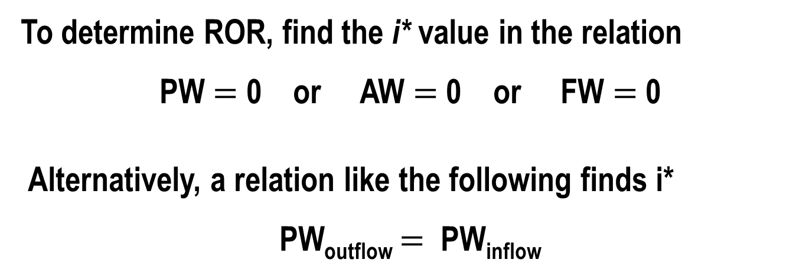
ROR Calculation and Project Evaluation
To determine ROR, find the i* value in the relation
PW $=$ 0 or AW $=$ 0 or FW $=$ 0
Alternatively, a relation like the following finds i*
PW_{outflow} $=$ PW_{inflow}
For evaluation, a project is economically viable if
i* $≥$ MARR

Slide 6
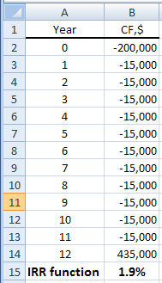

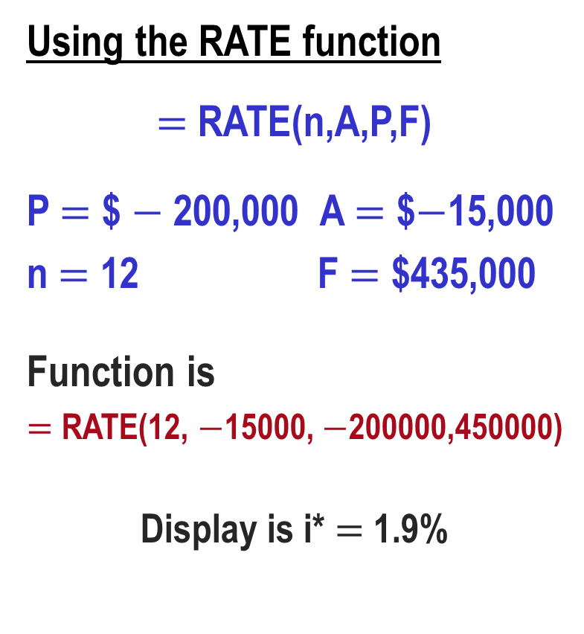

Finding ROR by Spreadsheet Function
Using the RATE function
$=$ RATE(n,A,P,F)
P $=$ $ $−$200,000 A $=$ $$−$15,000
n $=$ 12 F $=$ $435,000
Function is
$=$ RATE(12, $−$15000, $−$200000,450000)
Display is i* $=$ 1.9%
Using the IRR function
$=$ IRR(first_cell, last_cell)
$=$ IRR(B2:B14)

Slide 7
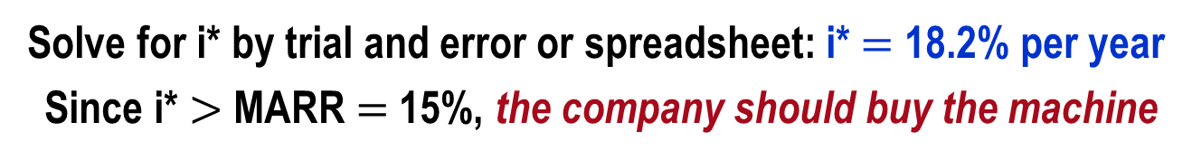
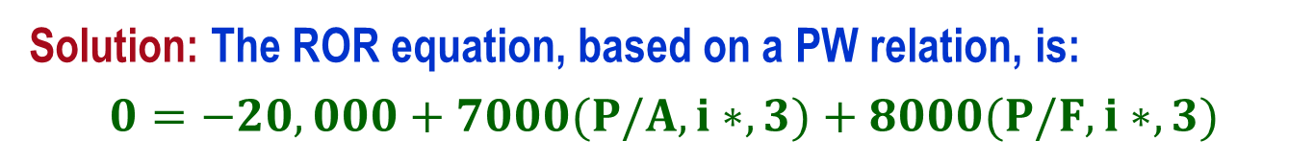
ROR Calculation Using PW, FW or AW Relation
ROR is the unique i* rate at which a PW, FW, or AW relation equals exactly 0
Example: An investment of $20,000 in new equipment will generate income of $7000 per year for 3 years, at which time the machine can be sold for an estimated $8000. If the company’s MARR is 15% per year, should it buy the machine?
Solution: The ROR equation, based on a PW relation, is:
$$0=−20,000+7000(P/A,i∗,3)+8000(P/F,i∗,3)$$
Solve for i* by trial and error or spreadsheet: i* $=$ 18.2% per year
Since i* $>$ MARR $=$ 15%, the company should buy the machine

Slide 8
Special Considerations for ROR
May get multiple i* values (discussed later)
i* assumes reinvestment of positive cash flows earn at i* rate (may be unrealistic)
Incremental analysis necessary for multiple alternative evaluations (discussed later)

Slide 9
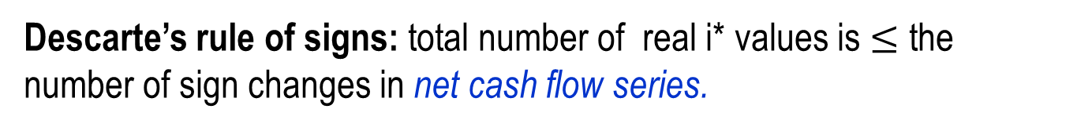
Multiple ROR Values
Multiple i* values may exist when there is more than one sign change in net cash flow (CF) series.
Such CF series are called non-conventional
Two tests for multiple i* values:
Descarte’s rule of signs: total number of real i* values is $≤$ the number of sign changes in net cash flow series.
Norstrom’s criterion: if the cumulative cash flow starts off negatively and has only one sign change, there is only one positive root.

Slide 10
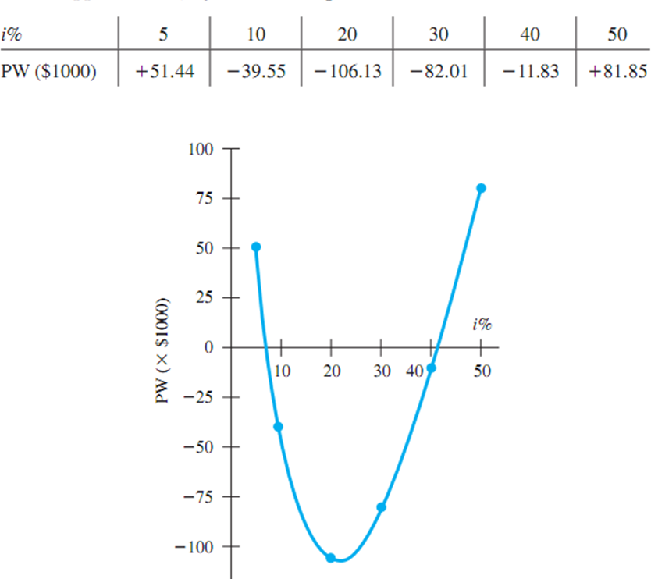
Plot of PW for CF Series with Multiple ROR Values
Year | Cash Flow ($1000) | Sequence Number | Cumulative Cash Flow ($1000)
0 | +2000 | S₀ | +2000
1 | –500 | S₁ | +1500
2 | –8100 | S₂ | –6600
3 | +6800 | S₃ | +200
i* values at ~8% and ~41%

Slide 11

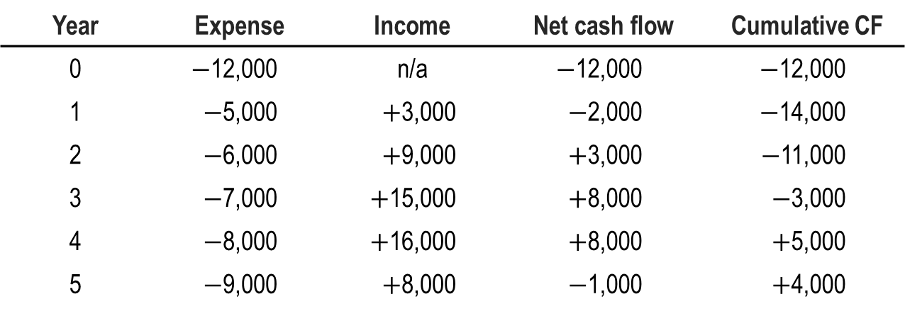
Example: Multiple i* Values
Determine the maximum number of i* values for the cash flow shown below
Year | Expense | Income | Net cash flow | Cumulative CF
0 | $−$12,000 | n/a | $−$12,000 | $−$12,000
1 | $−$5,000 | $+$3,000 | $−$2,000 | $−$14,000
2 | $−$6,000 | $+$9,000 | $+$3,000 | $−$11,000
3 | $−$7,000 | $+$15,000 | $+$8,000 | $−$3,000
4 | $−$8,000 | $+$16,000 | $+$8,000 | $+$5,000
5 | $−$9,000 | $+$8,000 | $−$1,000 | $+$4,000
Solution:
The sign on the net cash flow changes twice, indicating two possible i* values
The cumulative cash flow begins negatively with one sign change
Therefore, there is only one i* value ( i* $=$ 8.7%)

Slide 12
Removing Multiple i* Values
Two new interest rates to consider:
Investment rate i_{i} – rate at which extra funds are invested external to the project
Borrowing rate i_{b} – rate at which funds are borrowed from an external source to provide funds to the project
Two approaches to determine External ROR (EROR)
(1) Modified ROR (MIRR)
(2) Return on Invested Capital (ROIC)

Slide 13
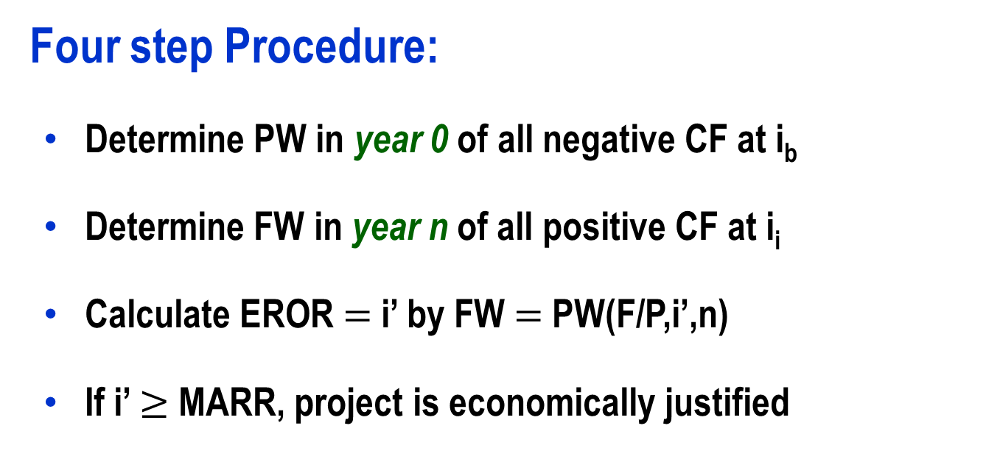
Modified ROR Approach (MIRR)
Four step Procedure:
Determine PW in year 0 of all negative CF at i_{b}
Determine FW in year n of all positive CF at i_{i}
Calculate EROR $=$ i’ by FW $=$ PW(F/P,i’,n)
If i’ $≥$ MARR, project is economically justified

Slide 14
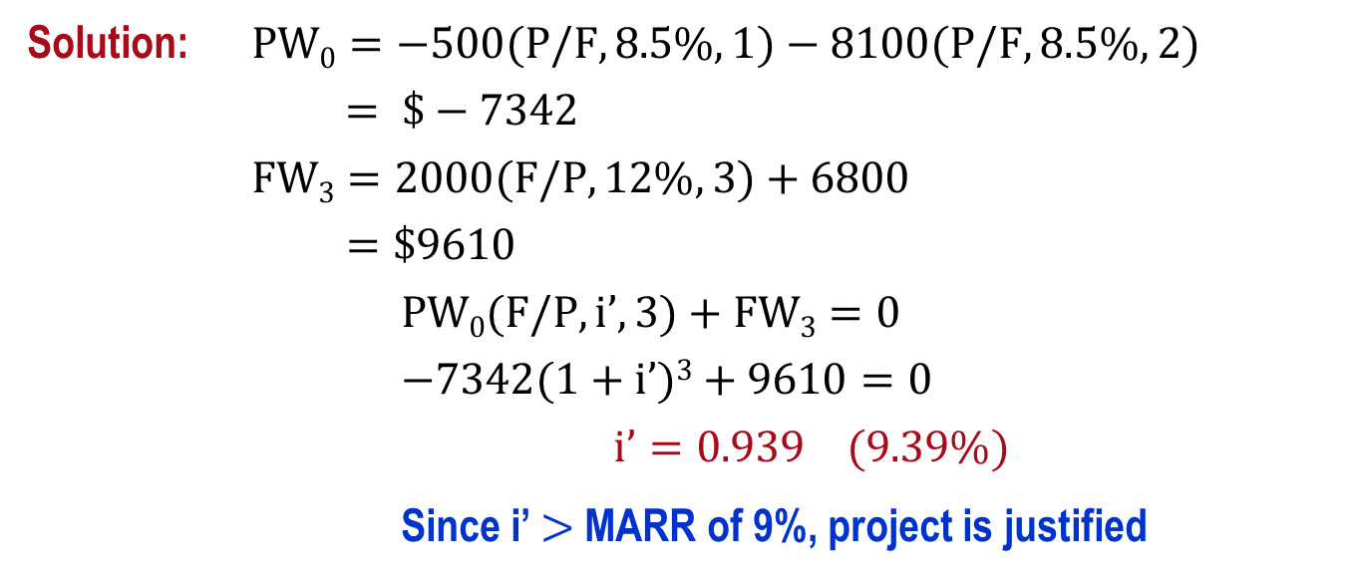
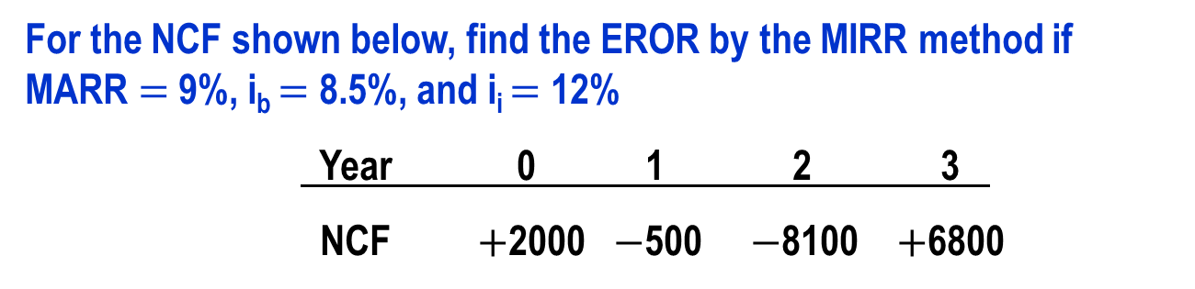
Example: EROR Using MIRR Method
For the NCF shown below, find the EROR by the MIRR method if MARR $=$ 9%, i_{b} $=$ 8.5%, and i_{i} $=$ 12%
Year 0 1 2 3
NCF $+$2000 $−$500 $−$8100 $+$6800
Solution: $PW0=−500(P/F,8.5\%,1)−8100(P/F,8.5\%,2)$
$= \$−7342$
$FW3=2000(F/P,12\%,3)+6800$
$=\$9610$
$PW0(F/P,i’,3)+FW3=0$
$−7342(1+i’)3+9610=0$
$$i’=0.939 (9.39\%)$$
Since i’ $>$ MARR of 9%, project is justified

Slide 15
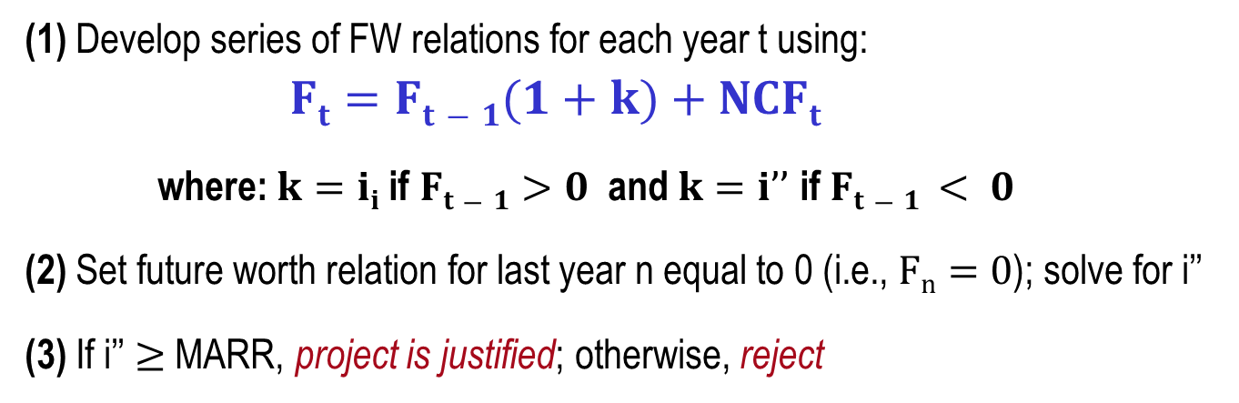
Return on Invested Capital Approach
Measure of how effectively project uses funds that remain internal to project
ROIC rate, i’’, is determined using net-investment procedure
Three step Procedure
(1) Develop series of FW relations for each year t using:
$Ft=Ft−1(1+k)+NCFt$
where: $k=ii$ if $Ft−1>0$ and $k=i’’$ if $Ft−1 < 0$
(2) Set future worth relation for last year n equal to 0 (i.e., $Fn=0$); solve for i’’
(3) If i’’ $≥$ MARR, project is justified; otherwise, reject

Slide 16
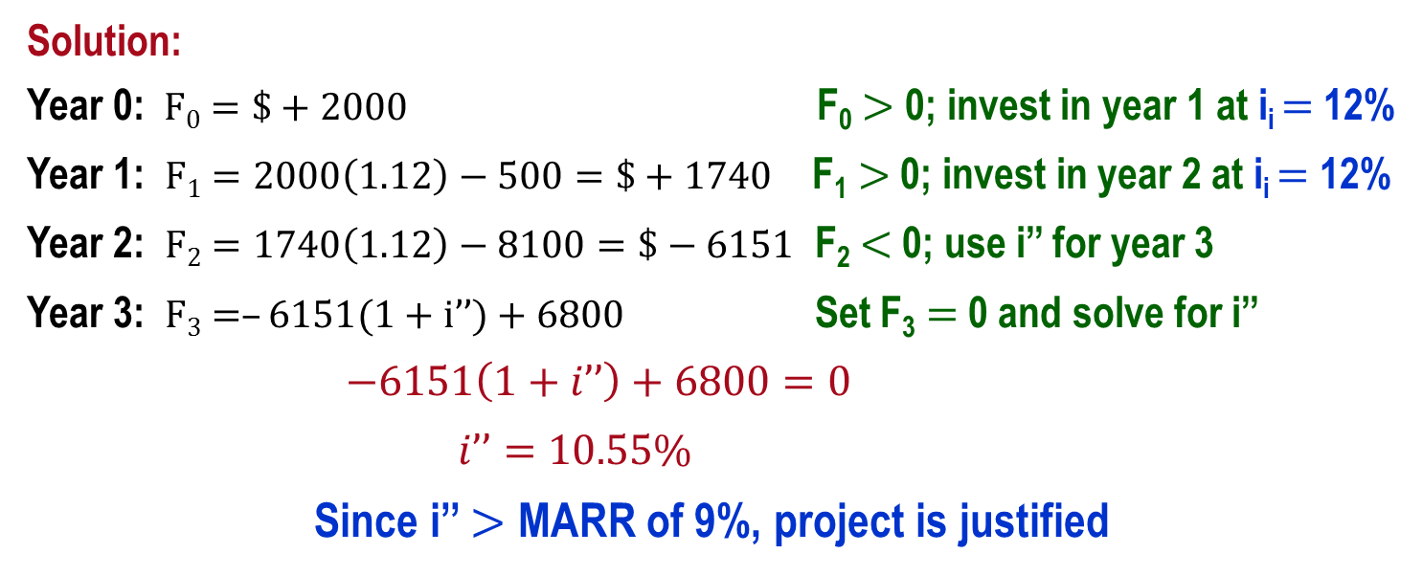
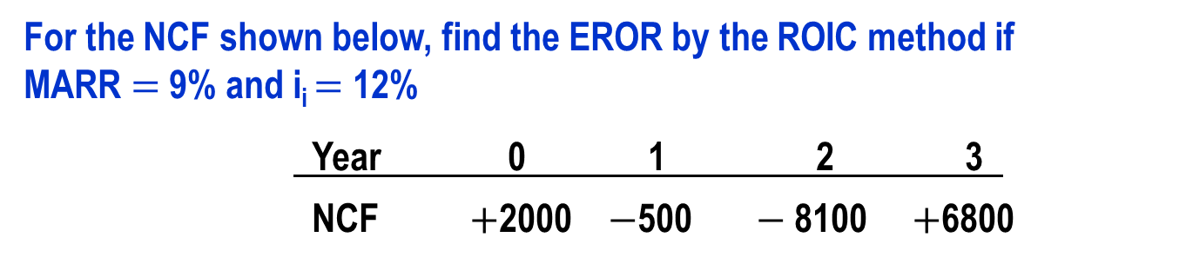
ROIC Example
For the NCF shown below, find the EROR by the ROIC method if
MARR $=$ 9% and i_{i} $=$ 12%
Year 0 1 2 3
NCF $+$2000 $−$500 $−$8100 $+$6800
Solution:
Year 0: $F0=\$+2000$ F₀ $>$ 0; invest in year 1 at i_{i} $=$ 12%
Year 1: $F1=2000\left(1.12\right)−500=\$+1740$ F₁ $>$ 0; invest in year 2 at i_{i} $=$ 12%
Year 2: $F2=1740\left(1.12\right)−8100=\$−6151$ F₂ $<$ 0; use i’’ for year 3
Year 3: $F3=–6151(1+i’’)+6800$ Set F₃ $=$ 0 and solve for i’’
$−6151\left(1+i’’\right)+6800=0$
$i’’=10.55\%$
Since i’’ $>$ MARR of 9%, project is justified

Slide 17
Important Points to Remember
About the computation of an EROR value
EROR values are dependent upon the selected investment and/or borrowing rates
Commonly, multiple i* rates, i’ from MIRR and i’’ from ROIC have different values
About the method used to decide
For a definitive economic decision, set the MARR value and use the PW or AW method to determine economic viability of the project

Slide 18
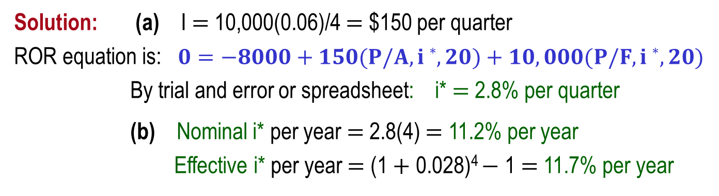
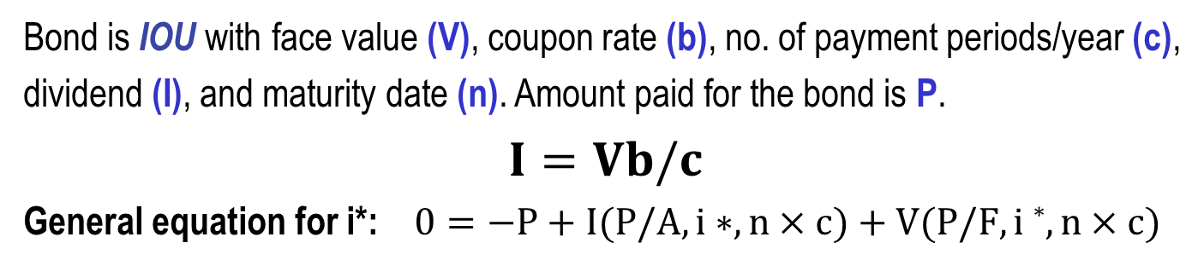
ROR of Bond Investment
Bond is IOU with face value (V), coupon rate (b), no. of payment periods/year (c),
dividend (I), and maturity date (n). Amount paid for the bond is P.
$I=Vb/c$
General equation for i*: $0=−P+I(P/A,i∗,n×c)+V(P/F,i∗,n×c)$
A $10,000 bond with 6% interest payable quarterly is purchased for $8000.
If the bond matures in 5 years, what is the ROR (a) per quarter, (b) per year?
Solution: (a) I $=$ 10,000(0.06)/4 $=$ $150 per quarter
ROR equation is: $0=−8000+150(P/A,i∗,20)+10,000(P/F,i∗,20)$
By trial and error or spreadsheet: i* $=$ 2.8% per quarter
(b) Nominal i* per year $=$ 2.8(4) $=$ 11.2% per year
Effective i* per year $=$ (1 $+$ 0.028)⁴ $−$ 1 $=$ 11.7% per year

Slide 19
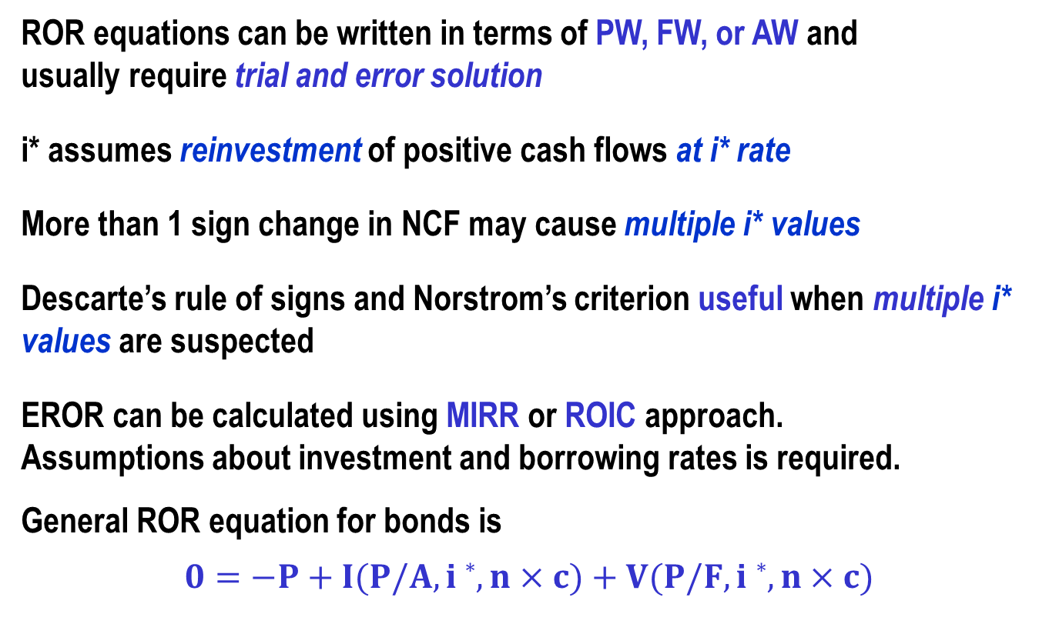
Summary of Important Points
ROR equations can be written in terms of PW, FW, or AW and
usually require trial and error solution
i* assumes reinvestment of positive cash flows at i* rate
More than 1 sign change in NCF may cause multiple i* values
Descarte’s rule of signs and Norstrom’s criterion useful when multiple i* values are suspected
EROR can be calculated using MIRR or ROIC approach.
Assumptions about investment and borrowing rates is required.
General ROR equation for bonds is
$$0=−P+I(P/A,i∗,n×c)+V(P/F,i∗,n×c)$$

