Slide 1
Lecture slides to accompany
Engineering Economy, 8th edition
Leland Blank, Anthony Tarquin
©McGraw-Hill Education. All rights reserved. Authorized only for instructor use in the classroom. No reproduction or further distribution permitted without the prior written consent of McGraw-Hill Education.

Slide 2
Chapter 5
Present Worth Analysis

Slide 3
LEARNING OUTCOMES
Formulate Alternatives
PW of equal-life alternatives
PW of different-life alternatives
Future Worth analysis
Capitalized Cost analysis

Slide 4
Formulating Alternatives (1)
Two types of economic proposals
Mutually Exclusive (ME) Alternatives: Only one can be selected; Compete against each other
Independent Projects: More than one can be selected;
Compete only against DN
Do Nothing (DN) – An ME alternative or independent project to maintain the current approach; no new costs, revenues or savings

Slide 5
Formulating Alternatives (2)
Two types of cash flow estimates
Revenue: Alternatives include estimates of costs
(cash outflows) and revenues (cash inflows)
Cost: Alternatives include only costs; revenues and savings assumed equal for all alternatives;
also called service alternatives

Slide 6
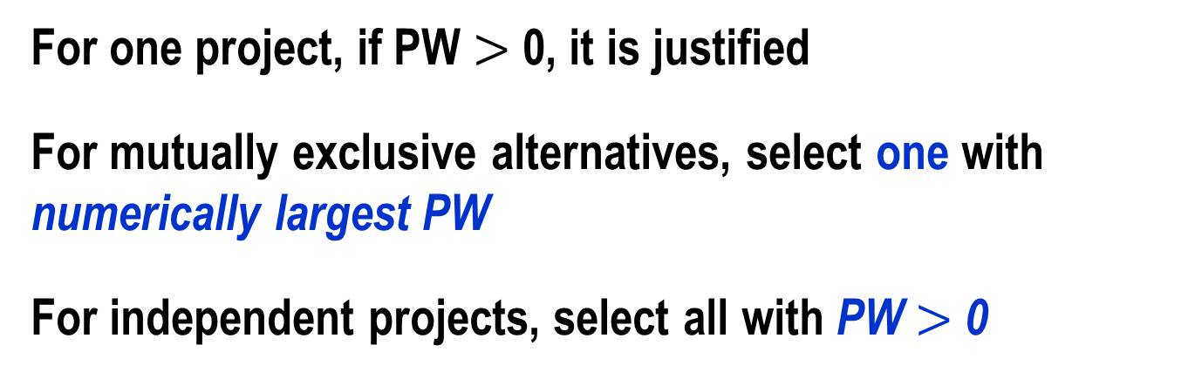
PW Analysis of Alternatives
Convert all cash flows to PW using MARR
Precede costs by minus sign; receipts by plus sign
EVALUATION
For one project, if PW $>$ 0, it is justified
For mutually exclusive alternatives, select one with numerically largest PW
For independent projects, select all with PW $>$ 0

Slide 7

Selection of Alternatives by PW
For the alternatives shown below, which should be selected
if they are (a) mutually exclusive; (b) independent?
Project ID Present Worth
A $30,000
B $12,500
C $-4,000
D $ 2,000
Solution: (a) Select numerically largest PW; alternative A
(b) Select all with PW $>$ 0; projects A, B & D

Slide 8
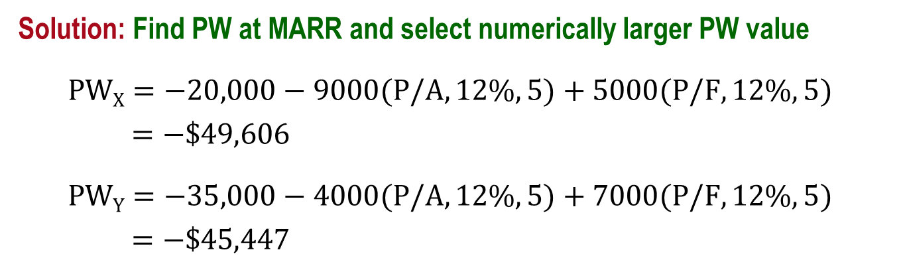
Example: PW Evaluation of Equal-Life ME Alts.
Alternative X has a first cost of $20,000, an operating cost of $9,000 per year, and a $5,000 salvage value after 5 years. Alternative Y will cost $35,000 with an operating cost of $4,000 per year and a salvage value of $7,000 after 5 years. At an MARR of 12% per year, which should be selected?
Solution: Find PW at MARR and select numerically larger PW value
$PWX=−20,000−9000(P/A,12\%,5)+5000(P/F,12\%,5)$
$=−\$49,606$
$PWY=−35,000−4000(P/A,12\%,5)+7000(P/F,12\%,5)$
$=−\$45,447$
Select alternative Y

Slide 9
PW of Different-Life Alternatives
Must compare alternatives for equal service
(i.e., alternatives must end at the same time)
Two ways to compare equal service:
  Least common multiple (LCM) of lives
  Specified study period
(The LCM procedure is used unless otherwise specified)

Slide 10
Assumptions of LCM approach
Service provided is needed over the LCM or more years
Selected alternative can be repeated over each life cycle of LCM in exactly the same manner
Cash flow estimates are the same for each life cycle (i.e., change in exact accord with the inflation or deflation rate)

Slide 11
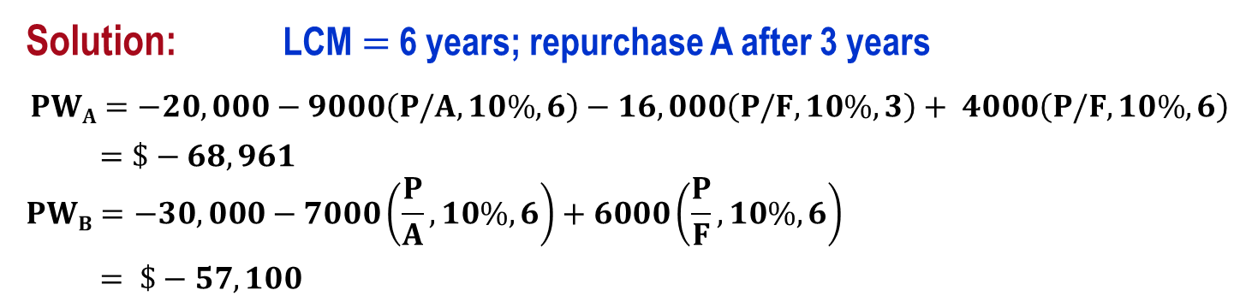
Example: Different-Life Alternatives
Compare the machines below using present worth analysis at i = 10% per year
            Machine A Machine B
            First cost, $ 20,000 30,000
            Annual cost, $/year 9000 7000
            Salvage value, $ 4000 6000
            Life, years 3 6
Solution: LCM $=$ 6 years; repurchase A after 3 years
$$PWA=−20,000−9000\left(P/A,10\%,6\right)−16,000\left(P/F,10\%,3\right)+ 4000\left(P/F,10\%,6\right)$$
$=\$−68,961$
$$PWB=−30,000−7000\left(\frac{P}{A},10\%,6\right)+6000\left(\frac{P}{F},10\%,6\right)$$
$= \$−57,100$
20,000 – 4,000 in year 3
Select alternative B

Slide 12
PW Evaluation Using a Study Period
Once a study period is specified, all cash flows after this time are ignored
Salvage value is the estimated market value at the end of study period
Short study periods are often defined by management when business goals are short-term
Study periods are commonly used in equipment replacement analysis

Slide 13
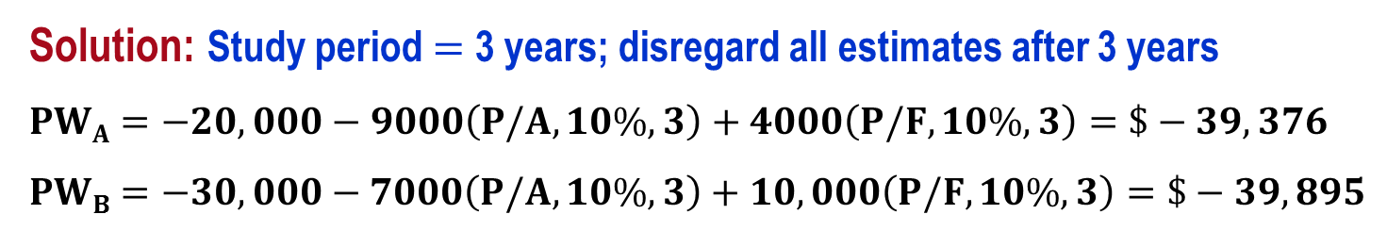
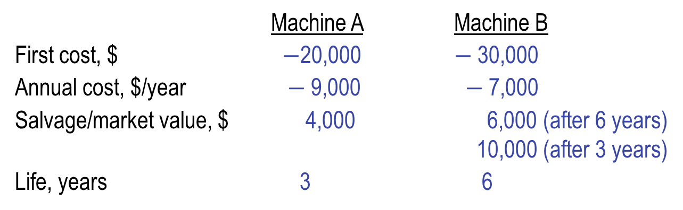
Example: Study Period PW Evaluation
Compare the alternatives below using present worth analysis at i = 10% per year and a 3-year study period
Machine A Machine B
First cost, $ $−$20,000 $−$30,000
Annual cost, $/year $−$9,000 $−$7,000
Salvage/market value, $ 4,000 6,000 (after 6 years)
10,000 (after 3 years)
Life, years 3 6
Solution: Study period $=$ 3 years; disregard all estimates after 3 years
$$PWA=−20,000−9000\left(P/A,10\%,3\right)+4000\left(P/F,10\%,3\right)=\$−39,376$$
$$PWB=−30,000−7000\left(P/A,10\%,3\right)+10,000\left(P/F,10\%,3\right)=\$−39,895$$
Marginally, select A; different selection than for LCM $=$ 6 years

Slide 14
Future Worth Analysis
FW exactly like PW analysis, except calculate FW
Must compare alternatives for equal service
(i.e. alternatives must end at the same time)
Two ways to compare equal service:
Least common multiple (LCM) of lives
Specified study period
(The LCM procedure is used unless otherwise specified)

Slide 15
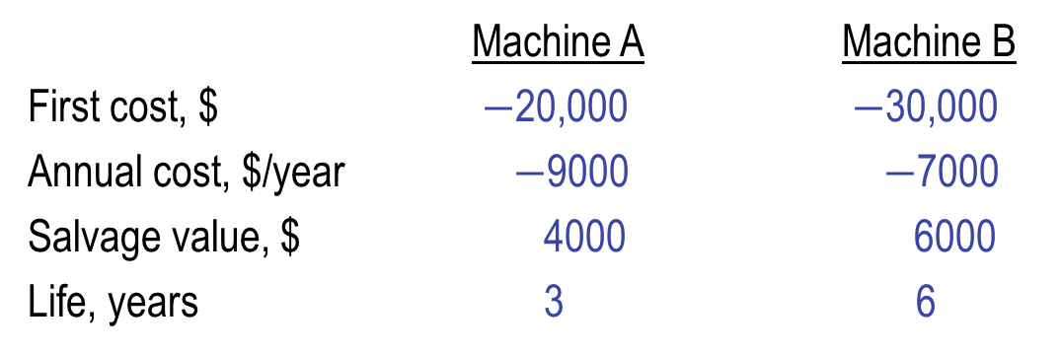
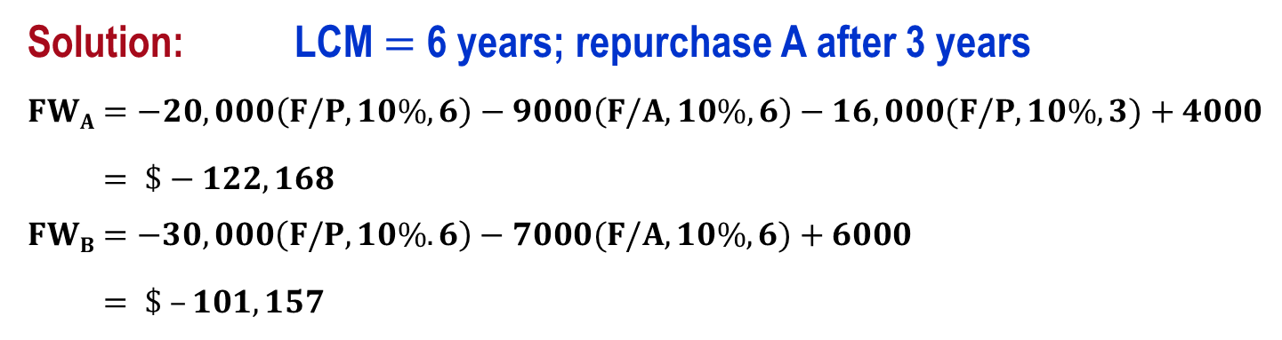
FW of Different-Life Alternatives
Compare the machines below using future worth analysis at i $=$ 10% per year
            Machine A Machine B
            First cost, $ $−$20,000 $−$30,000
            Annual cost, $/year $−$9000 $−$7000
            Salvage value, $ 4000 6000
            Life, years 3 6
Solution: LCM $=$ 6 years; repurchase A after 3 years
$$FWA=−20,000\left(F/P,10\%,6\right)−9000\left(F/A,10\%,6\right)−16,000(F/P,10\%,3)+4000$$
$= \$−122,168$
$$FWB=−30,000\left(F/P,10\%.6\right)−7000(F/A,10\%,6)+6000$$
$= \$ –101,157$
Select B (Note: PW and FW methods will always result in same selection)

Slide 16
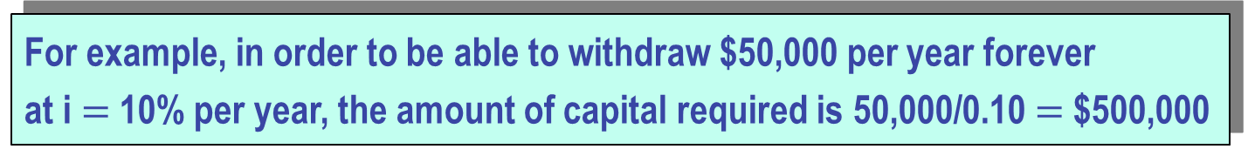
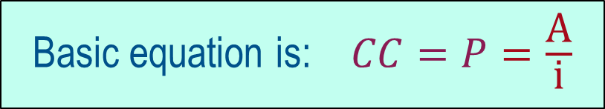
Capitalized Cost (CC) Analysis
CC refers to the present worth of a project with a very long life, that is, PW as n becomes infinite
Basic equation is: $CC=P=\frac{\text{A}}{\text{i}}$
“A” essentially represents the interest on a perpetual investment
For example, in order to be able to withdraw $50,000 per year forever
at i $=$ 10% per year, the amount of capital required is 50,000/0.10 $=$ $500,000
For finite life alternatives, convert all cash flows into an A value over one life cycle and then divide by i

Slide 17
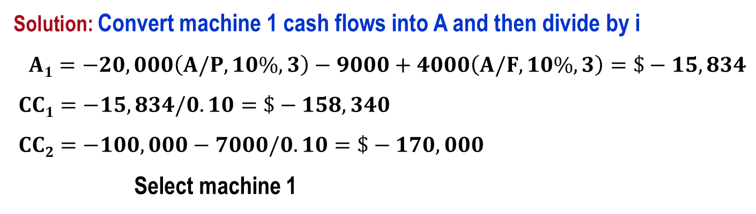
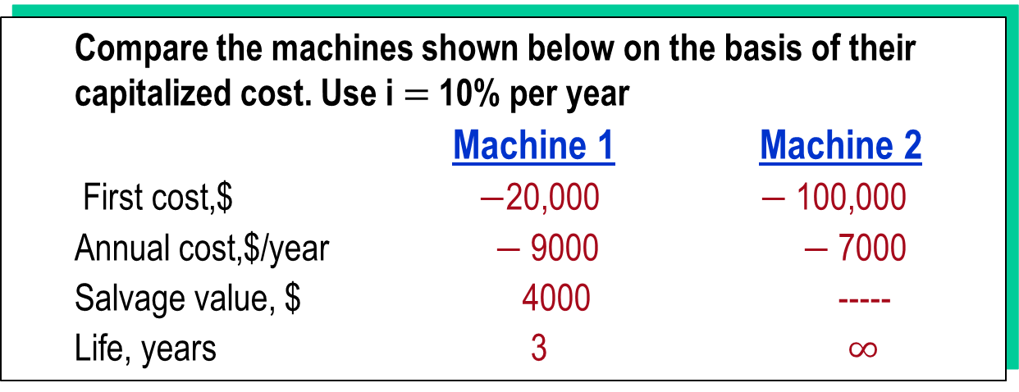
Example: Capitalized Cost
Compare the machines shown below on the basis of their capitalized cost. Use i $=$ 10% per year
Machine 1 Machine 2
First cost,$ $−$20,000 $−$100,000
Annual cost,$/year $−$9000 $−$7000
Salvage value, $ 4000 -----
Life, years 3 $∞$
Solution: Convert machine 1 cash flows into A and then divide by i
$A1=−20,000\left(A/P,10\%,3\right)−9000+4000\left(A/F,10\%,3\right)=\$−15,834$
$CC1=−15,834/0.10=\$−158,340$
$CC2=−100,000−7000/0.10=\$−170,000$
Select machine 1

Slide 18
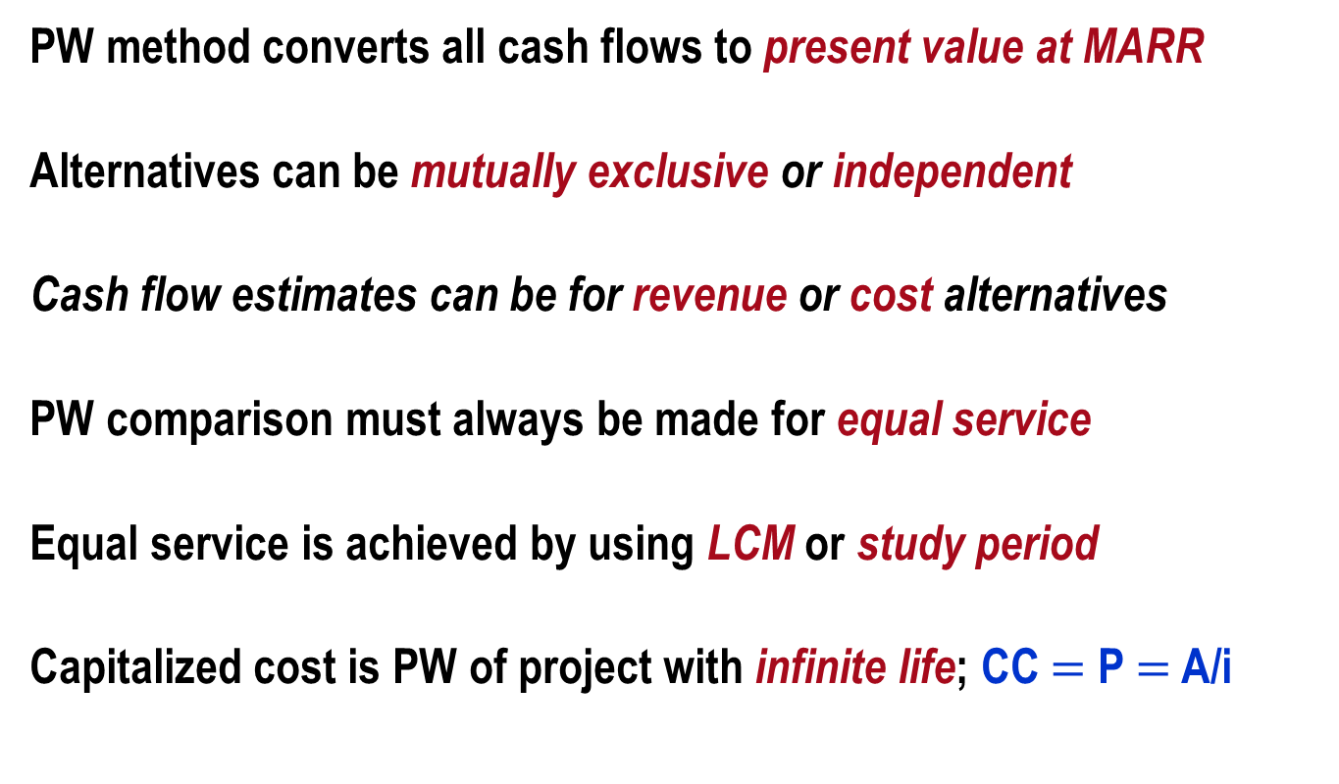
Summary of Important Points
PW method converts all cash flows to present value at MARR
Alternatives can be mutually exclusive or independent
Cash flow estimates can be for revenue or cost alternatives
PW comparison must always be made for equal service
Equal service is achieved by using LCM or study period
Capitalized cost is PW of project with infinite life; CC $=$ P $=$ A/i

