Slide 1
Lecture slides to accompany
Engineering Economy, 8th edition
Leland Blank, Anthony Tarquin
©McGraw-Hill Education. All rights reserved. Authorized only for instructor use in the classroom. No reproduction or further distribution permitted without the prior written consent of McGraw-Hill Education.

Slide 2
Chapter 4
Nominal and Effective Interest Rates

Slide 3
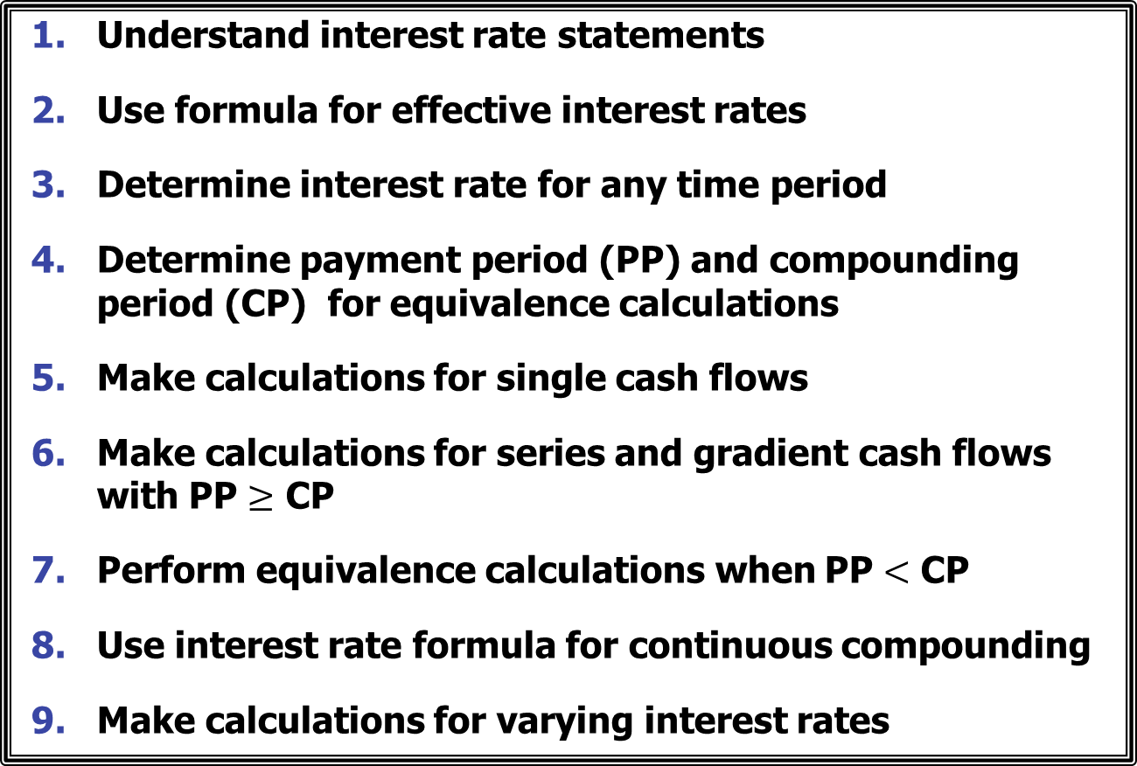
LEARNING OUTCOMES
Understand interest rate statements
Use formula for effective interest rates
Determine interest rate for any time period
Determine payment period (PP) and compounding period (CP) for equivalence calculations
Make calculations for single cash flows
Make calculations for series and gradient cash flows with PP $≥$ CP
Perform equivalence calculations when PP $<$ CP
Use interest rate formula for continuous compounding
Make calculations for varying interest rates

Slide 4
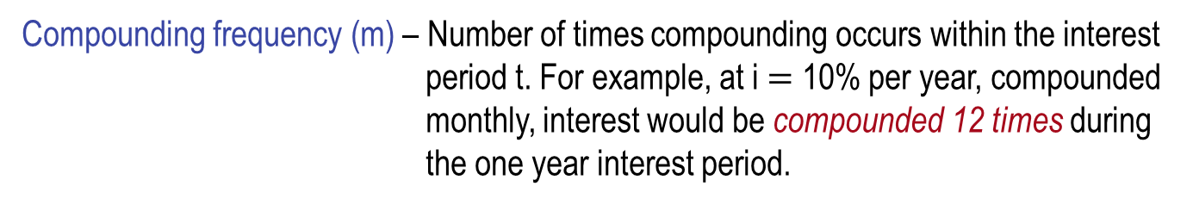
Interest Rate Statements
The terms ‘nominal’ and ‘effective’ enter into consideration when the interest period is less than one year.
New time-based definitions to understand and remember
Interest period (t) – period of time over which interest is expressed. For example,
1% per month.
Compounding period (CP) – Shortest time unit over which interest is charged or earned. For example,10% per year compounded monthly.
Compounding frequency (m) – Number of times compounding occurs within the interest period t. For example, at i $=$ 10% per year, compounded monthly, interest would be compounded 12 times during the one year interest period.

Slide 5

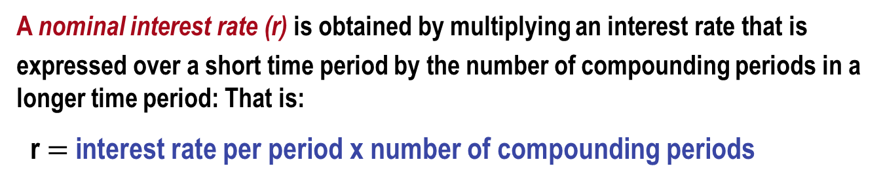
Understanding Interest Rate Terminology
A nominal interest rate (r) is obtained by multiplying an interest rate that is
expressed over a short time period by the number of compounding periods in a longer time period: That is:
r $=$ interest rate per period x number of compounding periods
Example: If i $=$ 1% per month, nominal rate per year is
r $=$ (1)(12) $=$ 12% per year)
Effective interest rates (i) take compounding into account (effective rates can be obtained from nominal rates via a formula to be discussed later).
IMPORTANT: Nominal interest rates are essentially simple interest rates. Therefore,
they can never be used in interest formulas.
Effective rates must always be used hereafter in all interest formulas.

Slide 6
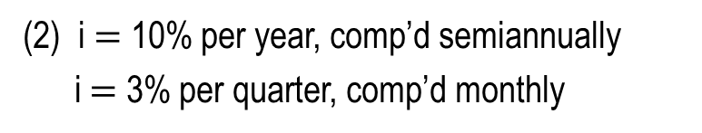
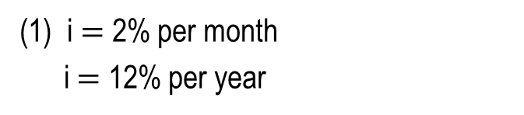
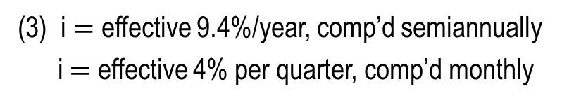
More About Interest Rate Terminology
There are 3 general ways to express interest rates as shown below
Sample Interest Rate Statements
Comment
(1) i $=$ 2% per month
i $=$ 12% per year
When no compounding period is given, rate is effective
(2) i $=$ 10% per year, comp’d semiannually
i $=$ 3% per quarter, comp’d monthly
When compounding period is given and it is not the same as interest period, it is nominal
(3) i $=$ effective 9.4%/year, comp’d semiannually
i $=$ effective 4% per quarter, comp’d monthly
When compounding period is given and rate is specified as effective, rate is effective over stated period

Slide 7
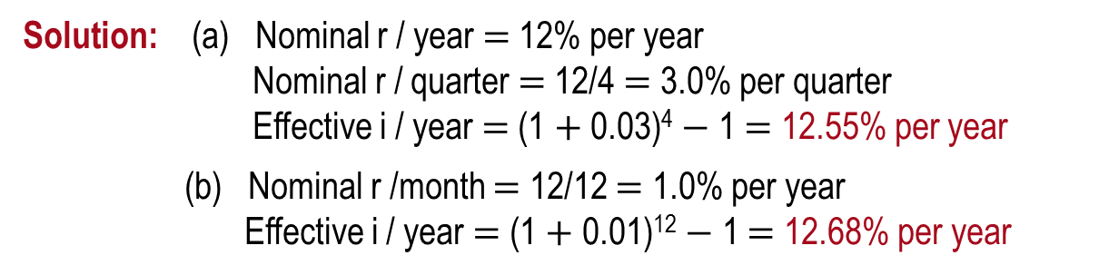
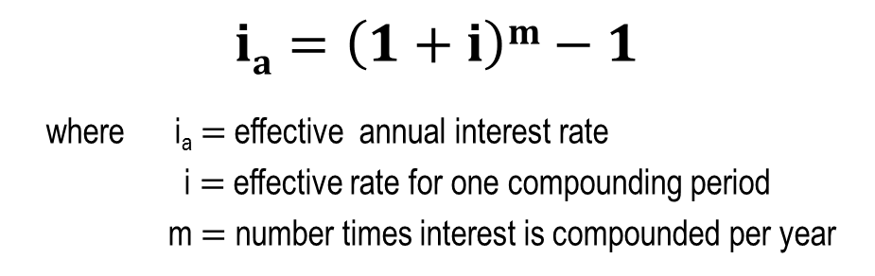
Effective Annual Interest Rates (1)
Nominal rates are converted into effective annual rates via the equation:
$$ia=\left(1+i\right)m−1$$
where i_{a} $=$ effective annual interest rate
i $=$ effective rate for one compounding period
m $=$ number times interest is compounded per year
Example: For a nominal interest rate of 12% per year, determine the nominal and effective rates per year for (a) quarterly, and (b) monthly compounding
Solution: (a) Nominal r / year $=$ 12% per year
Nominal r / quarter $=$ 12/4 $=$ 3.0% per quarter
Effective i / year $=$ (1 $+$ 0.03)⁴ $−$ 1 $=$ 12.55% per year
(b) Nominal r /month $=$ 12/12 $=$ 1.0% per year
Effective i / year $=$ (1 $+$ 0.01)¹² $−$ 1 $=$ 12.68% per year

Slide 8
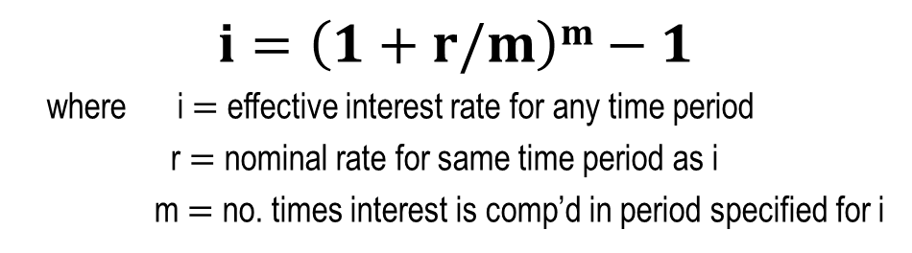
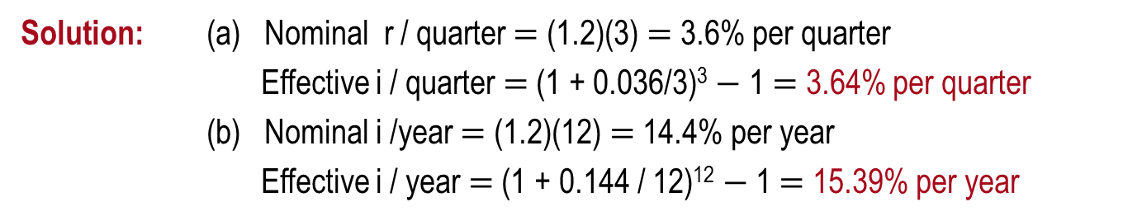
Effective Annual Interest Rates (2)
Nominal rates can be converted into effective rates for any time period via the following equation:
$$i=\left(1+r/m\right)m−1$$
where i $=$ effective interest rate for any time period
r $=$ nominal rate for same time period as i
m $=$ no. times interest is comp’d in period specified for i
Spreadsheet function is $=$ EFFECT(r%,m) where r $=$ nominal rate per period specified for i
Example: For an interest rate of 1.2% per month, determine the nominal and effective rates (a) per quarter, and (b) per year
Solution: (a) Nominal r / quarter $=$ (1.2)(3) $=$ 3.6% per quarter
Effective i / quarter $=$ (1 + 0.036/3)³ $−$ 1 $=$ 3.64% per quarter
(b) Nominal i /year $=$ (1.2)(12) $=$ 14.4% per year
Effective i / year $=$ (1 + 0.144 / 12)¹² $−$ 1 $=$ 15.39% per year

Slide 9
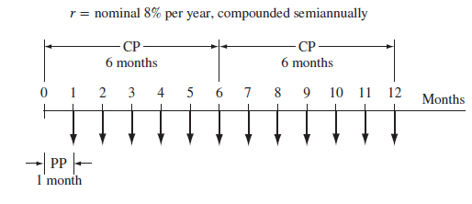



Equivalence Relations: PP and CP
New definition: Payment Period (PP) – Length of time between cash flows
In the diagram below, the compounding period (CP) is semiannual and the payment period (PP) is monthly
Similarly, for the diagram below, the CP is quarterly and the payment period (PP) is semiannual
i $=$ 10% per year, compounded quarterly
F $=$ ?
0 1 2 3 4 5
Years
0 1 2 3 4 5 6 7 8
Semi-annual periods
A $=$ $8000
Semi-annual PP

Slide 10
Single Amounts with PP > CP
For problems involving single amounts, the payment period (PP) is usually longer than the compounding period (CP). For these problems, there are an infinite number of i and n combinations that can be used, with only two restrictions:
(1) The i must be an effective interest rate, and
(2) The time units on n must be the same as those of I
(i.e., if i is a rate per quarter, then n is the number of quarters between P and F)
There are two equally correct ways to determine i and n
Method 1: Determine effective interest rate over the compounding period CP, and set n equal to the number of compounding periods between P and F
Method 2: Determine the effective interest rate for any time period t, and set n equal to the total number of those same time periods.

Slide 11
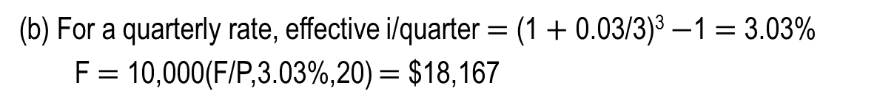
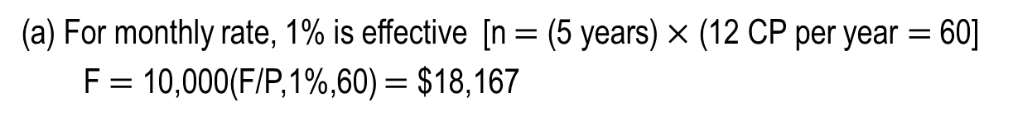
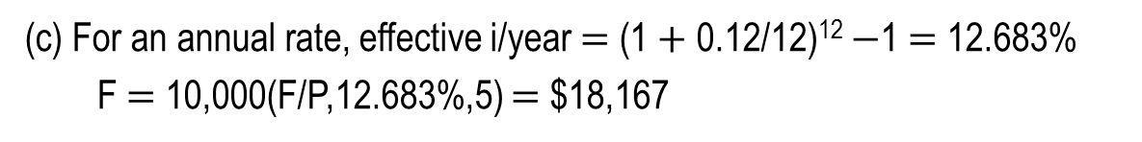
Example: Single Amounts with PP ≥ CP
How much money will be in an account in 5 years if $10,000 is deposited now at an interest rate of 1% per month? Use three different interest rates: (a) monthly, (b) quarterly , and (c) yearly.
(a) For monthly rate, 1% is effective [n $=$ (5 years)$×$ (12 CP per year $=$ 60]
F $=$ 10,000(F/P,1%,60) $=$ $18,167
months
i and n must always have same time units
effective i per month
(b) For a quarterly rate, effective i/quarter $=$ (1 $+$ 0.03/3)³ $−$1 $=$ 3.03%
F $=$ 10,000(F/P,3.03%,20) $=$ $18,167
quarters
i and n must always have same time units
effective i per quarter
(c) For an annual rate, effective i/year $=$ (1 $+$ 0.12/12)¹² $−$1 $=$ 12.683%
F $=$ 10,000(F/P,12.683%,5) $=$ $18,167
years
i and n must always have same time units
effective i per year

Slide 12
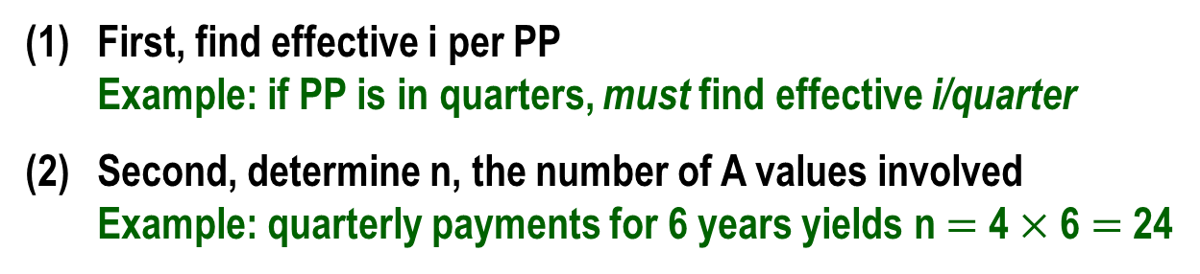

Series with PP ≥ CP
For series cash flows, first step is to determine relationship between PP and CP
When PP $≥$ CP, the only procedure (2 steps) that can be used is as follows:
First, find effective i per PP
Example: if PP is in quarters, must find effective i/quarter
Second, determine n, the number of A values involved
Example: quarterly payments for 6 years yields n $=$ 4 $×$ 6 $=$ 24
Note: Procedure when PP $<$ CP is discussed later

Slide 13
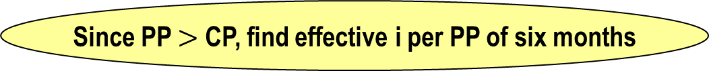
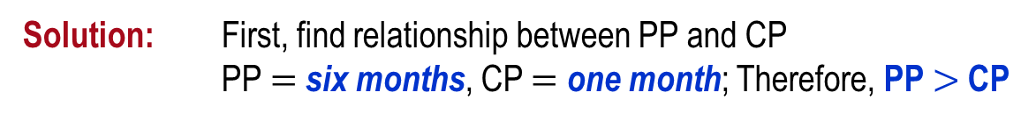


Example: Series with PP ≥ CP
How much money will be accumulated in 10 years from a deposit of $500 every 6 months if the interest rate is 1% per month?
Solution: First, find relationship between PP and CP
PP $=$ six months, CP $=$ one month; Therefore, PP $>$ CP
Since PP $>$ CP, find effective i per PP of six months
Step 1. i /6 months $=$ (1 $+$ 0.06/6)⁶ $−$ 1 $=$ 6.15%
Next, determine n (number of 6-month periods)
Step 2: n $=$ 10(2) $=$ 20 six month periods
Finally, set up equation and solve for F
F $=$ 500(F/A,6.15%,20) $=$ $18,692 (by factor or spreadsheet)

Slide 14
Series with PP < CP
Two policies: (1) interperiod cash flows earn no interest (most common)
(2) interperiod cash flows earn compound interest
For policy (1), positive cash flows are moved to beginning
of the interest period in which they occur
and negative cash flows are moved to the end of the interest period
Note: The condition of PP < CP with no interperiod interest is the only situation
in which the actual cash flow diagram is changed
For policy (2), cash flows are not moved and equivalent P, F, and A values are
determined using the effective interest rate per payment period

Slide 15

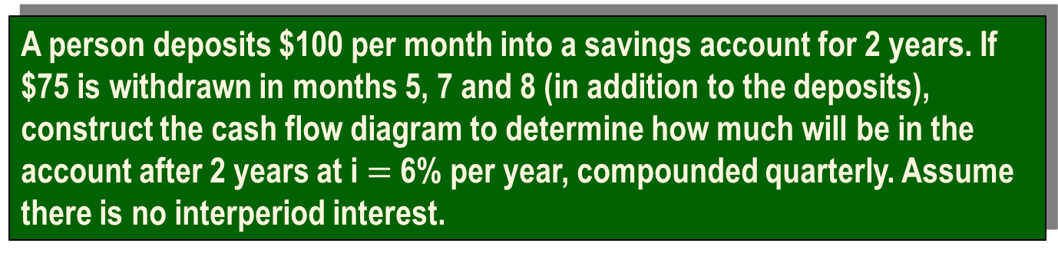


Example: Series with PP < CP
A person deposits $100 per month into a savings account for 2 years. If $75 is withdrawn in months 5, 7 and 8 (in addition to the deposits), construct the cash flow diagram to determine how much will be in the account after 2 years at i $=$ 6% per year, compounded quarterly. Assume there is no interperiod interest.
Solution: Since PP $<$ CP with no interperiod interest, the cash flow diagram must be changed using quarters as the time periods
F $=$ ?
75
75
75
F $=$ ?
75
150
from
to
0 1 2 3 4 5 6 7 8 9 10
21 24
Months
0 1 2 3 4 5 6 7 8 9 10
23 24
this
1 2 3 7 8
Quarters
this
100
300
300
300
300
300

Slide 16



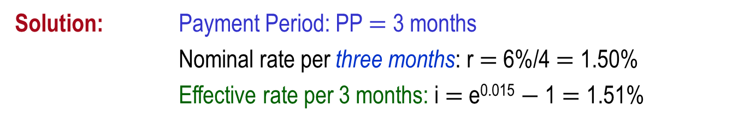
Continuous Compounding
When the interest period is infinitely small, interest is
compounded continuously. Therefore, PP $>$ CP and m increases.
Take limit as m → $∞$ to find the effective interest rate equation
$$i=er−1$$
Example: If a person deposits $500 into an account every 3 months at an interest rate of 6% per year, compounded continuously, how much will be in the account at the end of 5 years?
Solution: Payment Period: PP $=$ 3 months
Nominal rate per three months: r $=$ 6%/4 $=$ 1.50%
Effective rate per 3 months: i $=$ e^{0.015} $−$ 1 $=$ 1.51%
$$F = 500(F/A,1.51\%,20) = \$11,573$$

Slide 17
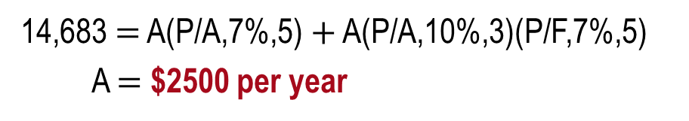

Varying Rates
When interest rates vary over time, use the interest rates associated with their respective time periods to find P
Example: Find the present worth of $2500 deposits in years 1 through 8 if the interest rate is 7% per year for the first five years and 10% per year thereafter.
Solution: P $=$ 2,500(P/A,7%,5) $+$ 2,500(P/A,10%,3)(P/F,7%,5)
$=$ $14,683
An equivalent annual worth value can be obtained by replacing each cash flow amount with ‘A’ and setting the equation equal to the calculated P value
14,683 $=$ A(P/A,7%,5) $+$ A(P/A,10%,3)(P/F,7%,5)
A $=$ $2500 per year

Slide 18
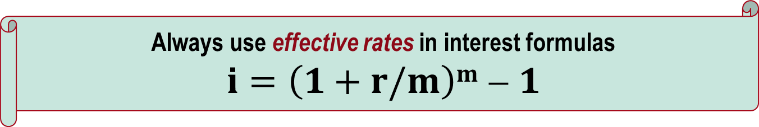
Summary of Important Points (1)
Must understand: interest period, compounding period, compounding frequency, and payment period
Always use effective rates in interest formulas
$$i=\left(1+r/m\right)m−1$$
Interest rates are stated different ways; must know how to get effective rates
For single amounts, make sure units on i and n are the same

Slide 19

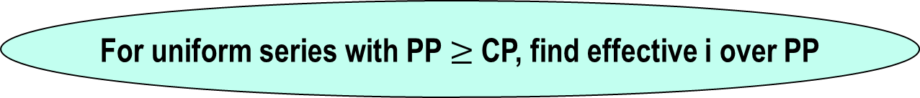
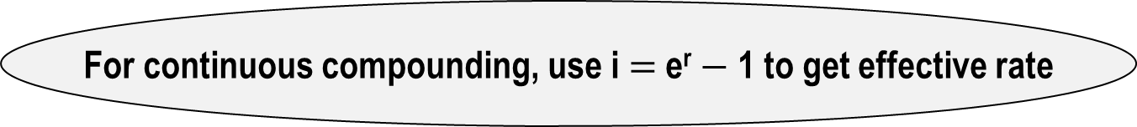
Summary of Important Points (2)
For uniform series with PP $≥$ CP, find effective i over PP
For uniform series with PP $<$ CP and no interperiod interest, move cash flows to match compounding period
For continuous compounding, use i $=$ e^{r} $−$ 1 to get effective rate
For varying rates, use stated i values for respective time periods

