Slide 1
Lecture slides to accompany
Engineering Economy, 8th edition
Leland Blank, Anthony Tarquin
©McGraw-Hill Education. All rights reserved. Authorized only for instructor use in the classroom. No reproduction or further distribution permitted without the prior written consent of McGraw-Hill Education.

Slide 2
Chapter 3
Combining Factors and Spreadsheet Functions

Slide 3
LEARNING OUTCOMES
Shifted uniform series
Shifted series and single cash flows
Shifted gradients

Slide 4



Shifted Uniform Series
A shifted uniform series starts at a time other than period 1
The cash flow diagram below is an example of a shifted series
Series starts in period 2, not period 1
A $=$ Given
F_{A} $=$ ?
Shifted series usually
require the use of
multiple factors
0
1
2
3
4
5
P_{A} $=$ ?
Remember: When using P/A or A/P factor, P_{A} is always one year ahead
of first A
When using F/A or A/F factor, F_{A} is in same year as last A

Slide 5

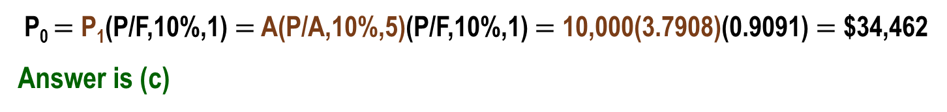
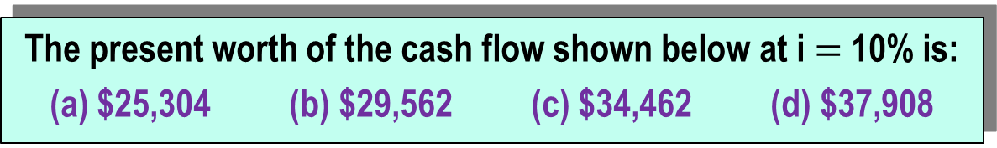
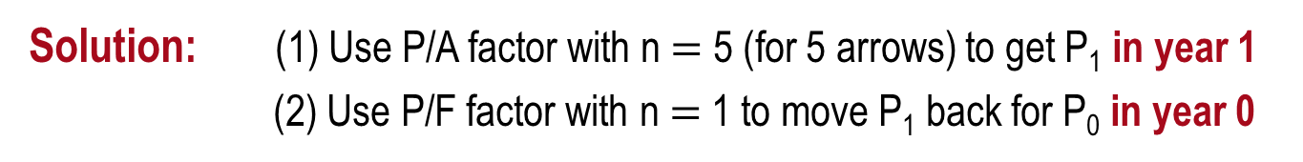


Example Using P/A Factor: Shifted Uniform Series
The present worth of the cash flow shown below at i $=$ 10% is:
(a) $25,304 (b) $29,562 (c) $34,462 (d) $37,908
P₀ $=$ ?
P₁ $=$ ?
i $=$ 10%
Actual year
0 1 2 3 4 5 6
0 1 2 3 4 5
Series year
A = $10,000
Solution: (1) Use P/A factor with n $=$ 5 (for 5 arrows) to get P₁ in year 1
(2) Use P/F factor with n $=$ 1 to move P₁ back for P₀ in year 0
P₀ $=$ P₁(P/F,10%,1) $=$ A(P/A,10%,5)(P/F,10%,1) $=$ 10,000(3.7908)(0.9091) $=$ $34,462
Answer is (c)

Slide 6


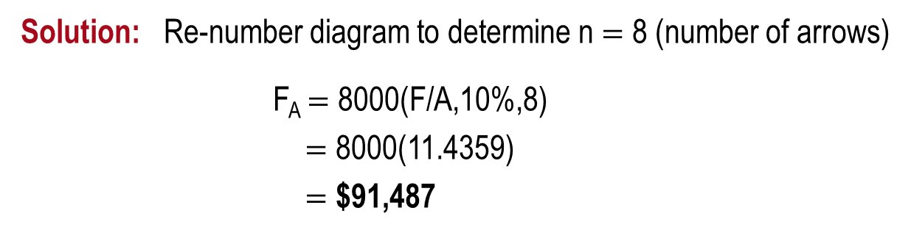

Example Using F/A Factor: Shifted Uniform Series
How much money would be available in year 10 if $8000 is deposited each year in years 3 through 10 at an interest rate of 10% per year?
Cash flow diagram is:
F_{A} $=$ ?
i $=$ 10%
Actual year
0 1 2 3 4 5 6 7 8 9 10
0 1 2 3 4 5 6 7 8
Series year
A $=$ $8000
Solution: Re-number diagram to determine n $=$ 8 (number of arrows)
F_{A} $=$ 8000(F/A,10%,8)
$=$ 8000(11.4359)
$=$ $91,487

Slide 7
Shifted Series and Random Single Amounts
For cash flows that include uniform series and randomly placed single amounts:
Uniform series procedures are applied to the series amounts
Single amount formulas are applied to the one-time cash flows
The resulting values are then combined per the problem statement
The following slides illustrate the procedure

Slide 8

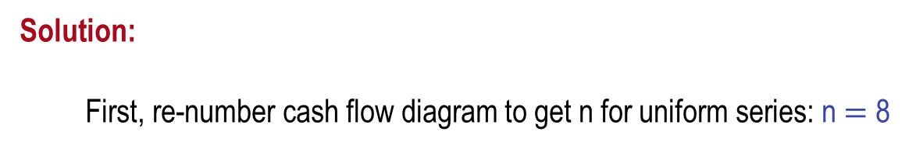




Example: Series and Random Single Amounts (1)
Find the present worth in year 0 for the cash flows
shown using an interest rate of 10% per year.
P_{T} $=$ ?
i $=$ 10%
0 1 2 3 4 5 6 7 8 9 10
A $=$ $5000
$2000
P_{T} $=$ ?
i $=$ 10%
Actual year
0 1 2 3 4 5 6 7 8 9 10
0 1 2 3 4 5 6 7 8
Series year
A $=$ $5000
Solution:
First, re-number cash flow diagram to get n for uniform series: n $=$ 8

Slide 9


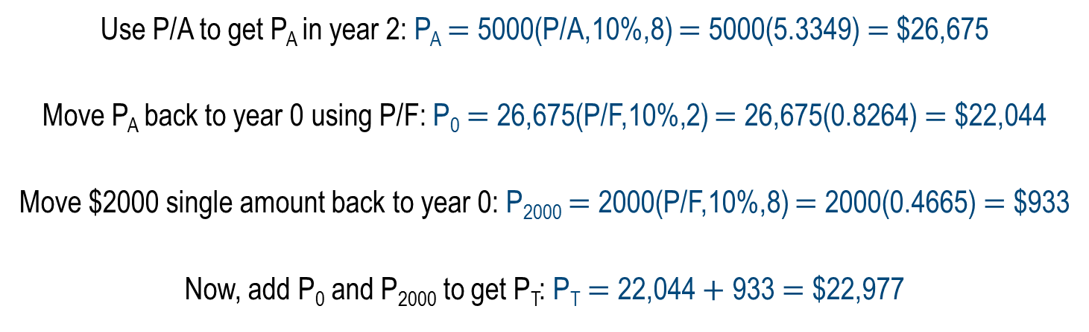

Example: Series and Random Single Amounts (2)
P_{A}
P_{T} $=$ ?
i $=$ 10%
0 1 2 3 4 5 6 7 8 9 10
Actual year
0 1 2 3 4 5 6 7 8
Series year
A $=$ $5000
$2000
Use P/A to get P_{A} in year 2: P_{A} $=$ 5000(P/A,10%,8) $=$ 5000(5.3349) $=$$26,675
Move P_{A} back to year 0 using P/F: P₀ $=$ 26,675(P/F,10%,2) $=$ 26,675(0.8264) $=$ $22,044
Move $2000 single amount back to year 0: P₂₀₀₀ $=$ 2000(P/F,10%,8) $=$ 2000(0.4665) $=$ $933
Now, add P₀ and P₂₀₀₀ to get P_{T}: P_{T} $=$ 22,044 $+$ 933 $=$ $22,977

Slide 10


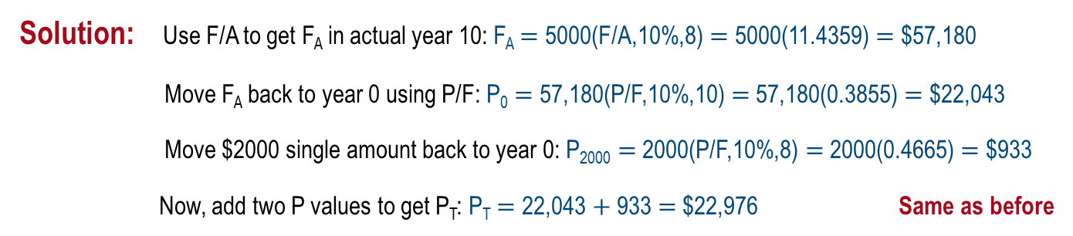

Example Worked a Different Way
(Using F/A instead of P/A for uniform series)
The same re-numbered diagram from the previous slide is used
P_{T} $=$ ?
F_{A} $=$ ?
i $=$ 10%
0 1 2 3 4 5 6 7 8 9 10
0 1 2 3 4 5 6 7 8
A $=$ $5000
$2000
Solution: Use F/A to get F_{A} in actual year 10: F_{A} $=$ 5000(F/A,10%,8) $=$ 5000(11.4359) $=$ $57,180
Move F_{A} back to year 0 using P/F: P₀ $=$ 57,180(P/F,10%,10) $=$ 57,180(0.3855) $=$ $22,043
Move $2000 single amount back to year 0: P₂₀₀₀ $=$ 2000(P/F,10%,8) $=$ 2000(0.4665) $=$ $933
Now, add two P values to get P_{T}: P_{T} $=$ 22,043 $+$ 933 $=$ $22,976 Same as before
As shown, there are usually multiple ways to work equivalency problems

Slide 11

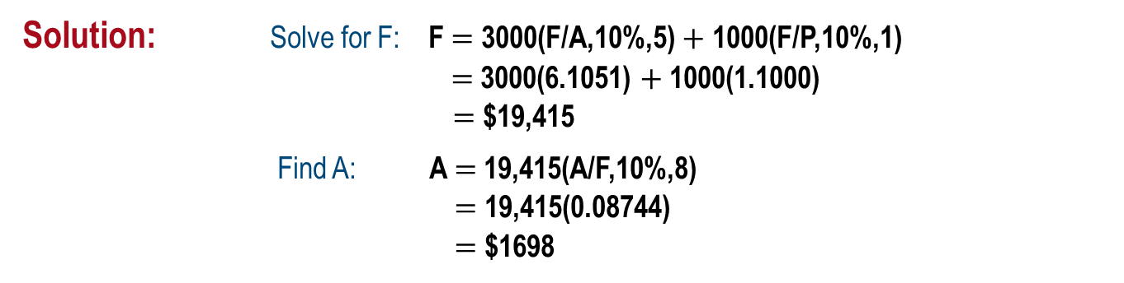
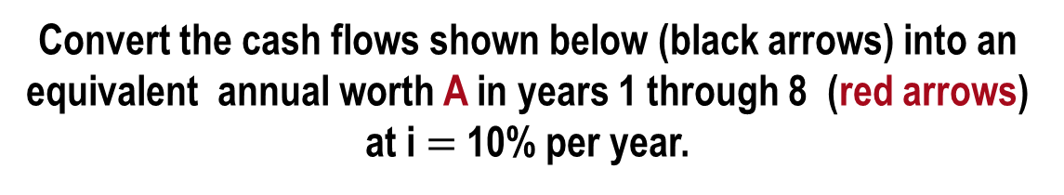
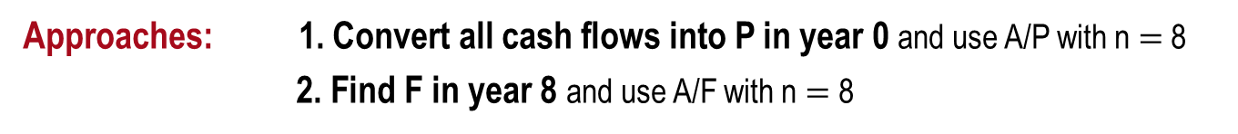


Example: Series and Random Amounts
Convert the cash flows shown below (black arrows) into an equivalent annual worth A in years 1 through 8 (red arrows) at i $=$ 10% per year.
A $=$ ?
i $=$ 10%
0 1 2 3 4 5 6 7 8
0 1 2 3 4 5
A $=$ $3000
$1000
Approaches: 1. Convert all cash flows into P in year 0 and use A/P with n $=$ 8
2. Find F in year 8 and use A/F with n $=$ 8
Solution: Solve for F: F $=$ 3000(F/A,10%,5) $+$ 1000(F/P,10%,1)
$=$ 3000(6.1051) $+$ 1000(1.1000)
$=$ $19,415
Find A: A $=$ 19,415(A/F,10%,8)
$=$ 19,415(0.08744)
$=$ $1698

Slide 12
Shifted Arithmetic Gradients
Shifted gradient begins at a time other than between periods 1 and 2
Present worth P_{G} is located 2 periods before gradient starts
Must use multiple factors to find P_{T} in actual year 0
To find equivalent A series, find P_{T} at actual time 0 and apply (A/P,i,n)

Slide 13







Example: Shifted Arithmetic Gradient
John Deere expects the cost of a tractor part to increase by $5 per year beginning 4 years from now. If the cost in years 1-3 is $60, determine the present worth in year 0
of the cost through year 10 at an interest rate of 12% per year.
P_{T} $=$ ?
i $=$ 12%
Actual years
0
1
2
3
4
5
10
0 1 2 3 8
Gradient years
60
60
60
65
70
G $=$ 5
95
Solution: First find P₂ for G $=$ $5 and base amount ($60) in actual year 2
P₂ $=$ 60(P/A,12%,8) $+$ 5(P/G,12%,8) $=$ $370.41
Next, move P₂ back to year 0
P₀ $=$ P₂(P/F,12%,2) $=$ $295.29
Next, find P_{A} for the $60 amounts of years 1 and 2
P_{A} $=$ 60(P/A,12%,2) $=$ $101.41
Finally, add P₀ and P_{A} to get P_{T} in year 0
P_{T} $=$ P₀ + P_{A} $=$ $396.70

Slide 14

Shifted Geometric Gradients
Shifted gradient begins at a time other than between periods 1 and 2
Equation yields P_{g} for all cash flows (base amount A₁ is included)
Equation (i ≠ g):
$$Pg=A 1\{1−[(1+g)/(1+i)]n/(i−g)\}$$
For negative gradient, change signs on both g values
There are no tables for geometric gradient factors

Slide 15
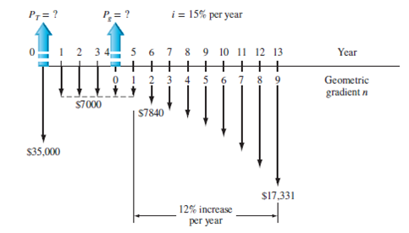
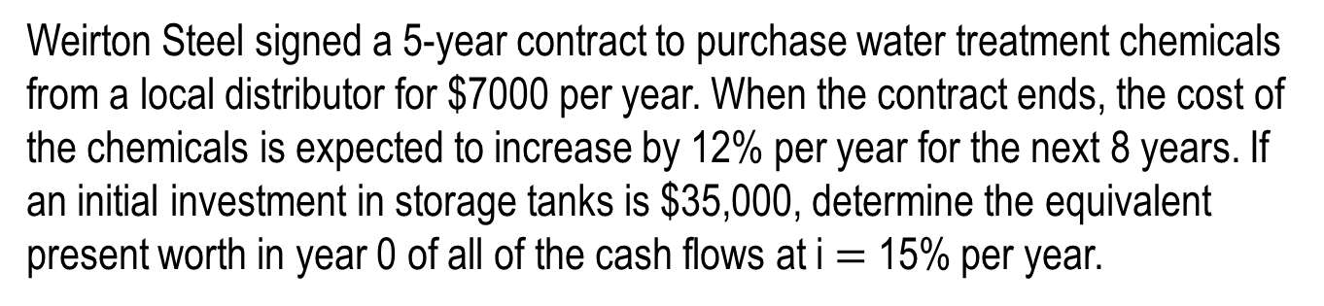
Example: Shifted Geometric Gradient (1)
Weirton Steel signed a 5-year contract to purchase water treatment chemicals from a local distributor for $7000 per year. When the contract ends, the cost of the chemicals is expected to increase by 12% per year for the next 8 years. If an initial investment in storage tanks is $35,000, determine the equivalent present worth in year 0 of all of the cash flows at i $=$ 15% per year.

Slide 16

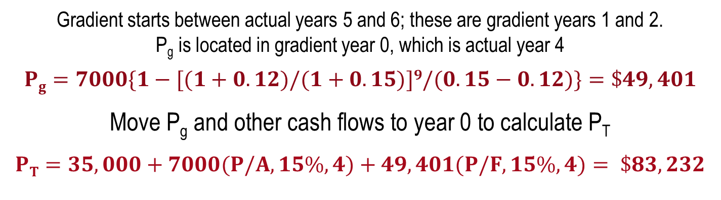
Example: Shifted Geometric Gradient (2)
Gradient starts between actual years 5 and 6; these are gradient years 1 and 2.
P_{g} is located in gradient year 0, which is actual year 4
$$Pg=7000\{1−[(1+0.12)/(1+0.15)]9/(0.15−0.12)\}=\$49,401$$
Move P_{g} and other cash flows to year 0 to calculate P_{T}
$PT=35,000+7000(P/A,15\%,4)+49,401(P/F,15\%,4)= \$83,232$

Slide 17



Negative Shifted Gradients
For negative arithmetic gradients, change sign on G term from $+$ to $−$
General equation for determining P: P $=$ present worth of base amount $−$ P_{G}
Changed from $+$ to $−$
For negative geometric gradients, change signs on both g values
Changed from $+$ to $−$
$$Pg=A1\{1−[(1−g)/(1+i)]n/(i+g)\}$$
Changed from $−$ to $+$
All other procedures are the same as for positive gradients

Slide 18

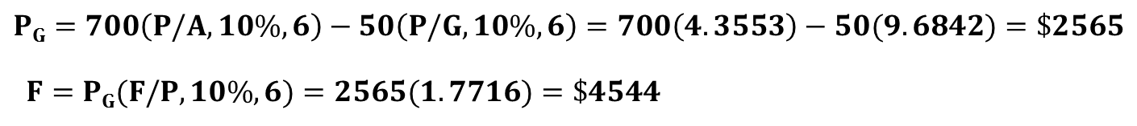



Example: Negative Shifted Arithmetic Gradient
For the cash flows shown, find the future worth in year 7 at i $=$ 10% per year
F $=$ ?
P_{G} $=$ ?
i $=$ 10%
Actual years
0 1 2 3 4 5 6 7
0 1 2 3 4 5 6
Gradient years
500
450
600
550
700
650
G $=$ $$−$50
Solution: Gradient G first occurs between actual years 2 and 3; these are gradient years 1 and 2
P_{G} is located in gradient year 0 (actual year 1); base amount of $700 is in gradient years 1-6
$$PG=700\left(P/A,10\%,6\right)−50\left(P/G,10\%,6\right)=700\left(4.3553\right)−50(9.6842)=\$2565$$
$F=PG(F/P,10\%,6)=2565(1.7716)=\$4544$

Slide 19
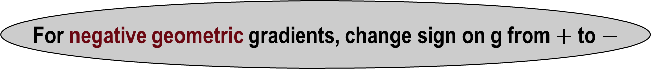
Summary of Important Points
P for shifted uniform series is one period ahead of first A;
n is equal to number of A values
F for shifted uniform series is in same period as last A;
n is equal to number of A values
For gradients, first change equal to G or g occurs
between gradient years 1 and 2
For negative arithmetic gradients, change sign on G from $+$ to $−$
For negative geometric gradients, change sign on g from $+$ to $−$

