Slide 1
Lecture slides to accompany
Engineering Economy, 8th edition
Leland Blank, Anthony Tarquin
©McGraw-Hill Education. All rights reserved. Authorized only for instructor use in the classroom. No reproduction or further distribution permitted without the prior written consent of McGraw-Hill Education.
Notes:
At this point:
1. Introduce yourself - your students are likely to want to know something about your qualifications and interests - overall, where you are coming from.
2. Have students introduce themselves. Ask why they are taking this class. If you are fortunate enough to have a Polaroid camera, take pictures of each student for later posting on a class “board” so both they and you get to know each other.
3. Discuss both choice of textbook and development of syllabus.
4. If you are expecting students to work in teams, at east introduce the choice of team members. If at all possible, have students participate in a team building or team study exercise. It works wonders. Most student have been told to work in teams in prior classes, but have never examined exactly what a team is and how it works. One hour spent in a team building/examination exercise saves many hours and avoids many problems later on.

Slide 2
Chapter 19
Decision Making Under Risk

Slide 3
LEARNING OUTCOMES
Understand decision making under risk
Construct probability distributions and cumulative distributions
Take random sample from a distribution
Estimate expected value and standard deviation from random sample
Use Monte Carlo sampling for simulation analysis to evaluate alternatives

Slide 4
Decision Making Classification
classifications of decision making: certainty, risk, uncertainty
Certainty
No variation in estimates
also called deterministic; no variation expected in a parameter
all estimates are single-valued
Risk
Two or more values for variables with estimated chances for each
Typical
situation
can use expected value analysis
can use simulation analysis
Uncertainty
Two or more values for a variable, but chances of occurrence are not known or not estimated
states of nature identified
approaches are relatively inconclusive

Slide 5
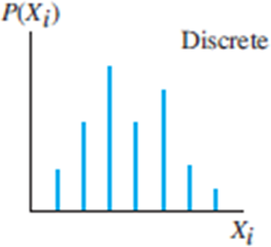
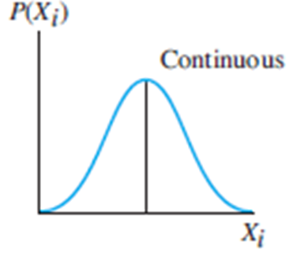

Decision Making Under Risk (1)
Important elements
Random variable Parameter that can take any one of several values
discrete – has several specific, isolated values
continuous – can assume any value between two limits
Probability Chance (divided by 100) that variable will take on a specific value; range is $0≤P(X)≤1.0$

Slide 6
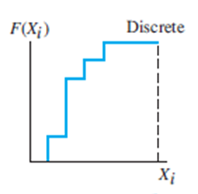
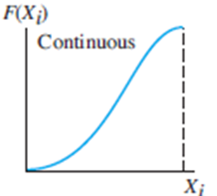
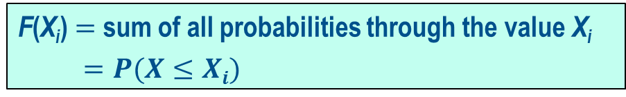

Decision Making Under Risk (2)
More important elements
Probability distribution Describes probability versus values of a variable
P(X_{i}) $=$ probability that X equals X_{i}
Cumulative distribution Accumulation of probability over all values of
variable up to and including a specific value
F(X_{i}) $=$ sum of all probabilities through the value X_{i}
$=P(X≤Xi)$
cumulative
discrete
cumulative
continuous

Slide 7
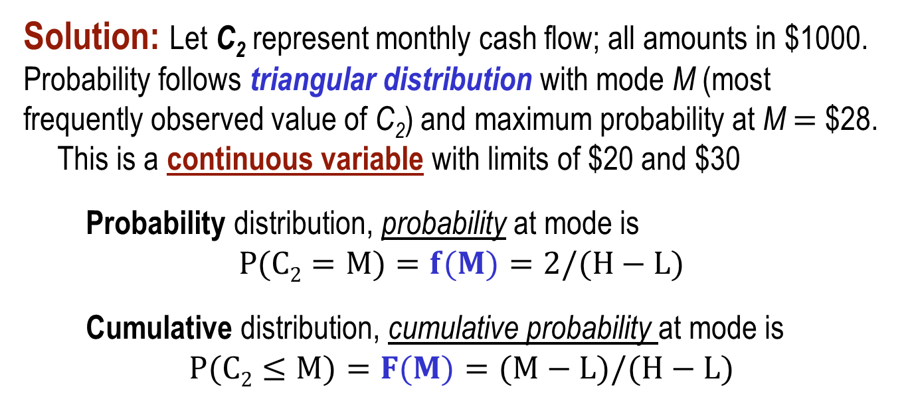
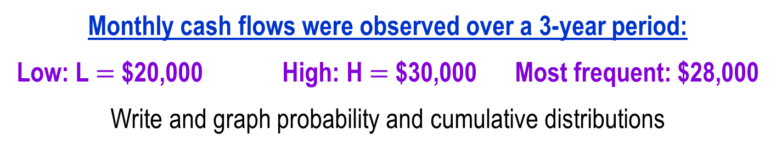
Example: Continuous Distribution (1)
Monthly cash flows were observed over a 3-year period:
Low: L $=$ $20,000 High: H $=$ $30,000 Most frequent: $28,000
Write and graph probability and cumulative distributions
Solution: Let C₂ represent monthly cash flow; all amounts in $1000.
Probability follows triangular distribution with mode M (most
frequently observed value of C₂) and maximum probability at M $=$ $28. This is a continuous variable with limits of $20 and $30
Probability distribution, probability at mode is
$$P(C2=M)=f(M)=2/(H−L)$$
Cumulative distribution, cumulative probability at mode is
$$P(C2≤M)=F(M)=(M−L)/(H−L)$$

Slide 8
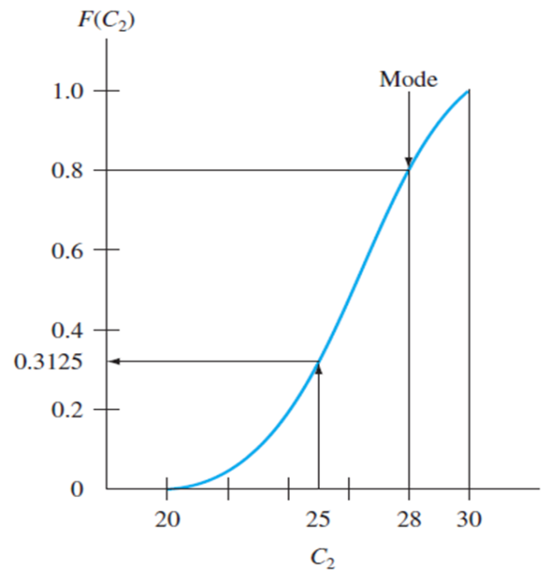
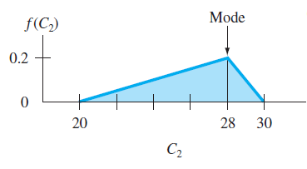
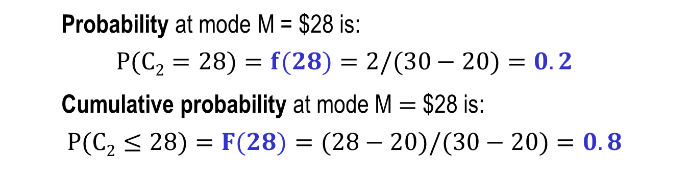
Example: Continuous Distribution (2)
Probability at mode M = $28 is:
$$P(C2=28)=f(28)=2/(30−20)=0.2$$
Cumulative probability at mode M $=$ $28 is:
$$P(C2≤28)=F(28)=(28−20)/(30−20)=0.8$$
The f(C₂) distribution and F(C₂) distribution are:

Slide 9
Random Sample
Definition: Selection in a random fashion of n values for a variable from a population with assumed or known probability distribution
Variable values assumed to have same chance of occurring in sample and population
Random numbers (RN) from either discrete or continuous distribution
Procedure to develop random sample (discrete or continuous):
Develop cumulative distribution F(X) from probability distribution
Assign RN values to F(X) scale in same proportion as probabilities
Determine scheme for selecting values from RN table for n values
Select the first number from RN table, enter F(X) scale, and record corresponding variable value. Repeat for n values.
Use n sample values for analysis and decision making under risk

Slide 10
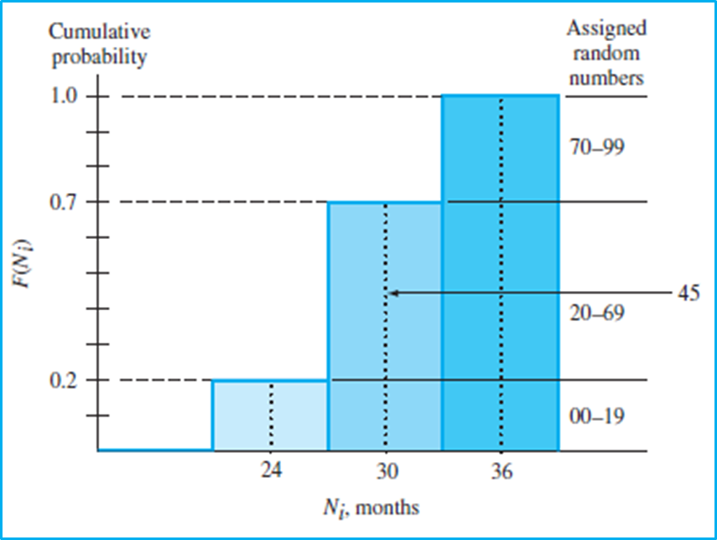
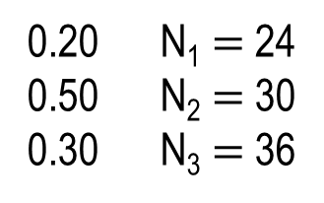
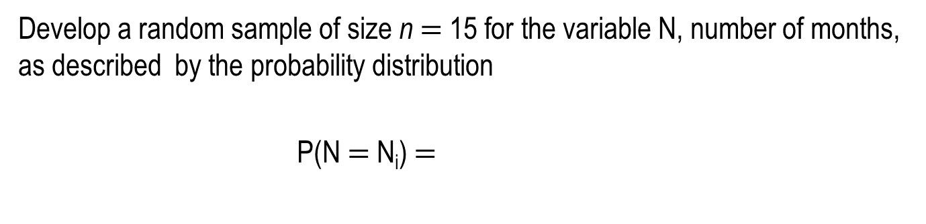
Example: Random Sample, Discrete Variable
Develop a random sample of size n $=$ 15 for the variable N, number of months, as described by the probability distribution
P(N $=$ N_{i}) $=$
0.20 N₁ $=$ 24
0.50 N₂ $=$30
0.30 N₃ $=$36
Solution:
This figure
shows the cumulative
probability distribution F(N_{i}) with 20 numbers assigned to N₁ (i.e., 00-19), 20-69 to N₂, and 70-99 to N₃
(see next slide)

Slide 11
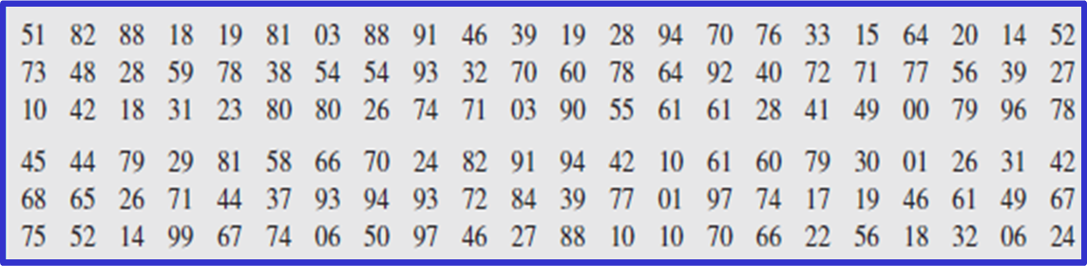
Example: Random Sample (1)
Select 15 two-digit numbers from RN table starting in
column 1, row 3 and moving to the right
Random digits clustered into two-digit numbers
RN: 10 42 18 31 23 80 80 26 74 71 03 90 55 61 61
N: 24 30 24 30 30 36 36 30 36 36 24 36 30 30 30
(see next slide)

Slide 12
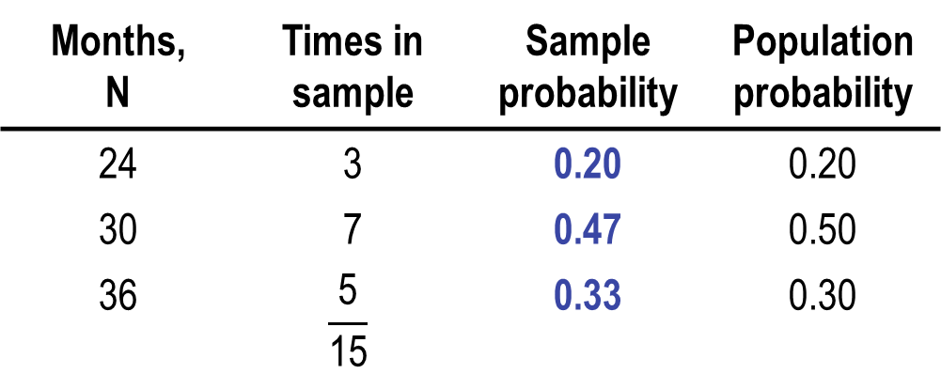
Example: Random Sample (2)
Use the 15 values to develop sample probabilities
Months, N | Times in sample | Sample probability | Population probability
24 | 3 | 0.20 | 0.20
30 | 7 | 0.47 | 0.50
36 | $$\frac{\text{5}}{\text{15}}$$ | 0.33 | 0.30
Good agreement between sample probabilities and actual probabilities

Slide 13
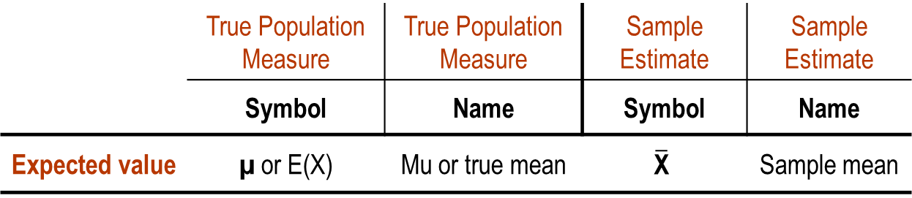
Expected Value
The expected value E(X) is the long-run expected average
if the variable is sampled many, many times
Expected Value Measure and Estimate
 | True Population Measure | True Population Measure | Sample Estimate | Sample Estimate
 | Symbol | Name | Symbol | Name
Expected value | µ or E(X) | Mu or true mean | $$\overline{\text{X}}$$ | Sample mean

Slide 14

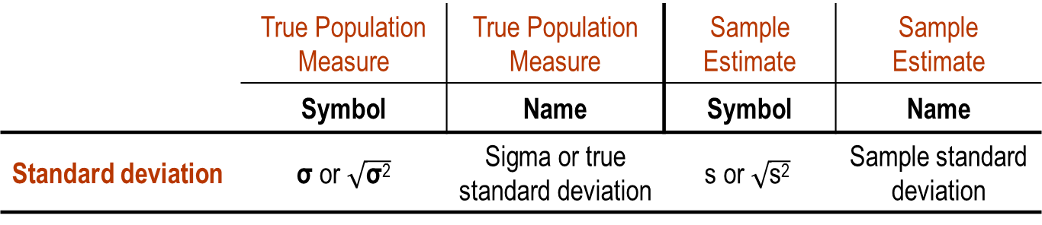
Standard Deviation
The standard deviation s or s(X) is t dispersion of values about
the expected value E(X) or the sample average $\overline{\text{X}}$
Standard Deviation Measure and Estimate
 | True Population Measure | True Population Measure | Sample Estimate | Sample Estimate
 | Symbol | Name | Symbol | Name
Standard deviation | σ or $\sqrt{\text{σ}\text{2}}$ | Sigma or true standard deviation | $$\text{s} \text{or} \sqrt{\text{s}\text{2}}$$ | Sample standard deviation

Slide 15
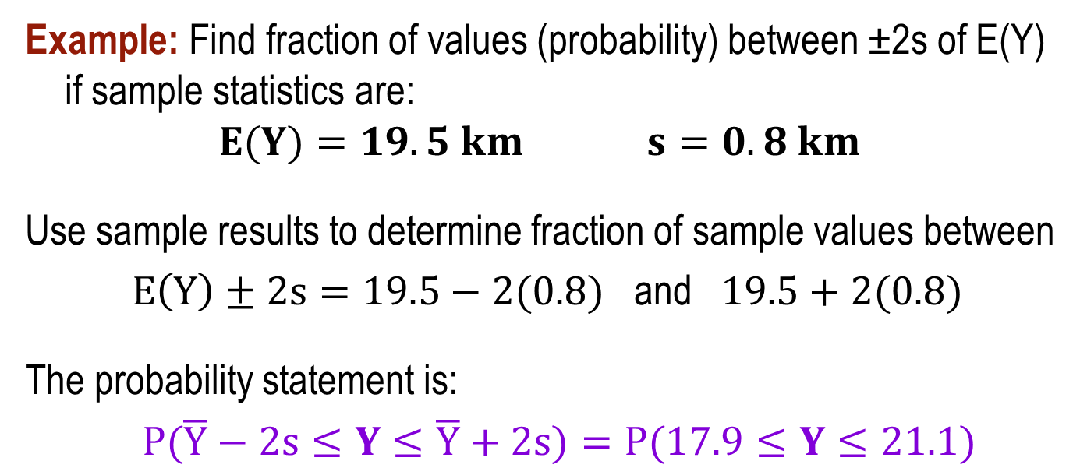
Fraction of Sample Values Between Two Limits
Combine expected value and standard deviation to estimate
probability that a variable is between two limits (or is less than
or more than a specified value)
Example: Find fraction of values (probability) between ±2s of E(Y) if sample statistics are:
$E(Y)=19.5 km$ $s=0.8 km$
Use sample results to determine fraction of sample values between
$E\left(Y\right)±2s=19.5−2(0.8)$ and $19.5+2(0.8)$
The probability statement is:
$P(\overline{Y}−2s≤Y≤\overline{Y}+2s)=P(17.9≤Y≤21.1)$

Slide 16
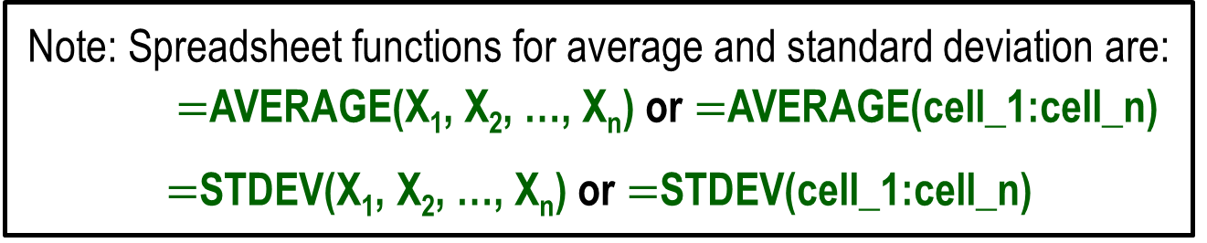
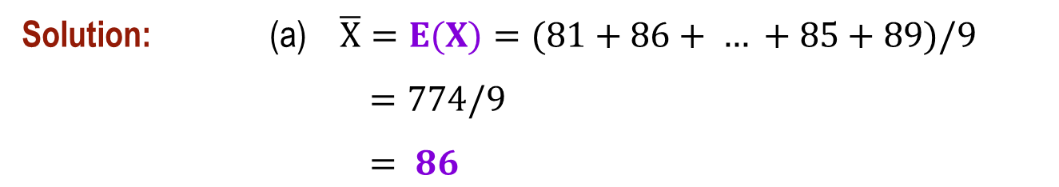
Example: Mean and Standard Deviation (1)
For the following nine air temperature readings, determine (a) the sample mean, (b) the standard deviation, and (c) the percent of values within ±1 standard deviation of the mean: 81, 86, 80, 91, 83, 83, 96, 85, 89
Solution: (a) $\overline{X}=E(X)=(81+86+ … +85+89)/9$
$=774/9$
$= 86$
(see next slide)
Note: Spreadsheet functions for average and standard deviation are: $=$AVERAGE(X₁, X₂, …, X_{n}) or $=$AVERAGE(cell_1:cell_n)
$=$STDEV(X₁, X₂, …, X_{n}) or $=$STDEV(cell_1:cell_n)

Slide 17
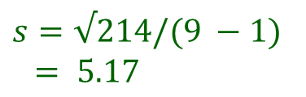
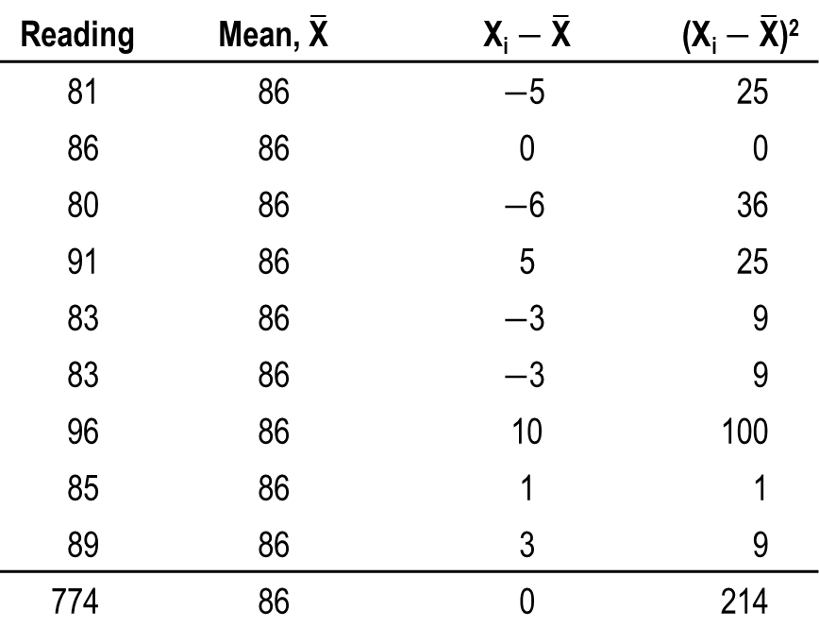
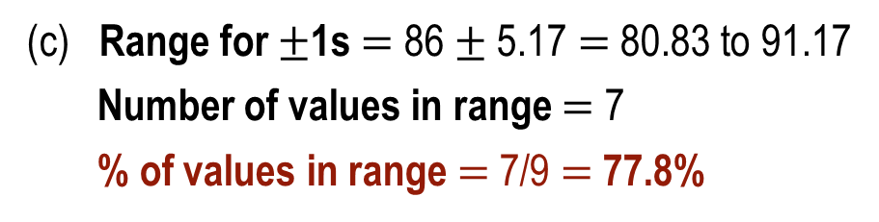
Example: Mean and Standard Deviation (2)
(b)
Reading | Mean, $\overline{\text{X}}$ | X_{i} $−$ $\overline{\text{X}}$ | (X_{i} $−$ $\overline{\text{X}}$)²
81 | 86 | $−$5 | 25
86 | 86 | 0 | 0
80 | 86 | $−$6 | 36
91 | 86 | 5 | 25
83 | 86 | $−$3 | 9
83 | 86 | $−$3 | 9
96 | 86 | 10 | 100
85 | 86 | 1 | 1
89 | 86 | 3 | 9
774 | 86 | 0 | 214
$$s=√214/(9 −1)$$
$$= 5.17$$
(c) Range for $±$1s $=$ 86 $±$ 5.17 $=$ 80.83 to 91.17
Number of values in range $=$ 7
% of values in range $=$ 7/9 $=$77.8%

Slide 18
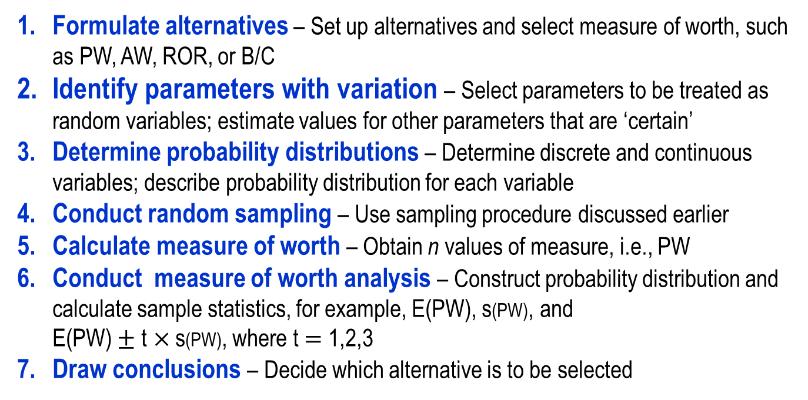
Simulation Analysis
Simulation analysis uses random samples from the probability distribution of selected variables for alternative evaluation using a measure of worth
Monte Carlo sampling is a commonly used simulation approach. The basic steps are:
Formulate alternatives – Set up alternatives and select measure of worth, such as PW, AW, ROR, or B/C
Identify parameters with variation – Select parameters to be treated as random variables; estimate values for other parameters that are ‘certain’
Determine probability distributions – Determine discrete and continuous variables; describe probability distribution for each variable
Conduct random sampling – Use sampling procedure discussed earlier
Calculate measure of worth – Obtain n values of measure, i.e., PW
Conduct measure of worth analysis – Construct probability distribution and calculate sample statistics, for example, E(PW), s(PW), and
E(PW) $±$ t$×$s(PW), where t $=$ 1,2,3
Draw conclusions – Decide which alternative is to be selected

Slide 19
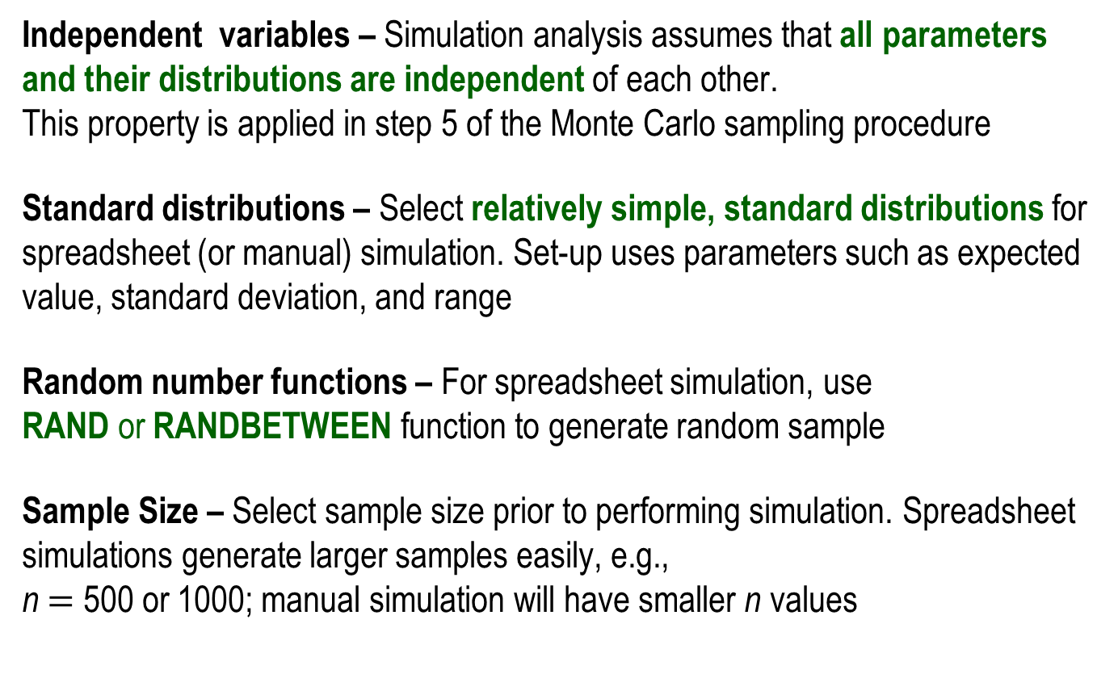
Simulation Analysis and Monte Carlo Sampling
Independent variables – Simulation analysis assumes that all parameters and their distributions are independent of each other.
This property is applied in step 5 of the Monte Carlo sampling procedure
Standard distributions – Select relatively simple, standard distributions for spreadsheet (or manual) simulation. Set-up uses parameters such as expected value, standard deviation, and range
Random number functions – For spreadsheet simulation, use
RAND or RANDBETWEEN function to generate random sample
Sample Size – Select sample size prior to performing simulation. Spreadsheet simulations generate larger samples easily, e.g.,
n $=$ 500 or 1000; manual simulation will have smaller n values

Slide 20
Summary of Important Points
Three classifications of decision making: certainty, under risk, and uncertainty. Virtually all decisions involve risk
Decision making under risk uses random variables (discrete or continuous) and their probability distribution
Random sampling involves cumulative probability distributions and the use of a random number table or spreadsheet function
Expected value E(X) and standard deviations are used routinely in making computations about risk and probability
Simulation analysis using Monte Carlo sampling is a powerful technique to account for risk in economic analyses

