Slide 1
Lecture slides to accompany
Engineering Economy, 8th edition
Leland Blank, Anthony Tarquin
©McGraw-Hill Education. All rights reserved. Authorized only for instructor use in the classroom. No reproduction or further distribution permitted without the prior written consent of McGraw-Hill Education.
Notes:
At this point:
1. Introduce yourself - your students are likely to want to know something about your qualifications and interests - overall, where you are coming from.
2. Have students introduce themselves. Ask why they are taking this class. If you are fortunate enough to have a Polaroid camera, take pictures of each student for later posting on a class “board” so both they and you get to know each other.
3. Discuss both choice of textbook and development of syllabus.
4. If you are expecting students to work in teams, at east introduce the choice of team members. If at all possible, have students participate in a team building or team study exercise. It works wonders. Most student have been told to work in teams in prior classes, but have never examined exactly what a team is and how it works. One hour spent in a team building/examination exercise saves many hours and avoids many problems later on.

Slide 2
Chapter 18
Sensitivity Analysis and Staged Decisions

Slide 3
LEARNING OBJECTIVES
Explain sensitivity to parameter variation
Use three estimates for sensitivity analysis
Calculate expected value E(X)
Determine E(X) of cash flow series
Use decision trees for staged decisions
Understand real options for staged funding

Slide 4
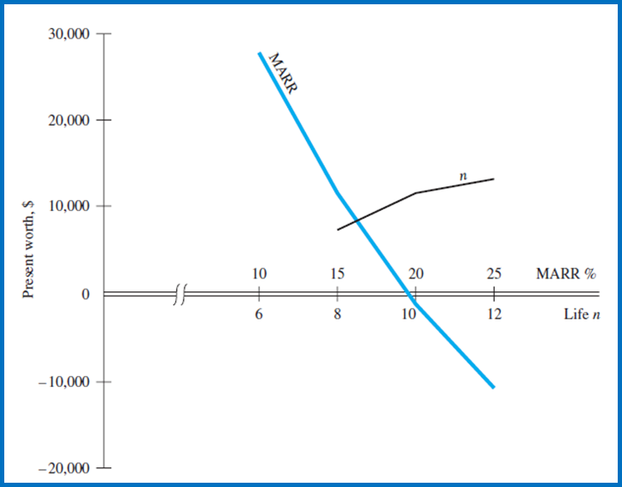
Parameters and Sensitivity Analysis
Parameter -- A variable or factor for which an estimated or stated value is necessary
Sensitivity analysis – An analysis to determine how a measure of worth (e.g., PW, AW, ROR, B/C) changes when one or more parameters vary over a selected range of values.
PROCEDURE:
1. Select parameter to analyze. Assume independence with other parameters
2. Select probable range and increment
3. Select measure of worth
4. Calculate measure of worth values
5. Interpret results. Graph measure vs. parameter for better understanding

Slide 5
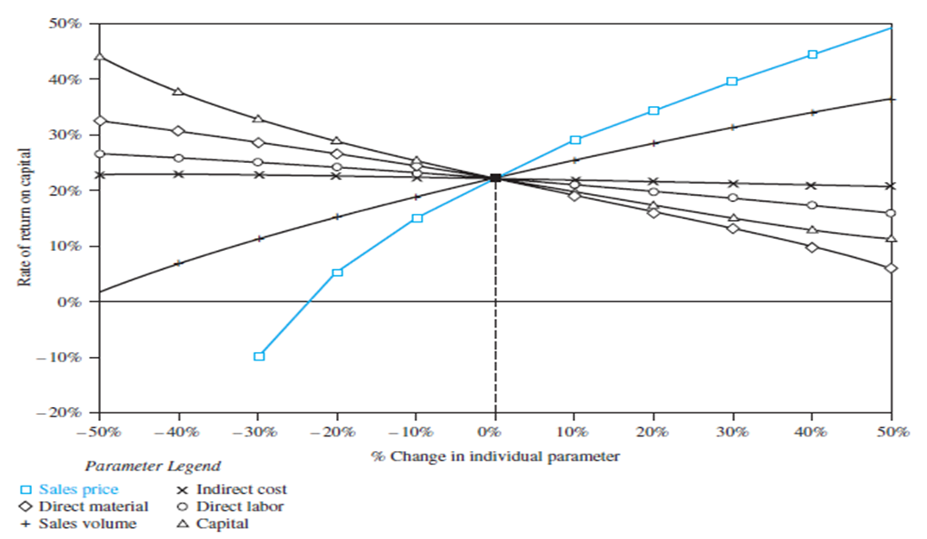
Sensitivity of Several Parameters
When several parameters for one alternative vary
and analysis of each parameter is required …
graph percentage change from the most likely estimate
for each parameter vs. measure of worth
Plots with larger slopes (positive or negative) have a higher sensitivity with parameter variation (sales price curve)
Plots that are relatively flat have little sensitivity to parameter variation (indirect cost curve)

Slide 6
Three Estimate Sensitivity Analysis
Applied when selecting one ME alternative from two or more
For each parameter that warrants analysis, provide three estimates:
  Pessimistic estimate P
  Most likely estimate ML
  Optimistic estimate O
Calculate measure of worth for each alternative and 3 estimates and select ‘best’ alternative
Notes -- 1. The pessimistic estimate may be the lowest for some parameters and
the highest for others, e.g., low life estimates and high first cost estimates are usually pessimistic
2. When calculating the measure of worth, use ML estimate of a parameter as others varies. This is the independence assumption

Slide 7
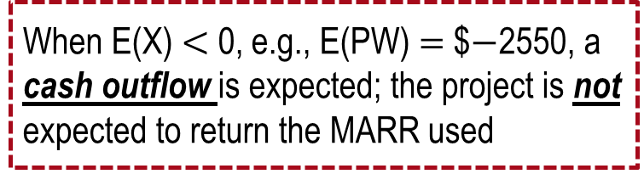

Expected Value Calculations
Expected Value -- Long-run average observable if a project
or activity is repeated many times
Result is a point estimate based on anticipated outcomes and estimated probabilities
Where: X_{i} $=$ value of variable X for i $=$ 1, …, m different values
P(X_{i}) $=$ probability that a specific value of X will occur
In all probability statements, the sum is:
When E(X) $<$ 0, e.g., E(PW) $=$ $$−$2550, a cash outflow is expected; the project is not expected to return the MARR used

Slide 8
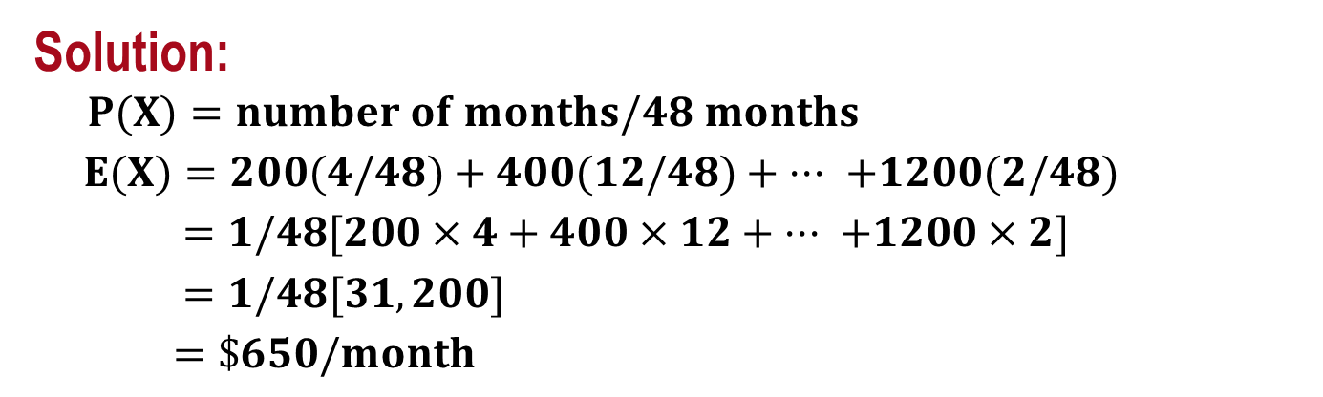
Example: Probability and Expected Value
Monthly M&O cost records over a 4-year period are shown in
$200 ranges. Determine the expected monthly cost for next year,
if conditions remain constant.
Range,$, X | No. of months | Range,$, X | No. of months
100–300 | 4 | 700–900 | 6
300–500 | 12 | 900–1100 | 10
500–700 | 14 | 1100–1300 | 2
Solution:
$$P(X)=number of months/48 months$$
$E(X)=200(4/48)+400(12/48)+ ··· +1200(2/48)$
$=1/48[200×4+400×12+ ··· +1200×2]$
$=1/48[31,200]$
$=\$650/month$

Slide 9
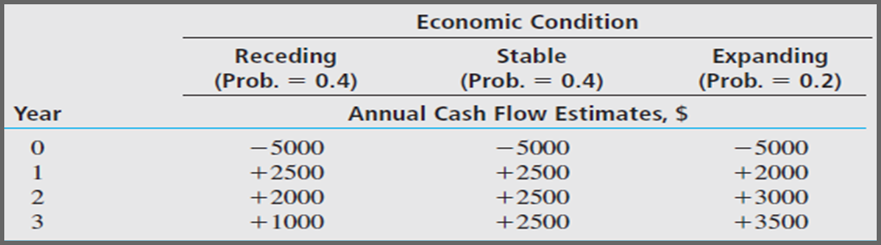
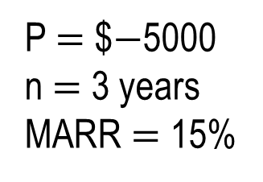
Expected Value for Alternative Evaluation
Two applications for Expected Value for estimates:
  Prepare information for use in an economic analysis
  Evaluate economic viability of fully formulated alternative
Example: Second use for a complete alternative. Is the investment viable?
P $=$ $$−$5000
n $=$ 3 years
MARR $=$ 15%

Slide 10
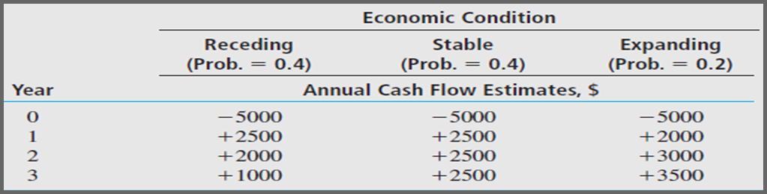
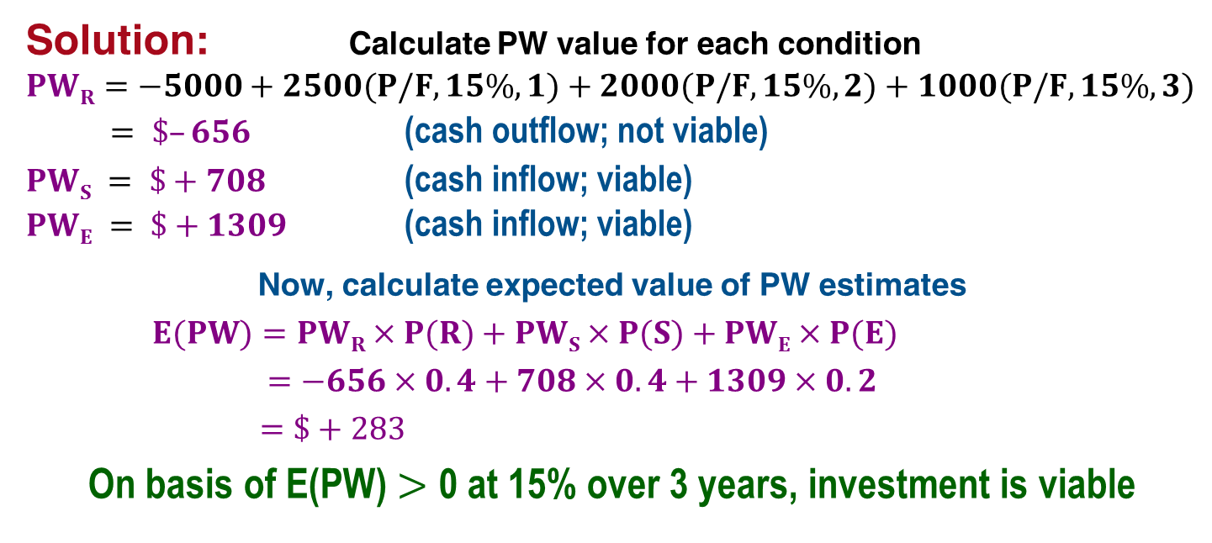
Example: Expected Value for Alternative Evaluation
Solution: Calculate PW value for each condition
$$PWR=−5000+2500(P/F,15\%,1)+2000(P/F,15\%,2)+1000(P/F,15\%,3)$$
$= \$–656$ (cash outflow; not viable)
$PWS = \$+708$ (cash inflow; viable)
$PWE = \$+1309$ (cash inflow; viable)
Now, calculate expected value of PW estimates
$E(PW)=PWR×P(R)+PWS×P(S)+PWE×P(E)$
$=−656×0.4+708×0.4+1309×0.2$
$=\$+283$
On basis of E(PW) $>$ 0 at 15% over 3 years, investment is viable

Slide 11
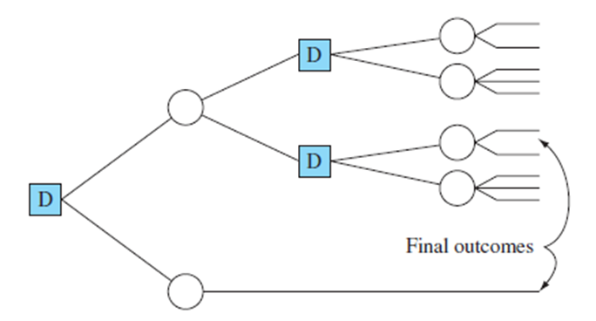
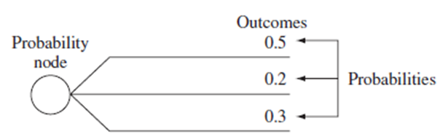
Decision Tree Characteristics
Staged Decision – Alternative has multiple stages; decision at one stage is important to next stage; risk is an inherent element of the evaluation
Decision Tree – Helps make risk more explicit for staged decisions
A DECISION TREE INCLUDES:
More than one stage of selection
Selection of an alternative at one stage leads to another stage
Expected results from a decision at each stage
Probability estimates for each outcome
Estimates of economic value (cost or revenue) for each outcome
Measure of worth as the selection criterion

Slide 12
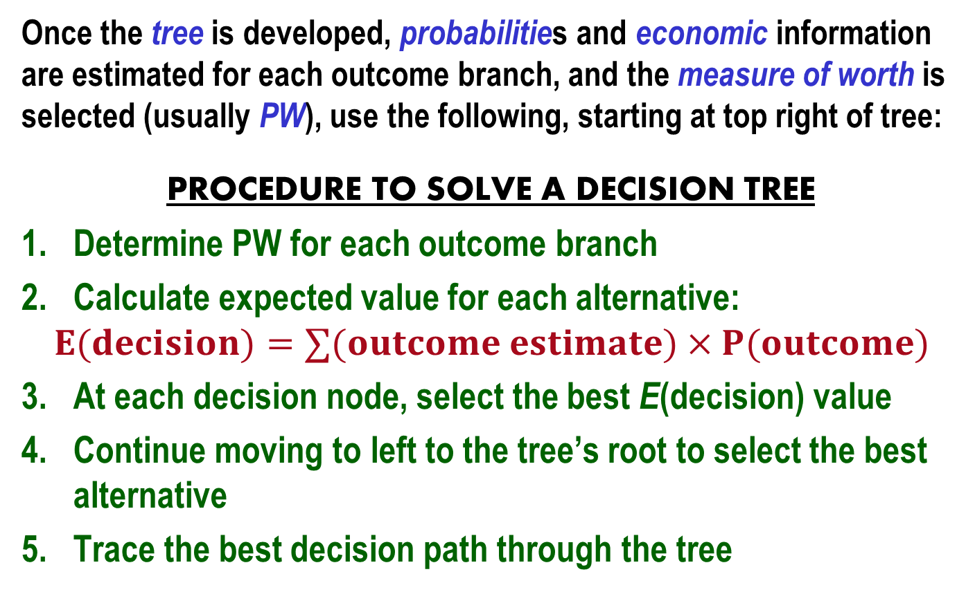
Solving a Decision Tree
Once the tree is developed, probabilities and economic information are estimated for each outcome branch, and the measure of worth is selected (usually PW), use the following, starting at top right of tree:
PROCEDURE TO SOLVE A DECISION TREE
Determine PW for each outcome branch
Calculate expected value for each alternative:
$$E(decision)=∑(outcome estimate)×P(outcome)$$
At each decision node, select the best E(decision) value
Continue moving to left to the tree’s root to select the best alternative
Trace the best decision path through the tree

Slide 13
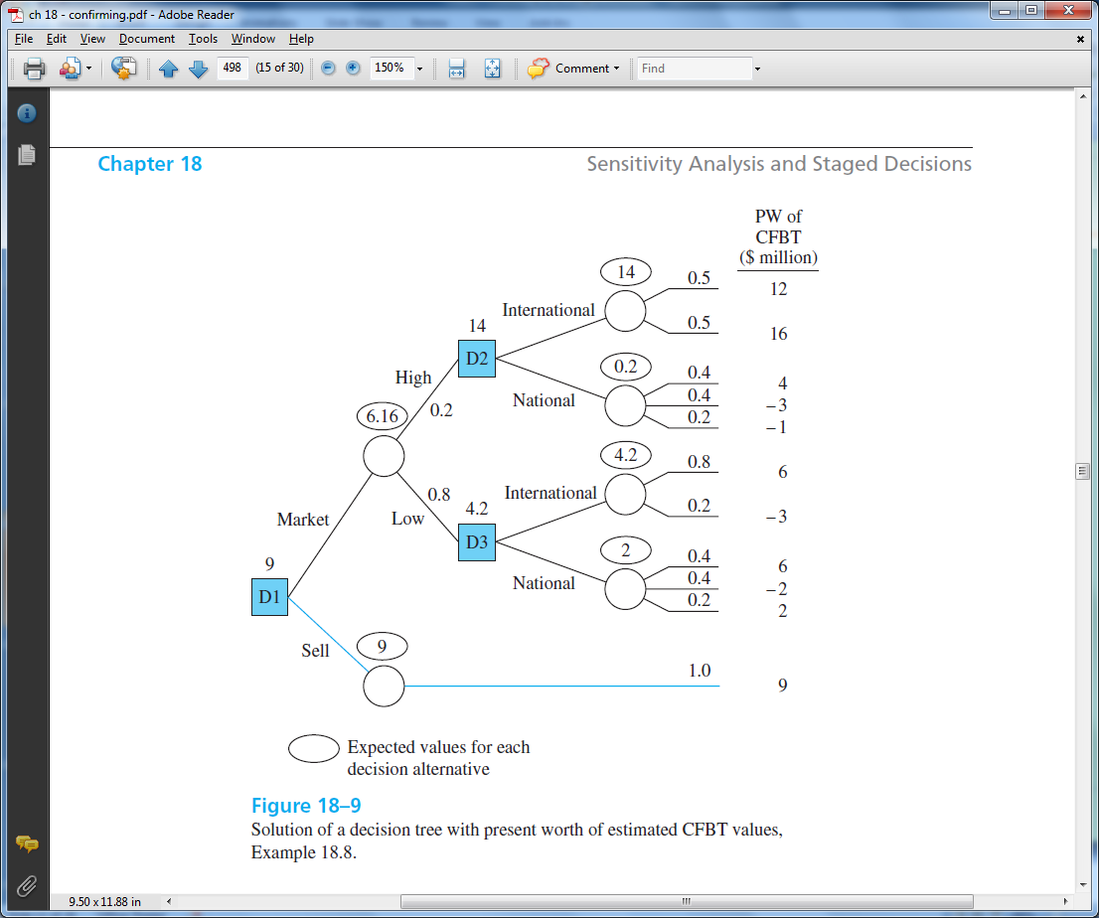
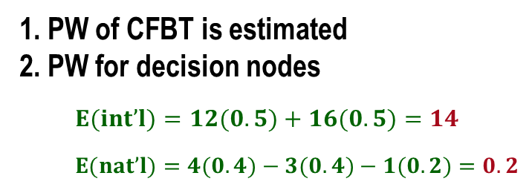
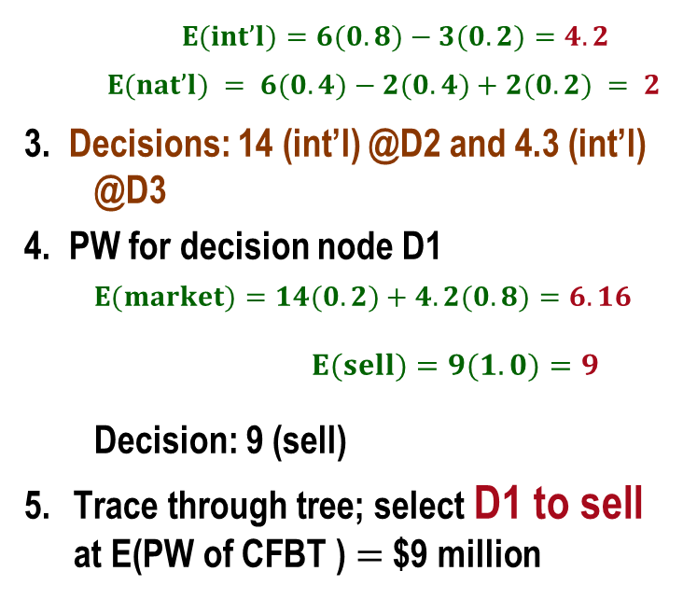
Example: Solving a Decision Tree
1. PW of CFBT is estimated
2. PW for decision nodes
$$E(int’l)=12(0.5)+16(0.5)=14$$
$$E(nat’l)=4(0.4)−3(0.4)−1(0.2)=0.2$$
14
D2
D2
$E(int’l)=6(0.8)−3(0.2)=4.2$
$$E(nat’l) = 6(0.4)−2(0.4)+2(0.2) = 2$$
3. Decisions: 14 (int’l) @D2 and 4.3 (int’l) @D3
4. PW for decision node D1
$E(market)=14(0.2)+4.2(0.8)=6.16$
$E(sell)=9(1.0)=9$
Decision: 9 (sell)
Trace through tree; select D1 to sell at E(PW of CFBT ) $=$ $9 million
D3
4.2
D3
D1
D1

Slide 14
Real Options
Staged funding ─ Decision to buy or invest can be delayed. There is usually cost and risk involved to delay the decision
Option ─ Contractual agreement to take a specified action at some stated future time. In other words, pay some amount now to reserve the right to accept or reject an offer in the future
Real option ─ In engineering economy, the option can involve physical assets (thus the title real option), leases, subcontracts, etc. Risk analysis is always involved for the predictable future events
Real option example: An airline purchases 3 commercial planes now and pays
$2 million to the manufacturer for the option to buy up to 5 more within the
next 3 years at today’s price.
If accepted, the $2 million is 25% credited toward the delayed purchase; if the
option is not exercised within 3 years, the entire $2 million is forfeited.

Slide 15
Real Options Analysis
Real options analysis ─ Determine the economic consequences of delaying the funding decision, that is, analyze staged funding
PRIMARY CHARACTERISTICS OF REAL OPTIONS ANALYSIS
Cost of option to delay, i.e., PW of investment/payment required now
Future options and cash flow estimates (staged funding)
Time period for follow-on decision (staged decision)
Market and risk-free interest rates (MARR and estimated inflation)
Estimates of risk, i.e., probabilities for each option’s cash flows
Economic criterion (PW, ROR) to make a decision now on the real option
If needed, decision tree of options, probabilities, and cash flow estimates to assist with the analysis

Slide 16

Example: Real Options Analysis (1)
A real estate developer has the option to buy prime property 2 years from now for $35M, if a $3.5M option is purchased now. In 2 years, the economy can be ‘up’ or ‘down’ and the decisions then are: (1) exercise the option (buy at $35M) and hold; (2) exercise and sell immediately; or (3) forfeit. PW of eventual net cash flows for further development are predicted in year 2 depending upon the economy (up or down). Selling price (high or low) 2 years hence is estimated. At MARR $=$ 12%, what is better economically now ; to accept or to decline the option? Assume probabilities and cash flows are estimated as follows:
Economy | P(economy) | PW of CF, year 2, if held, $M | Selling environment | P(selling environment) | Estimated selling price, $M
Up | 0.3 | 50 | High | 0.4 | 50
Up | 0.3 | 50 | Low | 0.6 | 40
Down | 0.7 | 30 | High | 0.4 | 30
Down | 0.7 | 30 | Low | 0.6 | 25
Solution: Construct the 2-stage decision tree for time now and 2 years from now. Probabilities and PW of cash flows are shown on the tree.

Slide 17
Example: Real Options Analysis (2)
YEAR NOW 2 Future outcome
Exercise/hold
-35 + 50 = $15M
15M
High
(-35 +50)(0.4) = $6M
D2
Exercise
/sell
P = 0.4
Accept option
Low
(-35+40)(0.6) = $3M
UP
P = 0.6
P = 0.3
0.1M
-$3.5M
Forfeit
$0
D1
DOWN
Exercise/hold
-35 + 30 = $-5M
Decline option
P = 0.7
0
High
(-35+30)(0.4) = $-2M
D3
Exercise
/sell
P = 0.4
0$
Low
(-35+25)(0.6) = $-6M
P = 0.6
Forfeit
$0
0
Largest E(X)
of decision branches
$0
P = 1.0

Slide 18
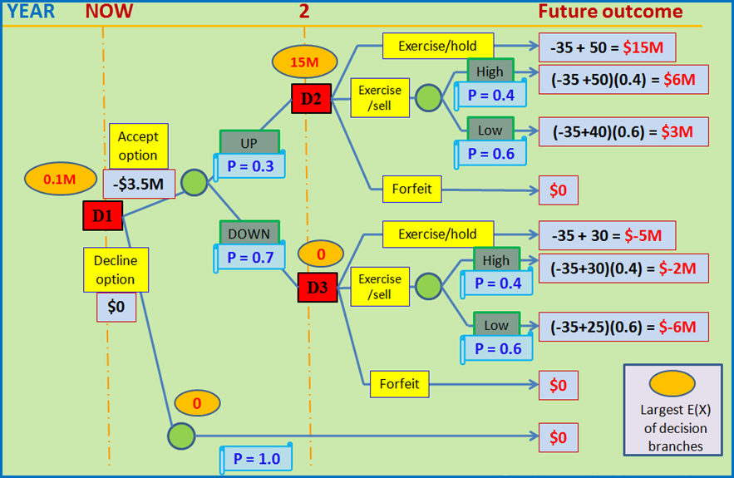
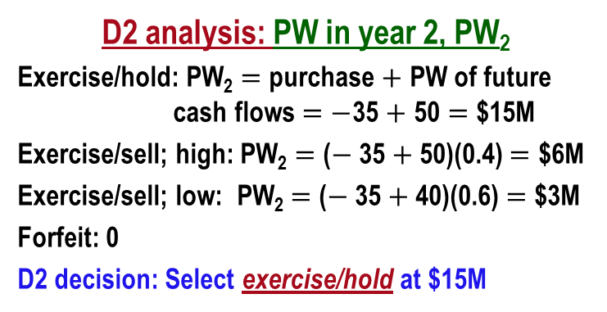
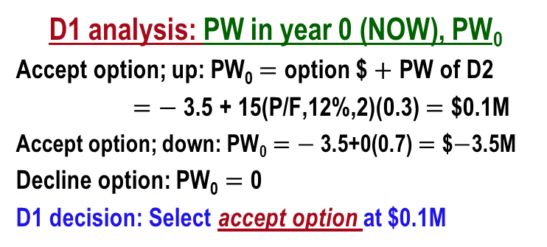
Example: Real Options Analysis (3)
D2 analysis: PW in year 2, PW₂
Exercise/hold: PW₂ $=$ purchase $+$ PW of future cash flows $=$ $−$35 $+$ 50 $=$ $15M
Exercise/sell; high: PW₂ $=$ ($−$35 $+$50)(0.4) $=$ $6M
Exercise/sell; low: PW₂ $=$ ($−$35 $+$40)(0.6) $=$ $3M
Forfeit: 0
D2 decision: Select exercise/hold at $15M
Tree from previous slide
D3 analysis: PW in year 2, PW₂
D3 decision: Select forfeit at 0
D1 analysis: PW in year 0 (NOW), PW₀
Accept option; up: PW₀ $=$ option $ $+$ PW of D2
$=$ $−$3.5 + 15(P/F,12%,2)(0.3) $=$ $0.1M
Accept option; down: PW₀ $=$ $−$3.5+0(0.7) $=$ $$−$3.5M
Decline option: PW₀ $=$ 0
D1 decision: Select accept option at $0.1M
CONCLUSION: Accept option now; buy property in two years and hold it

Slide 19
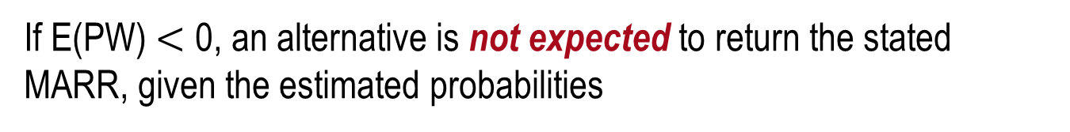
Summary of Important Points
Sensitivity analysis evaluates variation in parameters using a specific measure of worth (PW, ROR, B/C, etc.)
Independence of parameters is assumed in sensitivity analysis
If E(PW) $<$ 0, an alternative is not expected to return the stated MARR, given the estimated probabilities
Decision trees assist in making staged decisions when risk is explicitly considered
Real options analysis determines the economic consequences of delayed funding with risk accounted for; however, an up-front price is usually imposed to have the option of staged funding

