Slide 1
Lecture slides to accompany
Engineering Economy, 8th edition
Leland Blank, Anthony Tarquin
©McGraw-Hill Education. All rights reserved. Authorized only for instructor use in the classroom. No reproduction or further distribution permitted without the prior written consent of McGraw-Hill Education.
Notes:
At this point:
1. Introduce yourself - your students are likely to want to know something about your qualifications and interests - overall, where you are coming from.
2. Have students introduce themselves. Ask why they are taking this class. If you are fortunate enough to have a Polaroid camera, take pictures of each student for later posting on a class “board” so both they and you get to know each other.
3. Discuss both choice of textbook and development of syllabus.
4. If you are expecting students to work in teams, at east introduce the choice of team members. If at all possible, have students participate in a team building or team study exercise. It works wonders. Most student have been told to work in teams in prior classes, but have never examined exactly what a team is and how it works. One hour spent in a team building/examination exercise saves many hours and avoids many problems later on.

Slide 2
Chapter 17
After-tax Economic Analysis

Slide 3
LEARNING OBJECTIVES
Terminology and rates; marginal tax tables
Determining cash flows before taxes(CFBT) and after taxes (CFAT)
Effects of depreciation on taxes
Depreciation recapture and capital gains
Performing an after-tax analysis
Performing after-tax replacement studies
Economic value-added analysis
Tax structures outside the United States
Understanding value-added tax (VAT)

Slide 4
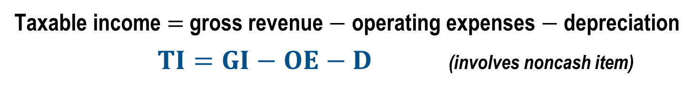
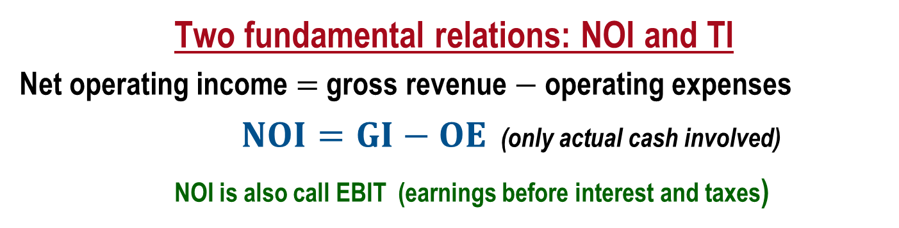
Income Tax Terms and Relations (Corporations)
Income taxes are real cash flow payments to governments levied against income and profits. The (noncash) allowance of asset depreciation is used in income tax computations.
Two fundamental relations: NOI and TI
Net operating income $=$ gross revenue $−$ operating expenses
$NOI=GI−OE$ (only actual cash involved)
NOI is also call EBIT (earnings before interest and taxes)
Taxable income $=$ gross revenue $−$ operating expenses $−$ depreciation
$TI=GI−OE−D$ (involves noncash item)
Note: All terms and relations are calculated for each year t, but the subscript is often omitted for simplicity

Slide 5
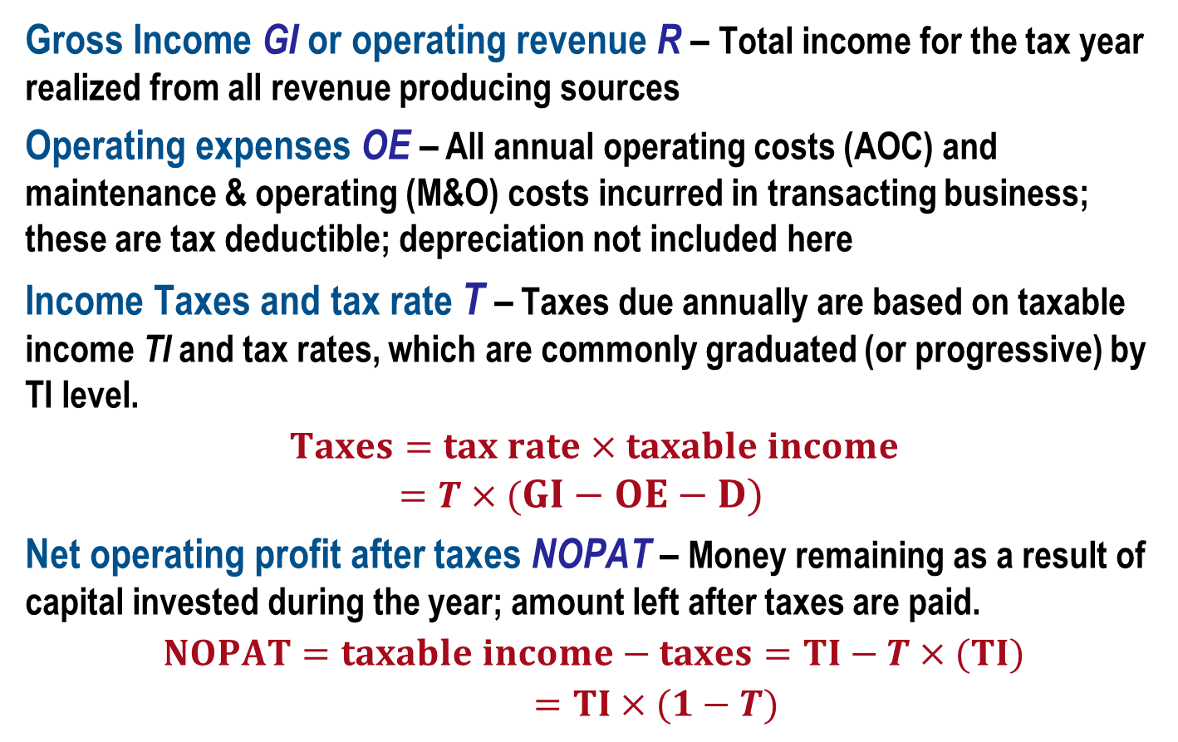
Tax Terms and Relations – Corporations
  Gross Income GI or operating revenue R – Total income for the tax year realized from all revenue producing sources
  Operating expenses OE – All annual operating costs (AOC) and maintenance & operating (M&O) costs incurred in transacting business; these are tax deductible; depreciation not included here
Income Taxes and tax rate T – Taxes due annually are based on taxable income TI and tax rates, which are commonly graduated (or progressive) by TI level.
$$Taxes=tax rate×taxable income \\ =T×(GI−OE−D)$$
  Net operating profit after taxes NOPAT – Money remaining as a result of capital invested during the year; amount left after taxes are paid.
$$NOPAT=taxable income−taxes=TI−T×(TI)$$
$=TI×(1−T)$

Slide 6
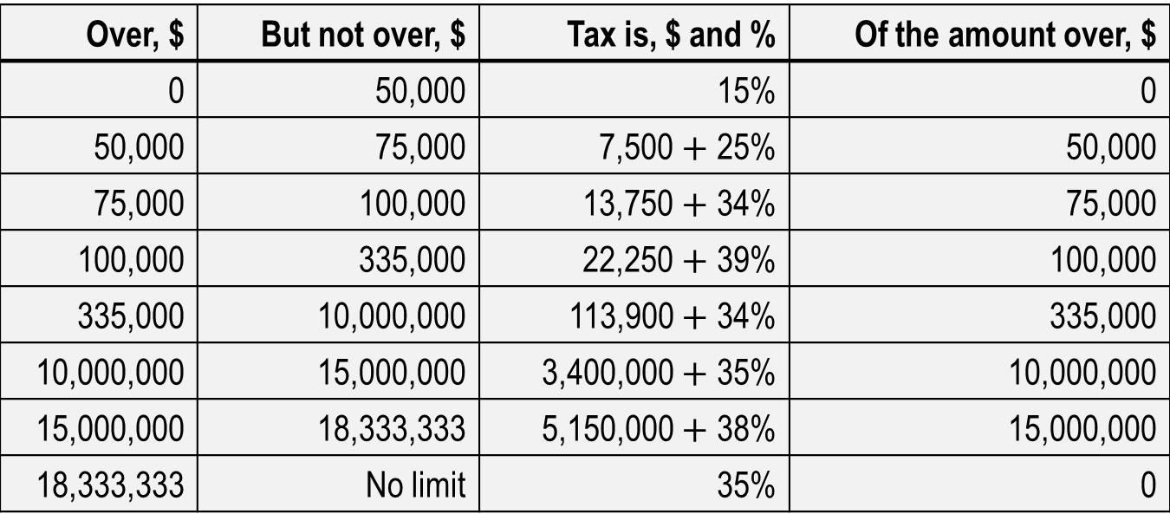
US Corporate Federal Tax Rates - 2010
If Taxable Income (TI) is:
Over, $ | But not over, $ | Tax is, $ and % | Of the amount over, $
0 | 50,000 | 15% | 0
50,000 | 75,000 | 7,500 $+$ 25% | 50,000
75,000 | 100,000 | 13,750 $+$ 34% | 75,000
100,000 | 335,000 | 22,250 $+$ 39% | 100,000
335,000 | 10,000,000 | 113,900 $+$ 34% | 335,000
10,000,000 | 15,000,000 | 3,400,000 $+$ 35% | 10,000,000
15,000,000 | 18,333,333 | 5,150,000 $+$ 38% | 15,000,000
18,333,333 | No limit | 35% | 0
US rates provide a slight tax advantage for small businesses
Rates are an effective 34% for TI > $335,000 and flat at 35% for TI > $18.33 M
Income tax rates are graduated or progressive as TI increases
Each rate bracket is the marginal tax rate for the TI range

Slide 7
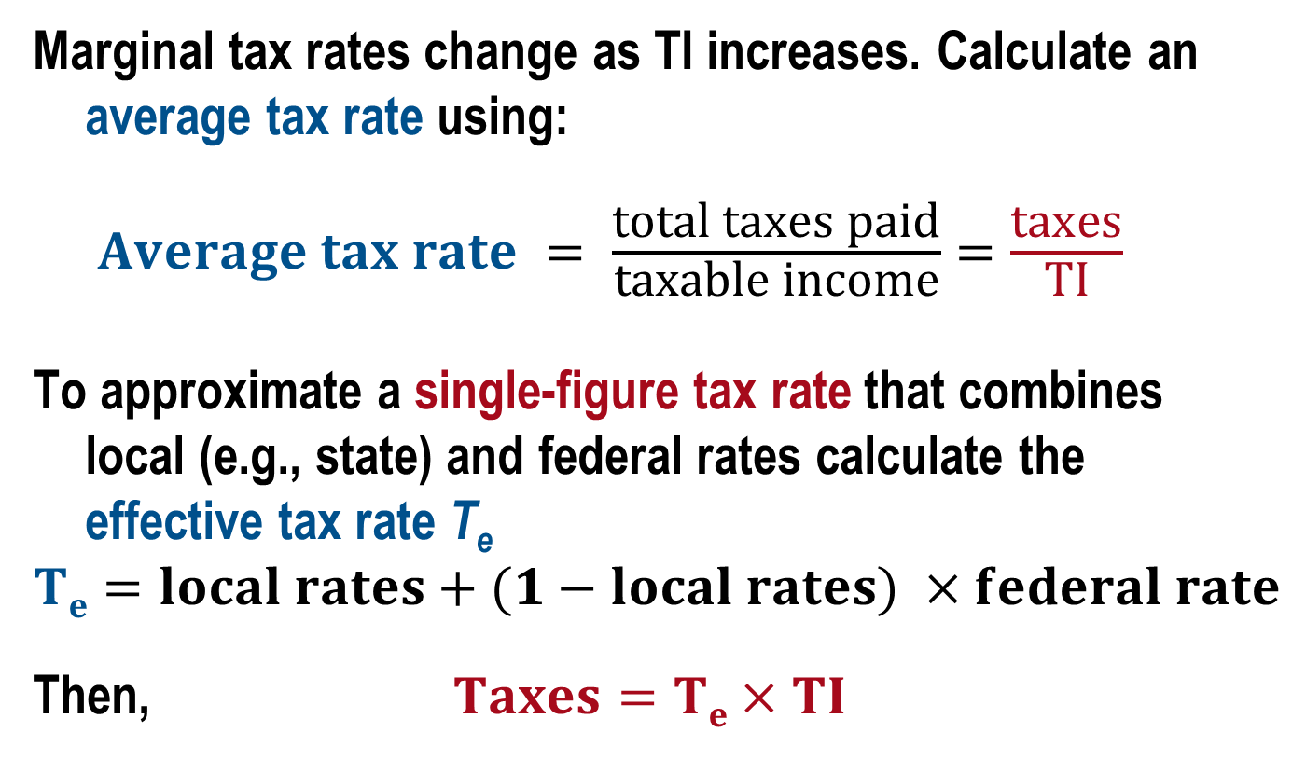
Average and Effective Tax Rates
Marginal tax rates change as TI increases. Calculate an average tax rate using:
$Average tax rate = \frac{\text{total} \text{taxes} \text{paid}}{\text{taxable} \text{income}}=\frac{\text{taxes}}{\text{TI}}$
To approximate a single-figure tax rate that combines
local (e.g., state) and federal rates calculate the
effective tax rate T_{e}
$$Te=local rates+(1−local rates) ×federal rate$$
Then, $Taxes=Te×TI$

Slide 8
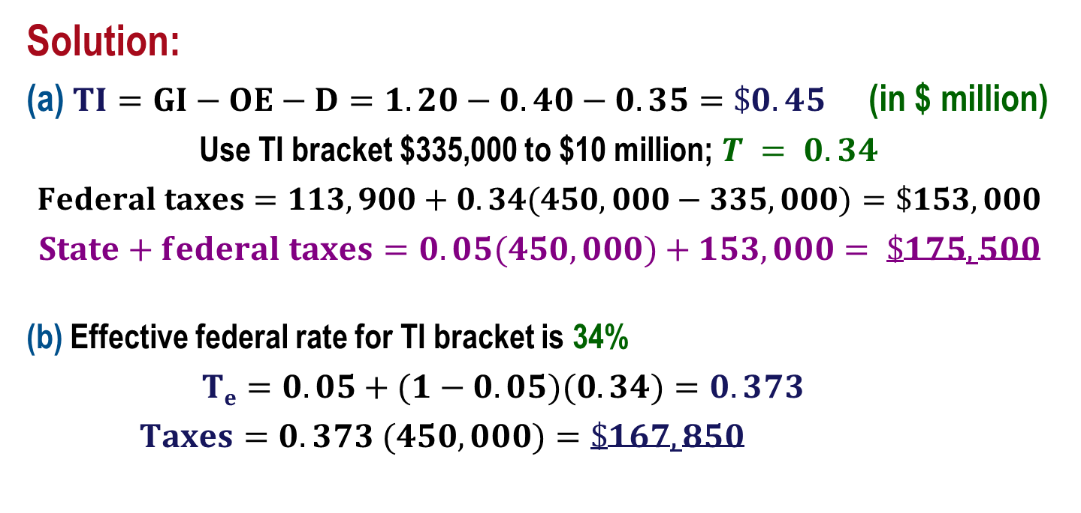
Example: Income Tax Calculations
Annual operating revenue is $1.2 million with expenses of $0.4 million and $350,000 depreciation on assets. The state imposes a flat rate of 5% of all TI. Determine (a) actual taxes and (b) approximate taxes using T_{e}.
Solution:
(a) $TI=GI−OE−D=1.20−0.40−0.35=\$0.45$ (in $ million)
Use TI bracket $335,000 to $10 million; $T = 0.34$
$$Federal taxes=113,900+0.34(450,000−335,000)=\$153,000$$
$$State+federal taxes=0.05(450,000)+153,000= \$175,500$$
(b) Effective federal rate for TI bracket is 34%
$Te=0.05+(1−0.05)(0.34)=0.373$
$Taxes=0.373 (450,000)=\$167,850$
Approximation
underestimates
actual by 4.4%

Slide 9
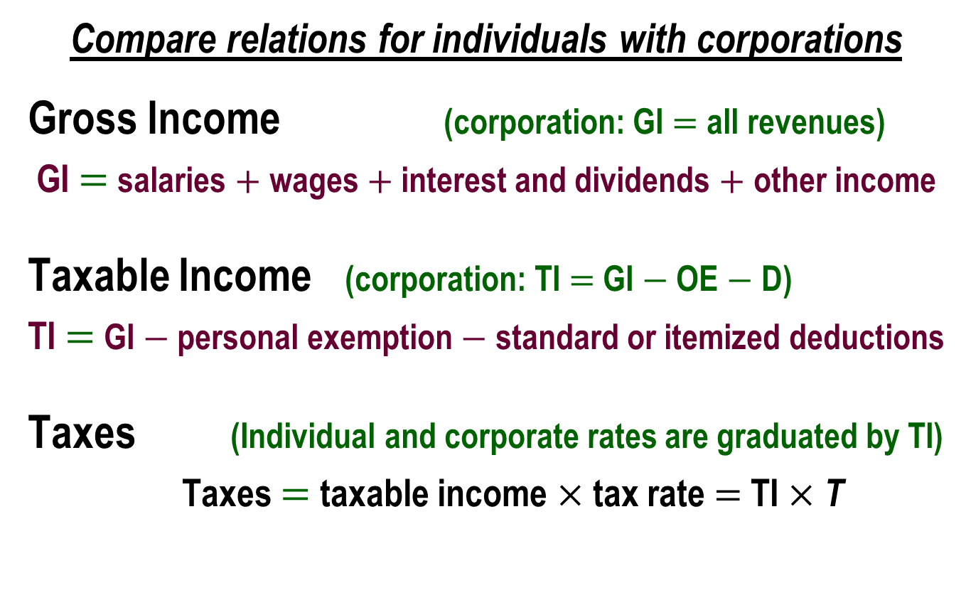
Income Taxes for Individuals
Compare relations for individuals with corporations
Gross Income (corporation: GI $=$ all revenues)
  GI $=$ salaries $+$ wages $+$ interest and dividends $+$ other income
Taxable Income (corporation: TI $=$ GI $−$ OE $−$ D)
  TI $=$ GI $−$ personal exemption $−$ standard or itemized deductions
Taxes (Individual and corporate rates are graduated by TI)
  Taxes $=$ taxable income $×$ tax rate $=$ TI $×$ T

Slide 10
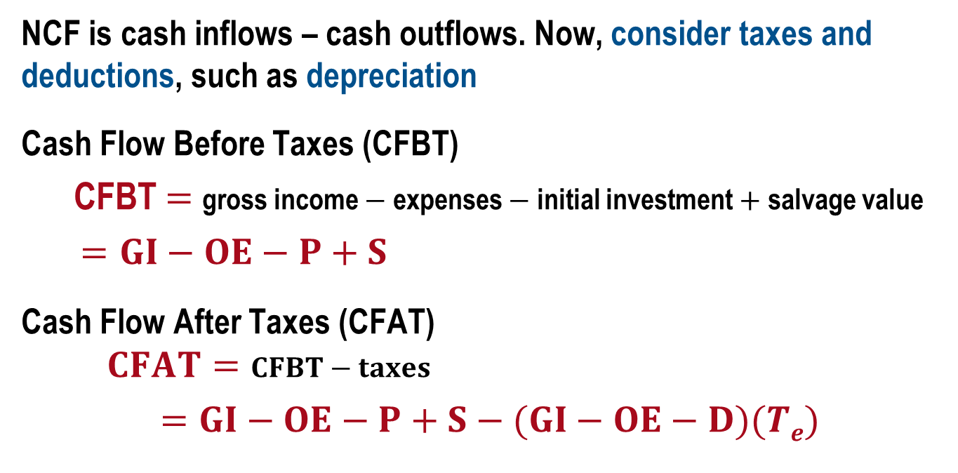
Cash Flow After Taxes (CFAT)
NCF is cash inflows – cash outflows. Now, consider taxes and deductions, such as depreciation
Cash Flow Before Taxes (CFBT)
  CFBT $=$ gross income $−$ expenses $−$ initial investment $+$ salvage value
  $=GI−OE−P+S$
Cash Flow After Taxes (CFAT)
  $$CFAT=CFBT−taxes$$
  $=GI−OE−P+S−(GI−OE−D)(Te)$
A negative TI value is considered a
tax savings
for the project
Once CFAT series is determined, economic evaluation using any method is performed the same as before taxes, now using estimated CFAT values

Slide 11
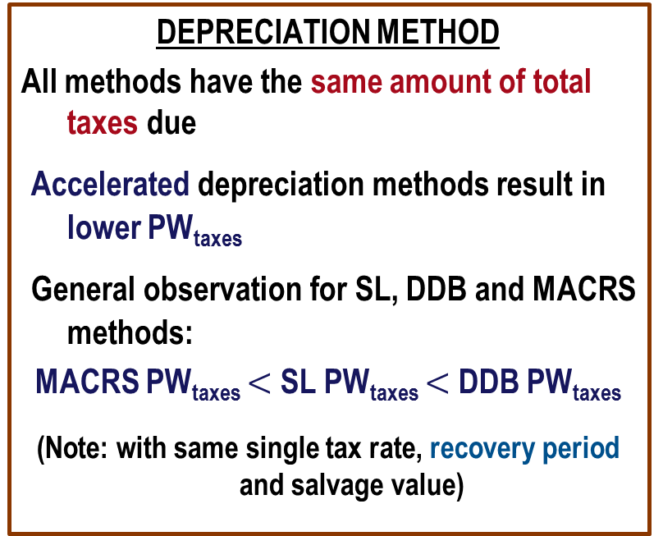
Effects on Taxes of Depreciation Method and Recovery Period
Goal is to minimize PW of taxes, which is equivalent to maximizing PW of depreciation
DEPRECIATION METHOD
All methods have the same amount of total taxes due
Accelerated depreciation methods result in lower PW_{taxes}
General observation for SL, DDB and MACRS methods:
MACRS PW_{taxes} $<$ SL PW_{taxes} $<$ DDB PW_{taxes}
(Note: with same single tax rate, recovery period and salvage value)
RECOVERY PERIOD
All lengths have the same amount of total taxes due
Shorter recovery periods result in lower PW_{taxes}
General goal: use shortest (MACRS) recovery period allowed
(Note: with same single tax rate, depreciation method
and salvage value)

Slide 12
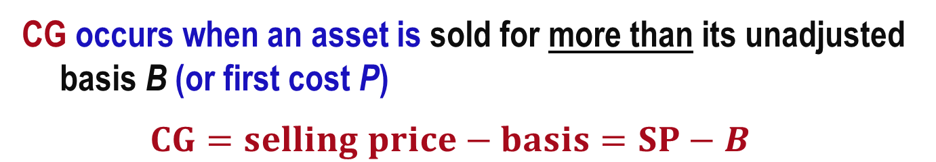
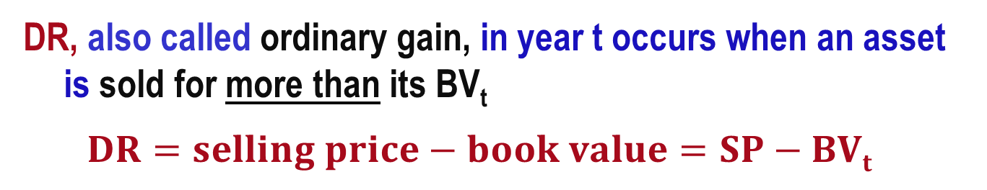
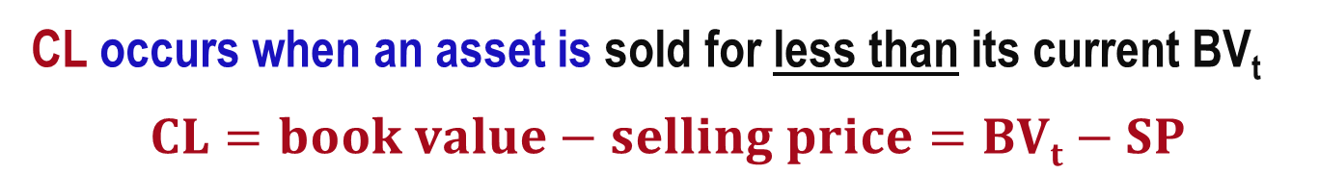
Depreciation Recapture (DR) and Capital Gain (CG) and Capital Loss (CL)
DR, also called ordinary gain, in year t occurs when an asset is sold for more than its BV_{t}
$$DR=selling price−book value=SP−BVt$$
CG occurs when an asset is sold for more than its unadjusted basis B (or first cost P)
$$CG=selling price−basis=SP−B$$
CL occurs when an asset is sold for less than its current BV_{t}
$$CL=book value−selling price=BVt−SP$$

Slide 13
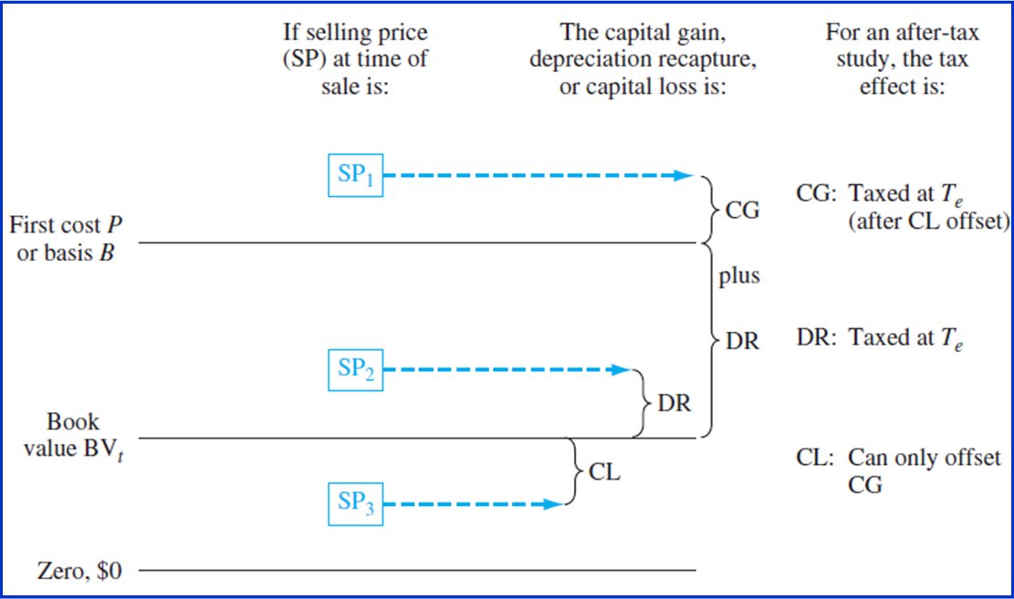
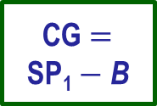
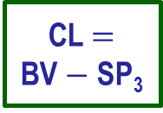
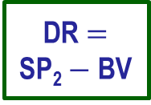
Effects of DR, CG and CL on TI and Taxes
CG $=$
SP₁ $−$ B
DR $=$
SP₂ $−$ BV
CL $=$
BV $−$ SP₃
Update of TI relation: TI $=$ GI $−$ OE $−$ D $+$ DR $+$ net CG $−$ net CL

Slide 14
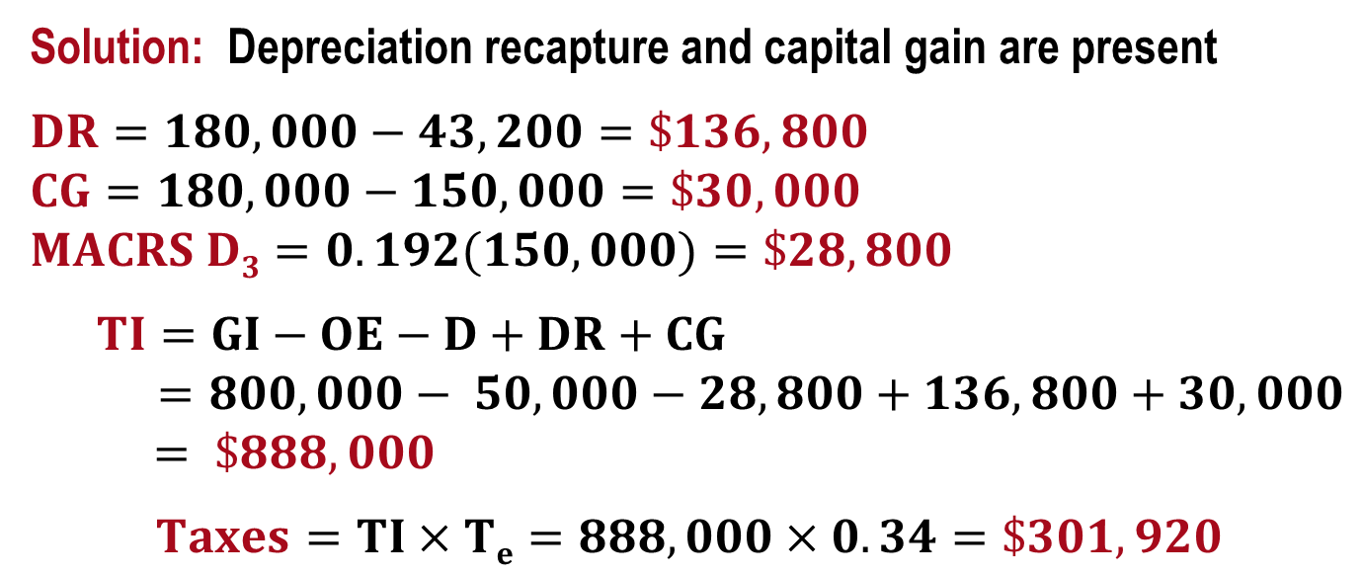
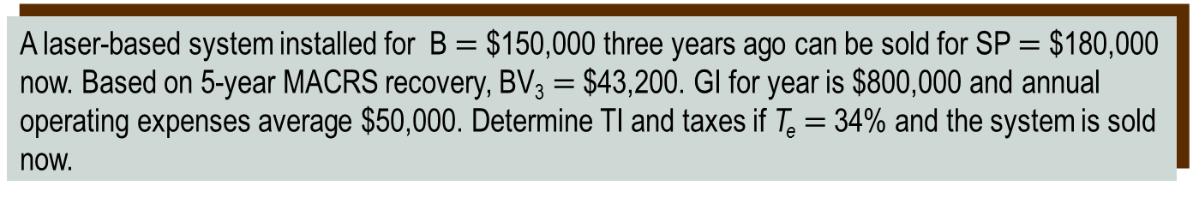
Example: Depreciation Recapture
A laser-based system installed for B $=$ $150,000 three years ago can be sold for SP $=$ $180,000 now. Based on 5-year MACRS recovery, BV₃ $=$ $43,200. GI for year is $800,000 and annual operating expenses average $50,000. Determine TI and taxes if T_{e} $=$ 34% and the system is sold now.
Solution: Depreciation recapture and capital gain are present
$DR=180,000−43,200=\$136,800$
$$CG=180,000−150,000=\$30,000$$
$$MACRS D3=0.192(150,000)=\$28,800$$
$TI=GI−OE−D+DR+CG$
$=800,000− 50,000−28,800+136,800+30,000$
$= \$888,000$
$$Taxes=TI×Te=888,000×0.34=\$301,920$$
Note: If not sold now, taxes $=$ (800,000 $−$ 50,000$−$28,800)$×$(0.34)$=$$245,208

Slide 15
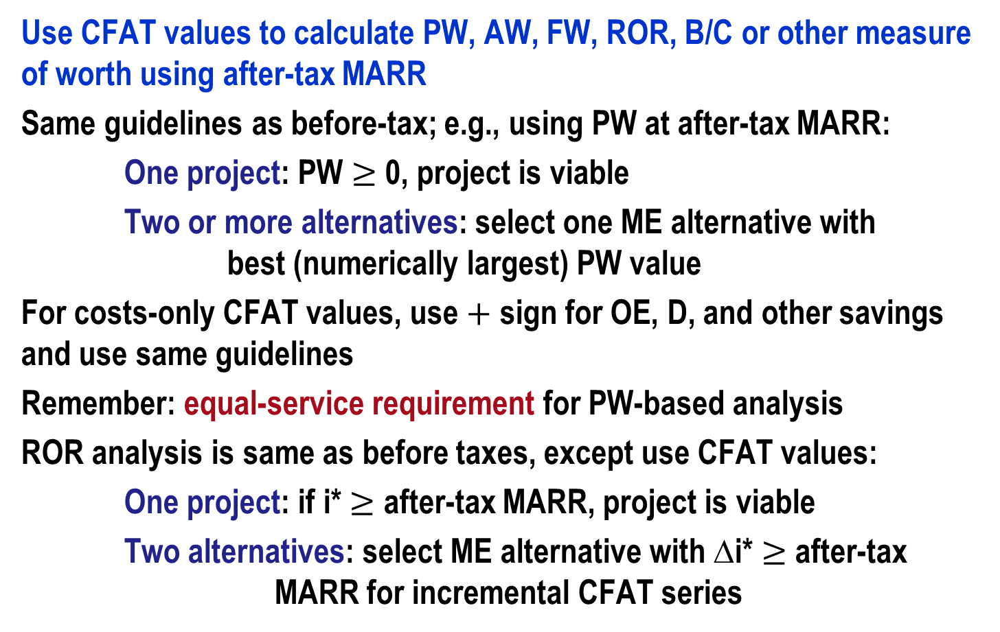
After-Tax Evaluation
Use CFAT values to calculate PW, AW, FW, ROR, B/C or other measure of worth using after-tax MARR
Same guidelines as before-tax; e.g., using PW at after-tax MARR:
One project: PW $≥$ 0, project is viable
Two or more alternatives: select one ME alternative with best (numerically largest) PW value
For costs-only CFAT values, use $+$ sign for OE, D, and other savings and use same guidelines
Remember: equal-service requirement for PW-based analysis
ROR analysis is same as before taxes, except use CFAT values:
One project: if i* $≥$ after-tax MARR, project is viable
Two alternatives: select ME alternative with ∆i* $≥$ after-tax MARR for incremental CFAT series

Slide 16
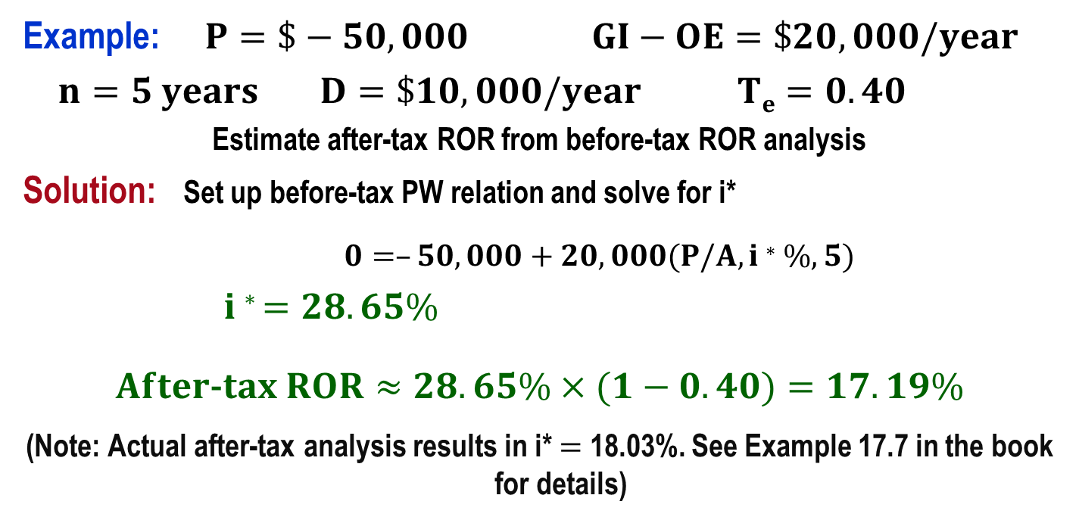
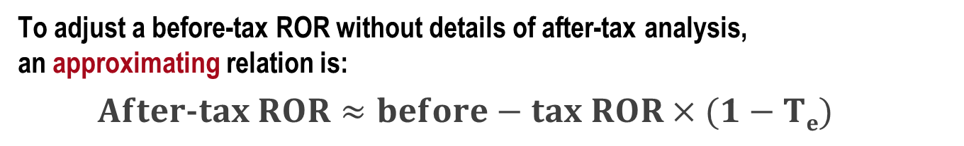
Approximating After-Tax ROR Value
To adjust a before-tax ROR without details of after-tax analysis,
an approximating relation is:
$$After\text{-}tax ROR≈before−tax ROR×(1−Te)$$
Example: $P=\$−50,000$ $GI−OE=\$20,000/year$
$n=5 years$ $D=\$10,000/year$ $Te=0.40$
Estimate after-tax ROR from before-tax ROR analysis
Solution: Set up before-tax PW relation and solve for i*
$0=–50,000+20,000(P/A,i∗\%,5)$
$i∗ =28.65\%$
$After\text{-}tax ROR≈28.65\%×(1−0.40)=17.19\%$
(Note: Actual after-tax analysis results in i* $=$ 18.03%. See Example 17.7 in the book for details)

Slide 17
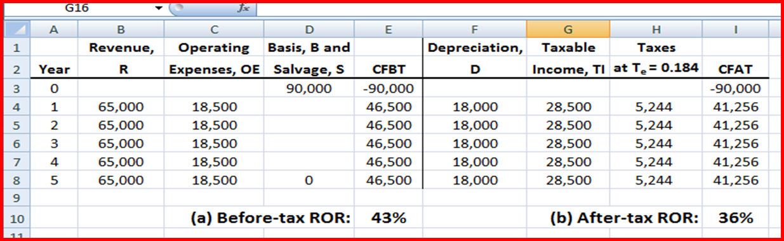
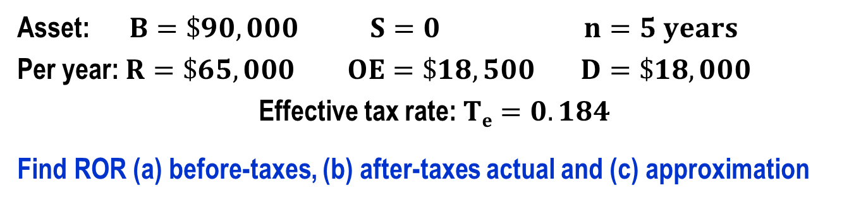
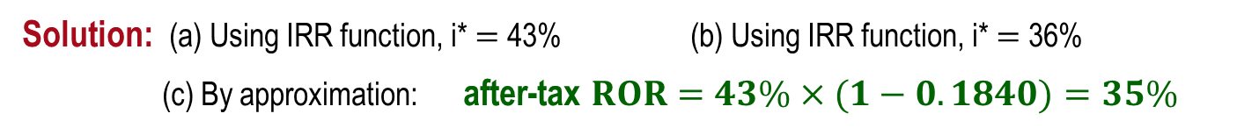
Example: After-Tax Analysis
Asset: $B=\$90,000$ $S=0$ $n=5 years$
Per year: $R=\$65,000$ $OE=\$18,500$ $D=\$18,000$
Effective tax rate: $Te=0.184$
Find ROR (a) before-taxes, (b) after-taxes actual and (c) approximation
Solution: (a) Using IRR function, i* $=$ 43% (b) Using IRR function, i* $=$ 36%
(c) By approximation: after-tax $ROR=43\%×(1−0.1840)=35\%$

Slide 18
After-Tax Replacement Analysis
Consider depreciation recapture (DR) or capital gain (CG), if challenger is selected over defender
Can include capital loss, if trade occurs at very low (‘sacrifice’) trade-in for defender
An after-tax analysis can reverse the selection compared to before-tax analysis, but more likely it will provide information about differences in PW, AW or ROR value when taxes are included
Apply same procedure as before-tax replacement evaluation once CFAT series is estimated

Slide 19
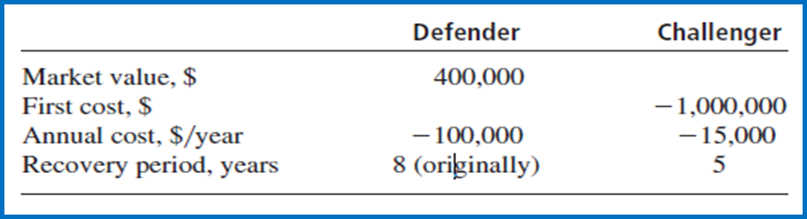
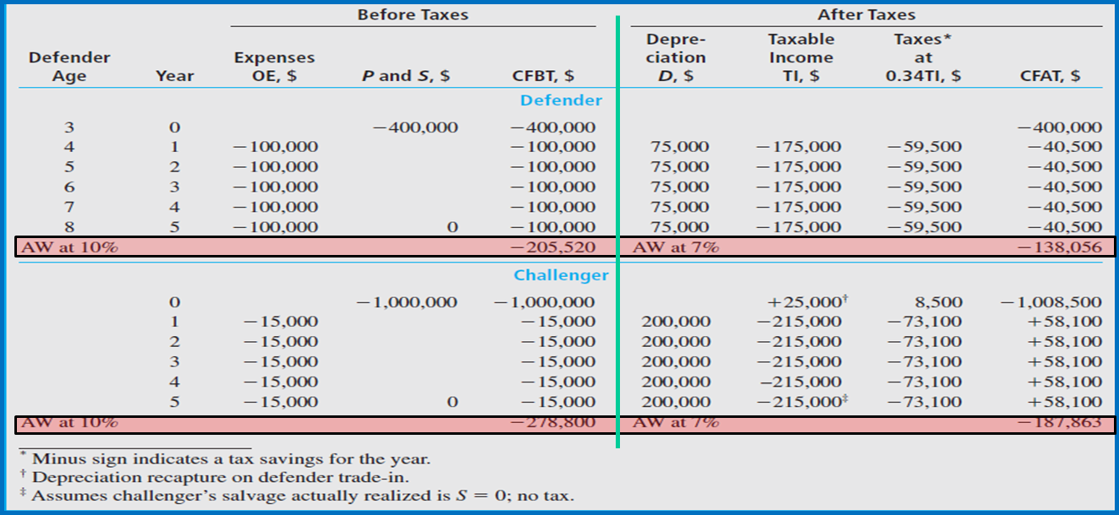
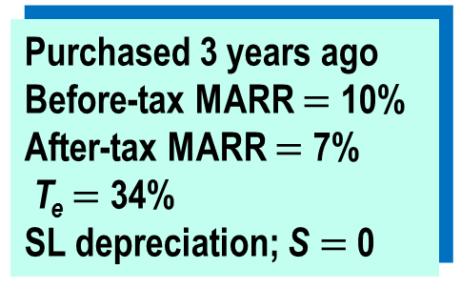
Example: Before- and After-Tax Replacement Study
Purchased 3 years ago
Before-tax MARR $=$ 10%
After-tax MARR $=$ 7%
T_{e} $=$ 34%
SL depreciation; S $=$ 0
S
O
L
U
T
I
O
N
Select defender both ways

Slide 20
Economic Value Added (EVA)TM Analysis
  Definition: The economic worth added by a product or service from the perspective of the consumer, owner or investor
  In other words, it is the contribution of a capital investment to the net worth of a corporation after taxes
  Example: The average consumer is willing to pay significantly more for potatoes processed and served at a fast-food restaurant as fries (chips) than as raw potatoes in the skin from a supermarket.
  Value-added analysis is performed in a different way than CFAT analysis, however…
  Selection of the better economic alternative is the same for EVA and CFAT analysis, because it is always correct that …
  AW of EVA estimates $=$ AW and CFAT estimates

Slide 21

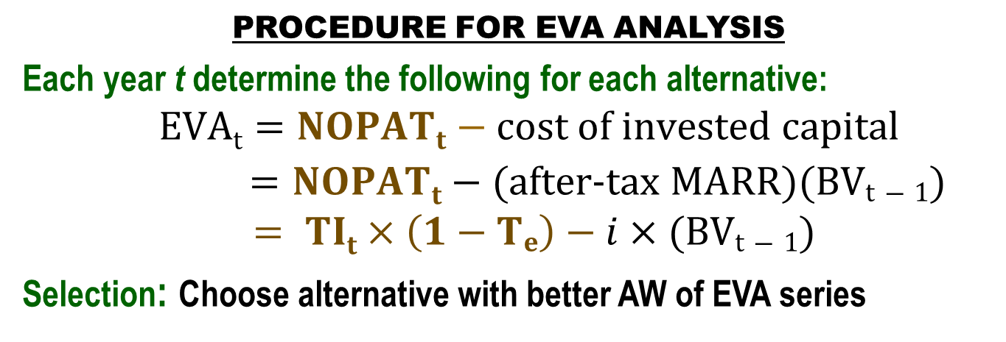
EVA Analysis: Procedure
DIFFERENCE BETWEEN CFAT AND EVA APPROACHES
CFAT estimates (describes) how actual cash will flow
EVA estimates extra worth that an alternative adds
EVA is a measure of worth that mingles actual cash flows and noncash flows
PROCEDURE FOR EVA ANALYSIS
Each year t determine the following for each alternative:
$EVAt=NOPATt−cost of invested capital$
$=NOPATt−(after\text{-}tax MARR)(BVt−1)$
$= TIt×\left(1−Te\right)−i×(BVt−1)$
Selection: Choose alternative with better AW of EVA series
Remember: Since AW of EVA series will always $=$ AW of CFAT series, the same alternative is selected by either method

Slide 22
International Tax Structures
Tax related questions for internationally located projects concentrate on items such as:
  Depreciation methods approved by host country
  Capital investment allowances
  Business expense deductibility
  Corporate tax rates
  Indirect tax rates – Value-Added Tax and Goods and Service Tax (VAT/GST)
Rules and laws vary considerably from country to country

Slide 23
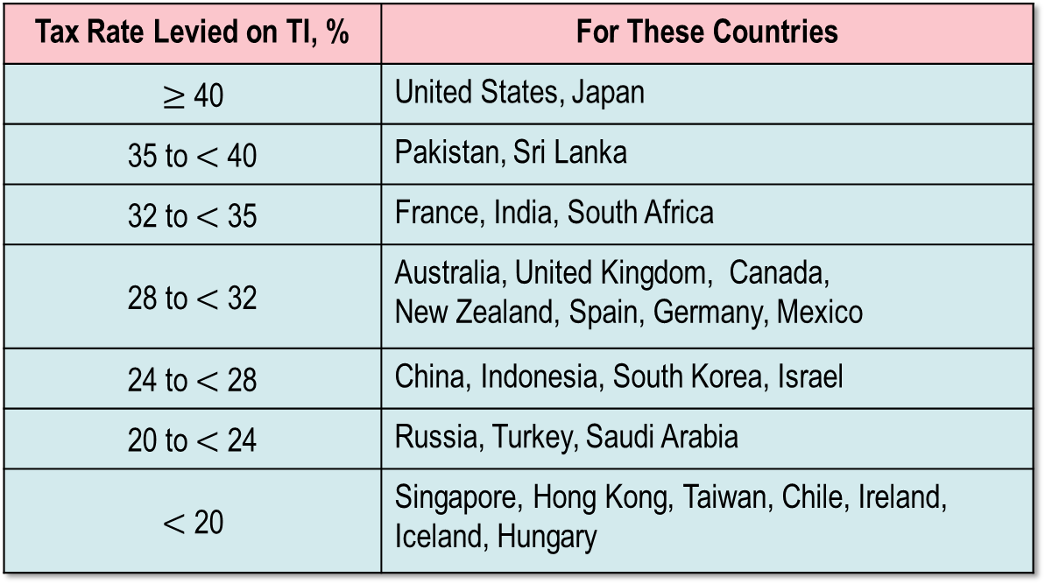
Summary of International Corporate Tax Rates
Tax Rate Levied on TI, % | For These Countries
$≥$ 40 | United States, Japan
35 to $<$ 40 | Pakistan, Sri Lanka
32 to $<$ 35 | France, India, South Africa
28 to $<$ 32 | Australia, United Kingdom, Canada, New Zealand, Spain, Germany, Mexico
24 to $<$ 28 | China, Indonesia, South Korea, Israel
20 to $<$ 24 | Russia, Turkey, Saudi Arabia
$<$ 20 | Singapore, Hong Kong, Taiwan, Chile, Ireland, Iceland, Hungary
Source: KPMG Corporate and Indirect Tax Rate Survey, 2010

Slide 24
Value-Added Tax (VAT)
VAT is an indirect tax placed on goods and services, not on people and corporations like an income tax. The VAT is charged sequentially throughout the process of manufacturing a good or providing a service. The VAT is also called Goods and Service Tax (GST).
VAT CHARACTERISTICS
A percent, e.g., 10%, of current value, of unfinished goods or service (G/S) is charged to the purchaser and sent to taxing entity by manufacturer or provider
VAT charged to buyer at purchase time whether buyer is an end user or intermediate business
As next transfer occurs, VAT previously paid on unfinished G/S is subtracted from VAT currently due
SALES TAX CHARACTERISTICS
Charged only once at final product sale to the end user or consumer
Selling merchant sends tax to taxing entity
Businesses do not pay sales tax on raw materials or unfinished goods or service
Businesses do pay sales tax on items for which they are the end user

Slide 25
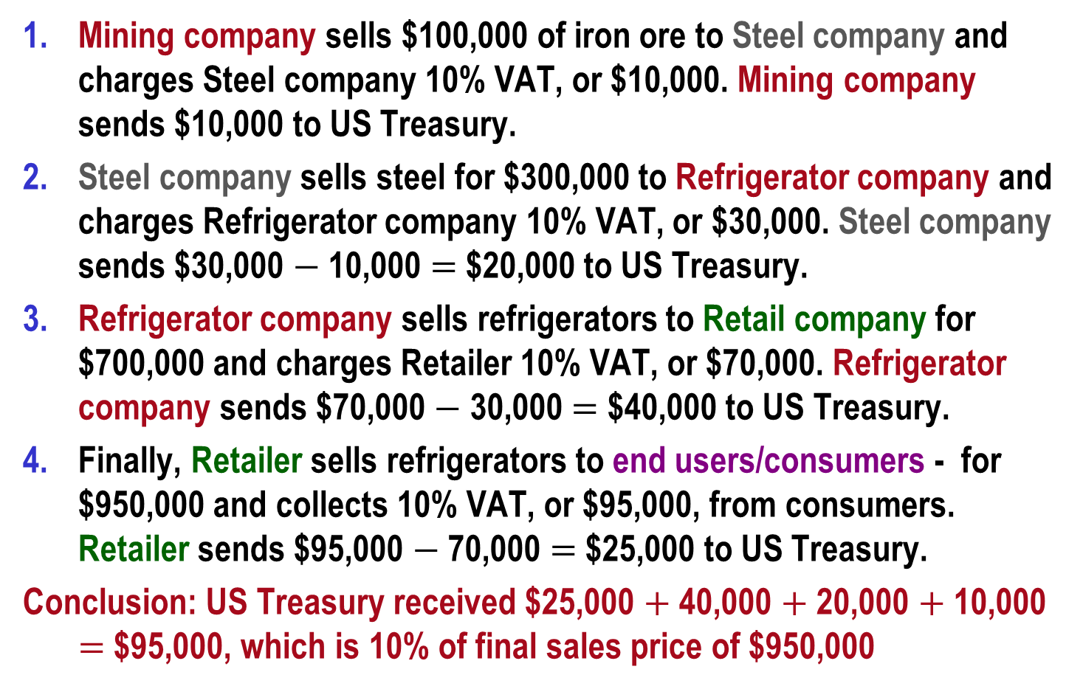
Example: How a 10% VAT Could Work in the US
Mining company sells $100,000 of iron ore to Steel company and charges Steel company 10% VAT, or $10,000. Mining company sends $10,000 to US Treasury.
Steel company sells steel for $300,000 to Refrigerator company and charges Refrigerator company 10% VAT, or $30,000. Steel company sends $30,000 $−$ 10,000 $=$ $20,000 to US Treasury.
Refrigerator company sells refrigerators to Retail company for $700,000 and charges Retailer 10% VAT, or $70,000. Refrigerator company sends $70,000 $−$ 30,000 $=$ $40,000 to US Treasury.
Finally, Retailer sells refrigerators to end users/consumers - for $950,000 and collects 10% VAT, or $95,000, from consumers. Retailer sends $95,000 $−$ 70,000 $=$ $25,000 to US Treasury.
Conclusion: US Treasury received $25,000 $+$ 40,000 $+$ 20,000 $+$ 10,000 $=$ $95,000, which is 10% of final sales price of $950,000

Slide 26
Summary of Important Points
For a corporation’s taxable income (TI), operating expenses and asset depreciation are deductible items
Income tax rates for corporations and individuals are graduated by increasing TI levels
CFAT indirectly includes (noncash) depreciation through the TI computation
Depreciation recapture (DR) occurs when an asset is sold for more than the book value; DR is taxed as regular income in all after-tax evaluations
After-tax analysis uses CFAT values and the same guidelines for alternative selection as before-tax analysis
EVA estimates extra worth that an alternative adds to net worth after taxes; it mingles actual cash flows and noncash flows
A VAT system collects taxes progressively on unfinished goods and services; different than a sales tax system where only end users pay

