Slide 1
Lecture slides to accompany
Engineering Economy, 8th edition
Leland Blank, Anthony Tarquin
©McGraw-Hill Education. All rights reserved. Authorized only for instructor use in the classroom. No reproduction or further distribution permitted without the prior written consent of McGraw-Hill Education.
Notes:
At this point:
1. Introduce yourself - your students are likely to want to know something about your qualifications and interests - overall, where you are coming from.
2. Have students introduce themselves. Ask why they are taking this class. If you are fortunate enough to have a Polaroid camera, take pictures of each student for later posting on a class “board” so both they and you get to know each other.
3. Discuss both choice of textbook and development of syllabus.
4. If you are expecting students to work in teams, at east introduce the choice of team members. If at all possible, have students participate in a team building or team study exercise. It works wonders. Most student have been told to work in teams in prior classes, but have never examined exactly what a team is and how it works. One hour spent in a team building/examination exercise saves many hours and avoids many problems later on.

Slide 2
Chapter 16
Depreciation Methods

Slide 3
LEARNING OUTCOMES
Understand basic terms of asset depreciation
Apply straight line method of depreciation
Apply DB and DDB methods of depreciation; switch between DDB and SL methods
Apply MACRS method of depreciation
Select asset recovery period for MACRS
Explain depletion and apply cost depletion & percentage depletion methods

Slide 4
Depreciation Terminology
Definition: Book (noncash) method to represent decrease in value of
a tangible asset over time
Two types: book depreciation and tax depreciation
Book depreciation: used for internal accounting to track value of assets
Tax depreciation: used to determine taxes due based on tax laws
In USA only, tax depreciation must be calculated using MACRS; book depreciation can be calculated using any method

Slide 5
Common Depreciation Terms
First cost P or unadjusted basis B: Total installed cost of asset
Book value BV_{t}: Remaining undepreciated capital investment in year t
Recovery period n: Depreciable life of asset in years
Market value MV: Amount realizable if asset were sold on open market
Salvage value S: Estimated trade-in or MV at end of asset’s useful life
Depreciation rate d_{t}: Fraction of first cost or basis removed each year t
Personal property: Possessions of company used to conduct business
Real property: Real estate and all improvements (land is not depreciable)
Half-year convention: Assumes assets are placed in service in midyear

Slide 6
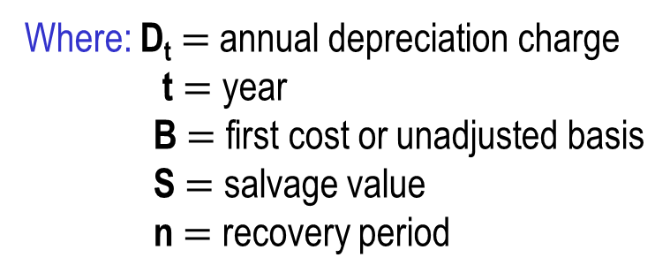
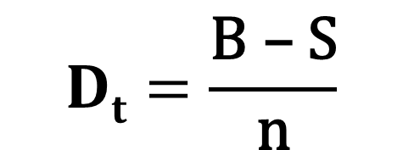

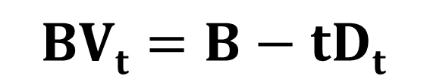
Straight Line Depreciation
Book value decreases linearly with time
$$Dt=\frac{\text{B} \text{–} \text{S}}{\text{n}}$$
Where: D_{t} $=$ annual depreciation charge
t $=$ year
B $=$ first cost or unadjusted basis
S $=$ salvage value
n $=$ recovery period
$$BVt=B−tDt$$
Where: BV_{t} $=$ book value after t years
SL depreciation rate is constant for each year: d $=$ d_{t} $=$ 1/n

Slide 7
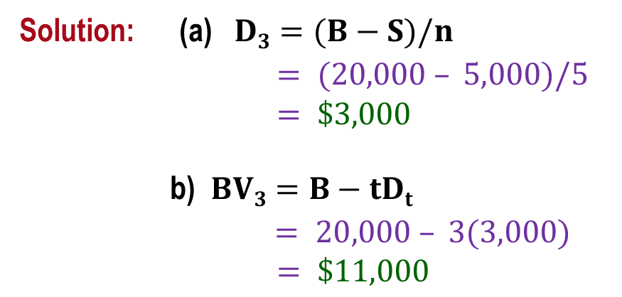
Example: SL Depreciation
An argon gas processor has a first cost of $20,000 with a $5,000 salvage value after 5 years. Find (a) D₃ and (b) BV₃ for year three. (c) Plot book value vs. time.
Solution: (a) $D3=(B−S)/n$
$= (20,000 – 5,000)/5$
$= \$3,000$
b) $BV3=B−tDt$
$= 20,000 – 3(3,000)$
$= \$11,000$
(c) Plot BV vs. time
BV_{t}
20,000
11,000
5,000
0
3
5
Year, t

Slide 8
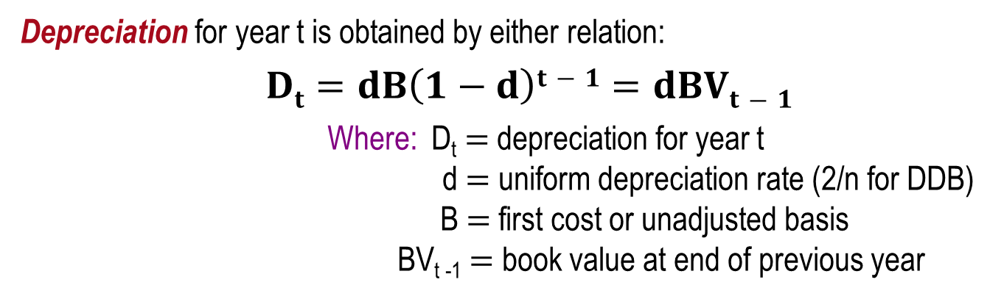
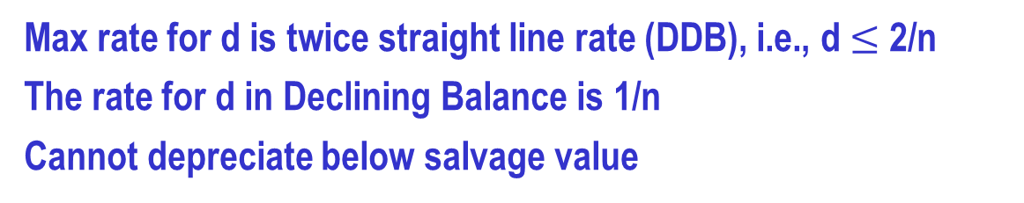
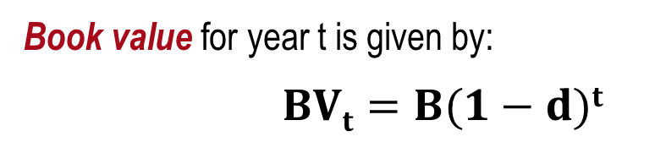
Declining Balance (DB) and
Double Declining Balance (DDB) Depreciation
Determined by multiplying BV at beginning of year by fixed percentage d
Max rate for d is twice straight line rate (DDB), i.e., d $≤$ 2/n
The rate for d in Declining Balance is 1/n
Cannot depreciate below salvage value
Depreciation for year t is obtained by either relation:
$Dt=dB\left(1−d\right)t−1=dBVt−1$
Where: D_{t} $=$ depreciation for year t
d $=$ uniform depreciation rate (2/n for DDB)
B $=$ first cost or unadjusted basis
BV_{t -1} $=$ book value at end of previous year
Book value for year t is given by:
$BVt=B(1−d)t$

Slide 9
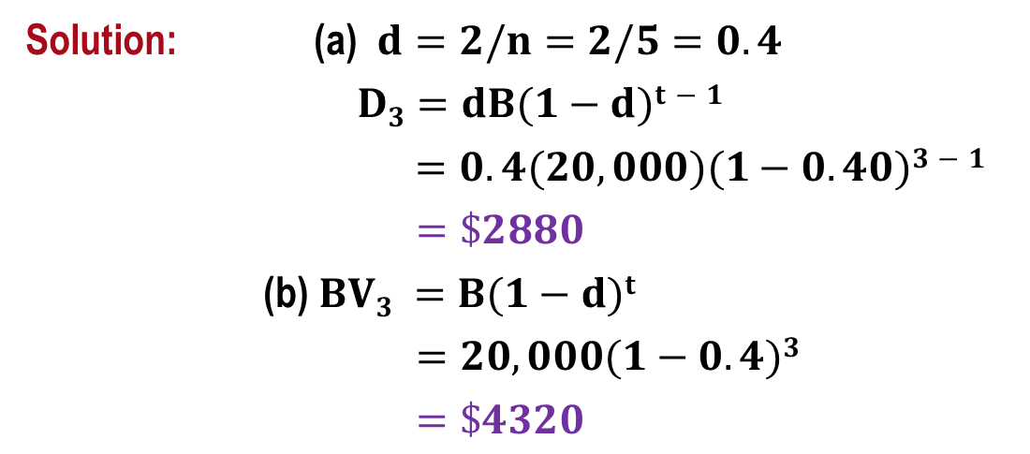
Example: Double Declining Balance
A depreciable construction truck has a first cost of $20,000 with a
$4,000 salvage value after 5 years. Find the (a) depreciation, and
(b) book value after 3 years using DDB depreciation.
Solution: (a) $d=2/n=2/5=0.4$
$D3=dB(1−d)t−1$
$=0.4(20,000)(1−0.40)3−1$
$=\$2880$
(b)$BV3 =B(1−d)t$
$=20,000(1−0.4)3$
$=\$4320$

Slide 10
Spreadsheet Functions for Depreciation
Straight line function: SLN(B,S,n)
Declining balance function: DB(B,S,n,t)
Double declining balance function: DDB(B,S,n,t,d)
Note: It is better to use the DDB function for DB and DDB depreciation. DDB function checks for BV < S and is more accurate than the DB function.

Slide 11
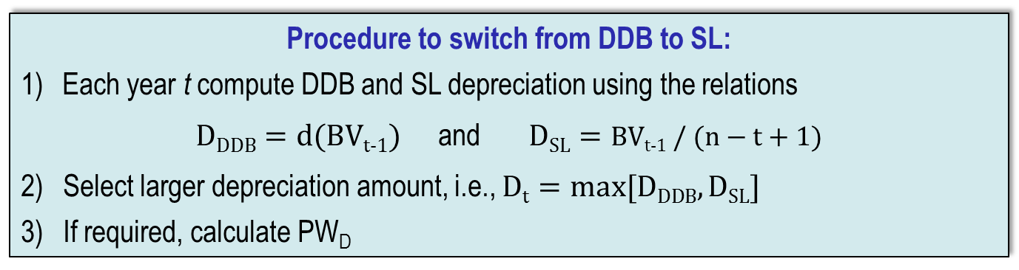
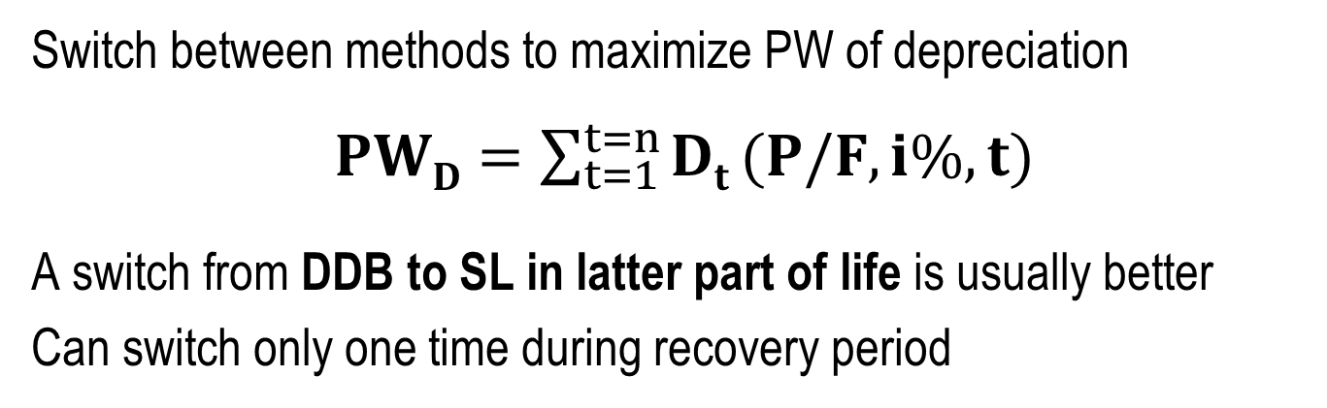
Switching Between Depreciation Methods
Switch between methods to maximize PW of depreciation
$PWD=\sum_{t=1}^{t=n}{Dt}(P/F,i\%,t)$
A switch from DDB to SL in latter part of life is usually better
Can switch only one time during recovery period
Procedure to switch from DDB to SL:
Each year t compute DDB and SL depreciation using the relations
$DDDB=d(BVt\text{-}1)$ and $DSL=BVt\text{-}1 / (n−t+1)$
Select larger depreciation amount, i.e., $Dt=max⁡[DDDB, DSL]$
If required, calculate PW_{D}
Alternatively, use spreadsheet function VDB(B,S,n,start_t,end_t) to determine D_{t}

Slide 12
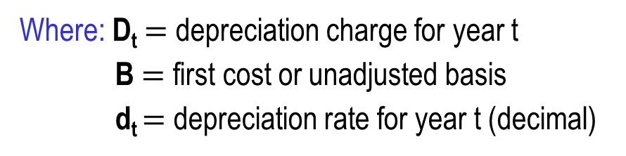
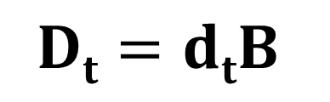

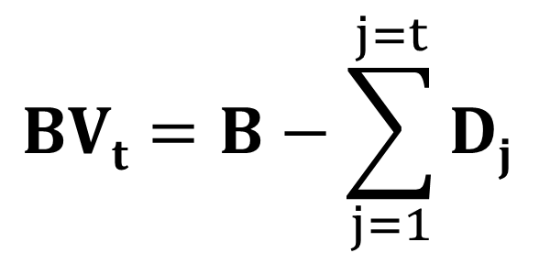
MACRS Depreciation (1)
Required method to use for tax depreciation in USA only
Originally developed to offer accelerated depreciation for economic growth
Where: D_{t} $=$ depreciation charge for year t
B $=$ first cost or unadjusted basis
d_{t} $=$ depreciation rate for year t (decimal)
$$Dt=dtB$$
Get value for d_{t} from IRS table for MACRS rates
$$BVt=B−\sum_{j=1}^{j=t}{Dj}$$
Where: D_{j} $=$ depreciation in year j
$∑$D_{j} $=$ all depreciation through year t

Slide 13
MACRS Depreciation (2)
Always depreciates to zero; no salvage value considered
Incorporates switching from DDB to SL depreciation
Standardized recovery periods (n) are tabulated
MACRS recovery time is always n+1 years;
half-year convention assumes purchase in midyear
No special spreadsheet function; can arrange VDB function to display MACRS depreciation each year

Slide 14
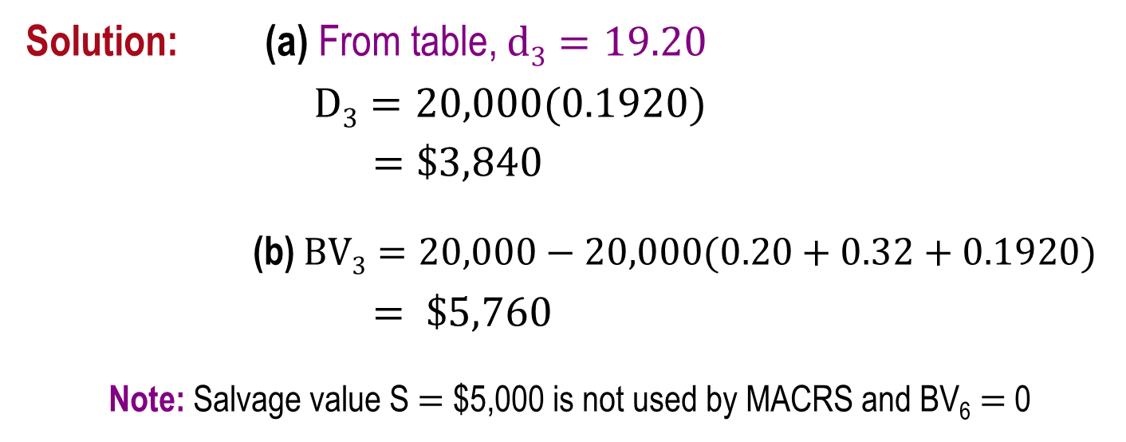
Example: MACRS Depreciation
A finishing machine has a first cost of $20,000 with a $5,000
salvage value after 5 years. Using MACRS, find (a) D and (b) BV
for year 3.
Solution: (a) From table, $d3=19.20$
$D3=20,000(0.1920)$
$=\$3,840$
(b) $BV3=20,000−20,000(0.20+0.32+0.1920)$
$= \$5,760$
Note: Salvage value S $=$ $5,000 is not used by MACRS and BV₆ $=$ 0

Slide 15
MACRS Recovery Period
Recovery period (n) is function of property class
Two systems for determining recovery period:
general depreciation system (GDS) – fastest write-off allowed
alternative depreciation system (ADS) – longer recovery; uses SL
IRS publication 946 gives n values for an asset. For example:
 | MACRS n value | MACRS n value
Asset description | GDS | ADS range
Special manufacturing devices, racehorses, tractors | 3 | 3 – 5
Computers, oil drilling equipment, autos, trucks, buses | 5 | 6 – 9.5
Office furniture, railroad car, property not in another class | 7 | 10 – 15
Nonresidential real property (not land itself) 39 40

Slide 16
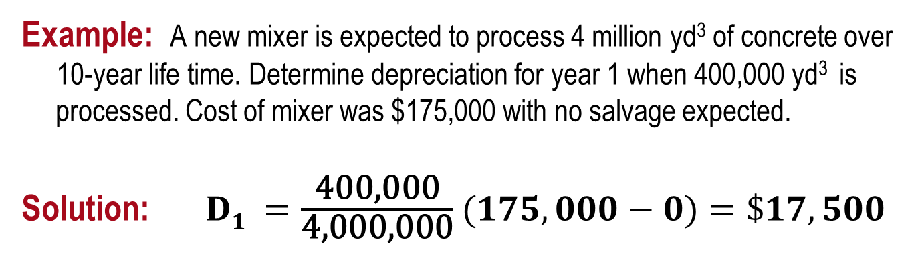
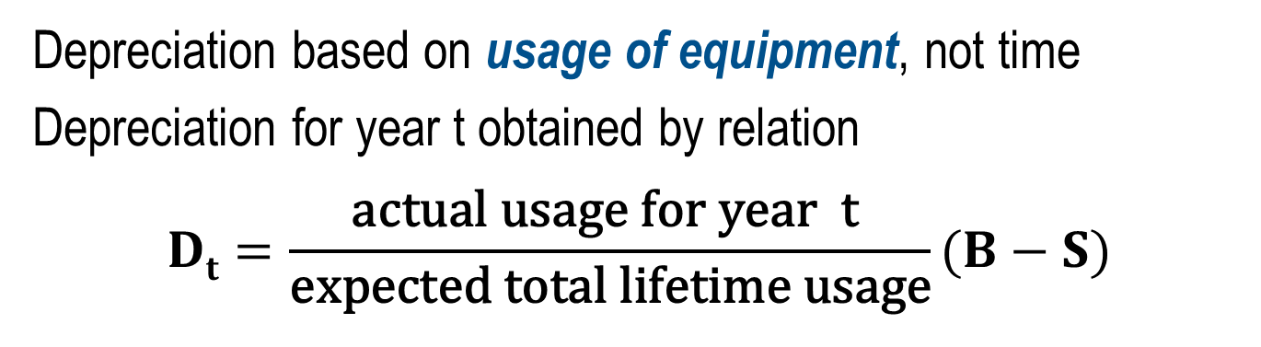
Unit-of-Production (UOP) Depreciation
Depreciation based on usage of equipment, not time
Depreciation for year t obtained by relation
$$Dt=\frac{\text{actual} \text{usage} \text{for} \text{year} \text{t} }{\text{expected} \text{total} \text{lifetime} \text{usage}}(B−S)$$
Example: A new mixer is expected to process 4 million yd³ of concrete over
10-year life time. Determine depreciation for year 1 when 400,000 yd³ is processed. Cost of mixer was $175,000 with no salvage expected.
Solution: $D1 =\frac{\text{400,000}}{\text{4,000,000}}$ $(175,000−0)=\$17,500$

Slide 17
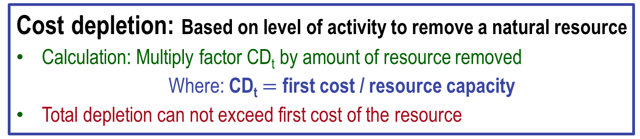
Depletion Methods
Depletion: book (noncash) method to represent decreasing value of natural resources
Two methods: cost depletion (CD) and percentage depletion (PD)
Cost depletion: Based on level of activity to remove a natural resource
Calculation: Multiply factor CD_{t} by amount of resource removed
Where: CD_{t} $=$ first cost / resource capacity
Total depletion can not exceed first cost of the resource
Percentage depletion: Based on gross income (GI) from resource
Calculation: Multiply GI by standardized rate (%) from table
Annual depletion can not exceed 50% of company’s taxable income (TI)

Slide 18
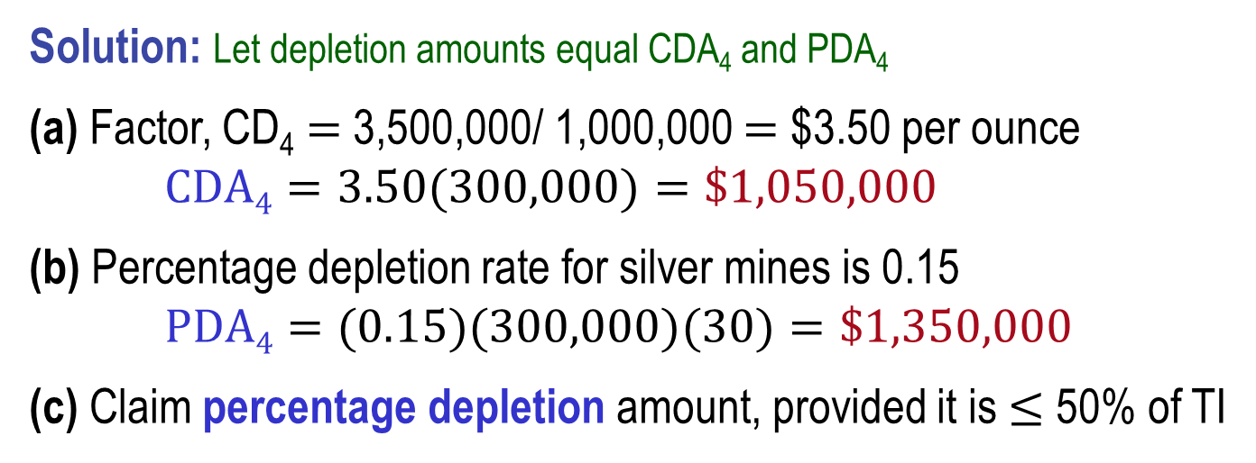
Example: Cost and Percentage Depletion
A mine purchased for $3.5 million has a total expected yield of one million ounces of silver. Determine the depletion charge in year 4 when 300,000 ounces are mined and sold for $30 per ounce using (a) cost depletion, and (b) percentage depletion. (c) Which is larger for year 4?
Solution: Let depletion amounts equal CDA₄ and PDA₄
(a) Factor, CD₄ $=$ 3,500,000/ 1,000,000 $=$ $3.50 per ounce
$CDA4=3.50(300,000)=\$1,050,000$
(b) Percentage depletion rate for silver mines is 0.15
$PDA4=(0.15)(300,000)(30)=\$1,350,000$
(c) Claim percentage depletion amount, provided it is $≤$ 50% of TI

Slide 19
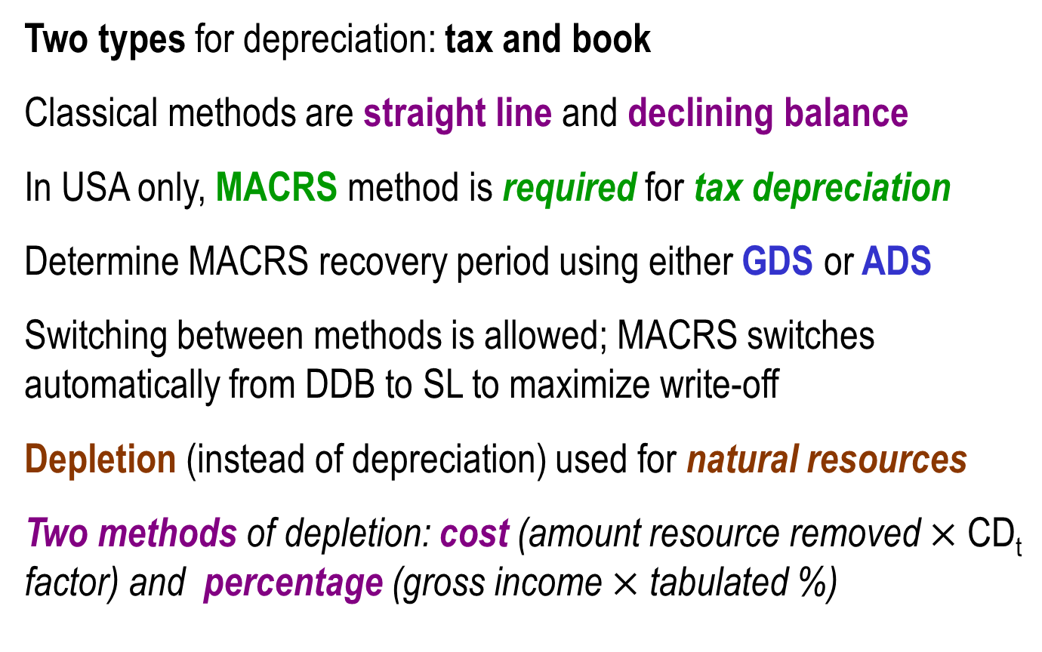
Summary of Important Points
Two types for depreciation: tax and book
Classical methods are straight line and declining balance
In USA only, MACRS method is required for tax depreciation
Determine MACRS recovery period using either GDS or ADS
Switching between methods is allowed; MACRS switches automatically from DDB to SL to maximize write-off
Depletion (instead of depreciation) used for natural resources
Two methods of depletion: cost (amount resource removed $×$ CD_{t} factor) and percentage (gross income $×$ tabulated %)

