Slide 1
Lecture slides to accompany
Engineering Economy, 8th edition
Leland Blank, Anthony Tarquin
©McGraw-Hill Education. All rights reserved. Authorized only for instructor use in the classroom. No reproduction or further distribution permitted without the prior written consent of McGraw-Hill Education.
Notes:
At this point:
1. Introduce yourself - your students are likely to want to know something about your qualifications and interests - overall, where you are coming from.
2. Have students introduce themselves. Ask why they are taking this class. If you are fortunate enough to have a Polaroid camera, take pictures of each student for later posting on a class “board” so both they and you get to know each other.
3. Discuss both choice of textbook and development of syllabus.
4. If you are expecting students to work in teams, at east introduce the choice of team members. If at all possible, have students participate in a team building or team study exercise. It works wonders. Most student have been told to work in teams in prior classes, but have never examined exactly what a team is and how it works. One hour spent in a team building/examination exercise saves many hours and avoids many problems later on.

Slide 2
Chapter 15
Cost Estimation and Indirect Costs

Slide 3
LEARNING OUTCOMES
Approaches to estimation
Unit method
Cost indexes
Cost-capacity equations
Factor method
Indirect cost rates and allocation
ABC allocation
Ethical considerations

Slide 4
Direct and Indirect Cost Estimates
Direct cost examples
Physical assets
Maintenance and operating costs (M&O)
Materials
Direct human labor (costs and benefits)
Scrapped and reworked product
Direct supervision of personnel
Indirect cost examples
Utilities
IT systems and networks
Purchasing
Management
Taxes
Legal functions
Warranty and guarantees
Quality assurance
Accounting functions
Marketing and publicity

Slide 5
What Direct Cost Estimation Includes
Direct costs are more commonly estimated than revenue in an engineering environment. Preliminary decisions required are:
What cost components should be estimated?
What approach to estimation is best to apply?
How accurate should the estimates be?
What technique(s) will be applied to estimate costs?
Sample direct cost components: first costs and its elements
(P); annual costs (AOC or M&O); salvage/market value (S)
Approaches: bottom-up; design-to-cost (top down)
Accuracy: feasibility stage through detailed design estimates
require more exacting estimates
Some techniques: unit; factor; cost estimating relations (CER)

Slide 6
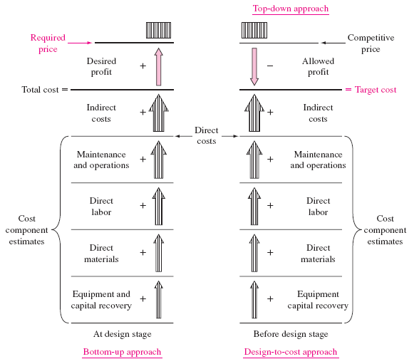
Different Approaches to Cost Estimation

Slide 7
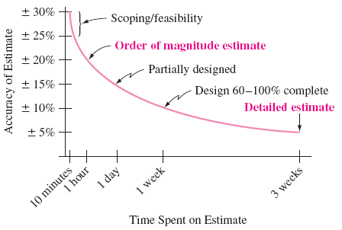
Accuracy of Cost Estimates
General guidelines for accuracy
Conceptual/Feasibility stage – order-of-magnitude estimates are in range of ±20% of actual costs
Detailed design stage – Detailed estimates are in range of ±5% of actual costs
Characteristic curve of accuracy vs. time to make estimates

Slide 8
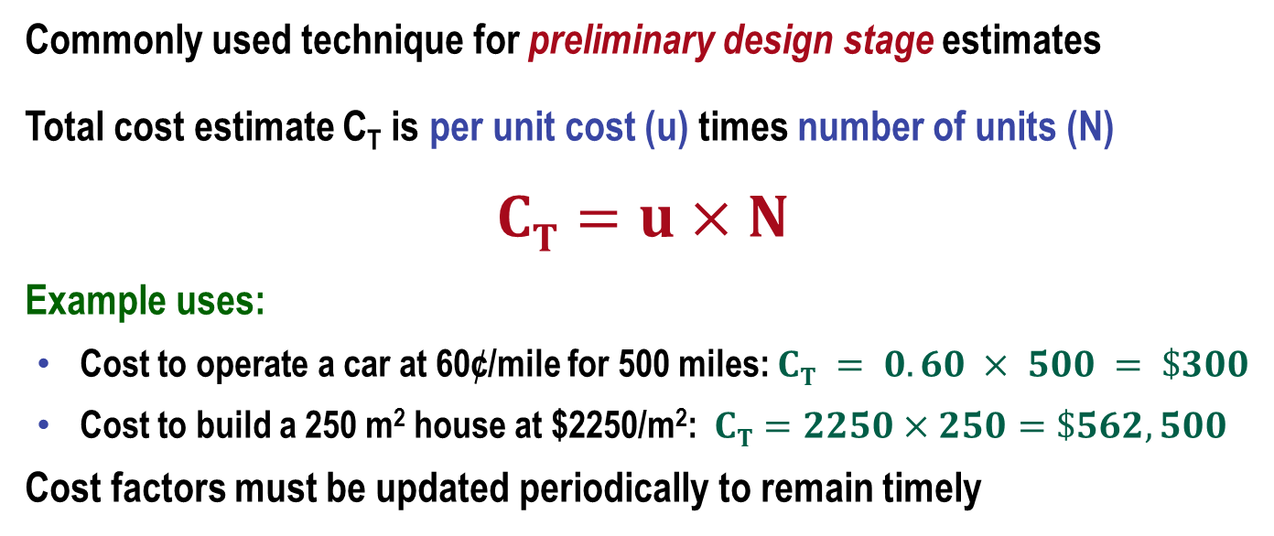
Unit Method
Commonly used technique for preliminary design stage estimates
Total cost estimate C_{T} is per unit cost (u) times number of units (N)
$$CT=u×N$$
Example uses:
  Cost to operate a car at 60¢/mile for 500 miles: $CT = 0.60 × 500 = \$300$
  Cost to build a 250 m² house at $2250/m²: $CT=2250×250=\$562,500$
Cost factors must be updated periodically to remain timely
When several components are involved, estimate cost of each component and add to determine total cost estimate C_{T}

Slide 9
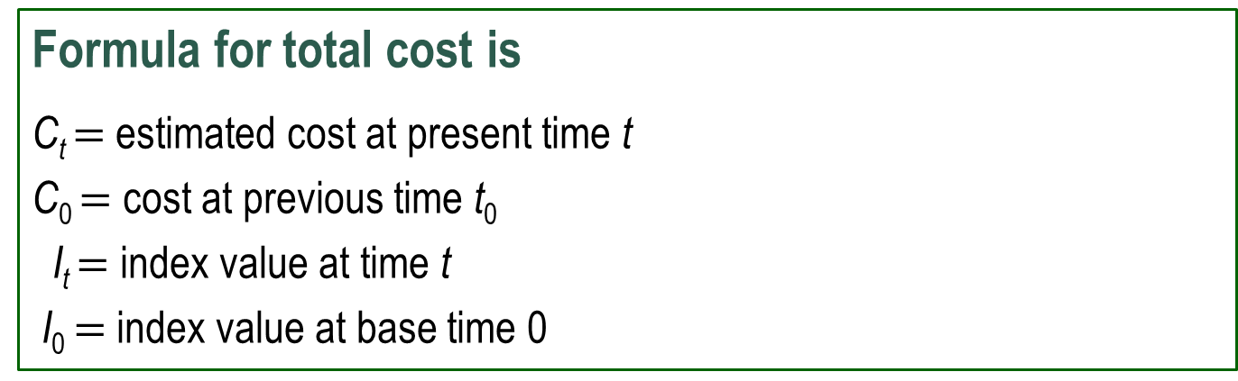
Cost Indexes
Definition: Cost Index is ratio of cost today to cost in the past
  Indicates change in cost over time; therefore, they account for the impact of inflation
  Index is dimensionless
  CPI (Consumer Price Index) is a good example
Formula for total cost is
C_{t} $=$ estimated cost at present time t
C₀ $=$ cost at previous time t₀
I_{t} $=$ index value at time t
I₀ $=$ index value at base time 0

Slide 10
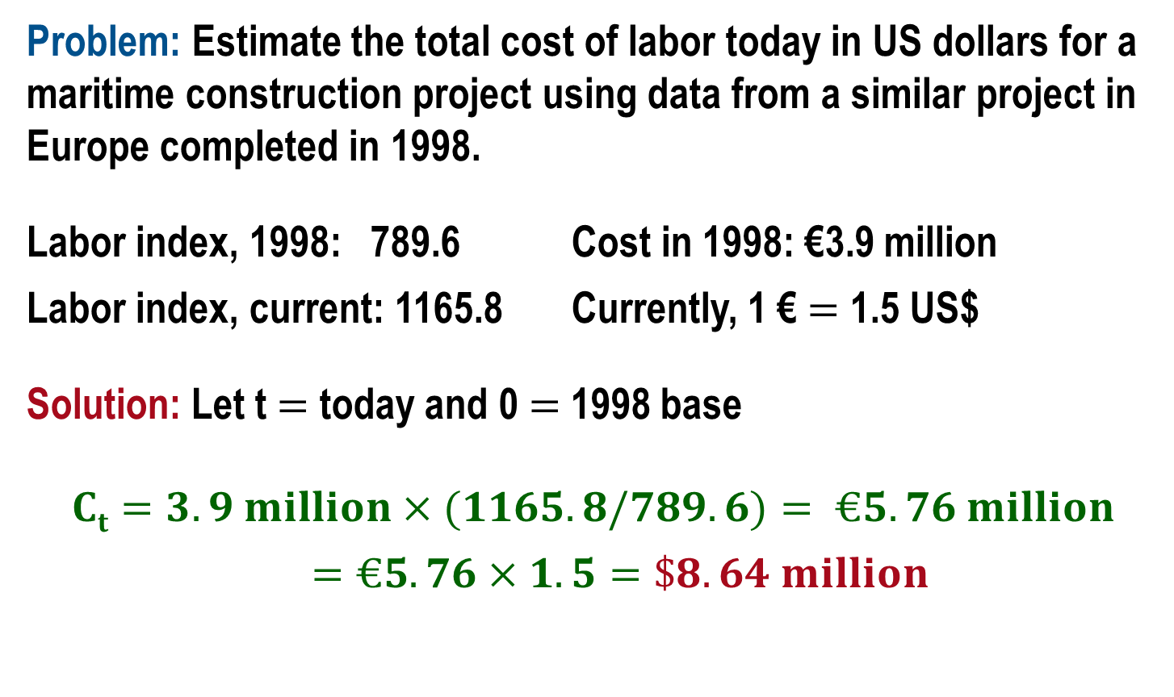
Example: Cost Index Method
Problem: Estimate the total cost of labor today in US dollars for a maritime construction project using data from a similar project in Europe completed in 1998.
Labor index, 1998: 789.6 Cost in 1998: €3.9 million
Labor index, current: 1165.8 Currently, 1 € $=$ 1.5 US$
Solution: Let t $=$ today and 0 $=$ 1998 base
$$Ct=3.9 million×(1165.8/789.6)= €5.76 million$$
$$=€5.76×1.5=\$8.64 million$$

Slide 11
Finding Cost Indexes
Cost indexes are maintained in areas such as construction, chemical and mechanical industries
  Updated monthly and annually; many include regionalized and international project indexes
  Indexes in these areas are often subdivided into smaller components and can be used in preliminary, as well as detailed design stages
Examples are:
  Chemical Engineering Plant Cost Index (CEPCI)
  www.che.com/pci
  McGraw-Hill Construction Index
  www.construction.com
  US Department of Labor, Bureau of Labor Statistics
  www.bls.gov

Slide 12
Cost-Estimating Relationships (CER)
CER equations are used in early design stages to estimate plant, equipment and construction costs
CERs are generically different from index relations, because they estimate based on design variables (weight, thrust, force, pressure, speed, etc.)
Two commonly used CERs
  Cost-capacity equation (relates cost to capacity)
  Factor method (total plant cost estimator, including indirect costs)

Slide 13
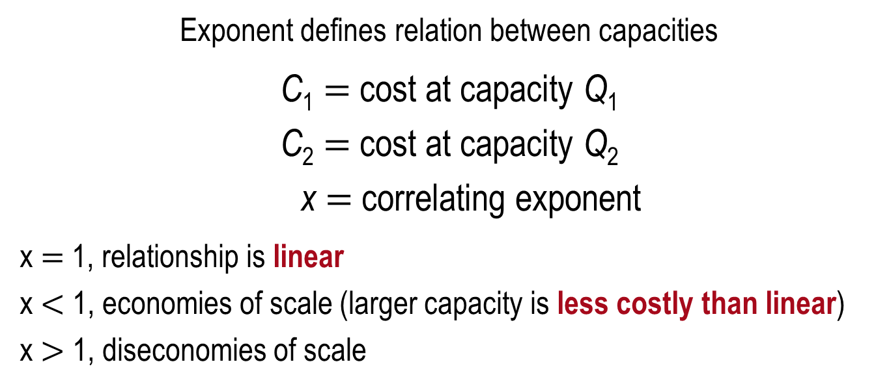
Cost-Capacity Equation
Also called power law and sizing model
Exponent defines relation between capacities
C₁ $=$ cost at capacity Q₁
C₂ $=$ cost at capacity Q₂
x $=$ correlating exponent
x $=$ 1, relationship is linear
x $<$ 1, economies of scale (larger capacity is less costly than linear)
x $>$ 1, diseconomies of scale

Slide 14
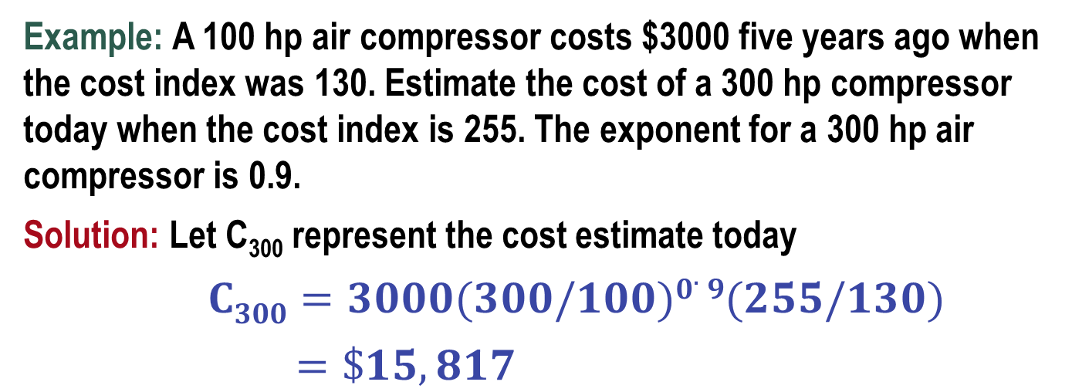
Cost-Capacity Combined with Cost Index
Multiply the cost-capacity equation by a cost index (I_{t}/I₀) to adjust for time differences and obtain estimates of current cost (in constant-value dollars)
Example: A 100 hp air compressor costs $3000 five years ago when the cost index was 130. Estimate the cost of a 300 hp compressor today when the cost index is 255. The exponent for a 300 hp air compressor is 0.9.
Solution: Let C₃₀₀ represent the cost estimate today
$C300=3000(300/100)0.9(255/130)$
$=\$15,817$

Slide 15
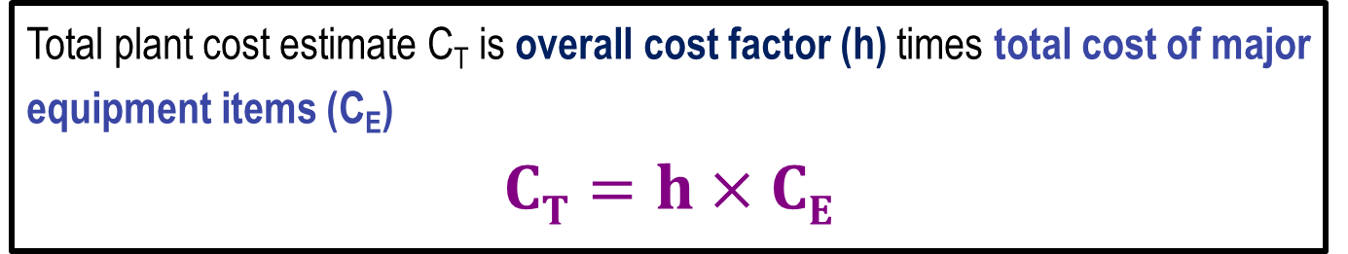
Factor Method
Factor method is especially useful in estimating total plant cost in processing industries
Both direct and indirect costs can be included
Total plant cost estimate C_{T} is overall cost factor (h) times total cost of major equipment items (C_{E})
$$CT=h×CE$$
Overall cost factor h is determined using one of two bases:
Delivered-equipment cost (purchase cost of major equipment)
Installed-equipment cost (equipment cost plus all make-ready costs)

Slide 16
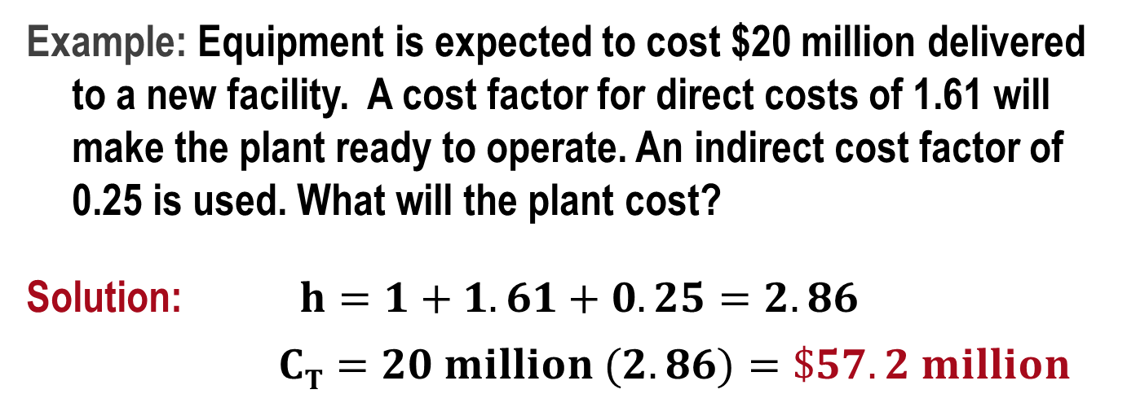
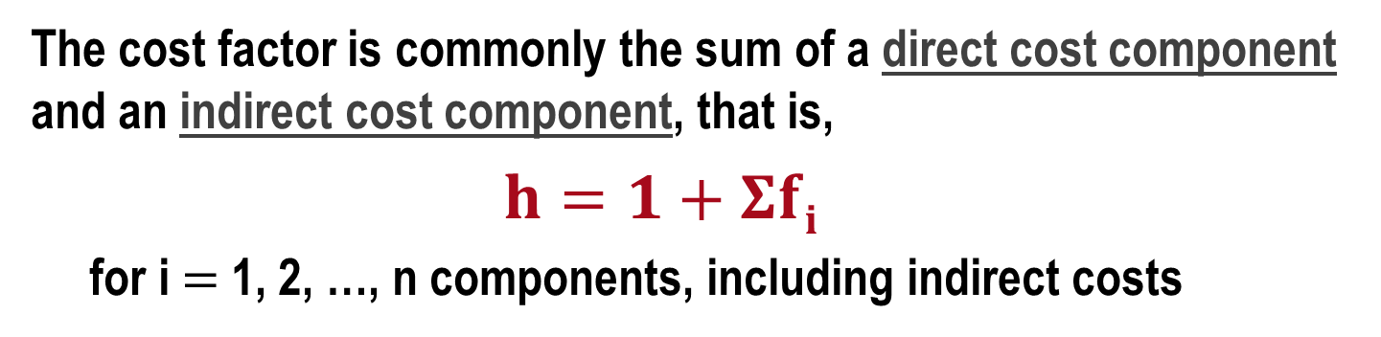
Cost Factor h (1)
The cost factor is commonly the sum of a direct cost component and an indirect cost component, that is,
$$h=1+Σfi$$
for i $=$ 1, 2, …, n components, including indirect costs
Example: Equipment is expected to cost $20 million delivered to a new facility. A cost factor for direct costs of 1.61 will make the plant ready to operate. An indirect cost factor of 0.25 is used. What will the plant cost?
Solution: $h=1+1.61+0.25=2.86$
$CT=20 million (2.86)=\$57.2 million$

Slide 17
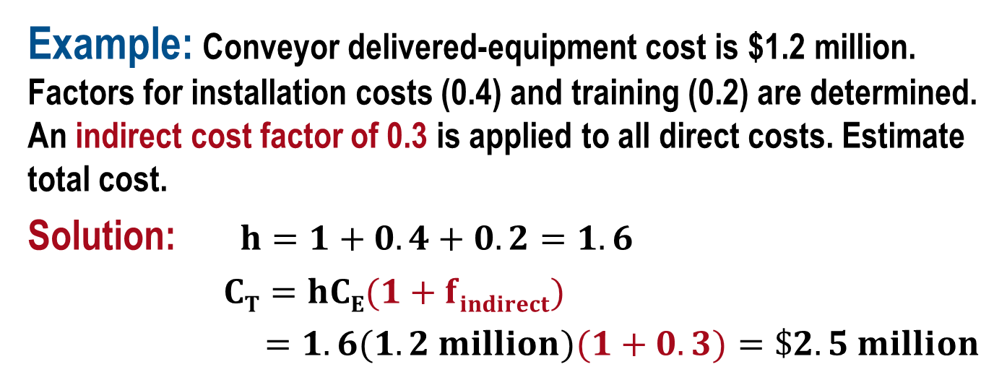
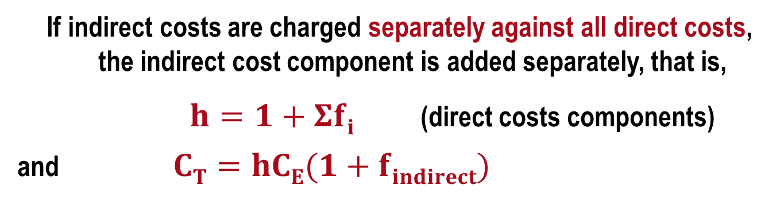
Cost Factor h (2)
If indirect costs are charged separately against all direct costs, the indirect cost component is added separately, that is,
$h=1+Σfi$ (direct costs components)
and $CT=hCE(1+findirect)$
Example: Conveyor delivered-equipment cost is $1.2 million. Factors for installation costs (0.4) and training (0.2) are determined. An indirect cost factor of 0.3 is applied to all direct costs. Estimate total cost.
Solution: $h=1+0.4+0.2=1.6$
$CT=hCE(1+findirect)$
$=1.6(1.2 million)(1+0.3)=\$2.5 million$

Slide 18
Indirect Costs
Indirect costs (IDC) are incurred in production, processes and service delivery that are not easily tracked and assignable to a specific function.
Indirect costs (IDC) are shared by many functions because they are necessary to perform the overall objective of the company
Indirect costs make up a significant percentage of the overall costs in many organizations – 25% to 65%
Sample indirect costs
  IT services
  Quality assurance
  Human resources
  Management
  Safety and security
  Purchasing; contracting
  Accounting; finance; legal

Slide 19
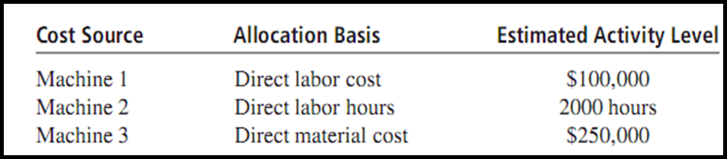
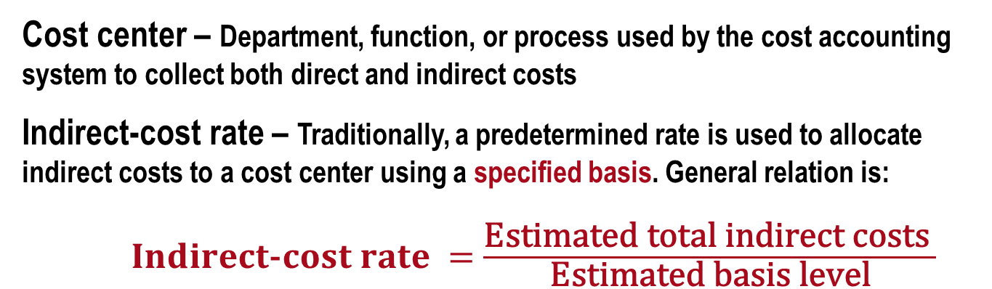
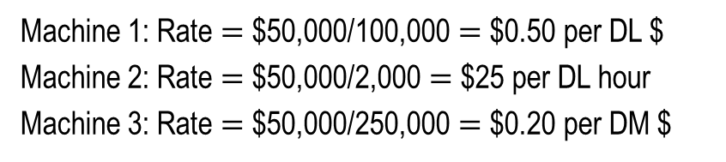
Indirect Cost Allocation - Traditional Method
Cost center – Department, function, or process used by the cost accounting system to collect both direct and indirect costs
Indirect-cost rate – Traditionally, a predetermined rate is used to allocate indirect costs to a cost center using a specified basis. General relation is:
$Indirect\text{-}cost rate =$ $\frac{\text{Estimated} \text{total} \text{indirect} \text{costs} }{\text{Estimated} \text{basis} \text{level}}$
Example:
Allocation rates for $50,000 to each machine
Machine 1: Rate $=$ $50,000/100,000 $=$ $0.50 per DL $
Machine 2: Rate $=$ $50,000/2,000 $=$ $25 per DL hour
Machine 3: Rate $=$ $50,000/250,000 $=$ $0.20 per DM $

Slide 20
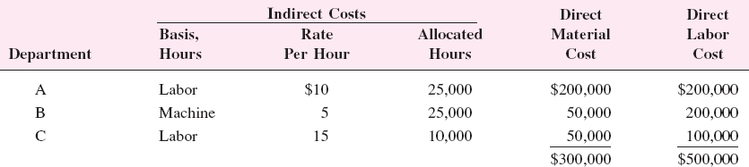
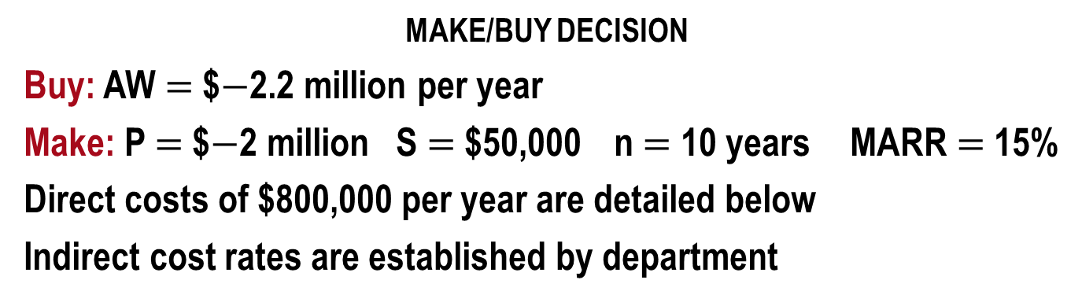
Example: AW Analysis - Traditional IDC Allocation
MAKE/BUY DECISION
Buy: AW $=$ $$−$2.2 million per year
Make: P $=$ $$−$2 million S $=$ $50,000 n $=$ 10 years MARR $=$ 15%
Direct costs of $800,000 per year are detailed below
Indirect cost rates are established by department

Slide 21
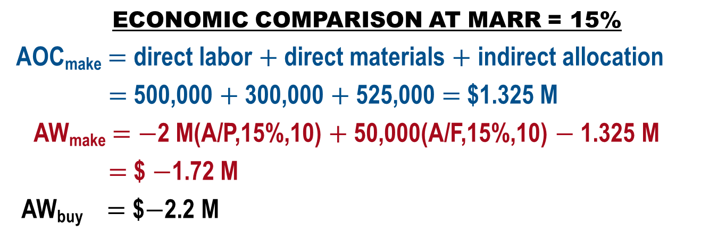
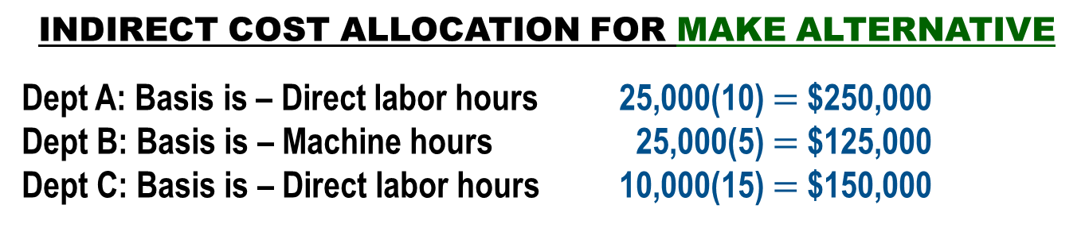
Example: Indirect Cost Analysis - Traditional Method
INDIRECT COST ALLOCATION FOR MAKE ALTERNATIVE
Dept A: Basis is – Direct labor hours 25,000(10) $=$ $250,000
Dept B: Basis is – Machine hours 25,000(5) $=$ $125,000
Dept C: Basis is – Direct labor hours 10,000(15) $=$ $150,000
$525,000
ECONOMIC COMPARISON AT MARR = 15%
AOC_{make} $=$ direct labor $+$ direct materials $+$ indirect allocation
$=$ 500,000 $+$ 300,000 $+$ 525,000 $=$ $1.325 M
AW_{make} $=$ $−$2 M(A/P,15%,10) $+$ 50,000(A/F,15%,10) $−$ 1.325 M
$=$ $ $−$1.72 M
AW_{buy} $=$ $$−$2.2 M
Conclusion: Cheaper to make

Slide 22
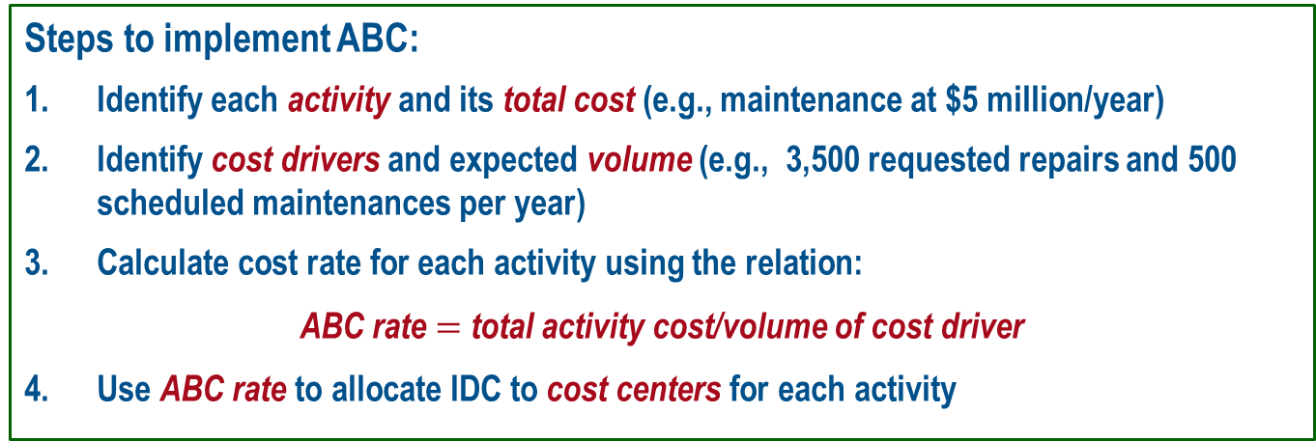
ABC Allocation
Activity-Based Costing ─ Provides excellent allocation strategy and analysis of costs for more advanced, high overhead, technologically-based systems
Cost Centers (cost pools) ─ Final products/services that receive allocations
Activities ─ Support departments that generate indirect costs for distribution to cost centers (maintenance, engineering, management)
Cost drivers ─ These are the volumes that drive consumption of shared resources (# of POs, # of machine setups, # of safety violations, # of scrapped items)
Steps to implement ABC:
Identify each activity and its total cost (e.g., maintenance at $5 million/year)
Identify cost drivers and expected volume (e.g., 3,500 requested repairs and 500 scheduled maintenances per year)
Calculate cost rate for each activity using the relation:
ABC rate $=$ total activity cost/volume of cost driver
Use ABC rate to allocate IDC to cost centers for each activity

Slide 23
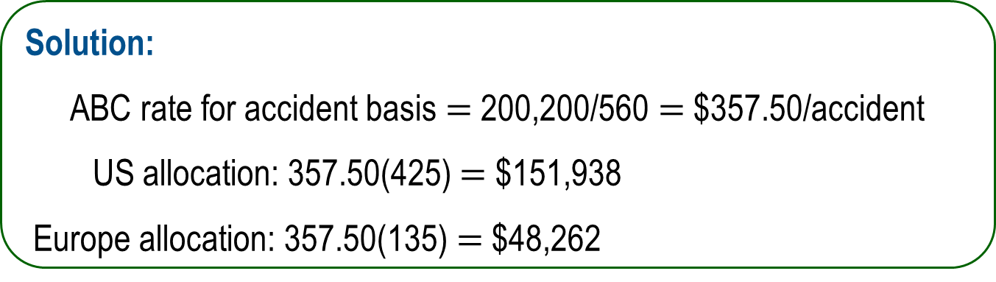
Example: ABC Allocation
Use ABC to allocate safety program costs to plants in US and Europe
Cost centers: US and European plants
Activity and cost: Safety program costs $200,200 per year
Cost driver: # of accidents
Volume: 560 accidents; 425 in US plants and 135 in European plants
Solution:
ABC rate for accident basis $=$ 200,200/560 $=$ $357.50/accident
US allocation: 357.50(425) $=$ $151,938
Europe allocation: 357.50(135) $=$ $48,262

Slide 24
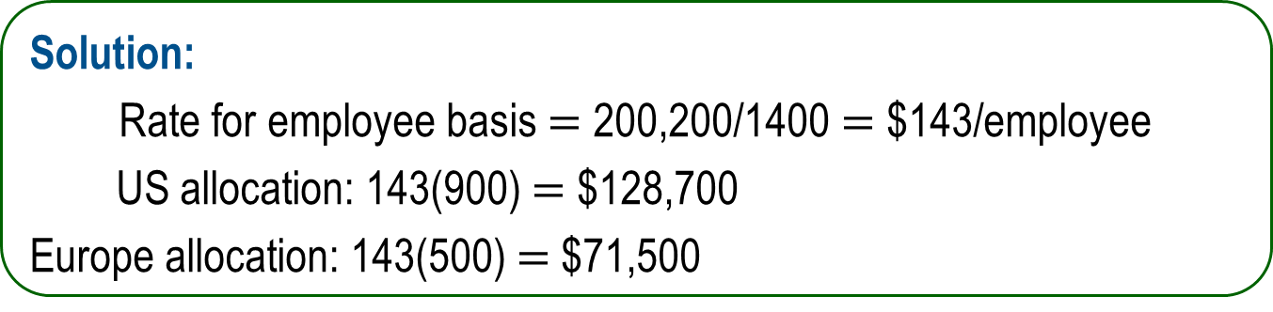
Example: Traditional Allocation Comparison
Use traditional rates to allocate safety costs to US and EU plants
Cost centers: US and European plants
Activity and cost: Safety program costs $200,200 per year
Basis: number of employees
Volume: 1400 employees; 900 in US plants and 500 in European plants
Solution:
Rate for employee basis $=$ 200,200/1400 $=$ $143/employee
US allocation: 143(900) $=$ $128,700
Europe allocation: 143(500) $=$ $71,500
Comparison: US allocation went down;
European allocation increased

Slide 25
Traditional vs. ABC Allocation
Traditional method is easier to set up and use
Traditional method is usually better when making cost estimates
ABC is more accurate when process is in operation
ABC is more costly, but provides more information for cost analysis and decision making
Traditional and ABC methods complement each other:
  Traditional is good for cost estimation and allocation
  ABC is better for cost tracking and cost control

Slide 26
Ethics and Cost Estimating
Unethical practices in estimation may be the result of:
Personal gain motivation
Bias
Deception
Favoritism toward an individual or organization
Intentional poor accuracy
Pre-arranged financial favors (bribes, kickbacks)
When making any type of estimates, always comply with the
Code of Ethics for Engineers
Avoid deceptive acts

Slide 27
Summary of Important Points
Required accuracy of cost estimates depends on the stage of a system design; accuracy varies from ±20% to ±5% of actual cost
Costs can be updated using the unit method and cost indexes, where time differences are considered (inflation over time)
The factor method estimates total plant costs, including indirect costs
Indirect costs comprise a large percentage of product and service costs
Traditional indirect cost allocation use bases such as direct labor hours, costs, and direct materials
The ABC method of indirect cost allocation uses cost drivers to allocate to cost centers; it is better for understanding and analyzing cost accumulation
Unethical practices in cost estimation result from personal financial motives, deception, financial pre-arrangements. Avoid deceptive acts

