Slide 1
Lecture slides to accompany
Engineering Economy, 8th edition
Leland Blank, Anthony Tarquin
©McGraw-Hill Education. All rights reserved. Authorized only for instructor use in the classroom. No reproduction or further distribution permitted without the prior written consent of McGraw-Hill Education.
Notes:
At this point:
1. Introduce yourself - your students are likely to want to know something about your qualifications and interests - overall, where you are coming from.
2. Have students introduce themselves. Ask why they are taking this class. If you are fortunate enough to have a Polaroid camera, take pictures of each student for later posting on a class “board” so both they and you get to know each other.
3. Discuss both choice of textbook and development of syllabus.
4. If you are expecting students to work in teams, at east introduce the choice of team members. If at all possible, have students participate in a team building or team study exercise. It works wonders. Most student have been told to work in teams in prior classes, but have never examined exactly what a team is and how it works. One hour spent in a team building/examination exercise saves many hours and avoids many problems later on.

Slide 2
Chapter 14
Effects of Inflation

Slide 3
LEARNING OUTCOMES
Understand inflation/deflation
Calculate PW of cash flows with inflation
Calculate FW with inflation considered
Calculate AW with inflation considered

Slide 4
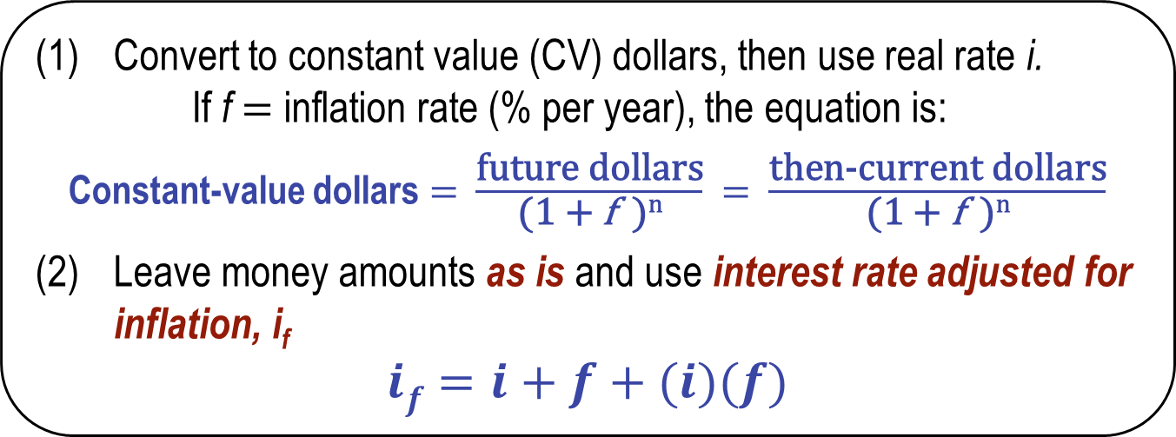
Understanding Inflation
Inflation: Increase in amount of money needed to purchase same amount of goods or services. Inflation results in a decrease in purchasing power, i.e., one unit of money buys less
goods or services
Two ways to work problems when considering inflation:
(1) Convert to constant value (CV) dollars, then use real rate i.
If f $=$ inflation rate (% per year), the equation is:
Constant-value dollars $=$ $\frac{\text{future} \text{dollars}}{\text{(1} \text{+} \text{f} \text{)}\text{n}}$ $=$ $\frac{\text{then}\text{-}\text{current} \text{dollars}}{\text{(1} \text{+ }\text{f} \text{)}\text{n}}$
(2) Leave money amounts as is and use interest rate adjusted for inflation, i_{f}
$$if=i+f+(i)(f)$$

Slide 5
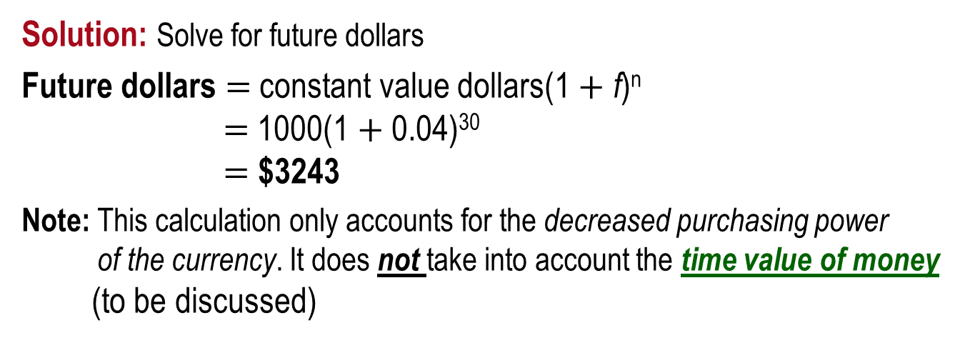
Example: Constant Value Dollars
How much would be required today to purchase an item that increased in cost by exactly the inflation rate? The cost 30 years ago was $1000 and inflation has consistently averaged 4% per year.
Solution: Solve for future dollars
Future dollars $=$ constant value dollars(1 $+$ f)^{n}
$=$ 1000(1 $+$ 0.04)³⁰
$=$ $3243
Note: This calculation only accounts for the decreased purchasing power
of the currency. It does not take into account the time value of money
(to be discussed)
Deflation: Opposite of inflation; purchasing power of money is greater in future than at present; however, money, credit, jobs are ‘tighter’

Slide 6
Three Different Rates
Real or inflation rate i – Rate at which interest is earned when effects of inflation are removed; i represents the real increase in purchasing power
Market or inflation-adjusted rate i_{f} – Rate that takes inflation into account. Commonly stated rate everyday
Inflation rate f – Rate of change in value of currency
Relation between three rates is derived using the relation
Market rate is: $if=i+f+(i)(f)$

Slide 7
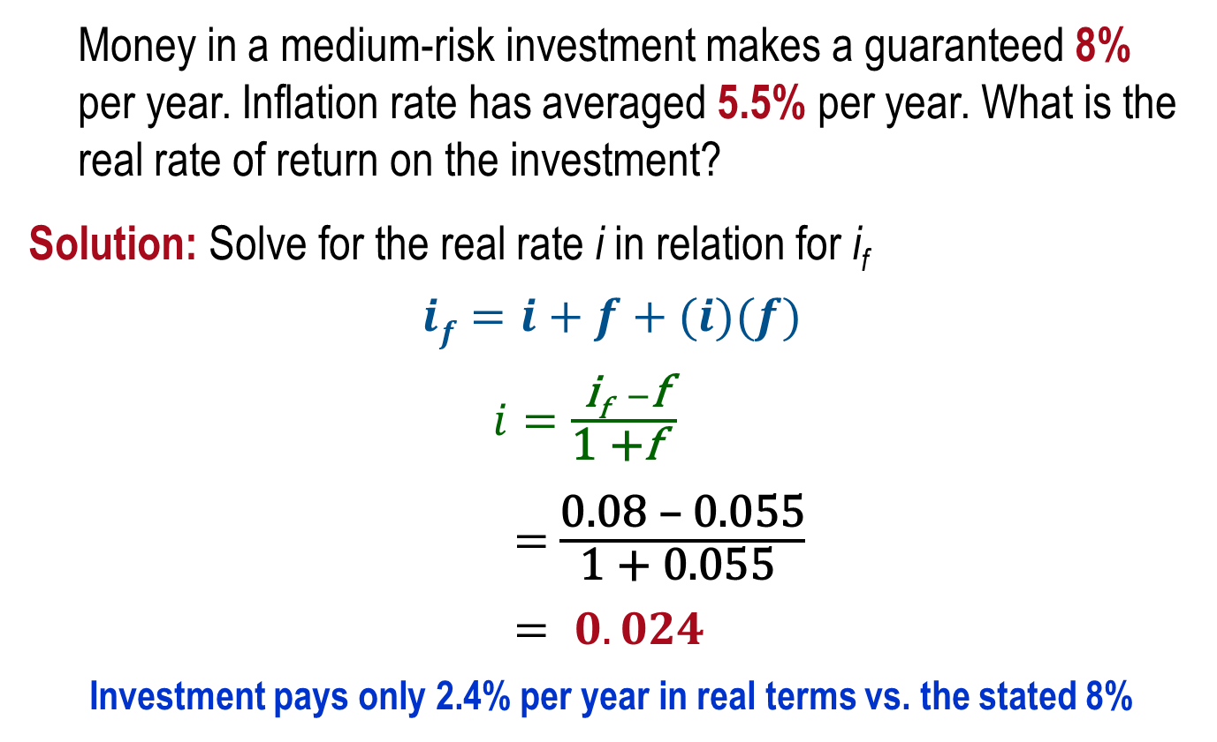
Example: Market vs. Real Rate
Money in a medium-risk investment makes a guaranteed 8% per year. Inflation rate has averaged 5.5% per year. What is the real rate of return on the investment?
Solution: Solve for the real rate i in relation for i_{f}
$$if=i+f+(i)(f)$$
$i=\frac{\text{i}\text{f} −\text{f}}{\text{1 +}\text{f} }$
$=$ $\frac{\text{0.08 – 0.055}}{\text{1 + 0.055 }}$
$= 0.024$
Investment pays only 2.4% per year in real terms vs. the stated 8%

Slide 8
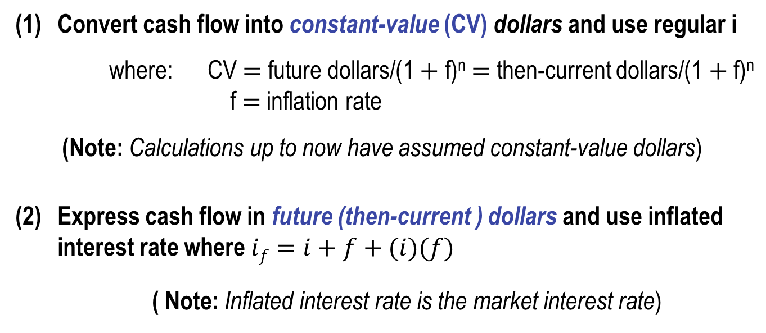
PW Calculations with Inflation
Two ways to account for inflation in PW calculations
(1) Convert cash flow into constant-value (CV) dollars and use regular i
where: CV $=$ future dollars/(1 $+$ f)^{n} $=$ then-current dollars/(1 $+$ f)^{n}
f $=$ inflation rate
(Note: Calculations up to now have assumed constant-value dollars)
(2) Express cash flow in future (then-current ) dollars and use inflated interest rate where $if=i+f+(i)(f)$
( Note: Inflated interest rate is the market interest rate)

Slide 9
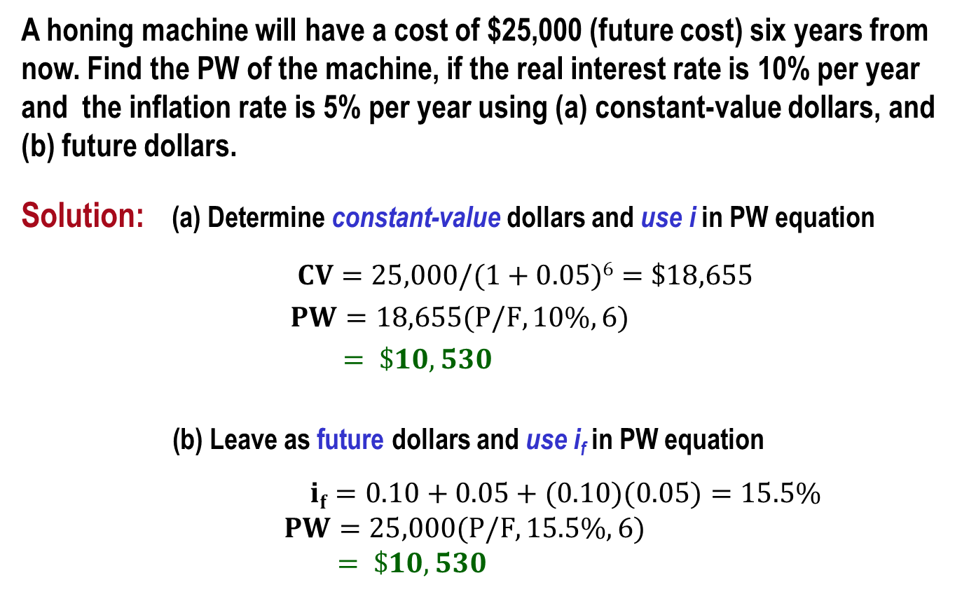
Example: PW with Inflation
A honing machine will have a cost of $25,000 (future cost) six years from now. Find the PW of the machine, if the real interest rate is 10% per year and the inflation rate is 5% per year using (a) constant-value dollars, and (b) future dollars.
Solution: (a) Determine constant-value dollars and use i in PW equation
$CV=25,000/(1+0.05)6=\$18,655$
$PW=18,655(P/F,10\%,6)$
$= \$10,530$
(b) Leave as future dollars and use i_{f} in PW equation
$if=0.10+0.05+(0.10)(0.05)=15.5\%$
$PW=25,000(P/F,15.5\%,6)$
$= \$10,530$

Slide 10
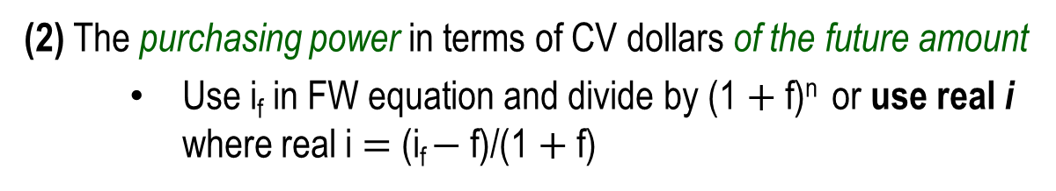




FW Calculations with Inflation
FW values can have four different interpretations
(1) The actual amount accumulated
    Use i_{f} in FW equation
$$FW=PW(F/P, if, n)$$
(2) The purchasing power in terms of CV dollars of the future amount
Use i_{f} in FW equation and divide by (1$+$f)^{n} or use real i where real i $=$ (i_{f} $−$f)/(1$+$f)
$$FW=PW(F/P,i,n)$$
(3) The number of future dollars required to have the same purchasing power as a dollar today with no time value of money considered
Use f instead of i in F/P factor
$$FW=PW(F/P,f,n)$$
(4) The amount required to maintain the purchasing power of the present sum and earn a stated real rate of return
Use i_{f} in FW equation
$$FW=PW(F/P, if, n)$$

Slide 11
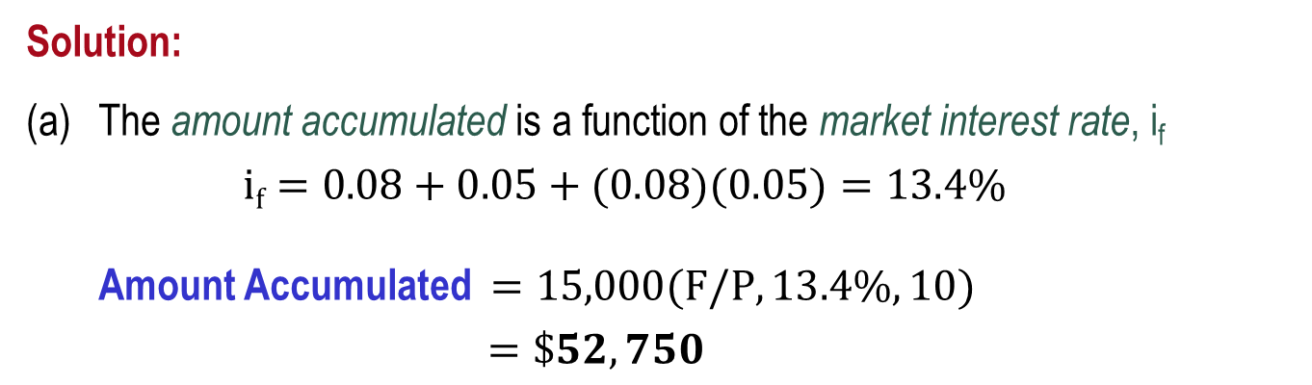
Example: FW with Inflation (1)
An engineer invests $15,000 in a savings account that pays interest at a real 8% per year. If the inflation rate is 5% per year, determine (a) the amount of money that will be accumulated in 10 years, (b) the purchasing power of the accumulated amount (in terms of today’s dollars), (c) the number of future dollars that will have the same purchasing power as the $15,000 today, and (d) the amount to maintain purchasing power and earn a real 8% per year return.
Solution:
The amount accumulated is a function of the market interest rate, i_{f}
$if=0.08+0.05+(0.08)(0.05)=13.4\%$
Amount Accumulated $=15,000(F/P,13.4\%,10)$
$=\$52,750$

Slide 12



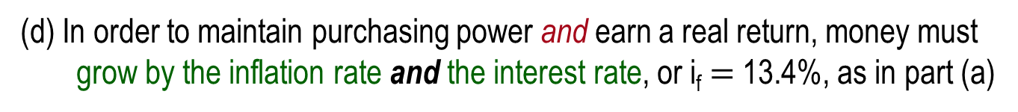
Example: FW with Inflation (2)
(b) To find the purchasing power of the accumulated amount deflate
the inflated dollars
Purchasing power $=15,000(F/P,13.4\%,10)/(1+0.05)10$
$= \$32,384$
(c) The number of future dollars required to purchase goods that cost
$15,000 now is the inflated cost of the goods
Number of future dollars $=15,000(F/P,5\%,10)$
$= \$24,434$
(d) In order to maintain purchasing power and earn a real return, money must grow by the inflation rate and the interest rate, or i_{f} $=$ 13.4%, as in part (a)
$FW=15,000(F/P,13.4\%,10)$
$= \$52,750$

Slide 13
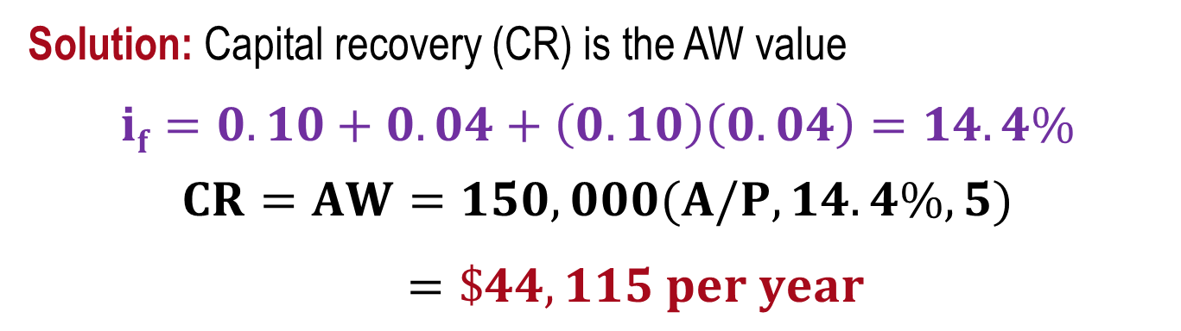
Capital Recovery with Inflation
The A/P and A/F factors require the use of i_{f} when inflation is considered
If a small company invests $150,000 in a new production line machine, how much must it receive each year to recover the investment in 5 years? The real interest rate is 10% and the inflation rate is 4% per year.
Solution: Capital recovery (CR) is the AW value
$$if=0.10+0.04+\left(0.10\right)\left(0.04\right)=14.4\%$$
$$CR=AW=150,000(A/P,14.4\%,5)$$
$=\$44,115 per year$

Slide 14
Summary of Important Points
Inflation occurs because value of currency has changed
Inflation reduces purchasing power; one unit buys less goods ort services
Two ways to account for inflation in economic analyses:
(1) Convert all cash flows into constant-value dollars and use i
(2) Leave cash flows as inflated dollars and use i_{f}
During deflation, purchasing power of money is greater in future than at present
Future worth values can have four different interpretations, requiring different interest rates to find FW
Use i_{f} in calculations involving A/P or A/F when inflation is considered

