Slide 1
Lecture slides to accompany
Engineering Economy, 8th edition
Leland Blank, Anthony Tarquin
©McGraw-Hill Education. All rights reserved. Authorized only for instructor use in the classroom. No reproduction or further distribution permitted without the prior written consent of McGraw-Hill Education.
Notes:
At this point:
1. Introduce yourself - your students are likely to want to know something about your qualifications and interests - overall, where you are coming from.
2. Have students introduce themselves. Ask why they are taking this class. If you are fortunate enough to have a Polaroid camera, take pictures of each student for later posting on a class “board” so both they and you get to know each other.
3. Discuss both choice of textbook and development of syllabus.
4. If you are expecting students to work in teams, at east introduce the choice of team members. If at all possible, have students participate in a team building or team study exercise. It works wonders. Most student have been told to work in teams in prior classes, but have never examined exactly what a team is and how it works. One hour spent in a team building/examination exercise saves many hours and avoids many problems later on.

Slide 2
Chapter 13
Breakeven and Payback Analysis

Slide 3
LEARNING OUTCOMES
Breakeven point – one parameter
Breakeven point – two alternatives
Payback period analysis

Slide 4
Breakeven Point
Value of a parameter that makes two elements equal
The parameter (or variable) can be an amount of revenue, cost, supply, demand, etc. for one project or between two alternatives
One project - Breakeven point is identified as Q_{BE}. Determined using linear or non-linear math relations for revenue and cost
Between two alternatives - Determine one of the parameters P, A, F, i, or n with others constant
Solution is by one of three methods:
Direct solution of relations
Trial and error
Spreadsheet functions or tools (Goal Seek or Solver)

Slide 5
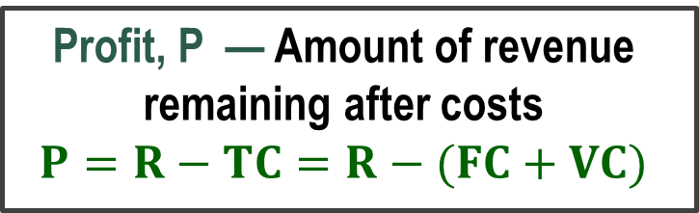
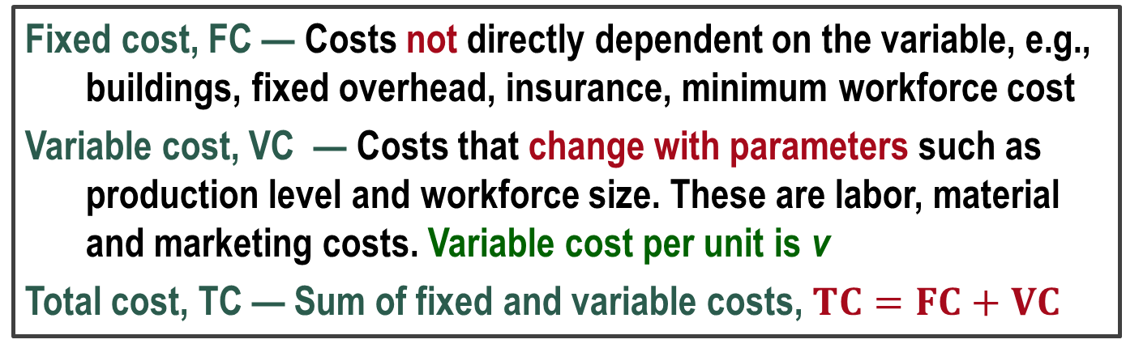
Cost-Revenue Model ― One Project
Quantity, Q — An amount of the variable in question, e.g., units/year, hours/month
Breakeven value is Q_{BE}
Fixed cost, FC — Costs not directly dependent on the variable, e.g., buildings, fixed overhead, insurance, minimum workforce cost
Variable cost, VC — Costs that change with parameters such as production level and workforce size. These are labor, material and marketing costs. Variable cost per unit is v
Total cost, TC — Sum of fixed and variable costs, $TC=FC+VC$
Revenue, R — Amount is dependent on quantity sold
Revenue per unit is r
Profit, P — Amount of revenue remaining after costs
$$P=R−TC=R−(FC+VC)$$

Slide 6
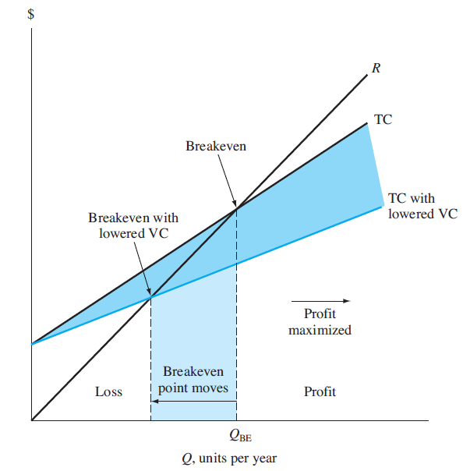
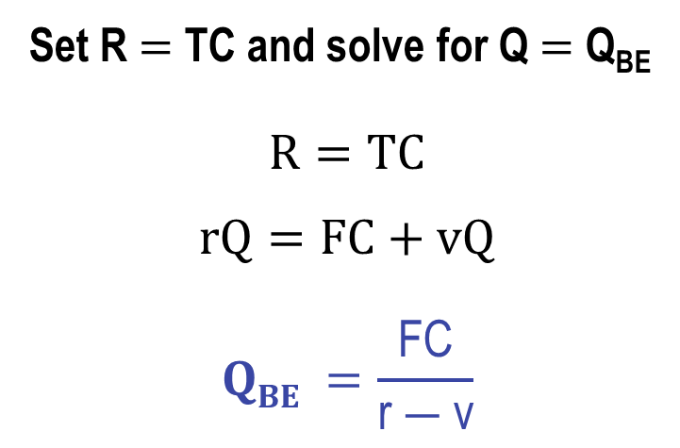
Breakeven for linear R and TC
Set R $=$ TC and solve for Q $=$ Q_{BE}
$$R=TC$$
$$rQ=FC+vQ$$
$$QBE =\frac{\text{FC}}{\text{r} ― \text{v}}$$
When variable cost, v, is lowered, Q_{BE} decreases (moves to left)

Slide 7
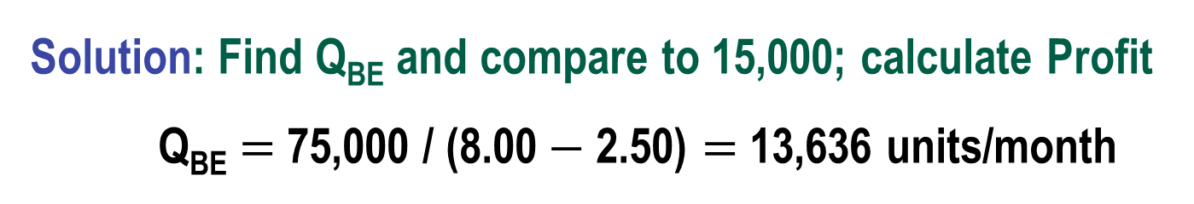
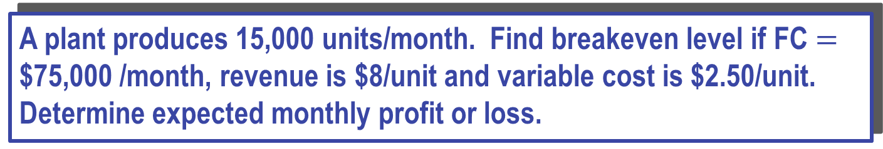
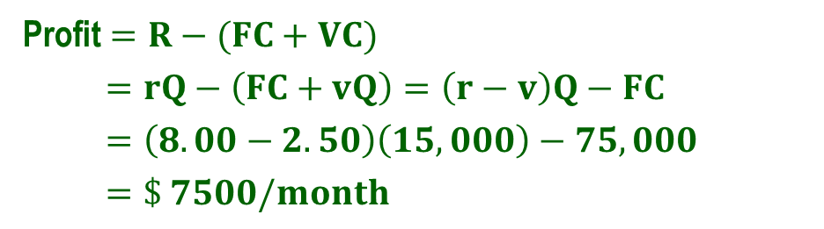
Example: One Project Breakeven Point
A plant produces 15,000 units/month. Find breakeven level if FC $=$ $75,000 /month, revenue is $8/unit and variable cost is $2.50/unit. Determine expected monthly profit or loss.
Solution: Find Q_{BE} and compare to 15,000; calculate Profit Q_{BE} $=$ 75,000 / (8.00$−$2.50) $=$ 13,636 units/month
Production level is above breakeven
Profit
Profit $=R−(FC+VC)$
$=rQ−\left(FC+vQ\right)=\left(r−v\right)Q−FC$
$=\left(8.00−2.50\right)\left(15,000\right)−75,000$
$=\$ 7500/month$

Slide 8
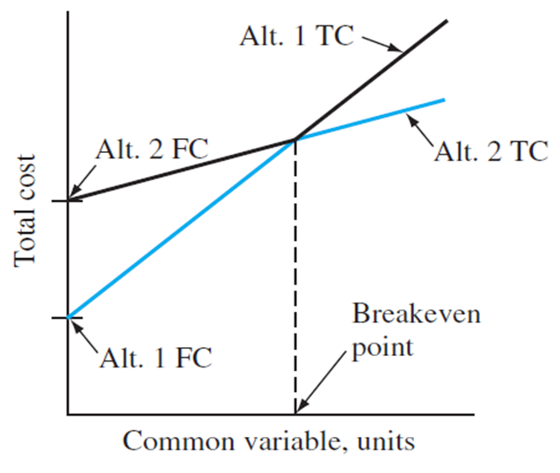
Breakeven Between Two Alternatives
To determine value of common variable between 2 alternatives, do the following:
Define the common variable
Develop equivalence PW, AW or FW relations as function of common variable for each alternative
Equate the relations; solve for variable. This is breakeven value
Selection of alternative is based on anticipated value of common variable:
Value BELOW breakeven;
select higher variable cost
Value ABOVE breakeven;
select lower variable cost

Slide 9
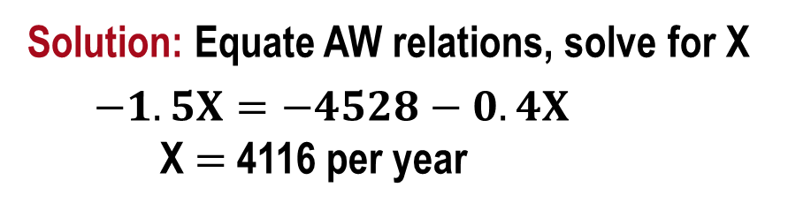
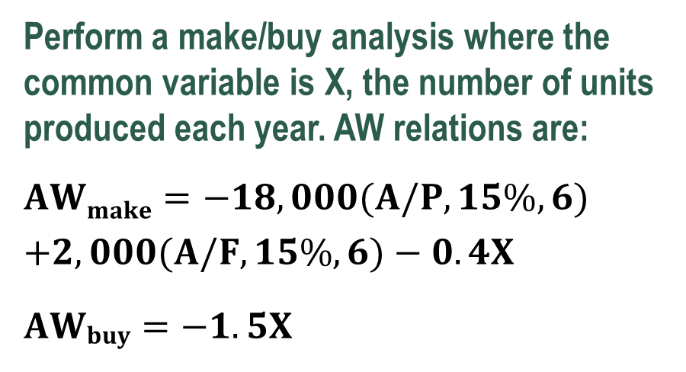
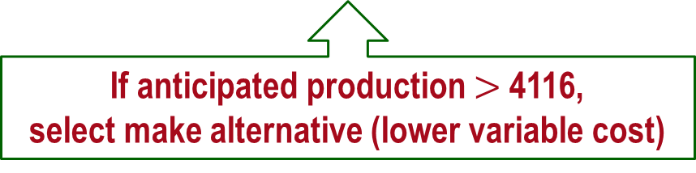
Example: Two Alternative Breakeven Analysis
Perform a make/buy analysis where the common variable is X, the number of units produced each year. AW relations are:
$$AWmake=−18,000(A/P,15\%,6) \\ +2,000(A/F,15\%,6)−0.4X$$
$$AWbuy=−1.5X$$
Breakeven value of X
AW, 1000 $/year
8
7
6
5
4
3
2
1
0
AW_{buy}
AW_{make}
Solution: Equate AW relations, solve for X
$−1.5X=−4528−0.4X$
X $=$ 4116 per year
If anticipated production $>$ 4116,
select make alternative (lower variable cost)
1 2 3 4 5
X, 1000 units per year

Slide 10
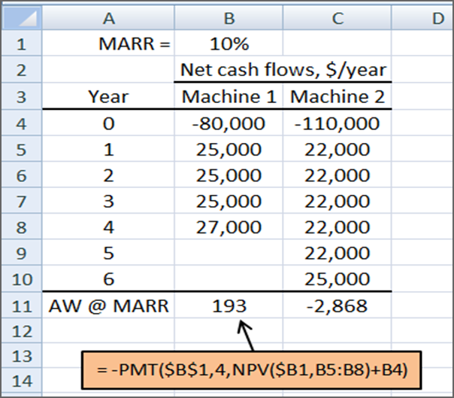
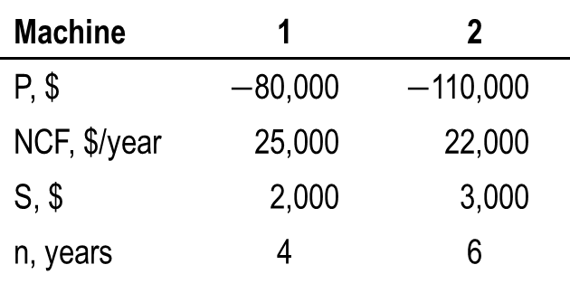
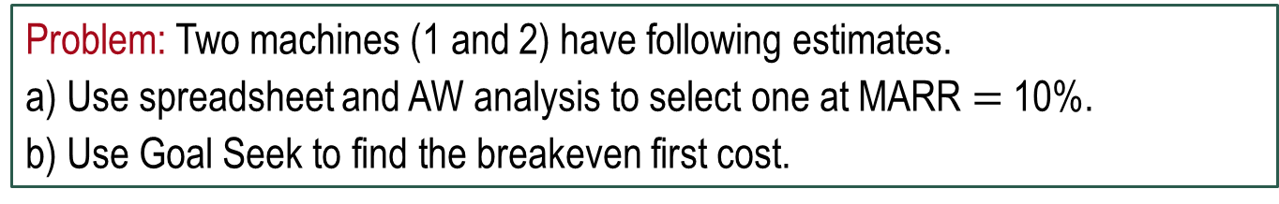

Breakeven Analysis Using Goal Seek Tool (1)
Spreadsheet tool Goal Seek finds breakeven value for the common variable between two alternatives
Problem: Two machines (1 and 2) have following estimates.
a) Use spreadsheet and AW analysis to select one at MARR $=$ 10%.
b) Use Goal Seek to find the breakeven first cost.
Machine | 1 | 2
P, $ | $−$80,000 | $−$110,000
NCF, $/year | 25,000 | 22,000
S, $ | 2,000 | 3,000
n, years | 4 | 6
Solution: a) Select machine A with AW_{A}$=$$193

Slide 11
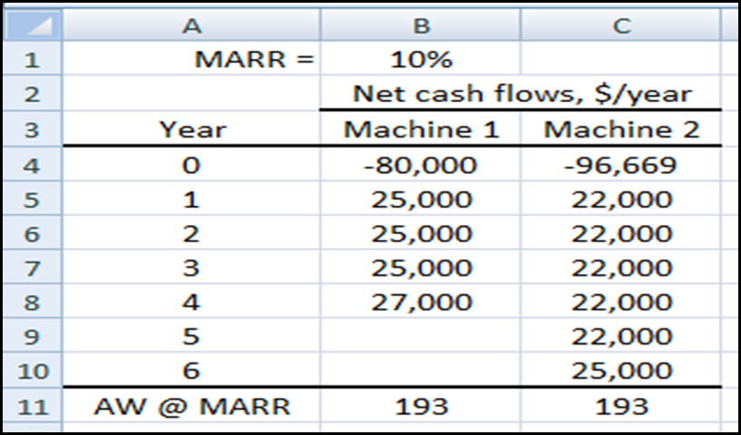
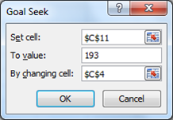
Breakeven Analysis Using Goal Seek Tool (2)
Solution: b) Goal Seek finds a first-cost breakeven of $96,669 to make machine B economically equivalent to A
Changing cell
Spreadsheet after Goal Seek is applied
Target cell

Slide 12
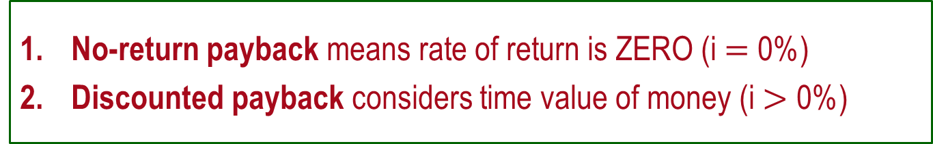
Payback Period Analysis
Payback period: Estimated amount of time (n_{p}) for cash inflows to recover an initial investment (P) plus a stated return of return (i%)
Types of payback analysis: No-return and discounted payback
No-return payback means rate of return is ZERO (i $=$ 0%)
Discounted payback considers time value of money (i $>$ 0%)
Caution: Payback period analysis is a good initial screening tool, rather than the primary method to justify a project or select an alternative (Discussed later)

Slide 13
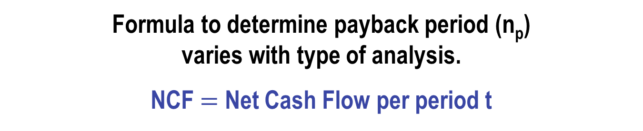
Payback Period Computation
Formula to determine payback period (n_{p})
varies with type of analysis.
NCF $=$ Net Cash Flow per period t

Slide 14
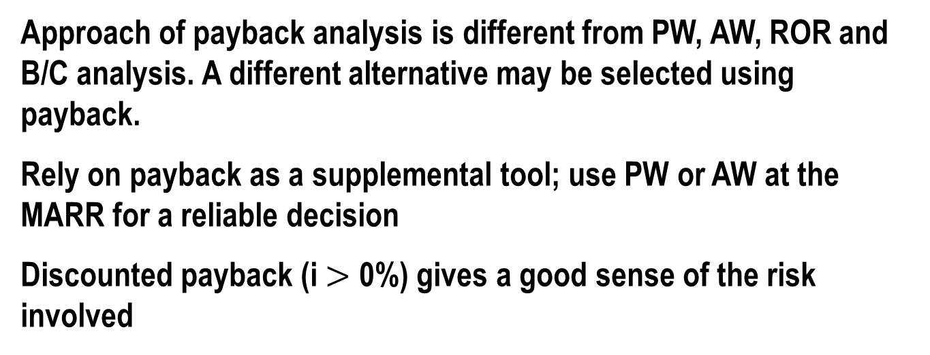
Points to Remember About Payback Analysis
No-return payback neglects time value of money, so no return is expected for the investment made
No cash flows after the payback period are considered in the analysis. Return may be higher if these cash flows are expected to be positive.
Approach of payback analysis is different from PW, AW, ROR and B/C analysis. A different alternative may be selected using payback.
Rely on payback as a supplemental tool; use PW or AW at the MARR for a reliable decision
Discounted payback (i $>$ 0%) gives a good sense of the risk involved

Slide 15
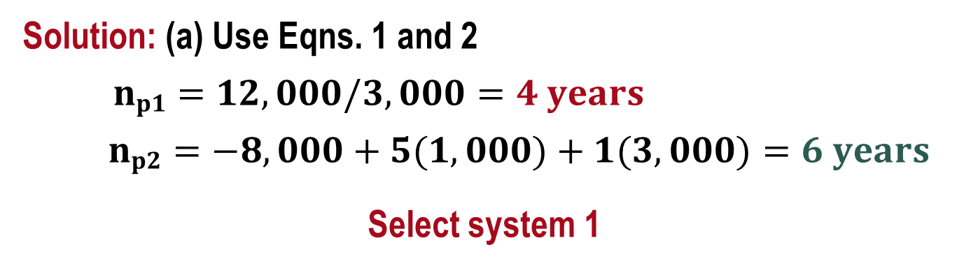
Example: Payback Analysis (1)
System | System 1 | System 2
First cost, $ | 12,000 | 8,000
NCF, $ per year | 3,000 | 1,000 (year 1-5) 3,000 (year 6-14)
Maximum life, years | 7 | 14
Problem: Use (a) no-return payback, (b) discounted payback at 15%, and (c) PW analysis at 15% to select a system. Comment on the results.
Solution: (a) Use Eqns. 1 and 2
$np1=12,000/3,000=4 years$
$np2=−8,000+5(1,000)+1(3,000)=6 years$
Select system 1

Slide 16
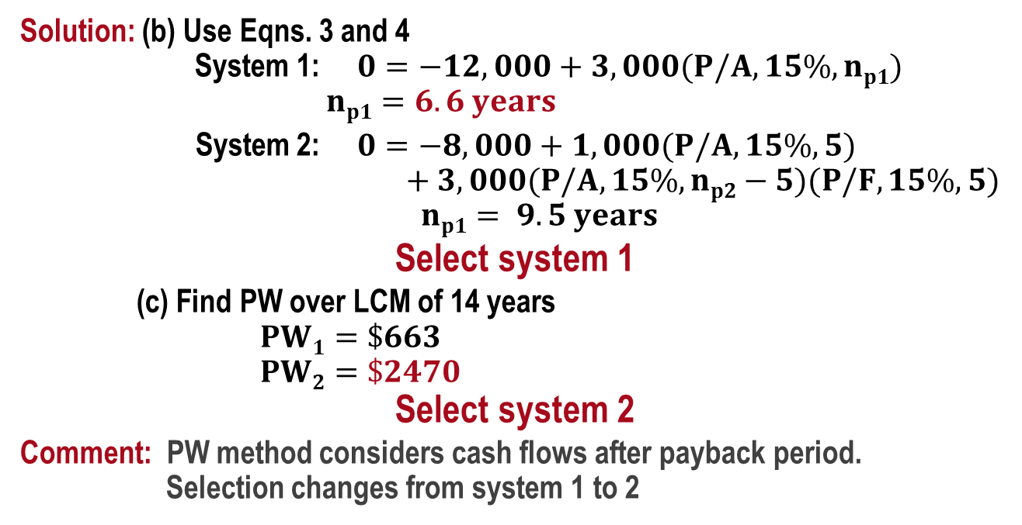
Example: Payback Analysis (2)
System | System 1 | System 2
First cost, $ | 12,000 | 8,000
NCF, $ per year | 3,000 | 1,000 (year 1-5) 3,000 (year 6-14)
Maximum life, years | 7 | 14
Solution: (b) Use Eqns. 3 and 4
System 1: $0=−12,000+3,000(P/A,15\%,np1)$
$np1=6.6 years$
System 2: $0=−8,000+1,000(P/A,15\%,5)$
$+ 3,000(P/A,15\%,np2−5)(P/F,15\%,5)$
$np1= 9.5 years$
Select system 1
(c) Find PW over LCM of 14 years
$PW1=\$663$
$PW2=\$2470$
Select system 2
Comment: PW method considers cash flows after payback period.
Selection changes from system 1 to 2

Slide 17
Summary of Important Points
Breakeven amount is a point of indifference to accept or reject a project
One project breakeven: accept if quantity is > Q_{BE}
Two alternative breakeven: if level > breakeven,
select lower variable cost alternative (smaller slope)
Payback estimates time to recover investment.
Return can be i = 0% or i > 0%
Use payback as supplemental to PW or other analyses,
because n_{p} neglects cash flows after payback,
and if i = 0%, it neglects time value of money
Payback is useful to sense the economic risk in a project

