Slide 1
Lecture slides to accompany
Engineering Economy, 8th edition
Leland Blank, Anthony Tarquin
©McGraw-Hill Education. All rights reserved. Authorized only for instructor use in the classroom. No reproduction or further distribution permitted without the prior written consent of McGraw-Hill Education.
Notes:
At this point:
1. Introduce yourself - your students are likely to want to know something about your qualifications and interests - overall, where you are coming from.
2. Have students introduce themselves. Ask why they are taking this class. If you are fortunate enough to have a Polaroid camera, take pictures of each student for later posting on a class “board” so both they and you get to know each other.
3. Discuss both choice of textbook and development of syllabus.
4. If you are expecting students to work in teams, at east introduce the choice of team members. If at all possible, have students participate in a team building or team study exercise. It works wonders. Most student have been told to work in teams in prior classes, but have never examined exactly what a team is and how it works. One hour spent in a team building/examination exercise saves many hours and avoids many problems later on.

Slide 2
Chapter 12
Independent Projects with Budget Limitation

Slide 3
LEARNING OUTCOMES
Capital rationing basics
Projects with equal lives
Projects with unequal lives
Linear program model
Ranking options

Slide 4
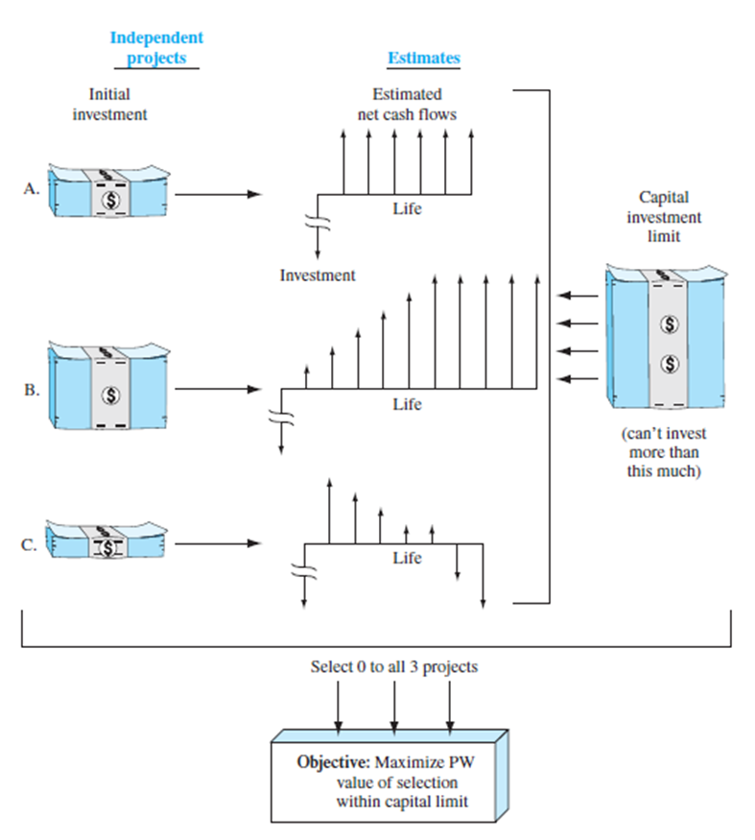
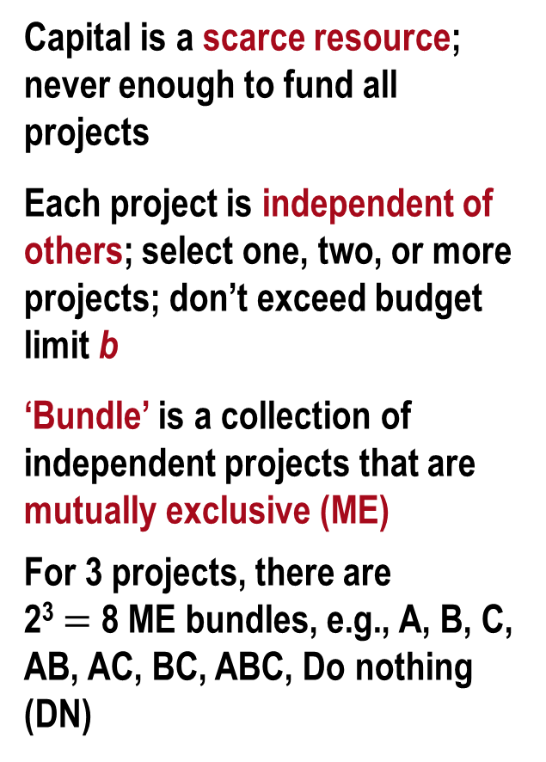
Overview of Capital Rationing
Capital is a scarce resource; never enough to fund all projects
Each project is independent of others; select one, two, or more projects; don’t exceed budget limit b
‘Bundle’ is a collection of independent projects that are mutually exclusive (ME)
For 3 projects, there are
2³ $=$ 8 ME bundles, e.g., A, B, C, AB, AC, BC, ABC, Do nothing (DN)

Slide 5
Capital Budgeting Problem
Each project selected entirely or not selected at all
Budget limit restricts total investment allowed
Projects usually quite different from each other and have different lives
Reinvestment assumption: Positive annual cash flows reinvested at MARR until end of life of longest-lived project
Objective of Capital Budgeting
Maximize return on project investments using a specific measure of worth, usually PW

Slide 6
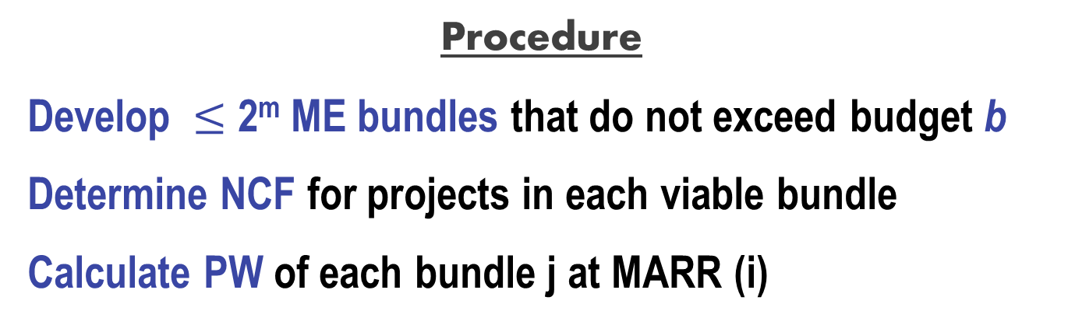
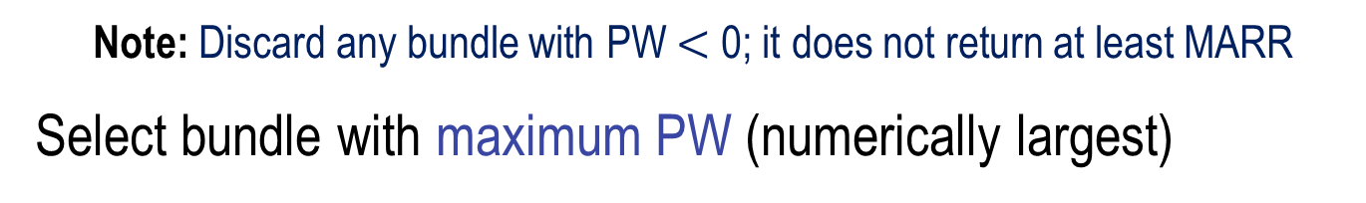
Capital Budgeting for Equal-Life Projects
Procedure
Develop $≤$ 2^{m} ME bundles that do not exceed budget b
Determine NCF for projects in each viable bundle
Calculate PW of each bundle j at MARR (i)
Note: Discard any bundle with PW $<$ 0; it does not return at least MARR
Select bundle with maximum PW (numerically largest)

Slide 7
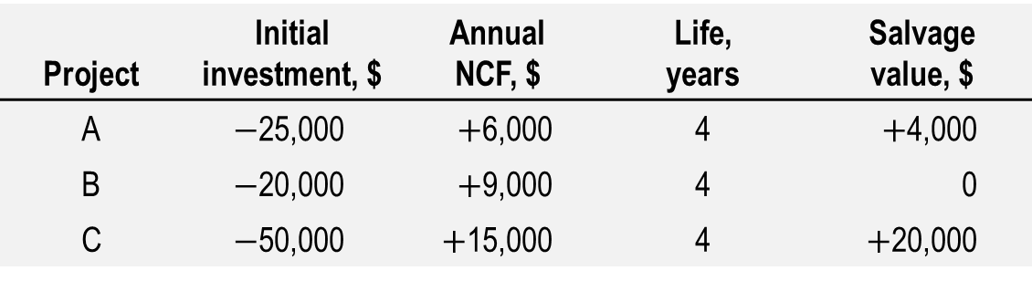
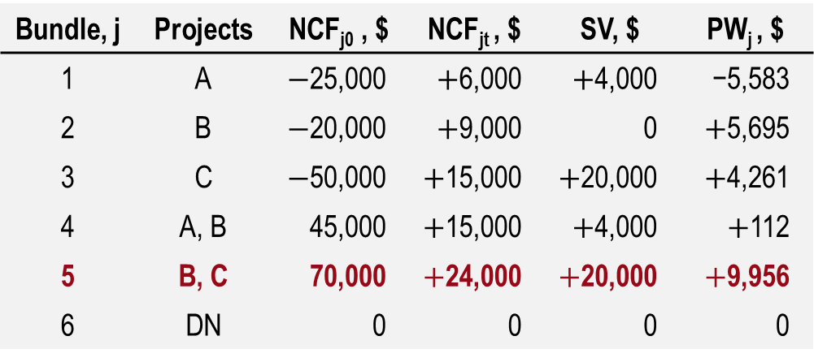
Example: Capital Budgeting for Equal Lives
Select projects to maximize PW at i $=$ 15% and b $=$ $70,000
Project | Initial investment, $ | Annual NCF, $ | Life, years | Salvage value, $
A | $−$25,000 | $+$6,000 | 4 | $+$4,000
B | $−$20,000 | $+$9,000 | 4 | 0
C | $−$50,000 | $+$15,000 | 4 | $+$20,000
Solution: Five bundles meet budget restriction. Calculate NCF and PW values
Bundle, j | Projects | NCF_{j0} , $ | NCF_{jt} , $ | SV, $ | PW_{j} , $
1 | A | $−$25,000 | $+$6,000 | $+$4,000 | −5,583
2 | B | $−$20,000 | $+$9,000 | 0 | $+$5,695
3 | C | $−$50,000 | $+$15,000 | $+$20,000 | $+$4,261
4 | A, B | 45,000 | $+$15,000 | $+$4,000 | $+$112
5 | B, C | 70,000 | $+$24,000 | $+$20,000 | $+$9,956
6 | DN | 0 | 0 | 0 | 0
Conclusion: Select projects B and C
with max PW value

Slide 8
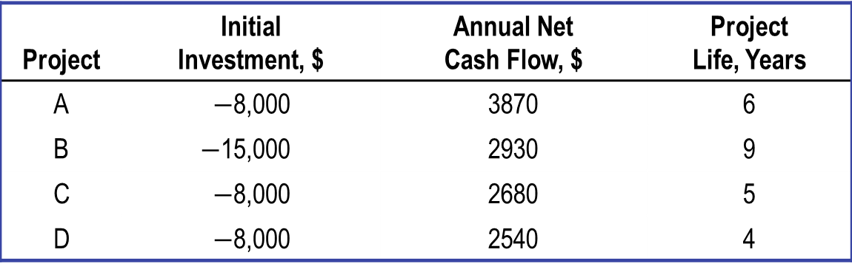
Capital Budgeting for Unequal-Life Projects
LCM is not necessary in capital budgeting; use PW over respective lives to select independent projects
Same procedure as that for equal lives
Example: If MARR is 15% and b $=$ $20,000 select projects
Project | Initial Investment, $ | Annual Net Cash Flow, $ | Project Life, Years
A | $−$8,000 | 3870 | 6
B | $−$15,000 | 2930 | 9
C | $−$8,000 | 2680 | 5
D | $−$8,000 | 2540 | 4

Slide 9
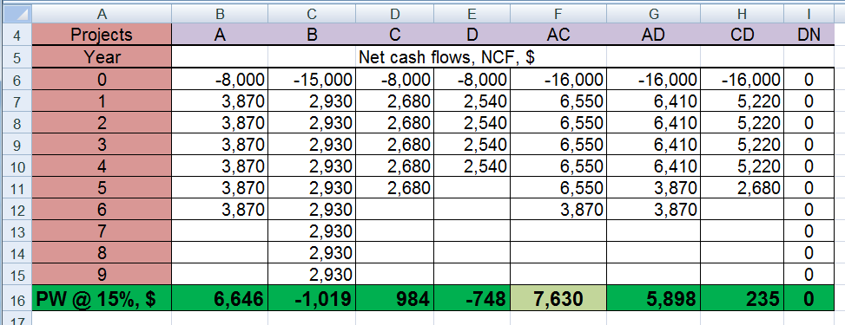

Example: Capital Budgeting for Unequal Lives
Solution: Of 2⁴ $=$ 16 bundles, 8 are feasible. By spreadsheet:
Reject with PW $<$ 0
Conclusion:
Select projects A and C

Slide 10
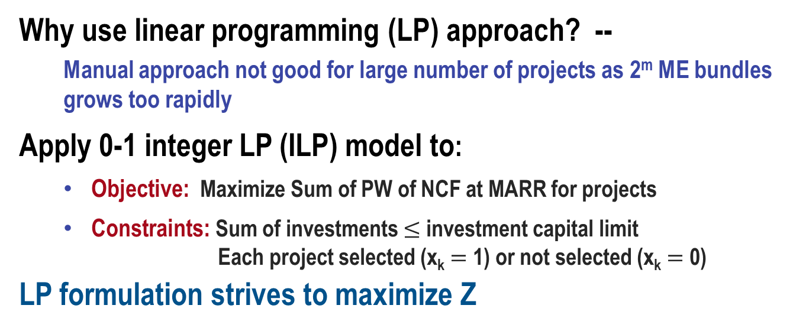
Capital Budgeting Using LP Formulation
Why use linear programming (LP) approach? --
Manual approach not good for large number of projects as 2^{m} ME bundles grows too rapidly
Apply 0-1 integer LP (ILP) model to:
  Objective: Maximize Sum of PW of NCF at MARR for projects
  Constraints: Sum of investments $≤$ investment capital limit
  Each project selected (x_{k} $=$ 1) or not selected (x_{k} $=$ 0)
LP formulation strives to maximize Z

Slide 11
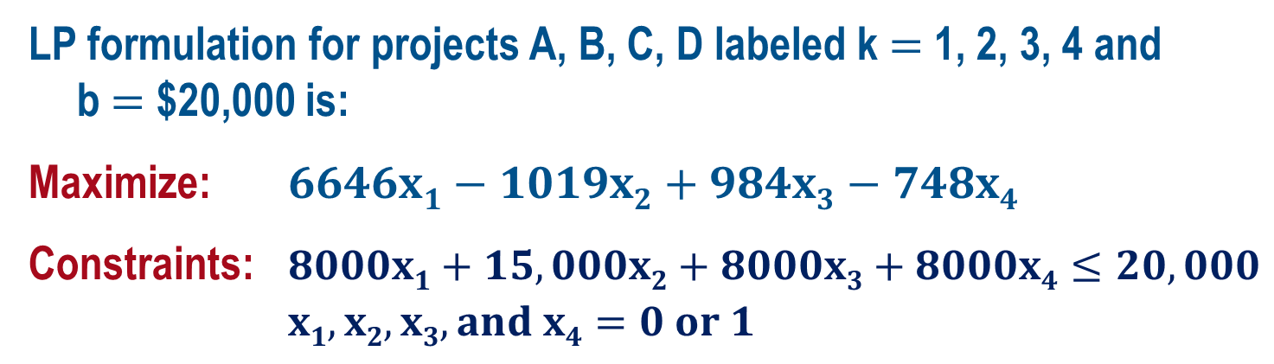
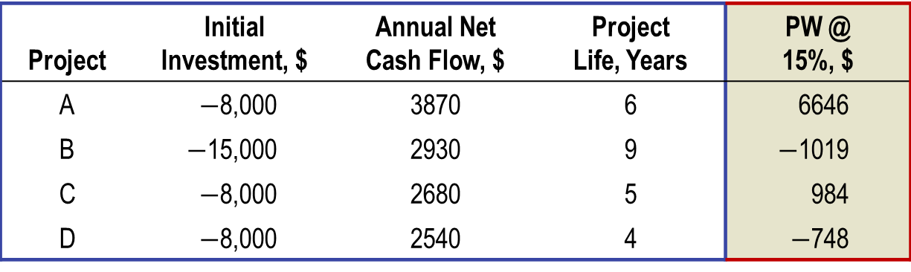
Example: LP Solution of Capital Budgeting Problem
MARR is 15%; limit is $20,000; select projects using LP
Project | Initial Investment, $ | Annual Net Cash Flow, $ | Project Life, Years | PW @ 15%, $
A | $−$8,000 | 3870 | 6 | 6646
B | $−$15,000 | 2930 | 9 | $−$1019
C | $−$8,000 | 2680 | 5 | 984
D | $−$8,000 | 2540 | 4 | $−$748
LP formulation for projects A, B, C, D labeled k $=$ 1, 2, 3, 4 and
b $=$ $20,000 is:
Maximize: $6646x1−1019x2+984x3−748x4$
Constraints: $8000x1+15,000x2+8000x3+8000x4≤20,000$
$x1, x2, x3, and x4=0 or 1$

Slide 12
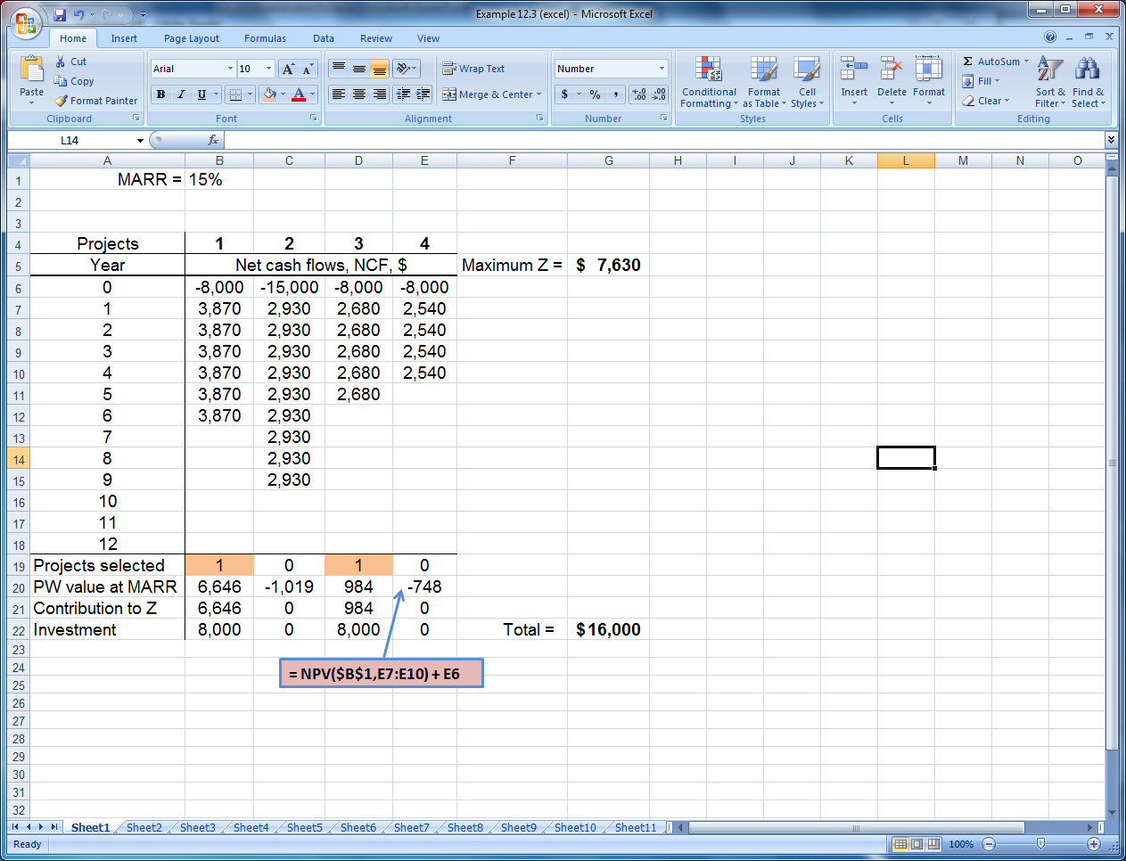
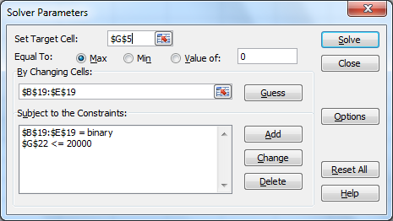
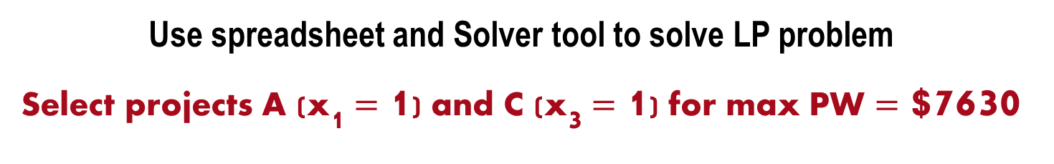
Example: LP Solution of Capital Budgeting Problem
Use spreadsheet and Solver tool to solve LP problem
Select projects A (x₁ $=$ 1) and C (x₃ $=$ 1) for max PW $=$ $7630

Slide 13
Different Project Ranking Measures
Possible measures to rank and select projects:
PW (present worth) – previously used to solve capital
budgeting problem; maximizes PW value)
IROR (internal ROR) – maximizes overall ROR; reinvestment
assumed at IROR value
PWI (present worth index) – same as PI (profitability index); provides most money for the investment amount over life of the project, i.e., maximizes ‘bang for the buck’. PWI measure is:
Projects selected by each measure can be different since each measure maximizes a different parameter

Slide 14
Summary of Important Points
Capital budgeting requires selection from independent projects. The PW measure is commonly maximized with a limited investment budget
Equal service assumption is not necessary for a capital budgeting solution
Manual solution requires development of ME bundles of projects
Solution using linear programming formulation and the Solver tool on a spreadsheet is used to maximize PW at a stated MARR
Projects ranked using different measures, e.g., PW, IROR and PWI, may select different projects since different measures are maximized

