Slide 1
Lecture slides to accompany
Engineering Economy, 8th edition
Leland Blank, Anthony Tarquin
©McGraw-Hill Education. All rights reserved. Authorized only for instructor use in the classroom. No reproduction or further distribution permitted without the prior written consent of McGraw-Hill Education.
Notes:
At this point:
1. Introduce yourself - your students are likely to want to know something about your qualifications and interests - overall, where you are coming from.
2. Have students introduce themselves. Ask why they are taking this class. If you are fortunate enough to have a Polaroid camera, take pictures of each student for later posting on a class “board” so both they and you get to know each other.
3. Discuss both choice of textbook and development of syllabus.
4. If you are expecting students to work in teams, at east introduce the choice of team members. If at all possible, have students participate in a team building or team study exercise. It works wonders. Most student have been told to work in teams in prior classes, but have never examined exactly what a team is and how it works. One hour spent in a team building/examination exercise saves many hours and avoids many problems later on.

Slide 2
Chapter 11
Retention and Replacement

Slide 3
LEARNING OUTCOMES
Explain replacement terminology and basics
Determine economic service life (ESL)
Perform replacement/retention study
Understand special situations in replacement
Perform replacement study over specified time
Calculate trade-in value of defender

Slide 4
Replacement Study Basics
Reasons for replacement study
Reduced performance
Altered requirements
Obsolescence
Terminology
Defender – Currently installed asset
Challenger – Potential replacement for defender
Market value (MV) – Value of defender if sold in open market
Economic service life – No. of years at which lowest AW of cost occurs
Defender first cost – MV of defender; used as its first cost (P) in analysis
Challenger first cost – Capital to recover for challenger (usually its P value)
Sunk cost – Prior expenditure not recoverable from challenger cost
Nonowner’s viewpoint – Outsider’s (consultant’s) viewpoint for objectivity

Slide 5
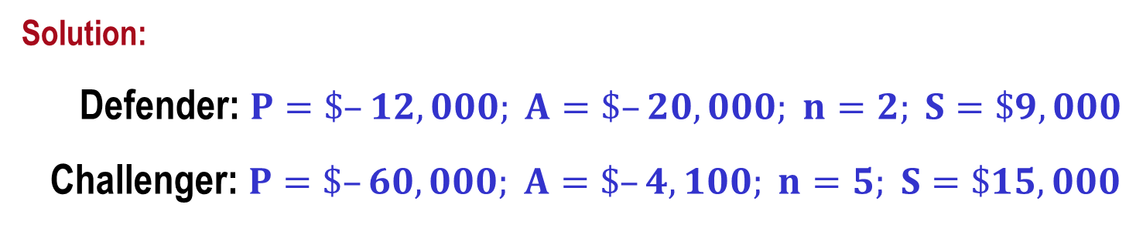
Example: Replacement Basics
An asset purchased 2 years ago for $40,000 is harder to maintain than expected. It can be sold now for $12,000 or kept for a maximum of 2 more years, in which case its operating cost will be $20,000 each year, with a salvage value of $9,000 two years from now. A suitable challenger will have a first cost of $60,000 with an annual operating cost of $4,100 per year and a salvage value of $15,000 after 5 years. Determine the values of P, A, n, and S for the defender and challenger for an AW analysis.
Solution:
Defender: $P=\$–12,000; A=\$–20,000; n=2; S=\$9,000$
Challenger: $P=\$–60,000; A=\$–4,100; n=5; S=\$15,000$

Slide 6
Overview of a Replacement Study
Replacement studies are applications of the AW method
Study periods (planning horizons) are either specified or unlimited
Assumptions for unlimited study period:
  Services provided for indefinite future
  Challenger is best available now and for future, and will be repeated in future life cycles
  Cost estimates for each life cycle for defender and challenger remain the same
If study period is specified, assumptions do not hold
Replacement study procedures differ for the two cases

Slide 7
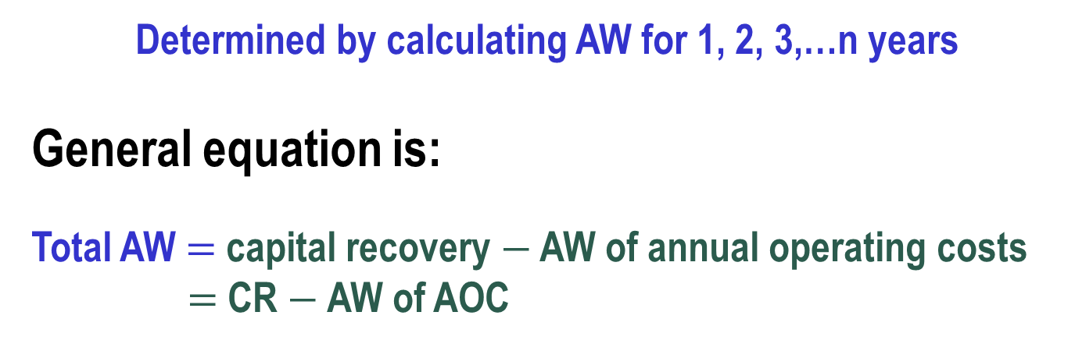
Economic Service Life
Economic service life (ESL) refers to the asset retention time (n) that yields its lowest equivalent AW
Determined by calculating AW for 1, 2, 3,…n years
General equation is:
Total AW $=$ capital recovery $−$ AW of annual operating costs
$=$ CR $−$ AW of AOC

Slide 8
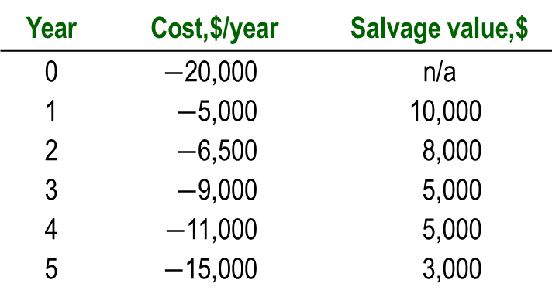

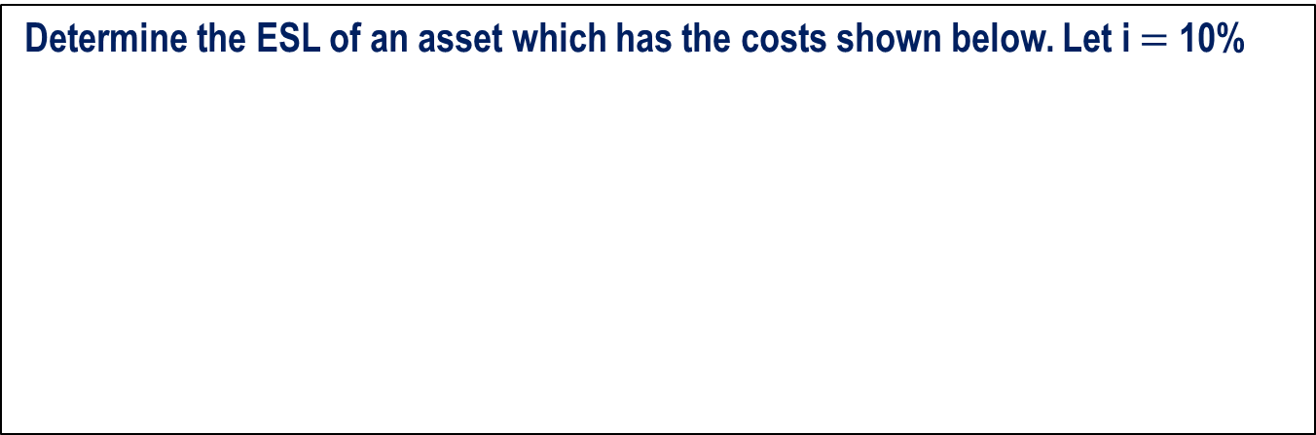


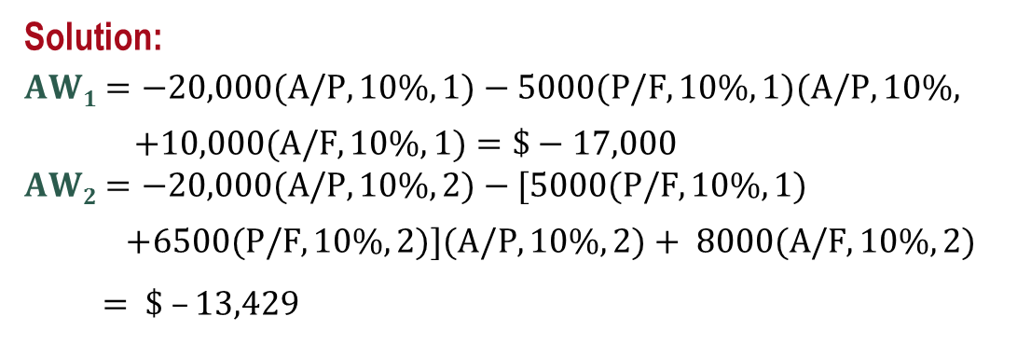
Example: Economic Service Life
Determine the ESL of an asset which has the costs shown below. Let i $=$ 10%
Year | Cost,$/year | Salvage value,$
0 | $−$20,000 | n/a
1 | $−$5,000 | 10,000
2 | $−$6,500 | 8,000
3 | $−$9,000 | 5,000
4 | $−$11,000 | 5,000
5 | $−$15,000 | 3,000
Solution:
$$AW1=−20,000(A/P,10\%,1)−5000(P/F,10\%,1)(A/P,10\%,$$
$+10,000(A/F,10\%,1)=\$−17,000$
$$AW2=−20,000(A/P,10\%,2)−[5000(P/F,10\%,1)$$
$+6500(P/F,10\%,2)](A/P,10\%,2)+ 8000(A/F,10\%,2)$
$= \$ –13,429$
Similarly, AW₃ $=$ $$−$13,239
AW₄ $=$ $ $−$12,864
AW₅ $=$ $ $−$13,623
Economic service life is 4 years

Slide 9
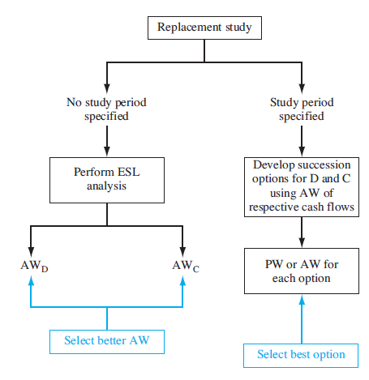
Performing a Replacement Study

Slide 10
Performing a Replacement Study −
Unlimited Study Period
1. Calculate AW_{D} and AW_{C} based on their ESL; select lower AW
2. If AW_{C} was selected in step (1), keep for n_{C} years (i.e., economic service life of challenger); if AW_{D} was selected, keep defender one more year and then repeat analysis (i.e., one-year-later analysis)
3. As long as all estimates remain current in succeeding years, keep defender until n_{D} is reached, and then replace defender with best challenger
4. If any estimates change before n_{D} is reached, repeat steps (1) through (4)
Note: If study period is specified, perform steps (1) through
(4) only through end of study period (discussed later)

Slide 11
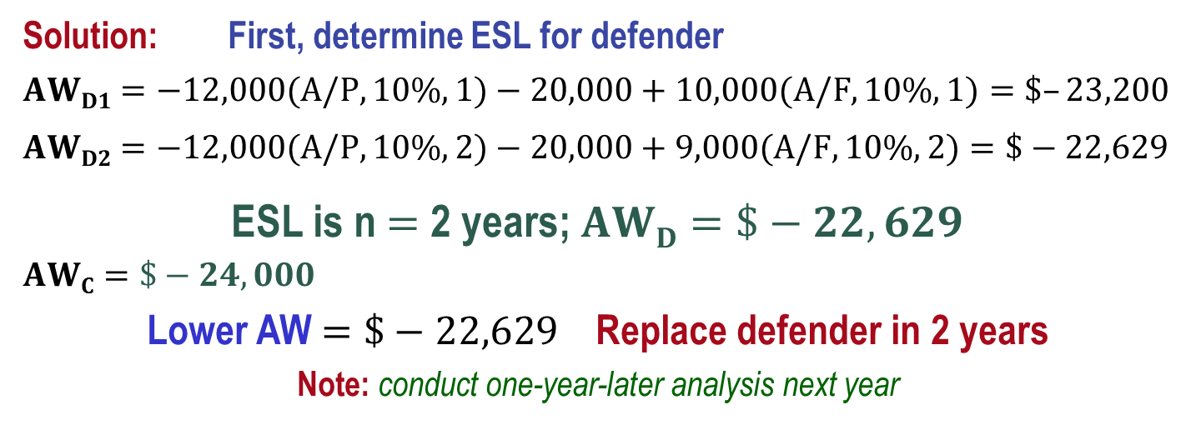
Example: Replacement Analysis
An asset purchased 2 years ago for $40,000 is harder to maintain than expected. It can be sold now for $12,000 or kept for a maximum of 2 more years, in which case its operating cost will be $20,000 each year, with a salvage value of $10,000 after 1 year or $9000 after two years. A suitable challenger will have an annual worth of $-24,000 per year. At an interest rate of 10% per year, should the defender be replaced now, one year from now, or two years from now?
Solution: First, determine ESL for defender
$$AWD1=−12,000(A/P,10\%,1)−20,000+10,000(A/F,10\%,1)=\$–23,200$$
$$AWD2=−12,000(A/P,10\%,2)−20,000+9,000(A/F,10\%,2)=\$−22,629$$
ESL is n $=$ 2 years; $AWD=\$−22,629$
$$AWC=\$−24,000$$
Lower AW$=\$−22,629$ Replace defender in 2 years
Note: conduct one-year-later analysis next year

Slide 12
Additional Considerations
Opportunity cost approach is the procedure that was previously presented for obtaining P for the defender. The opportunity cost is the money foregone by keeping the defender (i.e., not selling it). This approach is always correct
Cash flow approach subtracts income received from sale of defender from first cost of challenger.
Potential problems with cash flow approach:
    Provides falsely low value for capital recovery of challenger
    Can’t be used if remaining life of defender is not same as that of challenger

Slide 13
Replacement Analysis Over Specified Study Period
Same procedure as before, except calculate AW values over study period instead of over ESL years of n_{D} and n_{C}
It is necessary to develop all viable defender-challenger combinations and calculate AW or PW for each one over the study period
Select option with lowest cost or highest income

Slide 14
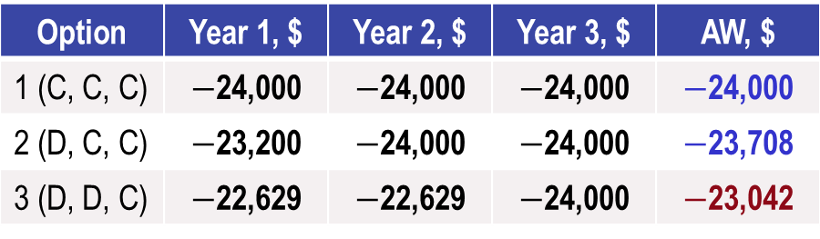
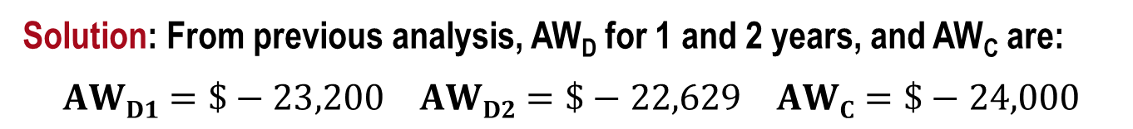
Example: Replacement Analysis; Specified Period
An asset purchased 2 years ago for $40,000 is harder to maintain than expected. It can be sold now for $12,000 or kept for a maximum of 2 more years, in which case its operating cost will be $20,000 each year, with a salvage value of $10,000 after 1 year or $9000 after two. A suitable challenger will have an annual worth of $-24,000 per year. At an interest rate of 10% per year and over a study period of exactly 2 years, determine when the defender should be replaced.
Solution: From previous analysis, AW_{D} for 1 and 2 years, and AW_{C} are:
$$AWD1=\$−23,200 AWD2=\$−22,629 AWC=\$−24,000$$
Option | Year 1, $ | Year 2, $ | Year 3, $ | AW, $
1 (C, C, C) | $−$24,000 | $−$24,000 | $−$24,000 | $−$24,000
2 (D, C, C) | $−$23,200 | $−$24,000 | $−$24,000 | $−$23,708
3 (D, D, C) | $−$22,629 | $−$22,629 | $−$24,000 | $−$23,042
Decision: Option 3; Keep D for 2 years, then replace

Slide 15
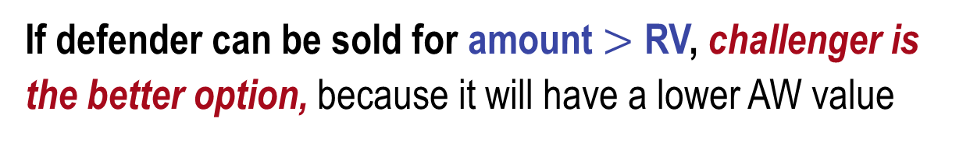
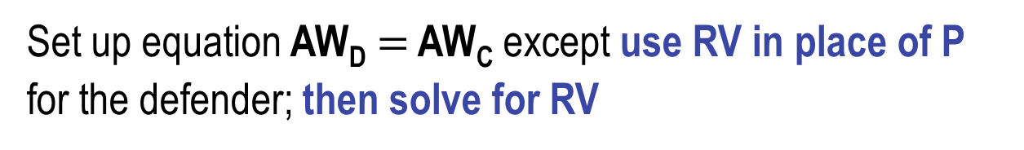
Replacement Value
Replacement value (RV) is market/trade-in value of defender that renders AW_{D} and AW_{C} equal to each other
Set up equation AW_{D} $=$ AW_{C} except use RV in place of P for the defender; then solve for RV
If defender can be sold for amount $>$ RV, challenger is the better option, because it will have a lower AW value

Slide 16
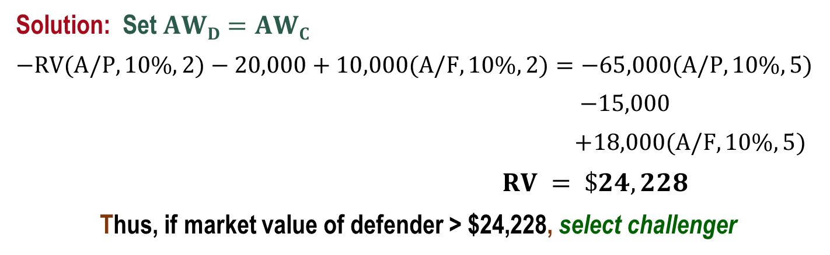
Example: Replacement Value
An asset purchased 2 years ago for $40,000 is harder to maintain than expected. It can be sold now for $12,000 or kept for a maximum of 2 more years, in which case its operating cost will be $20,000 each year, with a salvage value of $10,000 at the end of year two. A suitable challenger will have an initial cost of $65,000, an annual cost of $15,000, and a salvage value of $18,000 after its 5 year life. Determine the RV of the defender that will render its AW equal to that of the challenger, using an interest rate of 10% per year. Recommend a course of action.
Solution: Set $AWD=AWC$
$$−RV(A/P,10\%,2)−20,000+10,000(A/F,10\%,2)=−65,000(A/P,10\%,5)$$
$−15,000$
$+18,000(A/F,10\%,5)$
$RV = \$24,228$
Thus, if market value of defender > $24,228, select challenger

Slide 17
Summary of Important Points
In replacement study, P for presently-owned asset is its market value
Economic service life is the n value that yields lowest AW
In replacement study, if no study period is specified, calculate AW over the respective life of each alternative
Opportunity cost approach is correct, it recognizes money foregone by keeping the defender, not by reducing challenger’s first cost
When study period is specified, must consider all viable defender-challenger combinations in analysis
Replacement value (RV) is P value for defender that renders its AW equal to that of challenger

