Slide 1
Lecture slides to accompany
Engineering Economy, 8th edition
Leland Blank, Anthony Tarquin
©McGraw-Hill Education. All rights reserved. Authorized only for instructor use in the classroom. No reproduction or further distribution permitted without the prior written consent of McGraw-Hill Education.
Notes:
At this point:
1. Introduce yourself - your students are likely to want to know something about your qualifications and interests - overall, where you are coming from.
2. Have students introduce themselves. Ask why they are taking this class. If you are fortunate enough to have a Polaroid camera, take pictures of each student for later posting on a class “board” so both they and you get to know each other.
3. Discuss both choice of textbook and development of syllabus.
4. If you are expecting students to work in teams, at east introduce the choice of team members. If at all possible, have students participate in a team building or team study exercise. It works wonders. Most student have been told to work in teams in prior classes, but have never examined exactly what a team is and how it works. One hour spent in a team building/examination exercise saves many hours and avoids many problems later on.

Slide 2
Chapter 10
Project Financing and Non-Economic Attributes

Slide 3
LEARNING OUTCOMES
Explain cost of capital and MARR
Calculate weighted average cost of capital
Estimate cost of debt capital
Estimate cost of equity capital
Understand high D-E mix and risk
Develop weights for multiple attributes
Apply weighted attribute method to alternative evaluations

Slide 4
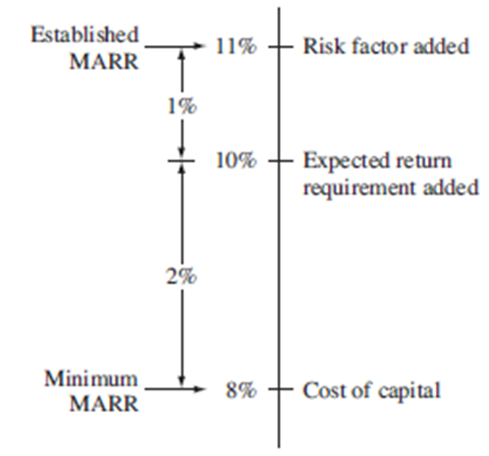
Cost of Capital and MARR
Cost of capital is the weighted average interest rate paid based on debt and equity sources
Debt capital represents borrowing outside company
Equity capital is from owners’ funds and retained earnings
MARR is set relative to cost of capital

Slide 5
Factors Affecting MARR
Project risk: higher risk leads to higher MARR
Investment opportunity: in order to capture perceived opportunity, MARR may be temporarily lowered
Government intervention: gov’t actions such as tariffs, subsidies, etc. can cause companies to raise or lower MARR
Tax structure: rising corporate tax rates lead to higher MARR
Limited capital: as capital becomes limited, MARR increases
Rates at other corporations: competition can cause companies to raise or lower MARR

Slide 6
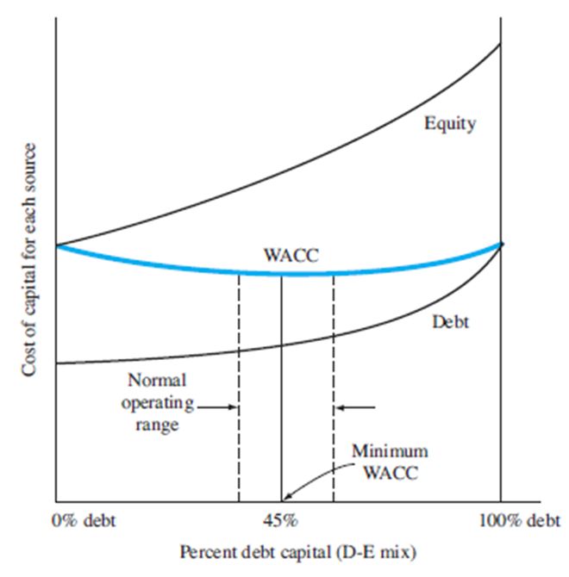
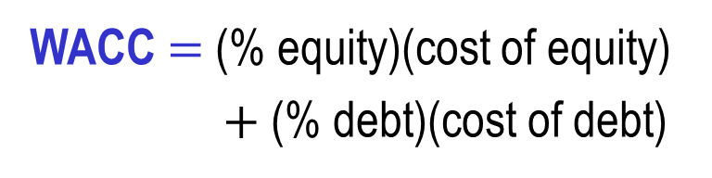
D-E Mix and Weighted Average COC
Debt-to equity (D-E) mix identifies percentages of debt and equity financing for a corporation
WACC $=$ (% equity)(cost of equity)
$+$ (% debt)(cost of debt)
This figure Illustrates WACC
If the percentage of equity capital from each source is known,
each component of WACC
is separately calculated

Slide 7
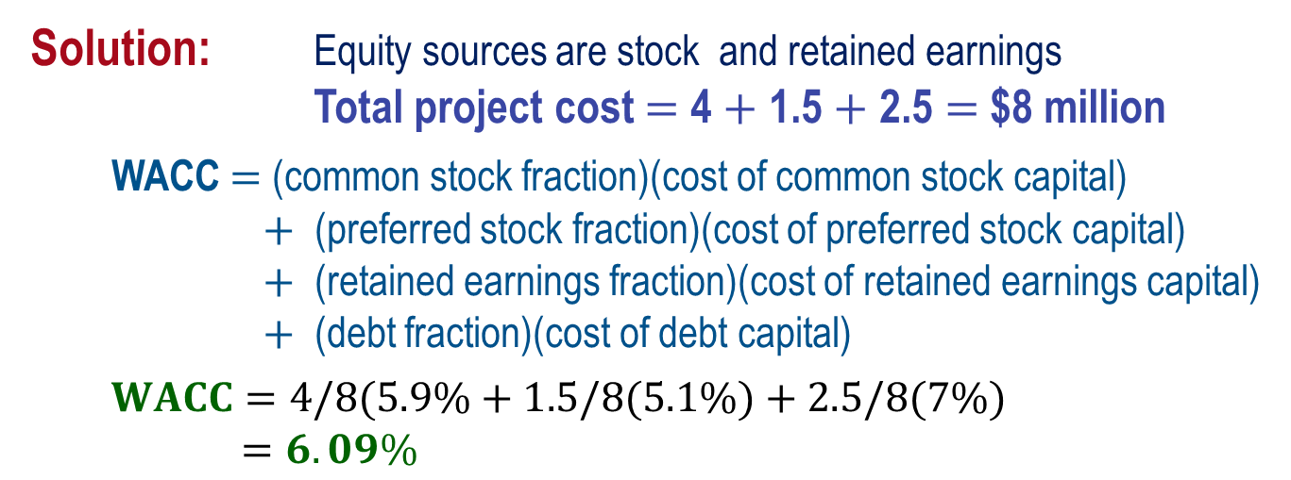
Example: WACC Calculation
A company that specializes in producing cold-weather clothing and accessories is expanding its ski-jacket and boot-sock manufacturing facilities. The company plans to borrow $2.5 million at 7% interest, issue stock worth $4 million worth at 5.9%, and use $1.5 million of retained earnings at 5.1% to finance the project. Determine the company’s WACC.
Solution: Equity sources are stock and retained earnings
Total project cost $=$ 4 $+$ 1.5 $+$ 2.5 $=$ $8 million
WACC $=$ (common stock fraction)(cost of common stock capital)
$+$ (preferred stock fraction)(cost of preferred stock capital)
$+$ (retained earnings fraction)(cost of retained earnings capital)
$+$ (debt fraction)(cost of debt capital)
$WACC=4/8(5.9\%+1.5/8(5.1\%)+2.5/8(7\%)$
$=6.09\%$

Slide 8
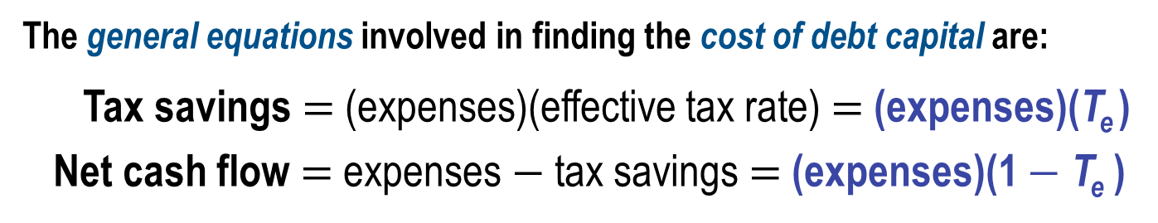
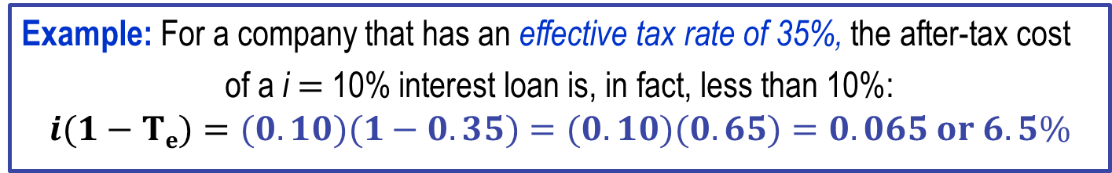
Cost of Debt Capital
Debt capital -- Funds received by borrowing; loans or issuance of bonds
This is important: Interest payments are tax deductible as a corporate operating expense
Example: For a company that has an effective tax rate of 35%, the after-tax cost
  of a i $=$ 10% interest loan is, in fact, less than 10%:
  $$i(1−Te)=(0.10)(1−0.35)=(0.10)(0.65)=0.065 or 6.5\%$$
The general equations involved in finding the cost of debt capital are:
Tax savings $=$ (expenses)(effective tax rate) $=$ (expenses)(T_{e} )
Net cash flow $=$ expenses $−$ tax savings $=$ (expenses)(1 $−$ T_{e} )
Set up PW or AW equation of net cash flows and solve for i*

Slide 9
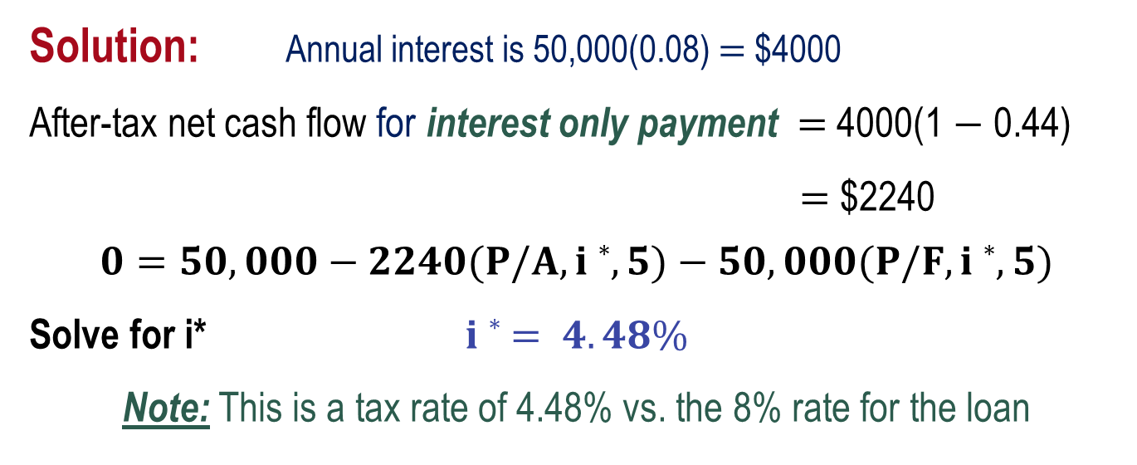
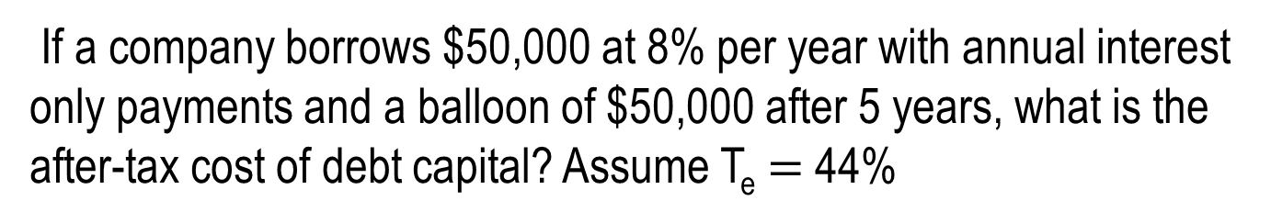
Example: Cost of Debt Capital
If a company borrows $50,000 at 8% per year with annual interest only payments and a balloon of $50,000 after 5 years, what is the after-tax cost of debt capital? Assume T_{e} $=$ 44%
Solution: Annual interest is 50,000(0.08) $=$ $4000
After-tax net cash flow for interest only payment $=$ 4000(1 $−$ 0.44)
$=$ $2240
$$0=50,000−2240(P/A,i∗,5)−50,000(P/F,i∗,5)$$
Solve for i* $i∗ = 4.48\%$
Note: This is a tax rate of 4.48% vs. the 8% rate for the loan

Slide 10
Cost of Equity Capital
Equity capital obtained from 4 possible sources:
(1) Sale of preferred stock (2) Use of retained earnings
(3) Owner’s private capital (4) Sale of common stock
Important: No tax advantage or tax savings for equity capital
Calculating the cost of different equity capital sources
For preferred stock:
Cost of capital is stated dividend percentage
For retained earnings and owner’s funds:
Cost is common stock cost (next slide)

Slide 11
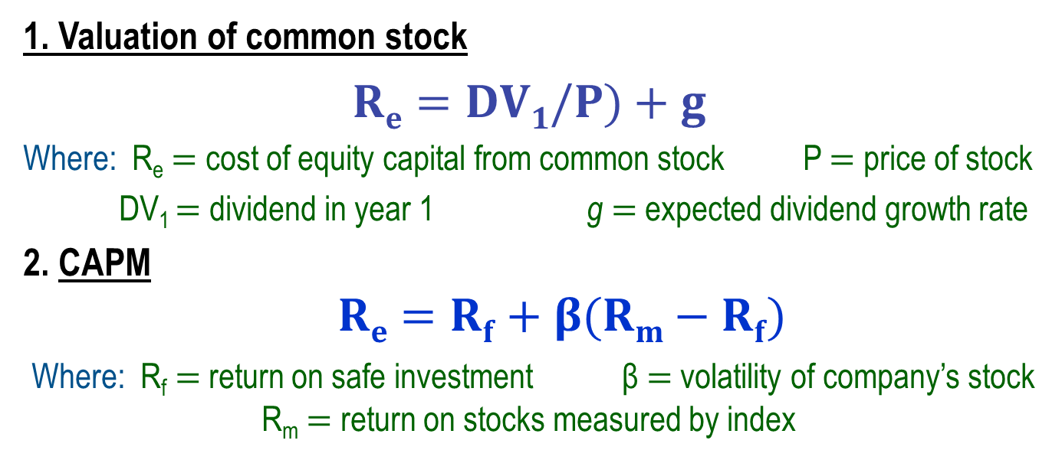
Cost of Equity Capital from Common Stock
Two ways to determine cost of common stock capital:
Valuation of common based on stock price and dividends
Capital asset pricing model (CAPM)
1. Valuation of common stock
$$Re=DV1/P)+g$$
Where: R_{e} $=$ cost of equity capital from common stock P $=$ price of stock
DV₁ $=$ dividend in year 1 g $=$ expected dividend growth rate
2. CAPM
$Re=Rf+β(Rm−Rf)$
Where: R_{f} $=$ return on safe investment β $=$ volatility of company’s stock
R_{m} $=$ return on stocks measured by index

Slide 12
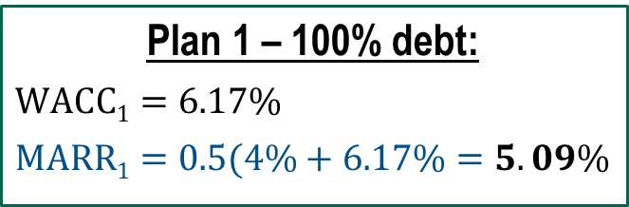
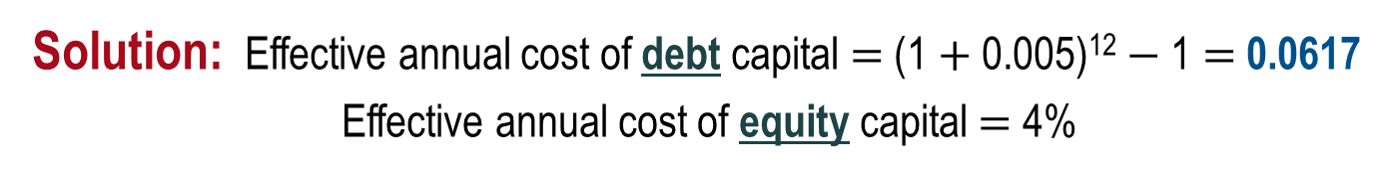
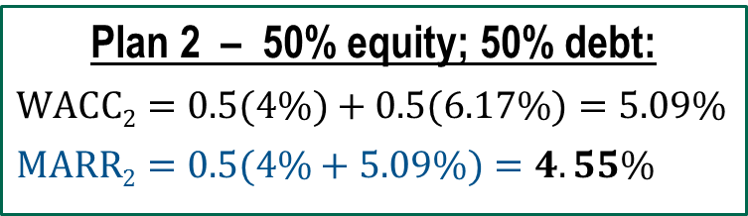
Example: Selection Based on Financing Plans
Good approach to set MARR: between corporation’s
cost of equity capital and WACC. Treat risk separately
Corporate MARR is historically set midway between cost of equity capital, which averages 4% per year, and the WACC for a major project. A project needs $3M start-up capital. Financing plan 1 borrows 100% lent at 0.5% per month. Plan 2 uses 50% equity and 50% borrowed funds. Which plan requires the lower MARR?
Solution: Effective annual cost of debt capital $=$ (1 $+$ 0.005)¹² $−$ 1 $=$ 0.0617
Effective annual cost of equity capital $=$ 4%
Plan 1 – 100% debt:
$$WACC1=6.17\%$$
$$MARR1=0.5(4\%+6.17\%=5.09\%$$
Plan 2 – 50% equity; 50% debt:
$$WACC2=0.5(4\%)+0.5(6.17\%)=5.09\%$$
$$MARR2=0.5(4\%+5.09\%)=4.55\%$$
Plan 2 requires a lower MARR

Slide 13
Debt-Equity Mix and Risk
As proportion of debt capital increases, overall cost of capital decreases
Because interest on debt capital offers a tax advantage
Corporations that become highly leveraged (large D-E mixes) have increased risk and more difficulty in obtaining project funding
Investors take more risk and lenders are leery to provide funds
Best: balance between debt and equity funding

Slide 14
Multiple Attribute Analysis
Attributes other than the economic one are considered in most alternative selections, e.g., public and service sector projects
Steps necessary to identify and use multiple attributes are:
  Identification of attributes
  Determination of importance weight of each attribute
  Assignment of a value rating to each attribute
  Alternative evaluation using a technique that accommodates several attributes
Attribute identification – Some methods are:
  Comparison with similar studies that involve multiple attributes
  Input from experts
  Surveys of constituencies
  Small group discussions
  Delphi method to develop consensus

Slide 15
Sample Attributes
Many attributes are commonly identified
  Safety
  Repair time
  Personnel needs
  Economics (used exclusively thus far to evaluate alternatives)
  Risk
Risk is a routinely identified attribute. Identification of type of risk to consider is vital to considering it thoroughly in the evaluation. Some types of risk are:
  Variation in specific parameters (estimate variation in n, AOC, etc.)
  Project funding (debt vs. equity capital)
  Market dynamics (effect on success of project in the future)
  Environmental impacts and government regulations

Slide 16
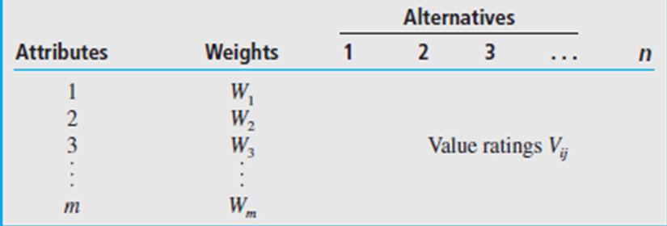
Importance Weight of Attributes
A weight W_{i} (between 0 and 1) is assigned to each attribute i to express its extent of importance relative to other attributes
Weights are normalized to sum to 1.0 as follows:
Arrange attributes, weights, and alternatives in a table
Weights for each attribute

Slide 17
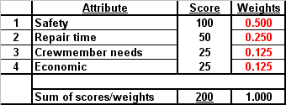
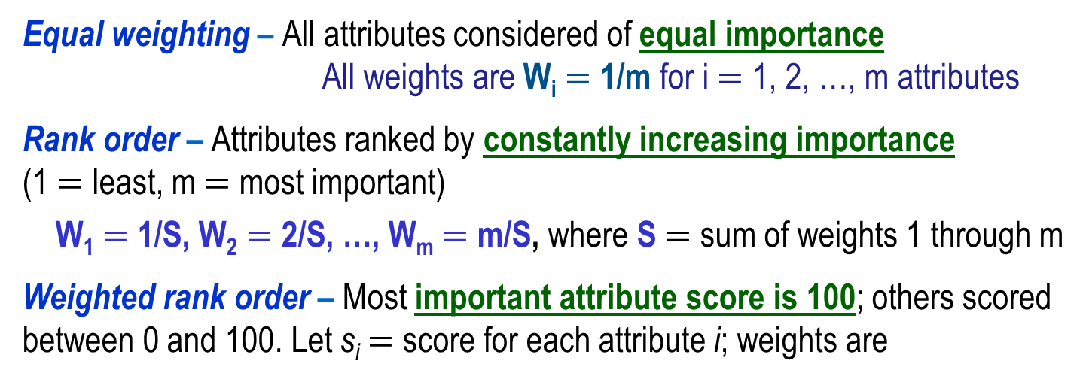
Procedures to Assign Weights
Equal weighting – All attributes considered of equal importance
All weights are W_{i} $=$ 1/m for i $=$ 1, 2, …, m attributes
Rank order – Attributes ranked by constantly increasing importance
(1 $=$ least, m $=$ most important)
W₁ $=$ 1/S, W₂ $=$ 2/S, …, W_{m} $=$ m/S, where S $=$ sum of weights 1 through m
Weighted rank order – Most important attribute score is 100; others scored between 0 and 100. Let s_{i} $=$ score for each attribute i; weights are

Slide 18
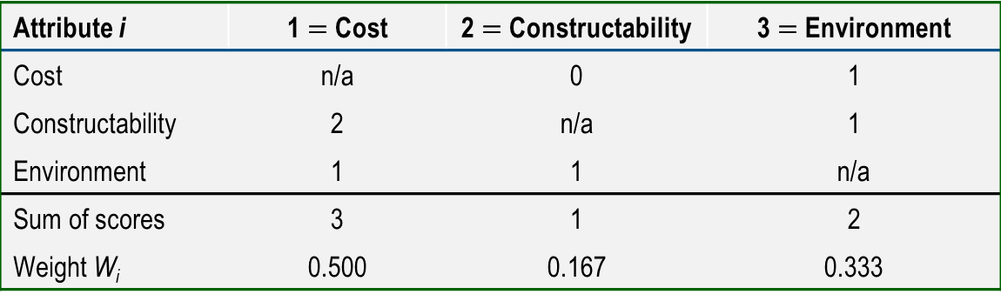
Procedures to Assign Weights
Pairwise comparison – Attributes are compared to each other. Importance comparison scale can be defined as follows:
0 if attribute is less important than one compared to
1 if attribute is equally important as one compared to
2 if attribute is more important than one compared to
Example:
Attribute i | 1 $=$ Cost | 2 $=$ Constructability | 3 $=$ Environment
Cost | n/a | 0 | 1
Constructability | 2 | n/a | 1
Environment | 1 | 1 | n/a
Sum of scores | 3 | 1 | 2
Weight W_{i} | 0.500 | 0.167 | 0.333

Slide 19
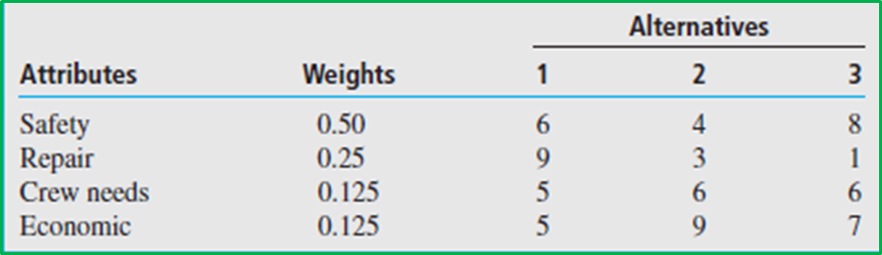
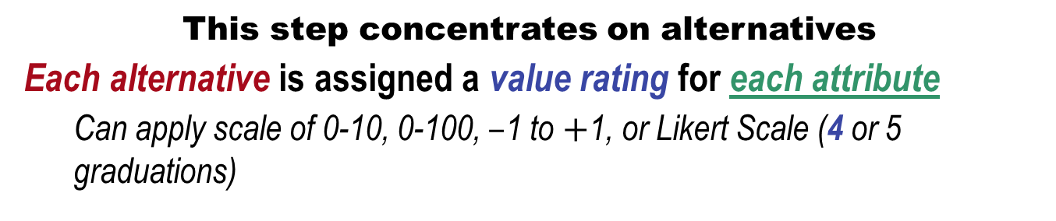
Value Rating of Alternatives by Attribute
This step concentrates on alternatives
Each alternative is assigned a value rating for each attribute
  Can apply scale of 0-10, 0-100, $–$1 to $+$1, or Likert Scale (4 or 5 graduations)
If You Value the Alternative as | Give It a Rating between the Numbers
Very poor | 0–2
Poor | 3–5
Good | 6–8
Very good | 9–10
Example: 3 alternatives and 4 attributes using weighted rank order method for attributes (0 to 100) and value ratings for alternatives (0 to 10)
Value ratings V_{ij} for attribute i and alternative j

Slide 20
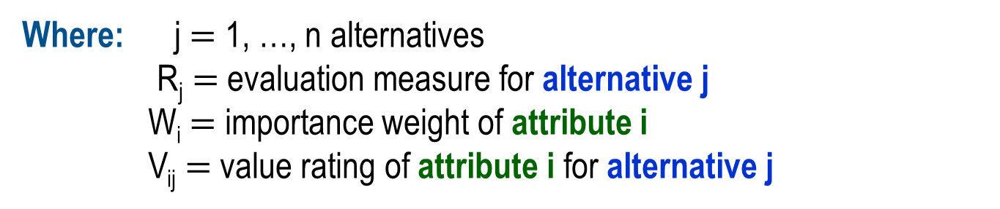
Evaluation Measure for Multiple Attributes
Weighted Attribute Method ─ A single-dimension measure to select one alternative from several, considering multiple attributes
Where: j $=$ 1, …, n alternatives
R_{j} $=$ evaluation measure for alternative j
W_{i} $=$ importance weight of attribute i
V_{ij} $=$ value rating of attribute i for alternative j
Selection guideline
  Choose alternative with largest R_{j} value

Slide 21
Example: Weighted Attribute Method
Three alternative software systems are available that schedule and dispatch long-haul trucks from warehouses to destinations. Six evaluation attributes are of varying importance, as shown by W_{i} scores below. Value ratings V_{ij} are the average ratings of a 7-person committee. Use the weighted attribute method to select the best system.
 |  | Value rating, V_{ij} (0 to 100 basis) | Value rating, V_{ij} (0 to 100 basis) | Value rating, V_{ij} (0 to 100 basis)
Attribute, i | Weight, W_{i} | System 1 | System 2 | System 3
Payback period | 0.11 | 75 | 50 | 100
Initial investment | 0.22 | 60 | 75 | 100
Response time | 0.20 | 50 | 100 | 20
User interface | 0.18 | 100 | 90 | 40
Maintenance support | 0.11 | 75 | 100 | 10
Upgradability | 0.18 | 100 | 100 | 75
TOTALS | 1.00

Slide 22
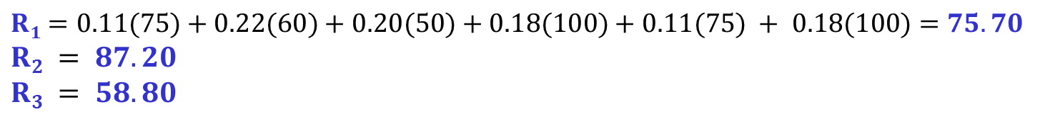
Example: Weighted Attribute Method (Cont.d)
 |  | Value rating, V_{ij} and Evaluation measure, R_{j} | Value rating, V_{ij} and Evaluation measure, R_{j} | Value rating, V_{ij} and Evaluation measure, R_{j} | Value rating, V_{ij} and Evaluation measure, R_{j} | Value rating, V_{ij} and Evaluation measure, R_{j} | Value rating, V_{ij} and Evaluation measure, R_{j}
Attribute, i | Weight, W_{i} | System 1 | System 1 | System 2 | System 2 | System 3 | System 3
Payback period | 0.11 | 75 | 8.25 | 50 | 5.50 | 100 | 11.00
Initial investment | 0.22 | 60 | 13.20 | 75 | 16.50 | 100 | 22.00
Response time | 0.20 | 50 | 10.00 | 100 | 20.00 | 20 | 4.00
User interface | 0.18 | 100 | 18.00 | 90 | 16.20 | 40 | 7.20
Maintenance support | 0.11 | 75 | 8.25 | 100 | 11.00 | 10 | 1.10
Upgradability | 0.18 | 100 | 18.00 | 100 | 18.00 | 75 | 13.50
TOTALS | 1.00 |  | 75.70 |  | 87.20 |  | 58.80
Use formula for R_{j} measure to determine:
$$R1=0.11(75)+0.22(60)+0.20(50)+0.18(100)+0.11(75) + 0.18(100)=75.70$$
$$R2 = 87.20$$
$$R3 = 58.80$$
Select system 2

Slide 23
Summary of Important Points
Cost of capital is weighted average of debt and equity funding
There is a tax savings with debt capital because interest is deductible; nothing is tax deductible for equity capital
High D-E mixes mean higher risk for lenders and investors; project funding becomes more problematic
Multiple attribute analysis brings other factors (besides cost) into the decision-making process
Four different techniques for assigning weights to attributes
Likert scale is good for assigning value ratings to alternatives
Multiple attribute evaluation measure is

