Slide 1
Lecture slides to accompany
Engineering Economy, 8th edition
Leland Blank, Anthony Tarquin
©McGraw-Hill Education. All rights reserved. Authorized only for instructor use in the classroom. No reproduction or further distribution permitted without the prior written consent of McGraw-Hill Education.
Notes:
At this point:
1. Introduce yourself - your students are likely to want to know something about your qualifications and interests - overall, where you are coming from.
2. Have students introduce themselves. Ask why they are taking this class. If you are fortunate enough to have a Polaroid camera, take pictures of each student for later posting on a class “board” so both they and you get to know each other.
3. Discuss both choice of textbook and development of syllabus.
4. If you are expecting students to work in teams, at east introduce the choice of team members. If at all possible, have students participate in a team building or team study exercise. It works wonders. Most student have been told to work in teams in prior classes, but have never examined exactly what a team is and how it works. One hour spent in a team building/examination exercise saves many hours and avoids many problems later on.

Slide 2
Chapter 1
Foundations Of Engineering Economy

Slide 3
LEARNING OUTCOMES
Economics role in decision making
Study approach
Ethics and economics
Interest rate
Terms and symbols
Cash flows
Economic equivalence
Simple and compound interest
Minimum attractive rate of return (MARR)
Spreadsheet functions

Slide 4
Why Engineering Economy is Important to Engineers
Engineers design and create
Designing involves economic decisions
Engineers must be able to incorporate economic analysis into their creative efforts
Understanding and applying time value of money, economic equivalence, and cost estimation are vital for engineers
Project decisions are made more on the return on investment or payback than on technology
You must communicate the basics of economy for your proposals to get funding

Slide 5
Time Value of Money (TVM)
Description: TVM explains the change in the amount of money over time for funds owed by or owned by a corporation or individual
Corporate investments are expected to earn a return
Investment always involves money
Money has a ‘time value’
The time value of money is the most important concept in engineering economy

Slide 6
Engineering Economy
Engineering Economy involves
  Formulating
  Estimating
  Evaluating
    Evaluating expected economic outcomes of alternatives
    designed to accomplish a defined purpose
Easy-to-use math techniques simplify the evaluation
Estimates of economic outcomes can be deterministic or stochastic in nature

Slide 7
General Steps for Decision Making Processes
Understand the problem – define objectives
Collect relevant information – e.g. cash flows, interest rate, estimated life
Define the set of feasible alternatives
Define the criteria for decision making
Evaluate the alternatives and explore sensitivity analysis
Select the “best” alternative (typically measured by dollars)
Implement the alternative and monitor results

Slide 8
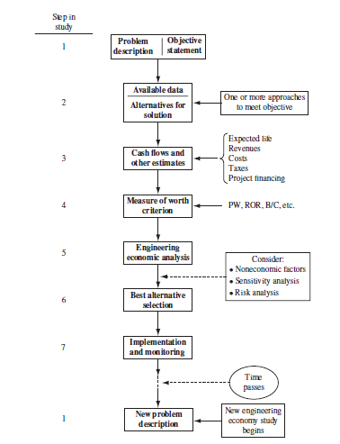
Steps in an Engineering Economy Study

Slide 9
Ethics – Different Levels
Universal morals or ethics – Fundamental beliefs: stealing, lying, harming or murdering another are wrong
Personal morals or ethics – Beliefs that an individual has and maintains over time; how a universal moral is interpreted and used by each person
Professional or engineering ethics – Formal standard or code that guides a person in work activities and decision making

Slide 10
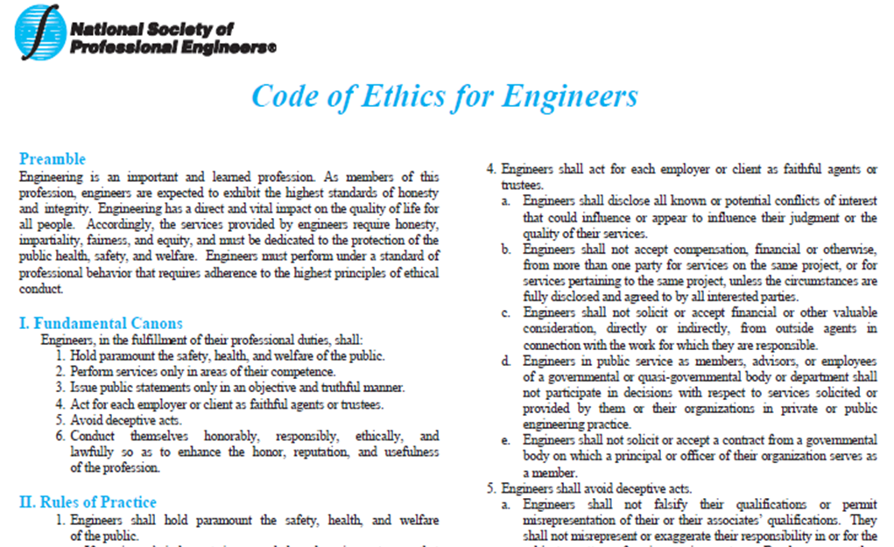
Code of Ethics for Engineers
All disciplines have a formal code of ethics. National Society of Professional Engineers (NSPE) maintains a code specifically for engineers; many engineering professional societies have their own code

Slide 11
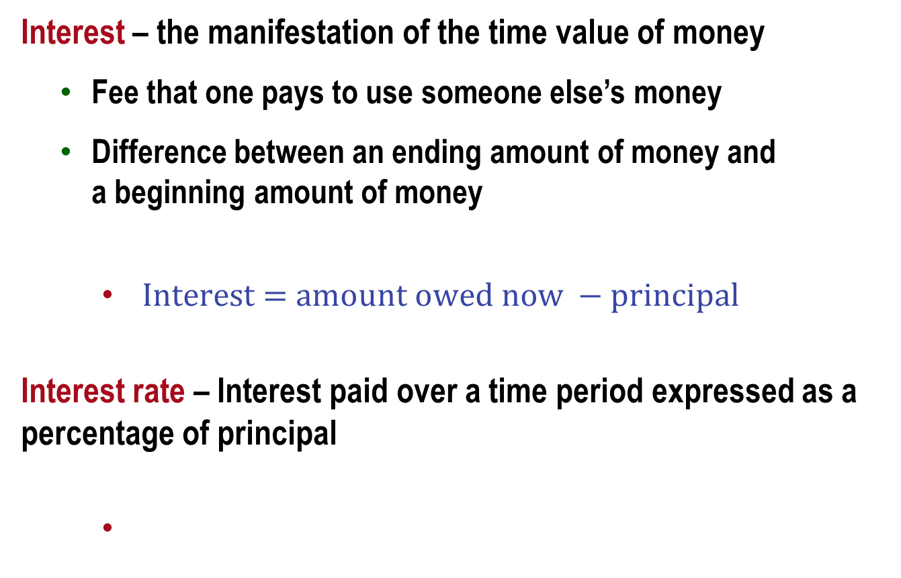
Interest and Interest Rate
Interest – the manifestation of the time value of money
  Fee that one pays to use someone else’s money
  Difference between an ending amount of money and
  a beginning amount of money
    $Interest$ $=$ $amount owed now −$ $principal$
Interest rate – Interest paid over a time period expressed as a percentage of principal

Slide 12
Rate of Return
Interest earned over a period of time is expressed as a percentage of the original amount (principal)
Borrower’s perspective – interest rate paid
Lender’s or investor’s perspective – rate of return earned

Slide 13
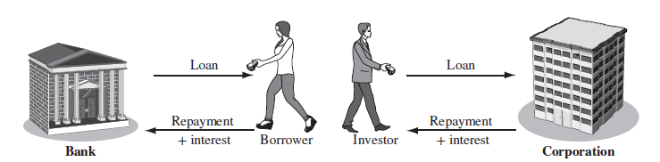
Depends on your point of view
Interest paid
Interest earned
Interest rate
Rate of return

Slide 14
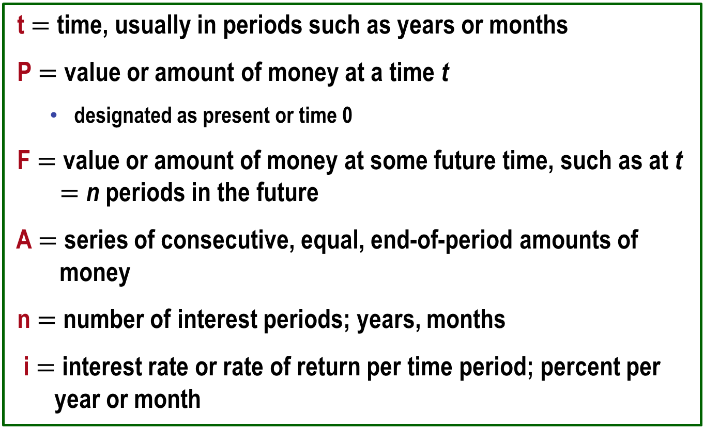
Commonly used Symbols
t $=$ time, usually in periods such as years or months
P $=$ value or amount of money at a time t
  designated as present or time 0
F $=$ value or amount of money at some future time, such as at t $=$ n periods in the future
A $=$ series of consecutive, equal, end-of-period amounts of money
n $=$ number of interest periods; years, months
i $=$ interest rate or rate of return per time period; percent per year or month

Slide 15
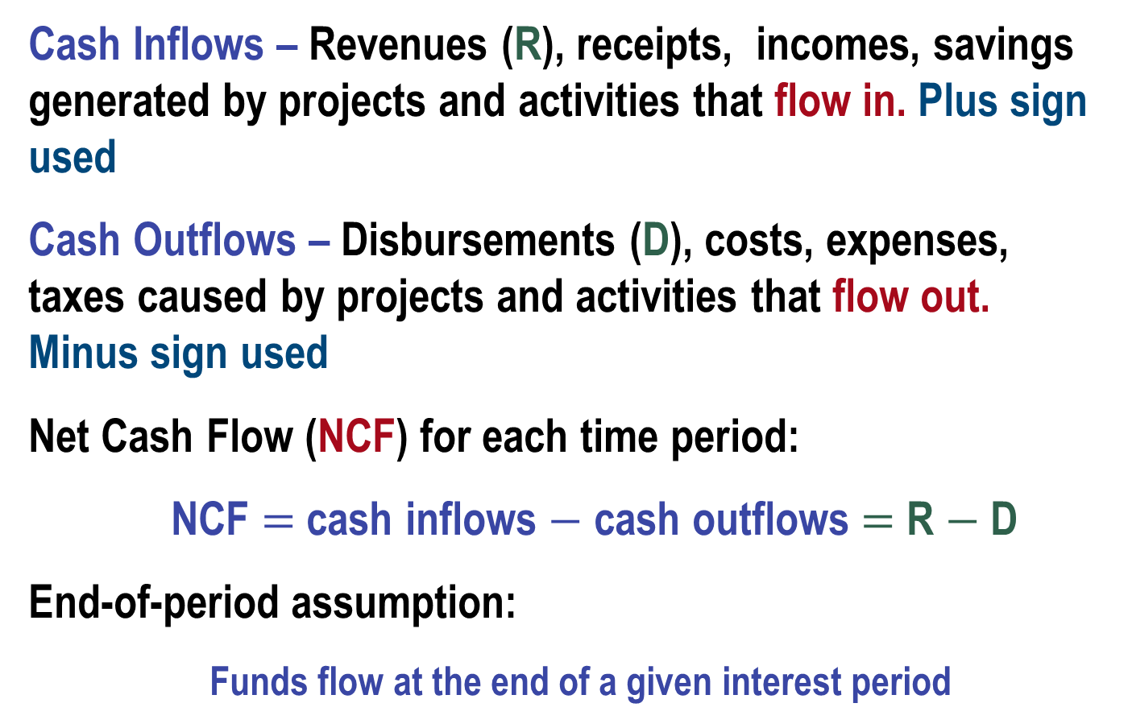
Cash Flows: Terms
Cash Inflows – Revenues (R), receipts, incomes, savings generated by projects and activities that flow in. Plus sign used
Cash Outflows – Disbursements (D), costs, expenses, taxes caused by projects and activities that flow out. Minus sign used
Net Cash Flow (NCF) for each time period:
  NCF $=$ cash inflows $−$ cash outflows $=$ R $−$ D
End-of-period assumption:
  Funds flow at the end of a given interest period

Slide 16
Cash Flows: Estimating
Point estimate – A single-value estimate of a cash flow element of an alternative
  Cash inflow: Income = $150,000 per month
Range estimate – Min and max values that estimate the cash flow
Cash outflow: Cost is between $2.5 M and $3.2 M
Point estimates (a constant) are commonly used; however, range estimates with probabilities assigned provide a better understanding of the variability and sensitivity of economic parameters used to make decisions.

Slide 17
Cash Flow Diagrams
What a typical cash flow diagram might look like
Draw a time line
Always assume end-of-period cash flows
Time
0 1 2 … … … n - 1 n
One time period
Show the cash flows (to approximate scale)
$100
$50
0 1 2 … … … n-1 n
P = $-80
Cash flows are shown as directed arrows: + (up) for inflow
- (down) for outflow
F = ?

Slide 18
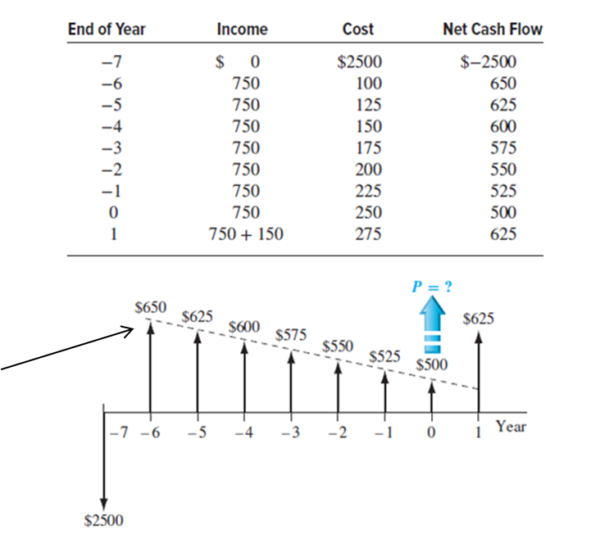
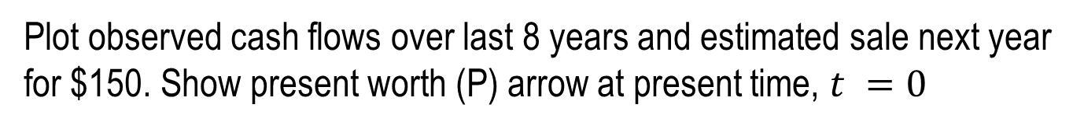
Cash Flow Diagram Example
Plot observed cash flows over last 8 years and estimated sale next year for $150. Show present worth (P) arrow at present time, $t =0$
This is called a ‘gradient’ – a constant change over each period.

Slide 19
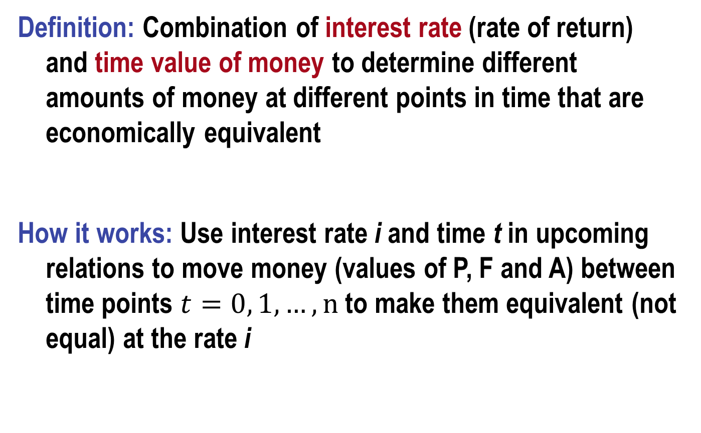
Economic Equivalence
Definition: Combination of interest rate (rate of return) and time value of money to determine different amounts of money at different points in time that are economically equivalent
How it works: Use interest rate i and time t in upcoming relations to move money (values of P, F and A) between time points $t=0, 1, …, n$ to make them equivalent (not equal) at the rate i

Slide 20

Example of Equivalence
Different sums of money at different times may be equal in economic value at a given rate
$110
Year
0 1
$$Rate of return=10\% per year$$
$100 now
$100 now is economically equivalent to $110 one year from now, if the $100 is invested at a rate of 10% per year.

Slide 21
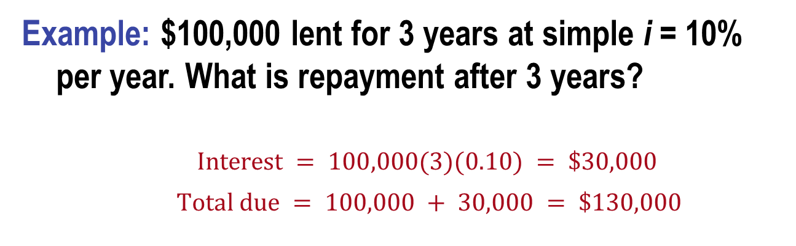
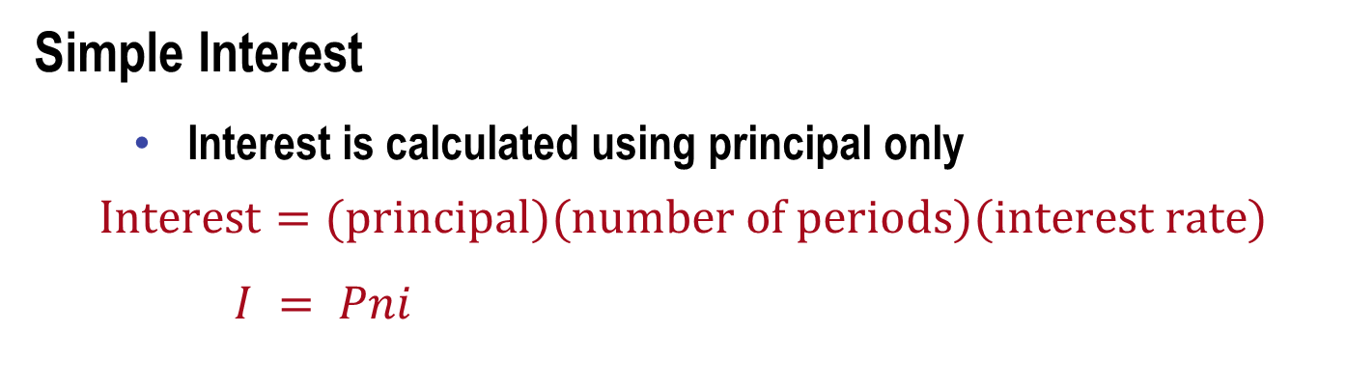
Simple and Compound Interest (1)
Simple Interest
Interest is calculated using principal only
  $$Interest=(principal)(number of periods)(interest rate)$$
  $I = Pni$
Example: $100,000 lent for 3 years at simple i = 10% per year. What is repayment after 3 years?
$Interest = 100,000(3)(0.10) = \$30,000$
$$Total due = 100,000 + 30,000 = \$130,000$$

Slide 22
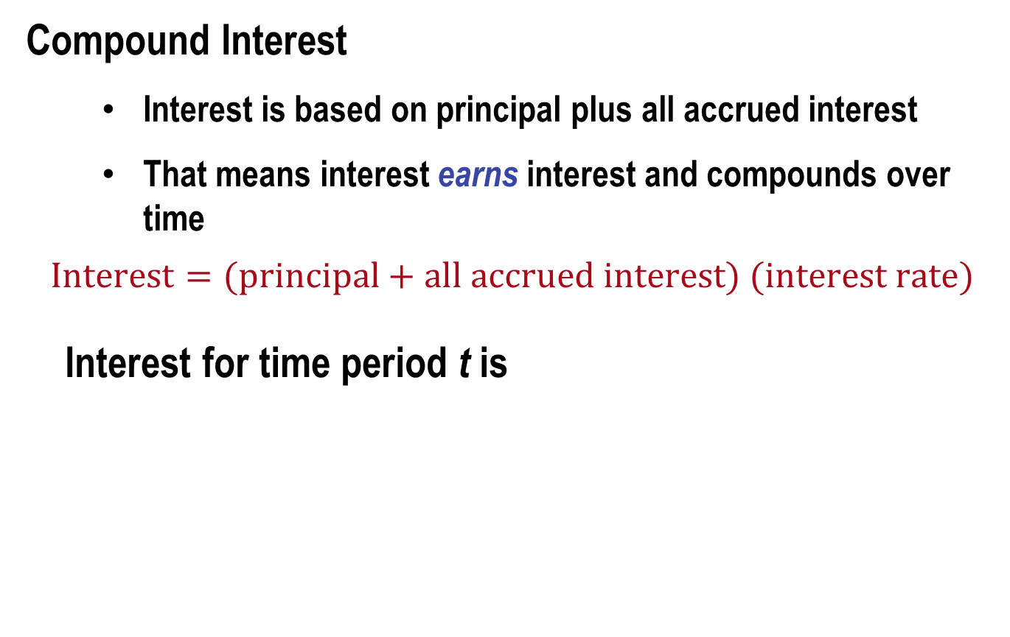
Simple and Compound Interest (2)
Compound Interest
  Interest is based on principal plus all accrued interest
  That means interest earns interest and compounds over time
  $$Interest=(principal+all accrued interest) (interest rate)$$
Interest for time period t is

Slide 23
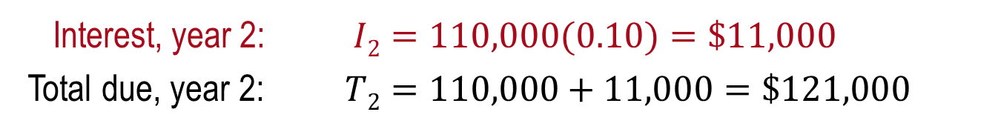
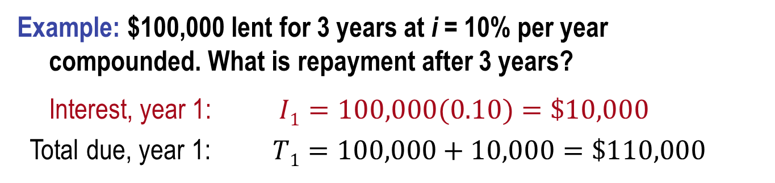

Compound Interest Example
Example: $100,000 lent for 3 years at i = 10% per year compounded. What is repayment after 3 years?
Interest, year 1: $I1=100,000(0.10)=\$10,000$
Total due, year 1: $T1=100,000+10,000=\$110,000$
Interest, year 2: $I2=110,000(0.10)=\$11,000$
Total due, year 2: $T2=110,000+11,000=\$121,000$
Interest, year 3: $I3=121,000(0.10=\$12,100$
Total due, year 3: $T3=121,000+12,100=\$133,100$
Compounded: $133,100 Simple: $130,000

Slide 24
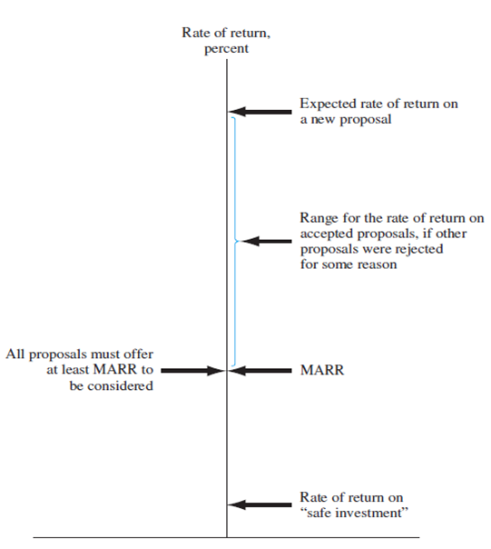
Minimum Attractive Rate of Return
MARR is a reasonable rate of return (percent) established for evaluating and selecting alternatives
An investment is justified economically if it is expected to return at least the MARR
Also termed hurdle rate, benchmark rate and cutoff rate

Slide 25
MARR Characteristics
MARR is established by the financial managers of the firm
MARR is fundamentally connected to the cost of capital
Both types of capital financing are used to determine the weighted average cost of capital (WACC) and the MARR
MARR usually considers the risk inherent to a project (the higher the risk means the higher the MARR)

Slide 26
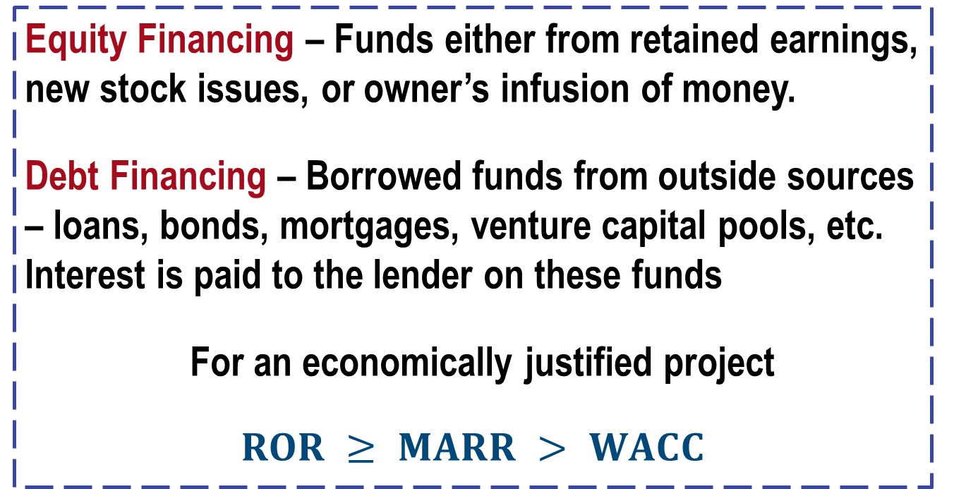
Types of Financing
Equity Financing – Funds either from retained earnings, new stock issues, or owner’s infusion of money.
Debt Financing – Borrowed funds from outside sources – loans, bonds, mortgages, venture capital pools, etc. Interest is paid to the lender on these funds
For an economically justified project
$$ROR ≥ MARR > WACC$$

Slide 27
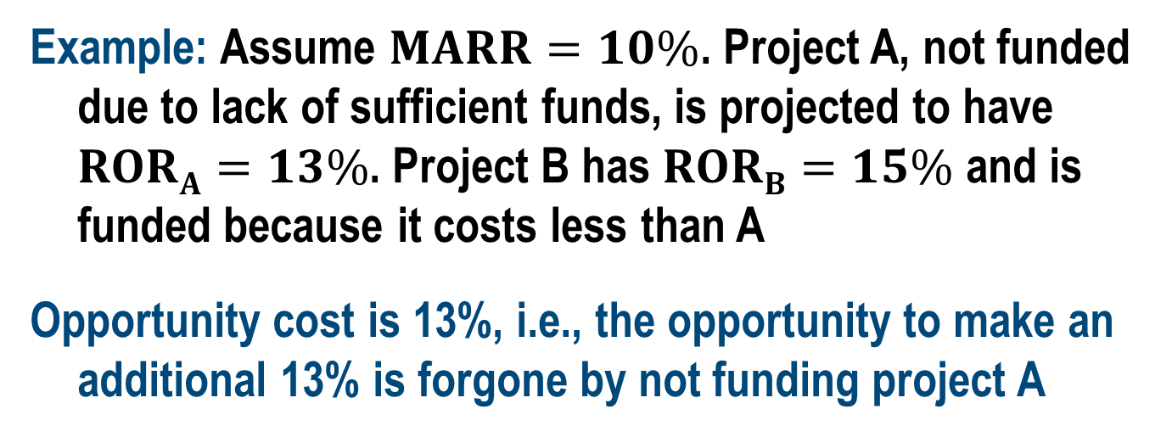
Opportunity Cost
Definition: Largest rate of return of all projects not accepted (forgone) due to a lack of capital funds
If no MARR is set, the ROR of the first project not undertaken establishes the opportunity cost
Example: Assume $MARR=10\%$. Project A, not funded due to lack of sufficient funds, is projected to have $RORA=13\%$. Project B has $RORB=15\%$ and is funded because it costs less than A
Opportunity cost is 13%, i.e., the opportunity to make an additional 13% is forgone by not funding project A

Slide 28
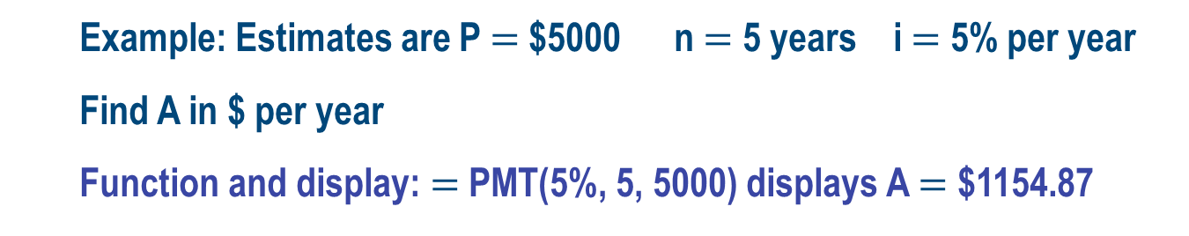
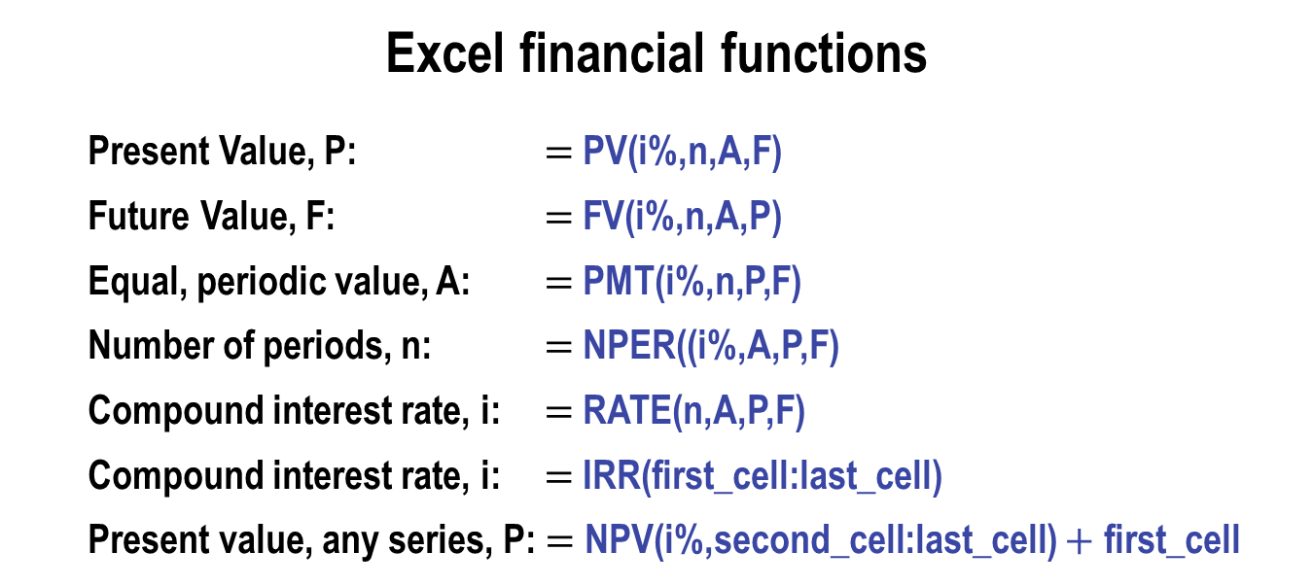
Introduction to Spreadsheet Functions
Excel financial functions
  Present Value, P: $=$ PV(i%,n,A,F)
  Future Value, F: $=$ FV(i%,n,A,P)
  Equal, periodic value, A: $=$ PMT(i%,n,P,F)
  Number of periods, n: $=$ NPER((i%,A,P,F)
  Compound interest rate, i: $=$ RATE(n,A,P,F)
  Compound interest rate, i: $=$ IRR(first_cell:last_cell)
  Present value, any series, P: $=$ NPV(i%,second_cell:last_cell) $+$ first_cell
  Example: Estimates are P $=$ $5000 n $=$ 5 years i $=$ 5% per year
  Find A in $ per year
  Function and display: $=$ PMT(5%, 5, 5000) displays A $=$ $1154.87

Slide 29
Chapter Summary (1)
Engineering Economy fundamentals
  Time value of money
  Economic equivalence
  Introduction to capital funding and MARR
  Spreadsheet functions
Interest rate and rate of return
  Simple and compound interest
Cash flow estimation
  Cash flow diagrams
  End-of-period assumption
  Net cash flow
  Perspectives taken for cash flow estimation

Slide 30
Chapter Summary (2)
Ethics
  Universal morals and personal morals
  Professional and engineering ethics (Code of Ethics)
Economic Equivalence
  Combination of interest rate and time value of money
Simple and Compound Interest
  Simple interest is Pni (Principal, #periods, and interest rate)
  Compound interest is where interest is earned/paid on interest
MARR and Opportunity Cost
  Debt or equity capital financing
  Impact of not selecting an project opportunity

