Slide 1
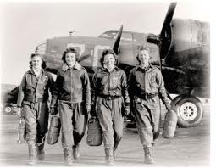
Women in Aviation
By: Mike Marchesan, Grigory Arzanyun, Ronnie Calderon, Julian Hipolito

Slide 2
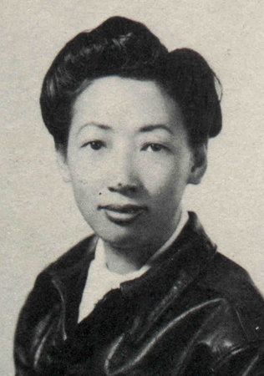
Hazel ying Lee
-Born 1912, in Portland, Oregon
-Fell in love with aviation after her first ride at the age of 20.
-Attempted to join the Chinese Airforce to help fight Japanese, but was turned down due to gender, and joined US Military.
-At the time, < 1% of the pilots in the US were female, let alone non-white females.
Marchesan-2

Slide 3
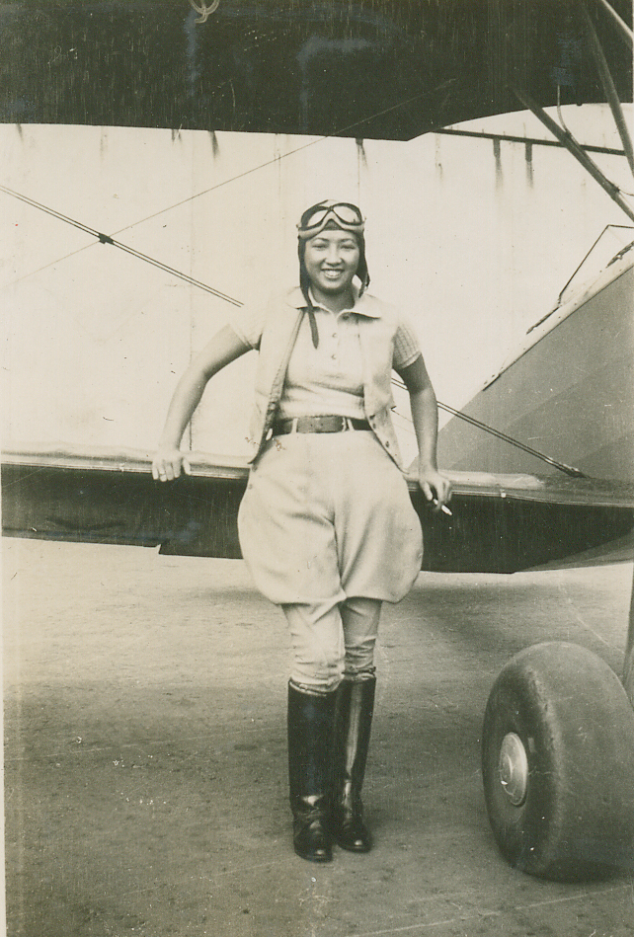
Career Peaks, and Legacy
-Joined WASP in the US Military, Women Airforce Service Pilots.
-After WASP training, and the start of WWII, Lee made several trips to and from the European and Pacific war fronts, carrying supplies.
-She later completed other training, such as OCS, which qualified her to fly all single engine fighter planes.
-Soon after, a flight control miscommunication caused her to land as another plane did, and collide on the runway, causing her to die in the hospital, due to burn complications.
A true warrior to break the trend of male domination in Aviation
Marchesan-3

Slide 4
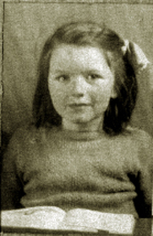
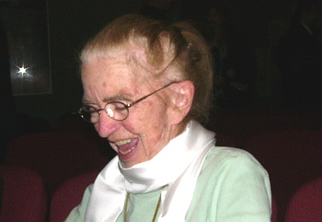
Lorna DeBlicquy
Born in Blyth, Ontario. In Nov. 30, 1931
Lived to be 77 with decades of awards
Canada’s first civil aviation inspector
Passed away March 29, 2009. In Ontario from Alzheimer Disease.
Grigor Arzunyan

Slide 5
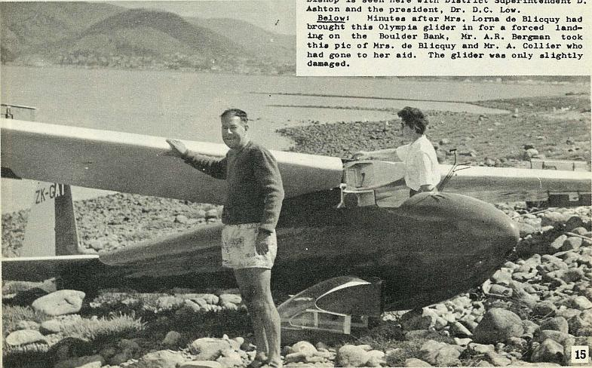
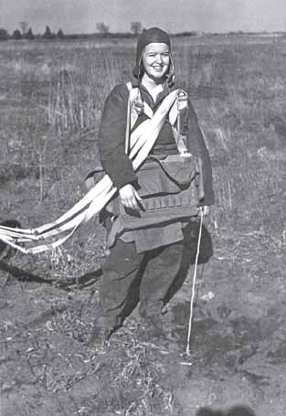
Lorna DeBlicquy
First woman in Canada to jump in a parachute
Flew to Ethiopia in order to help famine relief
Earned Ninety-Nines Amelia Earhart Scholarship
Grigor Arzunyan

Slide 6
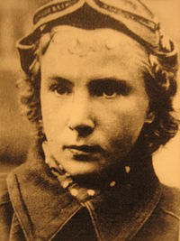
Lilya Litvak - The "White Rose" of Stalingrad
Lidya Vladimirovna Litvak was born in Moscow in August 18, 1921. Lilya was her nickname. Was a fighter pilot during World War II
She is one of the world's only two female fighter aces, along with Katya Budanova
Was interested in aviation since she was a teenager and flew solo a couple times. After going to an academy for aviation she was became an instructor
Litvyak tried to join a military aviation unit, but was turned down for lack of experience. It is said that she had to exagerrate about her flight hours to get in
Took out 2 enemy fighters, one of them a German ace pilot(ace: having more 10 or more victories) on the same evening of her first battle
Ronie Calderon

Slide 7
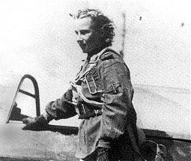
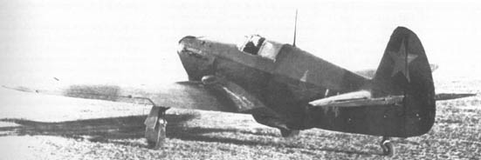
Lilya Litvak - The "White Rose" of Stalingrad
Suffered many physical and mental injuries, including the loss of her fiance and her close friend
Died from 8 German enemy pilots recognizing who she was and cornering her in a dogfight
Ronie Calderon

Slide 8
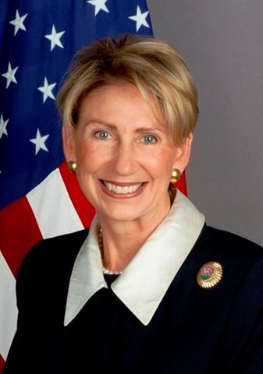
Barbara McConnell Bannett
Bachelors and Masters degree in law
Honorary Doctorates degree
President of leading organizations such as the (IWF).
She took her career to many heights such as U.S. Ambassador to Finland; As well as advisor for U.S. International trade.

Slide 9

Appointed by President Reagan as the vice chairperson for the Civil Aeronautics Board
Served as the Deputy Administrator to the Federal Aviation Administration (FAA)
Served as a representative for the Defense Advisory Committee on Women in the Services.
Paved the way for Women in the military flying combat missions.
Trained as a cosmonaut in preparation as back-up for space-flight mission to the International Space Station.
An International Business and Aviation Attorney.

Slide 10
CITATION
Tyminski, Dariusz. "WW II ACE STORIES." Ełk I Internet - ElkNet - Ełcka Część Sieci. 09 Dec. 1998. Web. 13 Oct. 2011. <http://www.elknet.pl/acestory/litvak/litvak.htm>.
Stockton, Harold, Dariusz Tyminski, and Christer Bergström. "WW II ACE STORIES." Ełk I Internet - ElkNet - Ełcka Część Sieci. 09 Dec. 1998. Web. 13 Oct. 2011. <http://www.elknet.pl/acestory/raskov/raskov.htm>.
"Global Council - International Museum of Women." Home - International Museum of Women. Web. 14 Oct. 2011. <http://www.imow.org/about/globalcouncil/index>.
"Pioneer Pilot - Lorna De Blicquy." Canadian 99s Home Page. Web. 14 Oct. 2011. <http://www.canadian99s.org/articles/P_deblicquy.htm>.
"Pioneer Pilot - Lorna De Blicquy." Canadian 99s Home Page. Web. 14 Oct. 2011. <http://www.canadian99s.org/articles/P_deblicquy_obit.htm>.
Welcome to Women in Aviation. Web. 14 Oct. 2011. <http://www.womeninaviation.com/calendar.html>.

