Slide 1
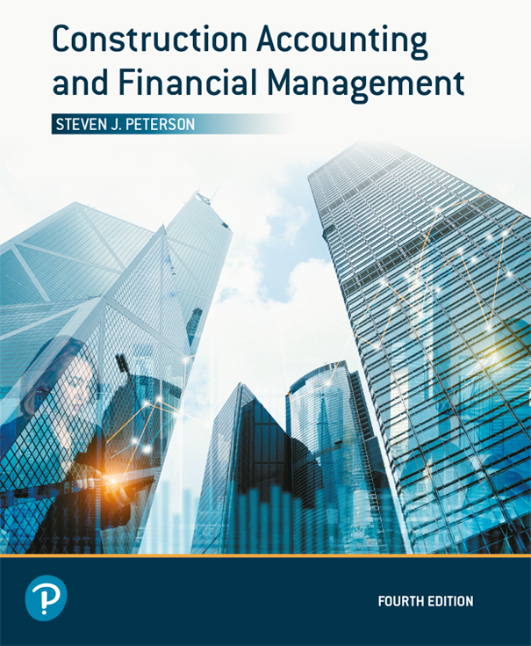
Construction Accounting and Financial Management
Fourth Edition
Chapter 18
Income Tax and Financial Decisions
Copyright © 2020, 2013, 2009 Pearson Education, Inc. All Rights Reserved

Slide 2
Effects of Income Taxes (1 of 4)
If all cash flows are treated the same for income tax, income tax has little effect on the decision process in Chapter 17
Losses carried forward defer tax to future years reducing their value when using decision methods that take into account time value of money (interest)

Slide 3
Effects of Income Taxes (2 of 4)
Changes in tax rates (brackets) from year to year can increase or decrease the taxs associated with an alternative
Depreciation defers to future years the tax savings associated with the purchase of depreciable equipment; reducing their value when using decision methods that take into account time value of money (interest)

Slide 4
Effects of Income Taxes (3 of 4)
Capital gains can reduce the tax rate used for an alternative increasing the alternative’s attractiveness
Tax credits replace the tax deduction associated with an alternative with a tax credit increasing the alternative’s attractiveness

Slide 5
Effects of Income Taxes (4 of 4)
When alternatives are treated differently for tax purposes, use after-tax cash flow when comparing

Slide 6

Copyright

