Slide 1
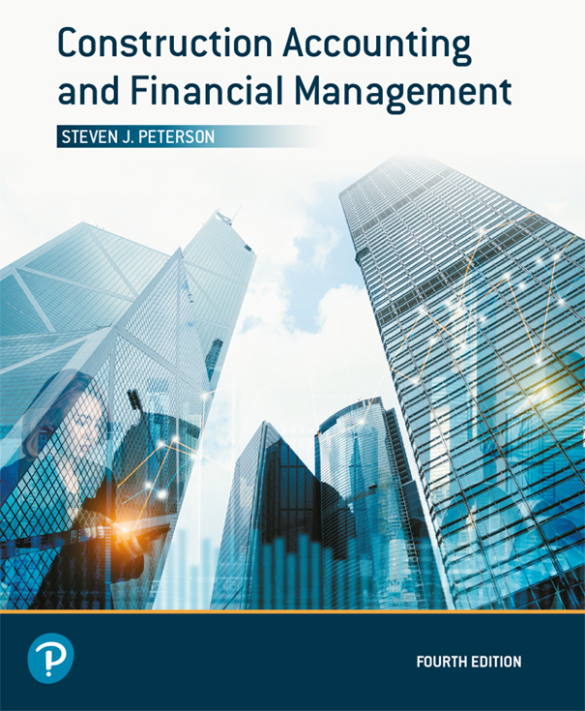
Construction Accounting and Financial Management
Fourth Edition
Chapter 17
Tools for Making Financial Decisions
Copyright © 2020, 2013, 2009 Pearson Education, Inc. All Rights Reserved

Slide 2
Types of Alternatives
Independent
  Does not preclude accepting another alternative
Mutually exclusive
  Precludes accepting all other alternatives
Contingent
  Must be selected with another alternative
“Do nothing”

Slide 3
Pool of Possible Alternatives
May be a single alternative or combination of alternative
Must be mutually exclusive
Must meet the desired objectives without going over budget

Slide 4
Sunk Costs
Sunk costs are:
  Costs already incurred
  Costs that have been committed to be paid that cannot be canceled
Sunk costs should not be used in decision making because the money has already been spent

Slide 5
Minimum Attractive Rate of Return (MARR)
Interest rate at which alternatives will be evaluated
Should cover cost of capital and minimum acceptable profit
  Profit covers risk

Slide 6
Study Period
The period of time over which the alternatives will be studied
All alternatives must have the same life span as the study period

Slide 7
Adjusting Live Spans
Shorten by adding salvage value
Lengthen by adding maintenance cost at end of life
  For example, upgrading a computer
Repurchase alternative
  May be done until all alternatives end at the same time
Combination of above

Slide 8
Net Present Value (NPV) or Present Worth
Determine present value (at beginning of the study period) for each alternatives’ cash flows
Select alternative with largest NPV
If:
  NPV > 0: Alternative has return > MARR
  NPV = 0: Alternative has return = MARR
  NPV < 0: Alternative has return < MARR

Slide 9
Incremental Net Present Value
Alternatives compared by the differences in their cash flows

Slide 10
Incremental Net Present Value
Steps
Step 1: Rank alternative based upon initial cost (low to high)
Step 2: Alternative with lowest cost is “current best alternative”
Step 3: Compare “current best alternative” with next alternative based upon net present value

Slide 11
Incremental Net Present Value Steps (1 of 2)
Step 4: if:
  If NPV is positive the next alternative becomes the “current best alternative”
  If NPV is zero or negative the “current best alternative” remains the “current best alternative”
Step 5: Repeat Steps 3 and 4 until all alternatives have been considered

Slide 12
Future Worth (FW) (1 of 2)
Determine future worth (at end of the study period) for each alternatives’ cash flows
Select alternative with largest future worth
If:
  FW > 0: Alternative has return > MARR
  FW = 0: Alternative has return = MARR
  FW < 0: Alternative has return < MARR

Slide 13
Future Worth (FW) (2 of 2)
Selects the same alternative as the net present value

Slide 14
Annual Equivalent (AE) (1 of 3)
Determine annual equivalent for each alternatives’ cash flows
Study periods may be different
  Assumes alternatives are repurchased
  Need not adjust lifes
Select alternative with largest annual equivalent

Slide 15
Annual Equivalent (AE) (2 of 3)
If:
  AE > 0: Alternative has return > MARR
  AE = 0: Alternative has return = MARR
  AE < 0: Alternative has return < MARR
Selects the same alternative as the net present value and future worth

Slide 16
Annual Equivalent (AE) (3 of 3)

Slide 17
Rate of Return
Interest rate that produces a NPV of zero
Select alternative with largest rate of return
If best rate of return is less than the MARR consider rejecting all alternative

Slide 18
Incremental Rate of Return
Alternatives compared in the differences in their cash flows

Slide 19
Incremental Rate of Return Steps
Step 1: Rank alternative based upon initial cost (low to high)
Step 2: Alternative with lowest cost is “current best alternative”
Step 3: Compare “current best alternative” with next alternative based on rate of return

Slide 20
Incremental Net Present Value Steps (2 of 2)
Step 4: if:
  If the rate of return in greater than the MARR the next alternative becomes the “current best alternative”
  If the rate of return is less than or equal to the MARR the “current best alternative” remains the “current best alternative”
Step 5: Repeat Steps 3 and 4 until all alternatives have been considered

Slide 21
Capital Recovery with Return
Similar to annual equivalent except it only looks at capital costs
Identifies how much revenue an alternative must generate to cover it capital cost with a return on investment
  Useful when trying to determine revenues

Slide 22
Payback Period without Interest
How long does it take to recover initial costs?
Ignores:
  Interest on the initial costs
  Salvage value
If payback period without interest is longer than the life of the alternative, the alternative should be rejected

Slide 23
Payback Period with Interest
How long does it take to recover initial costs plus interest?
Includes interest on the capital investment
Ignores the salvage value
If payback period with interest is longer than the life of the alternative, the alternative should be rejected

Slide 24
Project Balance (1 of 2)
Shows:
  Potential profit or loss at any time
  Future worth, which is related to NPV
  Show payback period with interest
Useful for:
  Risky alternatives
  Comparing alternatives with similar NPVs

Slide 25
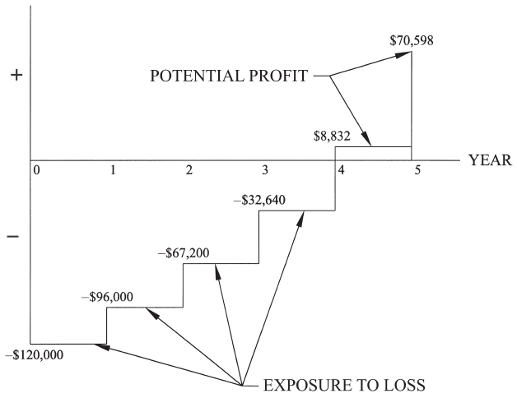
Project Balance (2 of 2)
Figure 17.11 Project Balance for Example 17-19

Slide 26

Copyright

