Slide 1

Construction Accounting and Financial Management
Fourth Edition
Chapter 16
Financing a Company’s Financial Needs
Copyright © 2020, 2013, 2009 Pearson Education, Inc. All Rights Reserved

Slide 2
Simple Interest
  - or -
  where
  I = Interest
  P = Principal
  i = Interest rate per year
  n = Number of years (may be a fraction)
  D = Days
Notes:
Slide 2 is list of textbook LO numbers and statements

Slide 3
Compound Interest (1 of 2)
  where
  i = Periodic interest rate (often monthly)
  r = Nominal interest rate per year or annual
  percentage rate (APR)
  c = Number of compounding periods in a year
  where c ≥ 1
Notes:
Slide 2 is list of textbook LO numbers and statements

Slide 4
Compound Interest (2 of 2)
  where
  i = Periodic interest rate
  r = Nominal interest rate per year or annual
  percentage rate (APR)
  r/365 = Daily finance charge
  D = Number of days
Often used for credit cards

Slide 5
Yield or Annual Percentage Yield (APY)
  where
  i_{a} = Yield
  r = Nominal interest rate per year or annual
  percentage rate (APR)
  c = Number of compounding periods in a year
  where c ≥ 1

Slide 6
Interest Rate
Fixed
  Remains the same throughout the loan
Variable
  Can change at specified times during the loan
  Usually tied to an index

Slide 7
Payment on Long-Term Loans
  where
  A = Monthly payment (excludes taxes and
  insurance)
  P = Principal
  i = Periodic interest rate for one month (r/12)
  n = Duration of loan in months

Slide 8
Interest Paid Over the Life of the Loan
  where
  I = Total interest paid
  A = Monthly payment
  n = Duration of loan in months
  P = Principal

Slide 9
Interest for Month t
  where
  I_{t} = Interest for month t
  U_{t−1} = Outstanding principal at the end of
  month t − 1 (the previous month)
  i = Periodic interest rate for one month (r/12)

Slide 10
Outstanding Principal at the End of
Month t
where
  U_{t} = Outstanding principal at the end of
  month t
  U_{t−1} = Outstanding principal at the end of
  month t − 1 (the previous month)
  I_{t} = Interest for month t
  A = Monthly payment

Slide 11
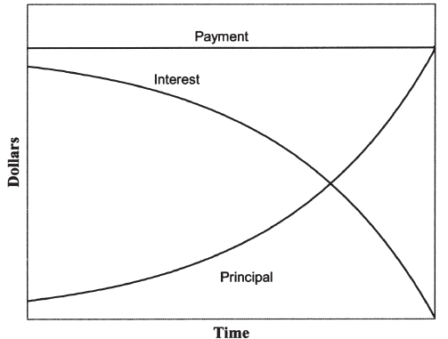
Principal versus Interest
Figure 16.1 Allocation of Loan Payments

Slide 12
Amortization Schedule (1 of 2)
Shows for each month:
  Outstanding principal
  Monthly interest
  Monthly payment

Slide 13
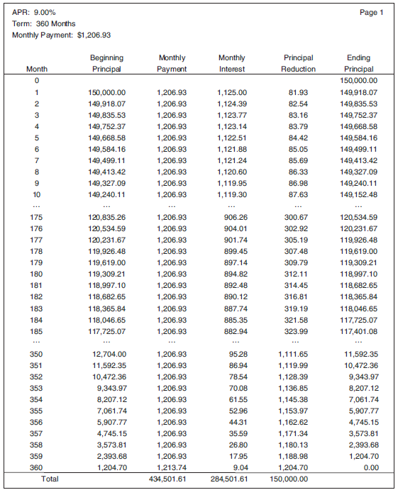
Amortization Schedule (2 of 2)
Figure 16.2 Amortization Schedule for Example 16-9

Slide 14
Effective Annual Interest Rate with Closing Costs
Closing costs increase effective annual interest rate
Step 1: Determine payment (P)
Step 2: Determine closing costs
Step 3: Solve the following equation for i :

Slide 15
Effective Annual Interest Rate with Closing Costs and Early Payment
Step 1: Determine payment (A)
Step 2: Determine closing costs
Step 3: Determine early payment
  Outstanding principal balance (U_{t})
Step 4: Solve for i using the following equation:

Slide 16
Interest on Short-Term Loans (1 of 2)
  where
  i = Periodic interest rate (period = life of loan)
  P = Principal
  I = Total interest paid

Slide 17
Interest on Short-Term Loans (2 of 2)
  where
  i_{a} = Yield
  i = Periodic interest rate (period = life of loan)
  c = Number of compounding periods per year
  where c ≥ 1

Slide 18
Lines of Credits
  Where
  I_{t} = Interest due for period t
  ADB_{t} = Average daily balance for period t
  i = Periodic interest rate

Slide 19
Compensating Balance (1 of 2)
Percentage of line of credit is placed in a low- or non-interest-bearing account
Determining effective annual interest rate with compensating balance
  Determine yield
  Use yield to determine interest paid on funds
  Determine effective annual interest rate

Slide 20
Compensating Balance (2 of 2)
  where
  i_{a} = Yield
  I = Interest
  Funds available = Average daily balance −
  Compensating balance

Slide 21
Commitment Fee (1 of 2)
Interest is paid on unused funds
Determining effective annual interest rate with commitment fee
  Determine yield
  Use yield to determine interest paid on funds
  Determine effective annual interest rate

Slide 22
Commitment Fee (2 of 2)
  where
  i_{a} = Yield
  I = Interest
  ADB = Average daily balance

Slide 23
Other Forms of Financing
Leasing
Trade financing
Credit cards
Equity

Slide 24
Selecting a Banker
Complete package
Specialize in the construction industry
Size
Convenient location

Slide 25
Applying for a Loan
Tax returns
Financial statements
Work on hand report
Overhead budget
Annual cash flow projection
Project pro forma (for projects)
Business plan
References

Slide 26

Copyright
Notes:
If this slide was not included in the original PPT, it should be added.

