Slide 1
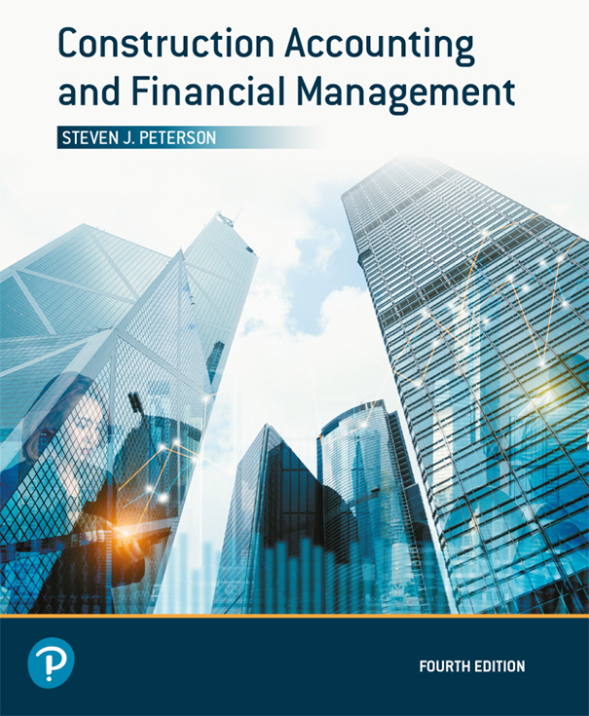
Construction Accounting and Financial Management
Fourth Edition
Chapter 15
Time Value of Money
Copyright © 2020, 2013, 2009 Pearson Education, Inc. All Rights Reserved

Slide 2
Equivalence
Cash flows have the same perceived value
Cash flows are not equal unless they occur at the same period of time
For example, $100 today may be equivalent to $105 a year from now
Basis of banking equations in Chapter 16

Slide 3
Equivalence Based Upon
Size of the cash flows
Timing of the cash flows
Interest rate

Slide 4
Variables (1 of 2)
P = Present value
  Value at beginning of period 1 (end of period 0)
F = Future value
  Value at end of period n
A = Uniform series
  Cash flows are the same for the end of periods 1 through n
  Occurs each and every period

Slide 5
Variables (2 of 2)
i = Periodic interest rate
  Interest rate for one period
  Period may be month or year
n = Number of interest compounding periods
  Must be the same length

Slide 6
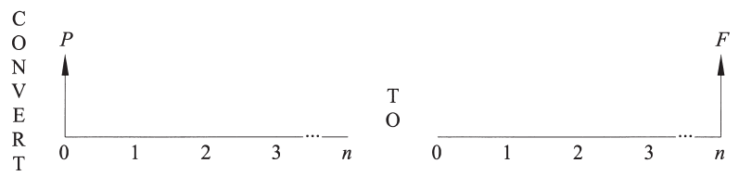
Single-Payment Compound-Amount Factor (1 of 2)
Figure 15.1 Single-Payment Compound-Amount Factor

Slide 7
Single-Payment Compound-Amount Factor (2 of 2)
Converts a present value into a future value
What will be the value of P dollars in n years at an annual interest rate of i?

Slide 8
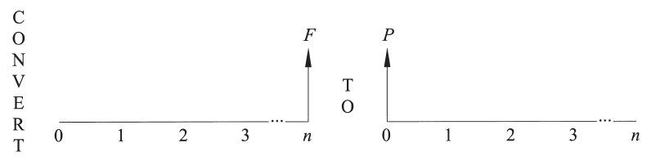
Single-Payment Present-Worth Factor (1 of 2)
Figure 15.3 Single-Payment Present-Worth Factor

Slide 9
Single-Payment Present-Worth Factor (2 of 2)
Converts a future value into a present value
How much (P) must I set aside today to have F dollars in n years at an annual interest rate of i?

Slide 10
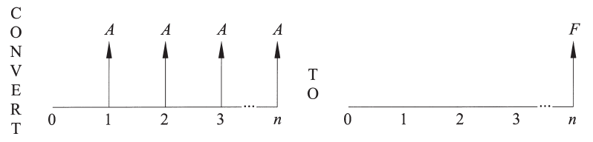
Uniform-Series Compound-Amount Factor (1 of 2)
Figure 15.5 Uniform-Series Compound-Amount Factor

Slide 11
Uniform-Series Compound-Amount Factor (2 of 2)
Converts a uniform series into a future value
If A dollars are set aside every year for n years, how much will there be at the end of n years at an annual interest rate of i?
  Saving for retirement

Slide 12
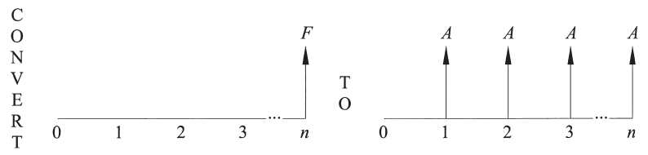
Uniform-Series Sinking-Fund Factor (1 of 2)
Figure 15.6 Uniform-Series Sinking-Fund Factor

Slide 13
Uniform-Series Sinking-Fund Factor (2 of 2)
Converts a future value into a uniform series
How much (A) must be set aside each year for n years to have F dollars at the end of n years at an annual interest rate of i?
  Saving for retirement

Slide 14
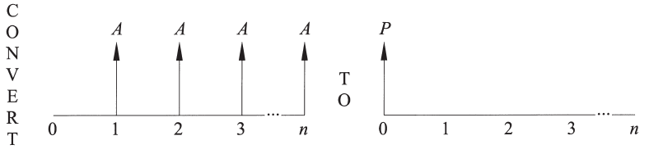
Uniform-Series Present-Worth Factor (1 of 2)
Figure 15.7 Uniform-Series Present-Worth Factor

Slide 15
Uniform-Series Present-Worth Factor (2 of 2)
Converts a uniform series into a present value
How much can be paid for a home if the buyer can afford a monthly payment of A dollars for n months at a monthly interest rate of i?

Slide 16
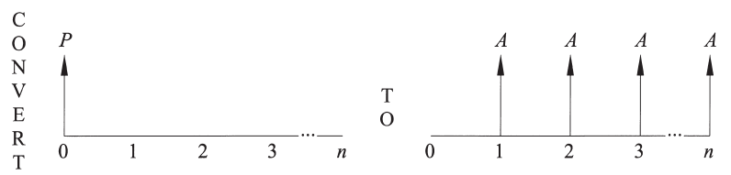
Uniform-Series Capital-Recovery Factor (1 of 2)
Figure 15.9 Uniform-Series Capital-Recovery Factor

Slide 17
Uniform-Series Capital-Recovery Factor (2 of 2)
Converts a present value in to a uniform series
How much would the monthly payment be on a P dollar loan with a term of n months at a monthly interest rate of i?

Slide 18
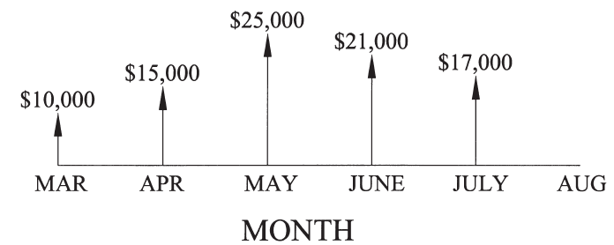
Cash-Flow Diagrams
Shows direction, size, and timing of cash flow
Figure 15.12 Cash Flow for Example 15-10

Slide 19
Complex Cash Flows (1 of 2)
Cash flows occurring at the same period of time may be added or subtracted
Use time value of money to move all of the cash flows to the same point in time and then add or subtract them

Slide 20
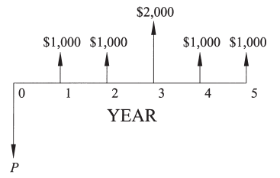
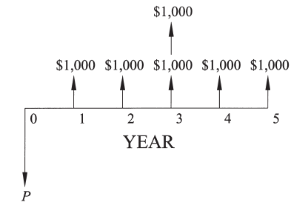
Complex Cash Flows (2 of 2)
Figure 15.13 Cash Flows
Figure 15.14 Equivalent Cash Flows for Figure 15-13

Slide 21
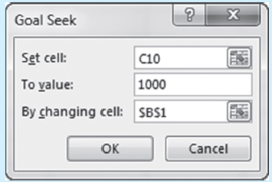
Finding Unknown Periodic Interest Rates
Solving by trial-and-error
Set up equations in Excel and use the Goal Seek function to find the solution
Cash flows that change directions more than once may have multiple solutions

Slide 22
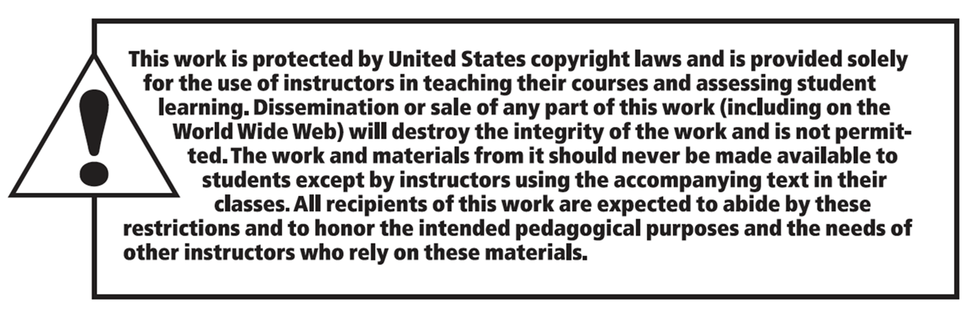
Copyright

