Slide 1
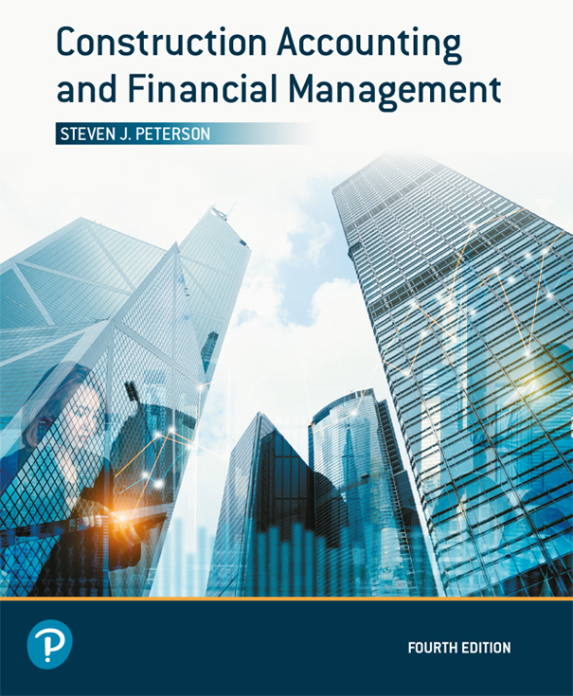
Construction Accounting and Financial Management
Fourth Edition
Chapter 13
Projecting Income Tax
Copyright © 2020, 2013, 2009 Pearson Education, Inc. All Rights Reserved

Slide 2
Corporate Income Tax
Pays tax at:
  Corporate level and
  Personal level on dividends
Paid by:
  C corporations
  Some partnerships

Slide 3
Personal Income Tax
Income tax passes through the company to the individual
Paid by:
  Sole proprietorships
  Some partnerships
  S corporations
  Limited liability companies

Slide 4
Taxable Income
Not all cost are tax deductable
  Only 50% of meals are tax deductible
  Entertainment is not deductible
  Limits on charitable donations
  Passive losses cannot offset non-passive gains
Unused (unallowed) losses may be carried back/forward

Slide 5
Payments of Income Tax
Payment of income taxes is due quarterly

Slide 6
Corporate Income Tax Rates
Flat 21%

Slide 7
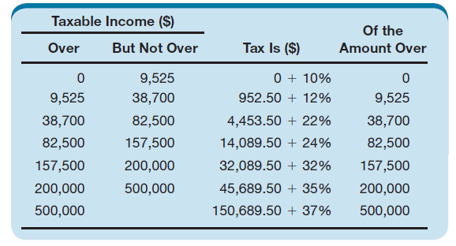
Personal Income Tax Rates—Single
Table 13.1 Personal Income Tax Rates for a Single Persons for the Year 2018

Slide 8
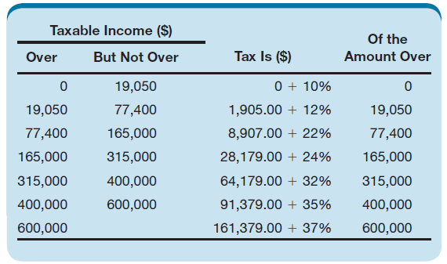
Personal Income Tax Rate—Married
Table 13.2 Personal Income Tax Rates for Married Persons Filing Jointly for the Year 2018

Slide 9
Marginal or Incremental Tax Rate
Tax rate paid on last dollar of income
  21% for corporate income tax

Slide 10
Capital Gains or Losses
Gain or loss on the sale of capital assets
May be taxed at a different rate than standard income

Slide 11
Tax Consequences of Depreciation
Spreads tax savings out over more years

Slide 12
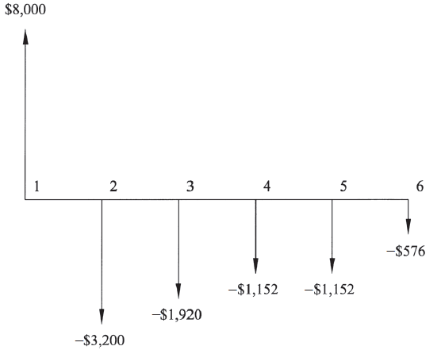
Difference Between Cash Flow and Deductibility of Depreciation (1 of 2)
Figure 13.1 Difference between Cash Flow and Deductibility for Example 13-4

Slide 13
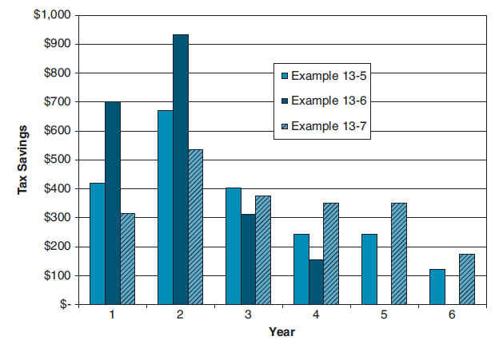
Difference Between Cash Flow and Deductibility of Depreciation (2 of 2)
Figure 13.2 Comparison of Tax Savings from Examples 13-6 through 13-8

Slide 14
Tax Credits
Reduce taxes not taxable income
Some credits cannot be used to reduce both taxable income and taxes

Slide 15
Alternate Minimum Tax
Alternate method of calculating income tax for those who have many tax deductions
Renders some deductions useless

Slide 16
Projecting Income Tax
Use when projecting cash flow for the company
Companies who pass their income tax through to their investors need to disburse cash so their investors can pay the income tax

Slide 17

Copyright

