Slide 1

Construction Accounting and Financial Management
Fourth Edition
Chapter 12
Cash Flows for Construction Projects
Copyright © 2020, 2013, 2009 Pearson Education, Inc. All Rights Reserved

Slide 2
Cost of Work (1 of 2)
Cost of work performed without profit and overhead markup

Slide 3
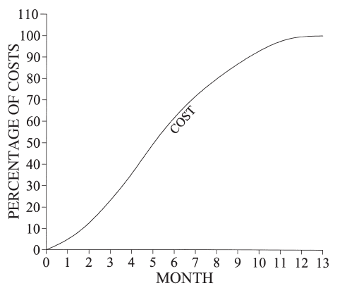
Cost of Work (2 of 2)
Figure 12.1 Cost Curve

Slide 4
Payment
Suppliers
  Monthly (preferably when paid)
Labor
  Weekly
Subcontractors
  When paid
  Withhold retention

Slide 5
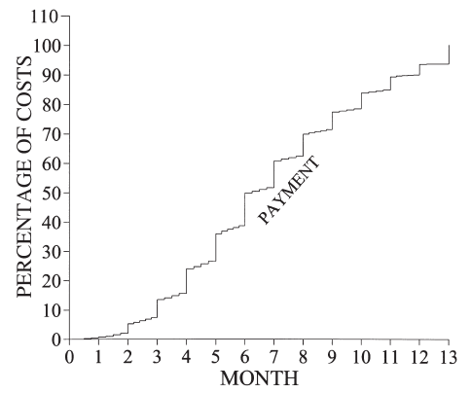
Payments
Figure 12.2 Payment Curve

Slide 6
Value, Costs, and Receipts (1 of 2)
Value
  Value of work based upon contract with the owner (schedule of values)
  Includes costs and profit and overhead markup
Cost
  Cost of work performed without P&O markup
Receipts
  Payments from the owner

Slide 7
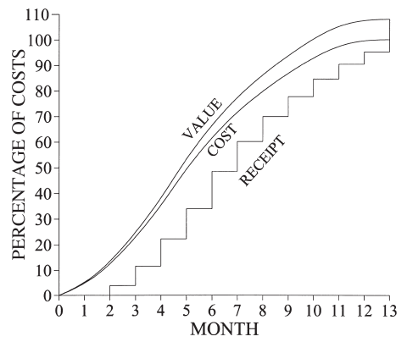
Value, Costs, and Receipts (2 of 2)
Figure 12.3 Receipt Curve

Slide 8
Cash Provided by Contractor (1 of 2)
Difference between payments and receipts

Slide 9
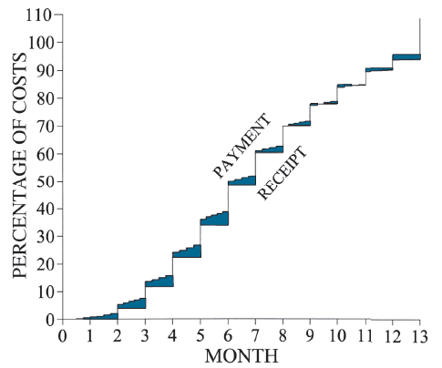
Cash Provided by Contractor (2 of 2)
Figure 12.4 Cash Provided by Construction Company

Slide 10
Determining a Project’s Cash Flow
(1 of 2)
Step 1: Prepare a cost-loaded schedule
Step 2: Determine when costs will be paid
  Following week (e.g., labor)
  End of month (e.g., some materials)
  When paid, paying retention (e.g., some materials)
  When paid, holding retention (e.g., subcontracts)

Slide 11
Determining a Project’s Cash Flow
(2 of 2)
Step 3: Determine when payments will be received from owner
  When will cost be billed
  When will bills be paid
Step 4: Difference in cash flows

Slide 12
Maximum Cash Required
When payments are received at the end of the month, the maximum amount of cash required often occurs during the month
  Not at months end

Slide 13
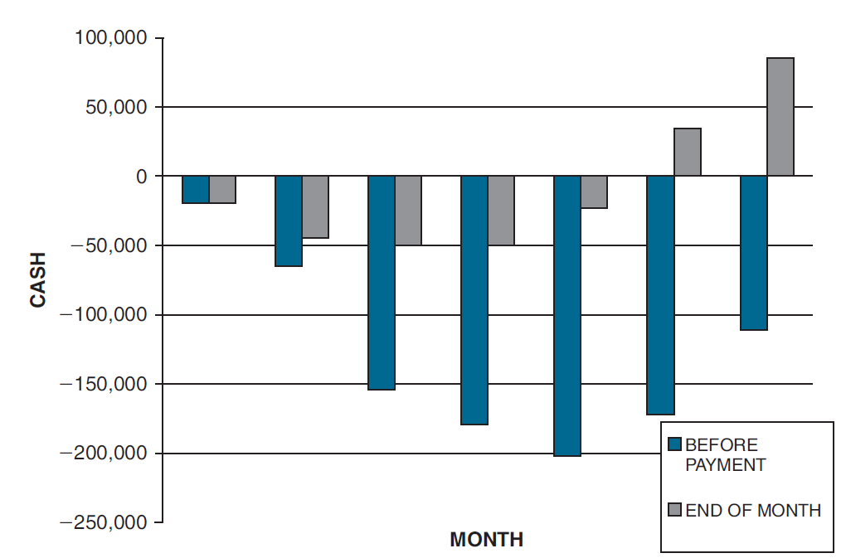
Cash Invested on Project with Progress Payments
Figure 12.12 Cash Generated by the Project in Example 12-6

Slide 14
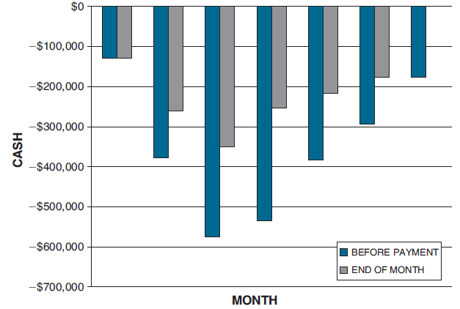
Cash Supplied to the Project’s Owners
Figure 12.9 Maximum Cash Invested for Example 12-3 and 12-4

Slide 15
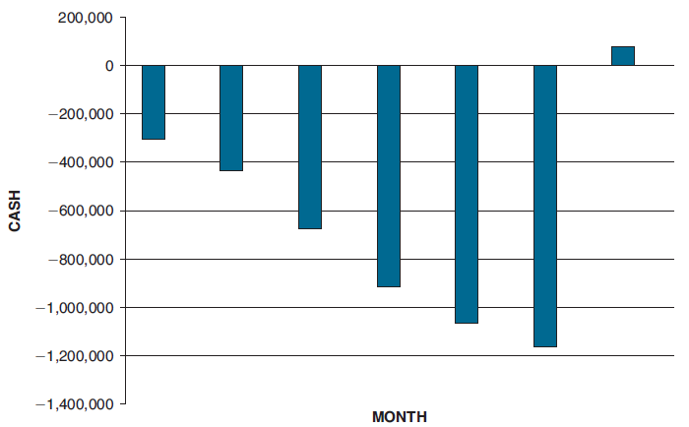
Cash Invested on Project without Progress Payments
Figure 12.10 Cash Invested at the End of Each Month for Example 12-3 and 12-4

Slide 16
Reducing the Cash Required
Increased use of subcontracts that are paid when paid
Resource (labor) leveling
Reduce retention rate
Increase profit and overhead markup
Front-load the schedule of values
  Increase value of early work and decrease value of later work

Slide 17
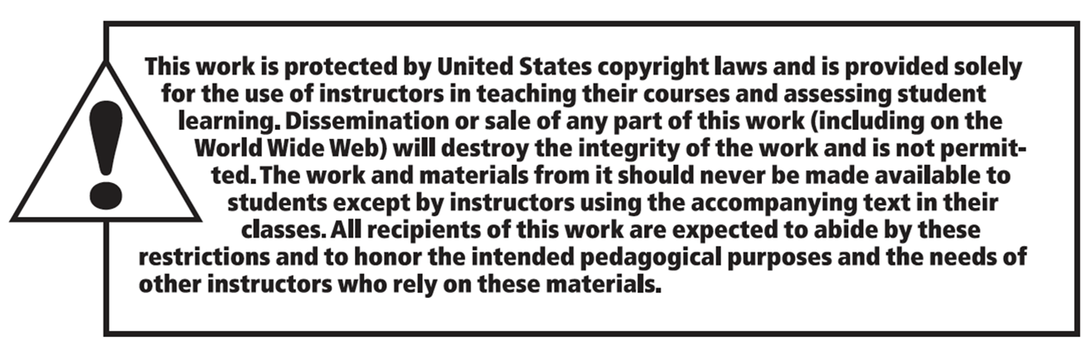
Copyright

