Slide 1

Construction Accounting and Financial Management
Fourth Edition
Chapter 11
Profit Center Analysis
Copyright © 2020, 2013, 2009 Pearson Education, Inc. All Rights Reserved

Slide 2
Sources of Profit
Minimum profit and overhead margin
Estimating/buyout profit
Crew based profit
Management based profit

Slide 3
Minimum Profit & Overhead Margin
Minimum profit and overhead margin required to:
  Cover general overhead costs
  Provide a return for the investors

Slide 4
Estimating/Buyout Profit
Profit or loss from:
  Purchase of materials at start of job
  Signing contracts with subcontractors
below or above costs in bid

Slide 5
Crew Based Profit
Profit or loss for in-house crews performing the work under or over budget

Slide 6
Project Management Based Profit
Profit or loss from the management of the project
Includes all work but in-house work

Slide 7
Allocation of Overhead
Revenue
Labor costs or hours
  Labor burden or unallocated labor
Material costs
  Unallocated materials
Actual or estimated usage of overhead
Incremental
  Changes in overhead if the profit center went away
Arbitrary assignment

Slide 8
Profit Centers
Crews
Project management
Estimators
Types of jobs
Customers
Equipment

Slide 9
Crews
Compare to:
  Other crews
  Past performance
  Subcontractors

Slide 10
Project Management
Compare project management teams to:
  Past performance
  Other teams

Slide 11
Estimators
Compare estimators to:
  Past performance
  Other estimators

Slide 12
Types of Jobs
Comparison should be based upon all of the following:
  Gross profit margin
  Return on cash invested
  Consumption of management’s time

Slide 13
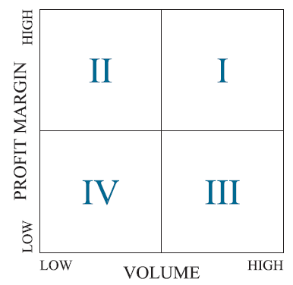
Customers
Figure 11.2 Customer Matrix

Slide 14
Equipment
Enough use to justify ownership
Economical to repair old equipment
Identify poor maintenance practices
Tire repair versus foam filled

Slide 15

Copyright

