Slide 1
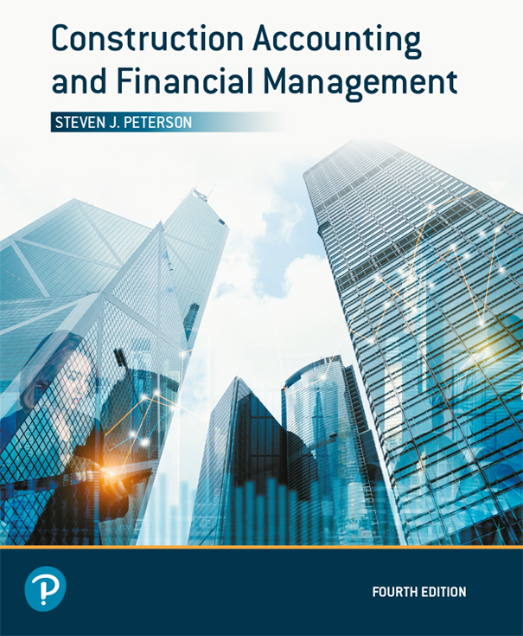
Construction Accounting and Financial Management
Fourth Edition
Chapter 10
Setting Profit Margins for Bidding
Copyright © 2020, 2013, 2009 Pearson Education, Inc. All Rights Reserved

Slide 2
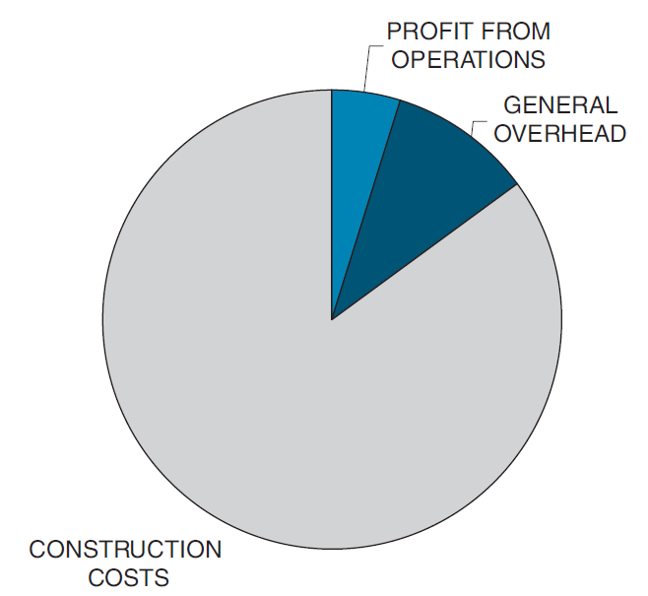
Profit Equation (1 of 2)
Figure 10.1 Use of Revenues

Slide 3
Profit Equation (2 of 2)

Slide 4
Contribution Margin (1 of 2)

Slide 5
Contribution Margin (2 of 2)

Slide 6
Break-Even Volume of Work (1 of 2)
Without profit
At fixed level of profit

Slide 7
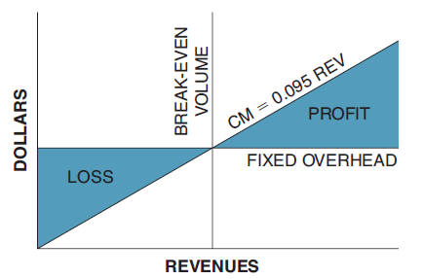
Break-Even Volume of Work (2 of 2)
Figure 10.2 Break-Even Volume

Slide 8
Break-Even Contribution Margin Ratio (1 of 2)
Without profit
At fixed level of profit

Slide 9
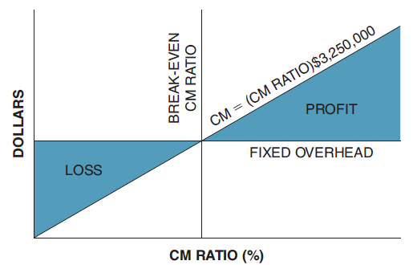
Break-Even Contribution Margin Ratio (2 of 2)
Figure 10.3 Break-Even CM Ratio

Slide 10
Adjusting the Financial Mix
Change prices
Reduce construction costs
Reduce general overhead

Slide 11
Profit and Overhead Markup

Slide 12
Tracking Competitors (1 of 2)
Determine what their profit and overhead markup would be based upon your construction costs
Use competitor’s historical P&O markups to aid in setting your profit and overhead markup

Slide 13
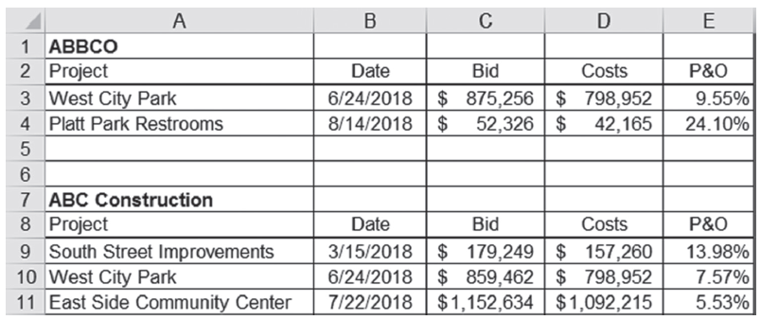
Tracking Competitors (2 of 2)
Figure 10.4 Spreadsheet for Tracking Competitors’ Bids

Slide 14
Best-Value Selection Process
Selected based on:
  Product
  Service
  Price
Use scoring matrix to assess your strength/weaknesses against your competitors

Slide 15
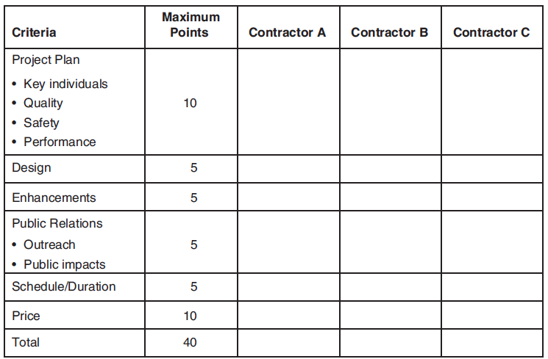
Sample Best-Value Scoring Matrix
Figure 10.5 Best Value Scoring Matrix

Slide 16

Copyright

