Slide 1

Construction Accounting and Financial Management
Fourth Edition
Chapter 09
Managing General Overhead Costs
Copyright © 2020, 2013, 2009 Pearson Education, Inc. All Rights Reserved

Slide 2
What is General Overhead?
Overhead costs that cannot be charged to a specific construction project or charged to the equipment section of the income statement

Slide 3
Cash Flow Versus Profit
Cash Flow
  Only include transactions that result in a cash flow
  Depreciation is not a cash flow; therefore, it is not included
Profit:
  Only include transactions that affect profit
  Purchase of a depreciable asset does not affect profit; therefore, it is not included, only the associated depreciation

Slide 4
What to Include? (1 of 4)
Advertising
Bad Debts
Bank Fees
Car and Truck Expenses
Charitable Contributions
Computer and Office Furniture
Depreciation
Dues and Memberships

Slide 5
What to Include? (2 of 4)
Employee Wages and Salaries
Employee Benefits
Employee Retirement
Employee Recruiting
Employee Training
Employee Taxes
Entertainment
Insurance
Interest Expense

Slide 6
What to Include? (3 of 4)
Janitorial and Cleaning
Legal and Professional Services
Meals
Office Supplies
Office Purchase
Office Rent
Office Utilities
Postage and Delivery

Slide 7
What to Include? (4 of 4)
Publications and Subscriptions
Repairs and Maintenance
Taxes and Licenses
Telephone
Travel
Unallocated Labor
Unallocated Materials
Miscellaneous

Slide 8
Estimating General Overhead
Based upon historical costs
Adjusted for inflation
Adjusted for change in business practice
  Company growth
  New markets

Slide 9
Types of Costs
Variable Costs
Fixed Costs
Mixed Costs

Slide 10
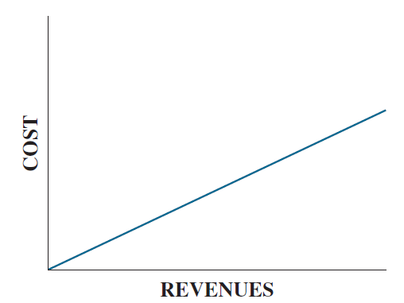
Variable Costs
Figure 9.2 Variable Cost

Slide 11
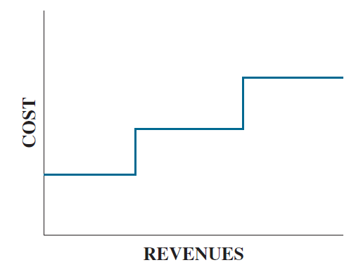
Fixed Costs
Figure 9.3 Fixed Cost

Slide 12
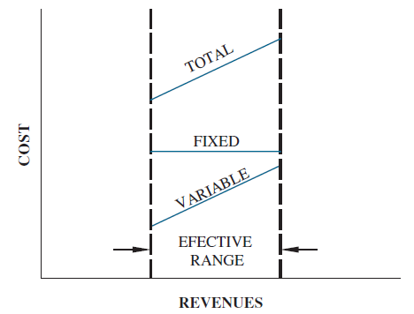
Mixed Costs
Figure 9.4 Mixed Cost

Slide 13
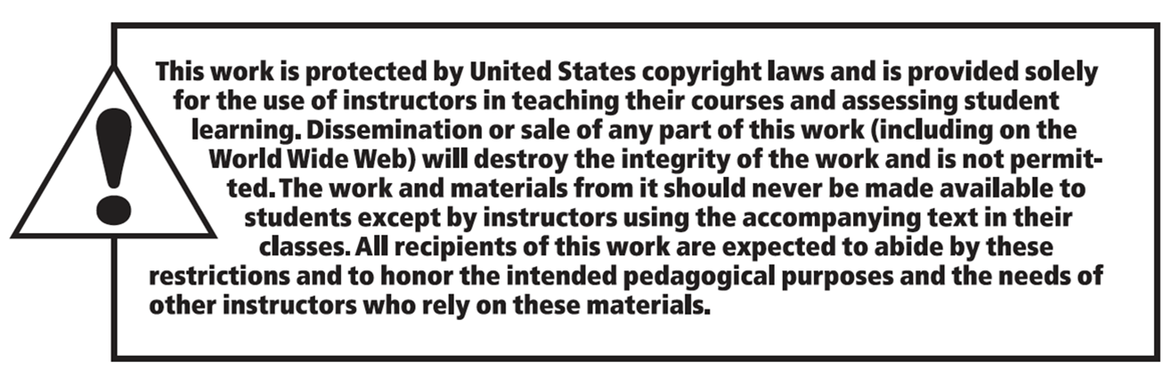
Copyright

