Slide 1

Construction Accounting and Financial Management
Fourth Edition
Chapter 07
Managing Costs
Copyright © 2020, 2013, 2009 Pearson Education, Inc. All Rights Reserved

Slide 2
Monitoring and Controlling Process
Establish a baseline
Collect data
Assess data
Take corrective action (if needed)

Slide 3
Material Purchases
Purchase orders approved by project manager
Supervisor has limited authority to approve small purchase orders

Slide 4
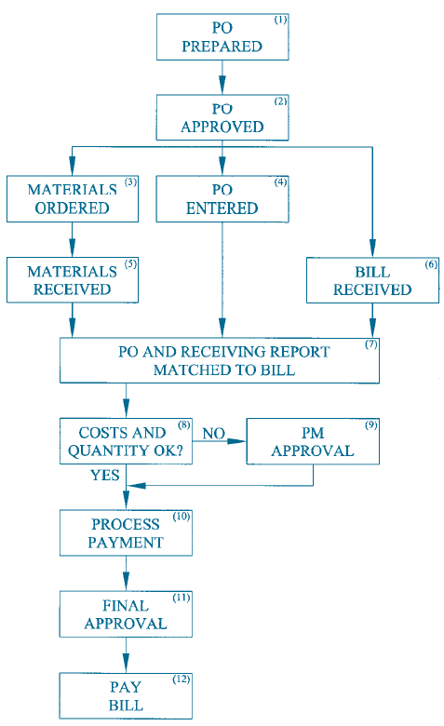
Materials Purchases
Figure 7.1 Material Purchases

Slide 5
Labor Costs (1 of 2)
Hard to control
Tracked by timecards
  Use electronic time cards
Must be processed quickly

Slide 6
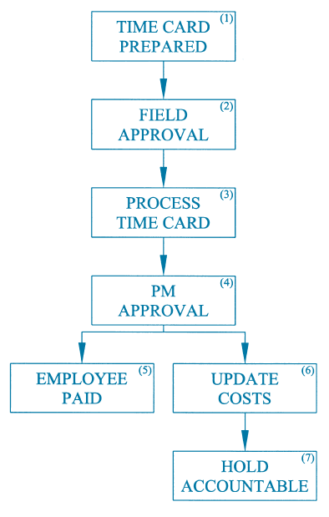
Labor Costs (2 of 2)
Figure 7.2 Labor

Slide 7
Subcontracts (1 of 2)
Often requires progress payments
Hard to determine percent complete

Slide 8
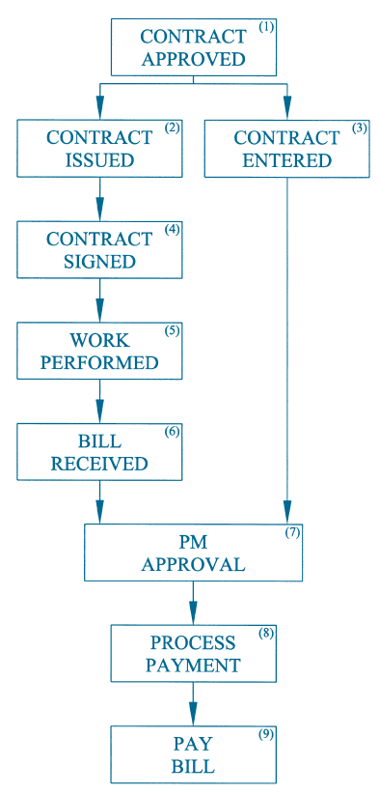
Subcontracts (2 of 2)
Figure 7.3 Subcontracts

Slide 9
Equipment
Hard to control
Controlled like labor
  Use equipment time cards or
  Use equipment information system
Be sure equipment is returned as soon as the project is done with it

Slide 10
Other Costs
Where possible, use purchase orders
When a purchase order has not been used, approval by project manager is required
  For example, for utility bills

Slide 11
General Overhead Costs
Must be managed as aggressively as construction costs

Slide 12
Job Profitability
Update weekly
  Cost to complete
  Estimated cost at completion
  Estimated profit
Include committed costs even if not tracked in the accounting system

Slide 13
Cost Loaded Schedule
Prepare schedule
Assign cost to the tasks
Determine the weekly or monthly costs

Slide 14
Earned Value
Measures performance with regards to
  Schedule
  Cost
Ignores items which do not have a cost
  For example, submittals

Slide 15
Budgeted Cost of Work Scheduled
(BCWS)
The expected cost of the work that is scheduled to be performed during a specific period of time

Slide 16
Budgeted Cost of Work Performed
(BCWP)
The expected cost of the work that is actually performed during a specific period of time

Slide 17
Actual Cost of Work Performed
(ACWP)
The actual cost of the work that is performed during a specific period of time
Hard to calculate in a timely matter because of lag in receiving and processing invoices

Slide 18
Schedule Performance Index (SPI)
Measures progress of work
Results

Slide 19
Cost Performance Index (CPI)
Measures control of budget
Results

Slide 20
Labor Cost Performance Index (LCPI) (1 of 2)
Same as CPI except it only looks only at in-house labor
  BCLP = budgeted cost of labor performed
  ACLP = actual cost of labor performed
Measures control of in-house labor costs

Slide 21
Labor Cost Performance Index (LCPI) (2 of 2)
Results

Slide 22
Total Estimate Cost at Completion
Assumes CPI will not change

Slide 23
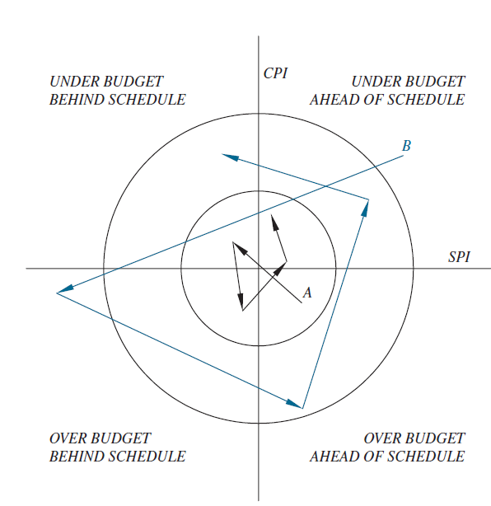
SPI/CPI Target levels
Figure 7.6 Graphing the CPI and SPI

Slide 24
Project Closeout Audit
Validate data
Find areas where performance was better than expected
  Learn how to repeat it
Find areas where performance was worse than expected
  Learn how to avoid it

Slide 25
Design-Build Projects (1 of 3)
Design to budget
  Establish a budget
  Prepare cost estimates
  Determine cost variance
  Redesign (as needed)

Slide 26
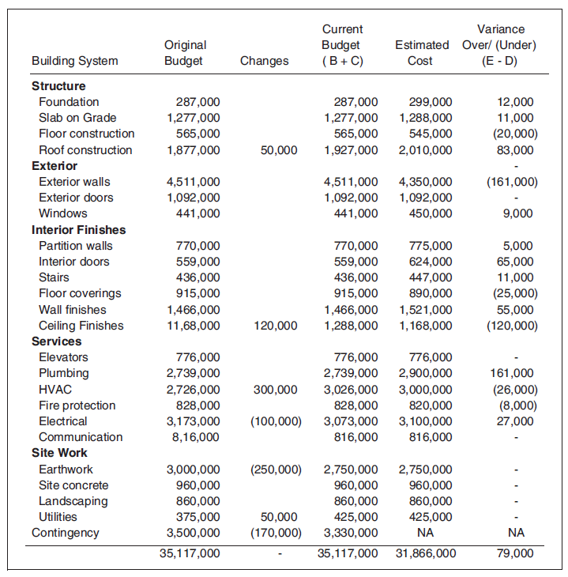
Design-Build Projects (2 of 3)
Figure 7.7 Budget for a Design-Build Project

Slide 27
Design-Build Projects (3 of 3)
Monitoring and controlling design costs (e.g., architect and engineers’ fees)
  Use same methods as used to monitor and control construction costs

Slide 28
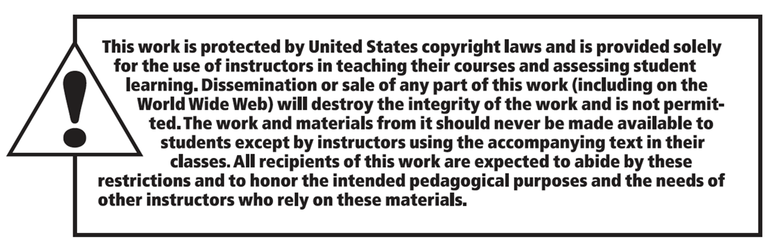
Copyright

